Slide 1
Open Hack
Team 14
Apurav Gupta
Mayur Barge
Sheena Gupta
Varun Jain

Slide 2
Introduction
Signup / Login (Firebase authentication)
Hackathon Creation / Admin Operations (Open/Close/Finalize)
Organization Creation and Membership
Team Registration and Payments
Submissions and Grading

Slide 3
TECHNOLOGIES
FRONTEND
JavaScript (ReactJS)
HTML5 / CSS
SERVER
Spring Boot (Java 8)
JUnit
Flyway
PERSISTENCE
MySQL 8
H2

Slide 4
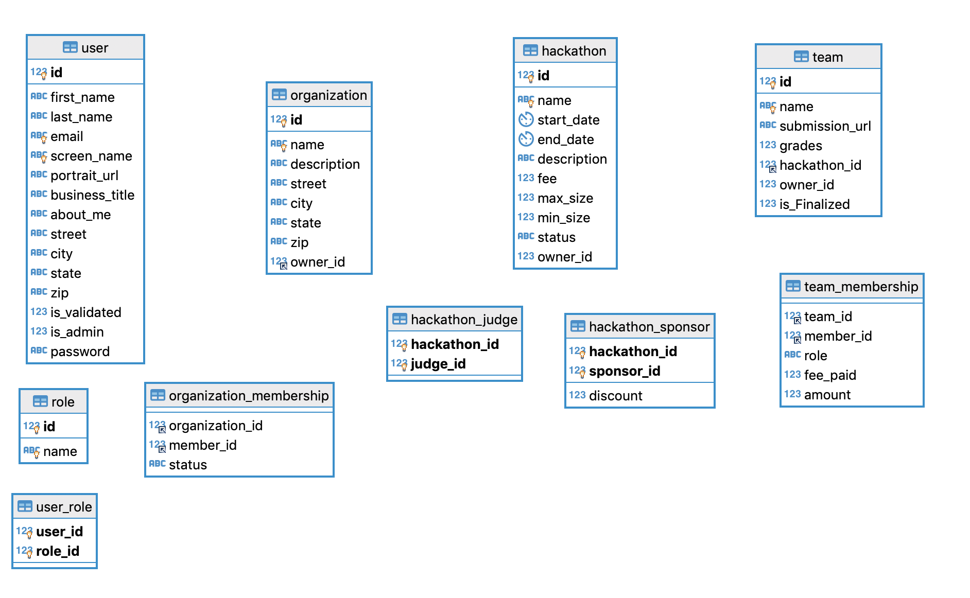
Database Design

Slide 5
API Design
User
POST | /users
GET | /users
PATCH | /users/{id}
GET | /users/{id}
GET | /users/{id}/hackathons
GET | /users/{id}/memberships
Hackathon
POST | /hackathons
GET | /hackathons
GET | /hackathons/{id}
PATCH | /hackathons/{id}
POST | /hackathons/{id}/teams
GET | /hackathons/{id}/teams
GET | /hackathons/{id}/teams{id}
PATCH | /hackathons/{id}/teams/{id}
GET | /hackathons/{id}/teams/{id}/payment
POST | /hackathons/{id}/teams/{id}/payment
Organization
POST | /orgs
GET | /orgs
GET | /orgs/{id}
GET | /orgs/{id}/members
POST | /orgs/{id}/memberships
GET | /orgs/{id}/memberships
PUT | /orgs/{id}/memberships

Slide 6
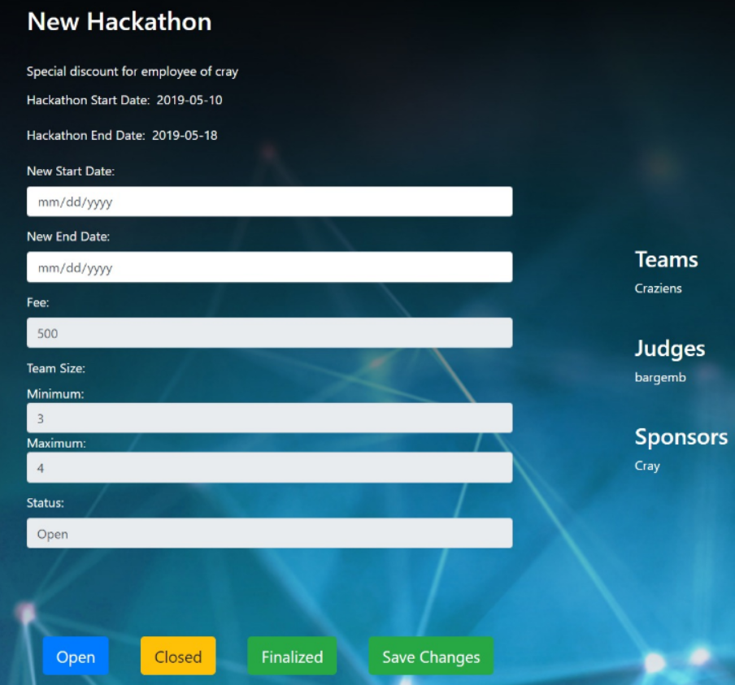
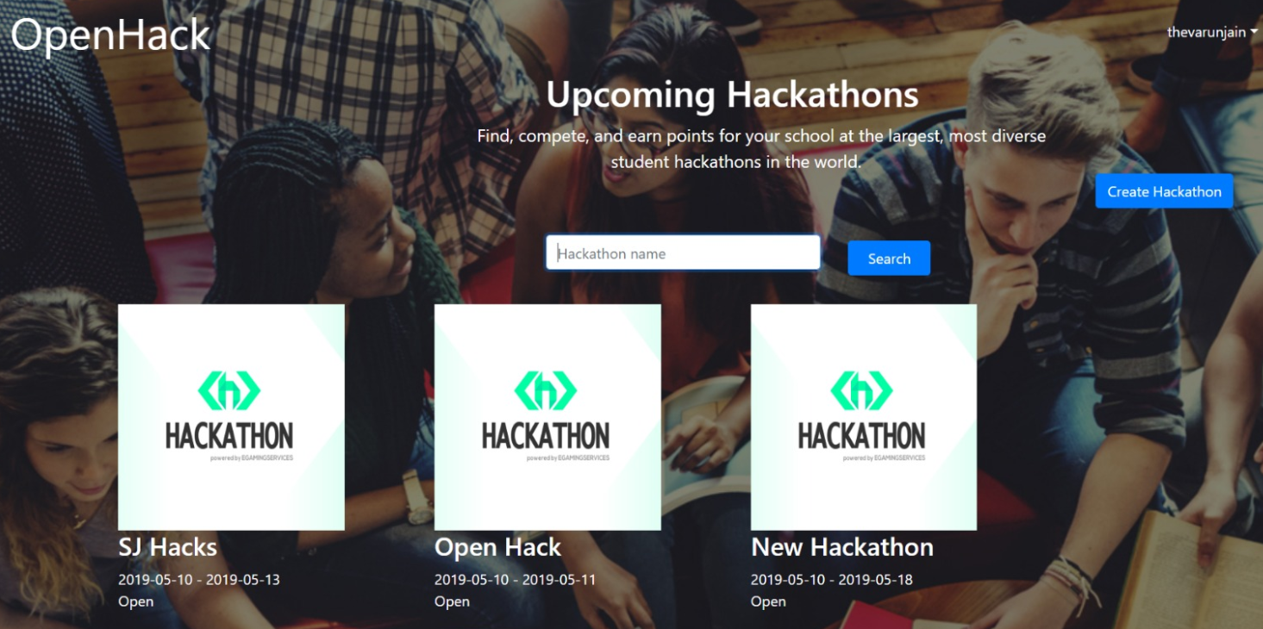


Slide 7
