Slide 1
MINI PROJECT | ESE OCTOBER 2026
PQFS 2.0
X25519
elliptic curve
ML-KEM
lattice
Post-Quantum File Sharing System
Files that stay secret even if a whole family of cryptography breaks, and even if some servers are hostile.
HQC
code-based
Pushkar Wagh (PRN 25030421030)
Vivaan Kriplani (PRN 25030421049)
github.com/theveryholypenguin/pqfs2
All three secrets feed one key derivation
Notes:
Introduce yourselves and the project in one sentence: PQFS 2.0 is a file-sharing system built so that no single algorithm and no single server is a single point of failure. The three circles are the three independent mathematical families we combine for key exchange; an attacker has to break all three. Version 1 was just AES with a passphrase over raw TCP; version 2 adds six upgrades, which we will walk through in six slides.

Slide 2



Harvest now, decrypt later
Record
Attacker copies encrypted data today
Wait
Large quantum computer is built
Decrypt
Old files and keys are readable
Key exchange breaks
AES-256 survives
New algorithms are young
Shor's algorithm defeats RSA and elliptic-curve key exchange. Recorded sessions become readable.
Grover's algorithm only halves its strength. The weak point is the key exchange, not bulk encryption.
SIKE and Rainbow were broken late in the NIST process. Betting on one algorithm is risky.
Design rule: no single algorithm, no single server, and upgrades without re-encrypting.
Notes:
Explain harvest-now-decrypt-later: data stolen today can be decrypted in 10-30 years. Be precise: Shor breaks the public-key part; AES-256 is fine. The new post-quantum algorithms are young, and two earlier NIST candidates (SIKE, Rainbow) were broken by ordinary computers, so we refuse to rely on one algorithm. This gives us the design rule at the bottom.

Slide 3
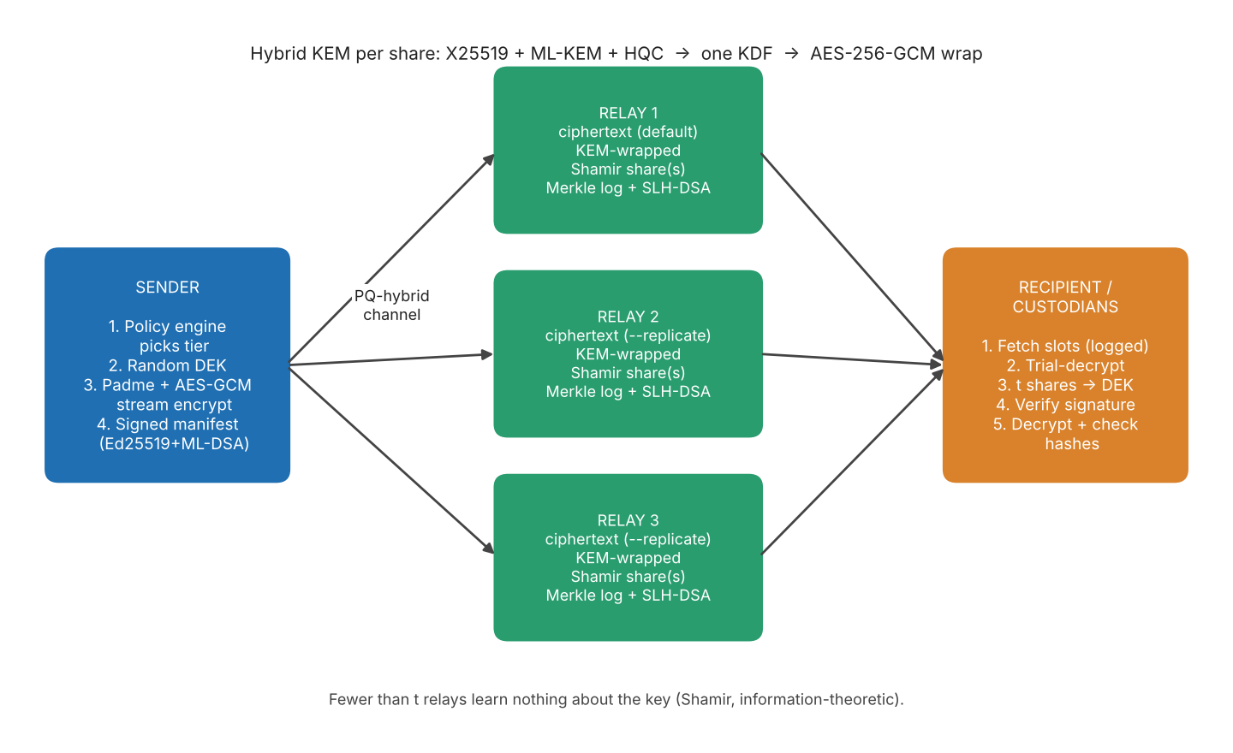
How it works
1
Encrypt once
AES-256-GCM in 64 KiB chunks under a random file key. Size hidden with Padme padding.
2
Split and wrap
Shamir t-of-n splits the key. Each share is wrapped with X25519 + ML-KEM + HQC.
3
Spread and verify
Shares live on different relays. Recipient needs t shares plus a valid sender signature.
Fewer than t relays learn nothing about the key, even against unlimited computing power.
Notes:
Walk left to right through the diagram. The sender encrypts the file once. The key is Shamir-split; each share is wrapped for the recipient with the hybrid KEM and stored on a different relay. Relays also keep signed Merkle logs. The recipient fetches the slots, rebuilds the key from t shares, verifies the sender's two signatures and only then decrypts. The italic line is the key security claim: below the threshold the key is information-theoretically hidden.

Slide 4






Six upgrades over version 1
Hybrid multi-family KEM
Multipath key sharing
Crypto-agility
X25519 + ML-KEM + HQC into one KDF. Break all three or get nothing.
Shamir t-of-n across relays. Below t relays, the key stays hidden.
Rewrap only the key layer when an algorithm is retired. File untouched.
Shelf-life policy engine
Threshold custody and logs
Metadata privacy
Years of secrecy plus file sensitivity pick tier T1, T2 or T3, with reasons.
t-of-n people approve. Relays keep signed Merkle logs with proofs.
Name, size, sender hidden. Padme padding, anonymous clients.
Notes:
One sentence per card. 1: the key is derived from all three algorithm families. 2: Shamir sharing across servers is information-theoretic. 3: rewrap is how we upgrade when an algorithm is deprecated; we demonstrated HQC-192 being declared broken and the file being upgraded to epoch 2 without touching the ciphertext. 4: the policy engine is a transparent rule-based scorer, not machine learning. 5: custodians must cooperate and relays are accountable via Merkle logs signed with the hash-based SLH-DSA. 6: the relay sees no file name, real size or sender.

Slide 5
Measured results
24/24
12
186 MiB/s
23 ms
unit tests pass
demo scenarios, incl. attacks
streaming encryption, 1 core
T3 key wrap per share
What it means
Post-quantum cost sits in the key wrap: milliseconds per share.
Bulk data runs at AES speed: 150 MiB/s with full verification.
HQC is the slow, large part (9-14 KB ciphertext): the price of a third family.
Notes:
Numbers are from our own runs on one cloud CPU core with relays on localhost, so network time is not included; say that if asked. 24 of 24 unit tests pass and all 12 demo scenarios behaved as designed. Throughput: about 186 MiB/s encrypt and 150 MiB/s decrypt with full verification on a 50 MiB file. Key wrapping: tier T1 is 0.1 ms, T2 about 10 ms, T3 about 23 ms to encapsulate and 35 ms to decapsulate, dominated by HQC. Package overhead falls from 2.6 percent at 1 MiB to 0.08 percent at 50 MiB; tiny files have high overhead because the trailer carries the sender's public key bundle.

Slide 6


Attacks stopped, limits stated
Stopped in the live demo
Honest limits
One flipped ciphertext byte
rejected at chunk 11 of 20
Educational prototype, not security audited
Relays hide the newer key epoch
rollback detected
Relays still see IP addresses and timing
3 shares on 1 relay, threshold 2
send refused
Policy engine is rules, not machine learning
Bob alone in a 2-of-3 custody
blocked until Carol approves
Rewrap cannot recall data already harvested
Takeaway: post-quantum security is layered design, not one algorithm swap. Thank you. Questions?
Notes:
Left: four attacks from the demo that the system refused rather than silently tolerated. Right: be honest about limits; it earns marks. Not audited, relays see IP and timing, the policy engine is a deterministic heuristic, and rewrap protects future recordings only. Close with the takeaway and invite questions. Future work if asked: fingerprint-referenced sender keys, gossip monitors, authenticated uploads, fuzzing the protocol parser.

