Slide 1
Can we use ALPR for live tracking of Vehicles
Descriptive Research - Vignesh Sivanandha Rao

Slide 2
Abstract
Nowadays the necessity of tracking vehicles has become a key to navigate around the world. Traditional tracking and navigation is done through applications which use GPS services to track the location and display it on a graphical map. In this paper, we briefly introduce the concepts of ALPR systems (Automatic License Plate Recognition), difficulties in implementing a fully working prototype and at last to propose an idea to track vehicles by their number plates using ALPR.

Slide 3
Introduction
As modern era is facing increase in population, we can also see increase in the number of vehicles on road. While commuting and logistics being the key for all business, we won’t be able to control the production of vehicles or the use of it. However with more increase of comfortability, comes the need of technology. Tracking vehicles has been vital and is being used for various purposes for the past few decades. Tracking vehicles are useful in knowing the location of a vehicle, prevent vehicles from being stolen, surveillance and transit tracking.

Slide 4
Tracking of unknown vehicles
With increase in population, there is an increase in number of vehicles and that is where tracking of vehicles come into picture.
While we use GPS for tracking known vehicles or vehicles under our control, how do we track vehicles that are not in our control or unknown vehicles. Well, the answer is obvious, “Surveillance Cameras”
We use surveillance cameras as our watch dogs which can not only report but show the incident the way it happened. Though we use cameras to detect, we need something to recognize the vehicles and that’s when ALPR comes into picture.

Slide 5
What is ALPR?
ALPR stands for Automatic License Plate Recognition
Automatic License Plate Recognition systems capture the images of vehicles’ license plates using surveillance cameras.
The images captured by the surveillance cameras are given as input for the ALPR systems.
The ALPR technology uses optical character recognition on these images to transform an image into alpha-numeric characters.
The ALPR does not identify any individual’s face or personal identification through it’s analysis.

Slide 6
Research Background
Though there are wide range of uses for ALPR systems, below are some of the traditional way the ALPR systems are being used:
Parking fee payment
Toll fee collection
Freeway monitoring systems for traffic surveillance
Neighborhood watch

Slide 7
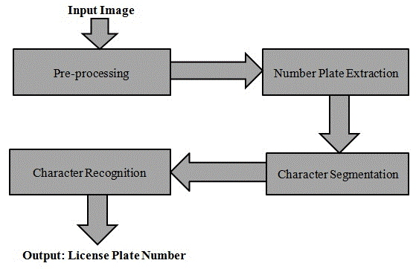
Proposed Framework

Slide 8
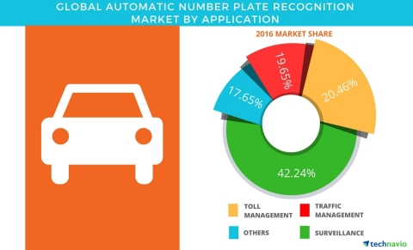
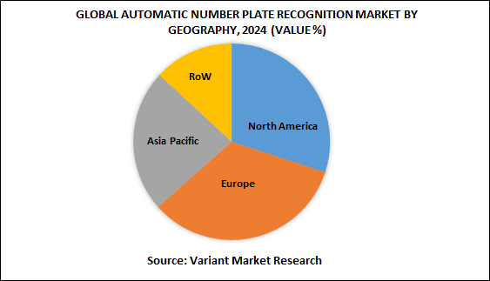
Data Analysis
Usage by purpose
Usage by Country

Slide 9
Challenges in achieving perfection
Quality of plates
Text orientation of the number plate
Number of characters in the plate
Place where the plates are located might change from vehicle to vehicle
Background
External/Natural features’ impact on clarity

Slide 10
Algorithms used
Optical Character Recognition (OCR)
Character segmentation
Histogram equalization
Viterbi (sequence of hidden states)
The sophistication and complexity of each of these algorithms determines the accuracy of the system

Slide 11
Key components in understanding the characters in a License Plate
License Plate Extraction
License Plate Segmentation
Character Recognition

Slide 12
Categorized License Plate Extraction Method
Using Boundary/Edge Information.
Using Global Image Information.
Using Texture Features
Using Color Features
Using Character Features
Combining two or more features

Slide 13
Categorized License Plate Segmentation Method
Using Pixel Connectivity
Using Projection Profiles (deals with rotation)
Using Prior Knowledge of Characters
Using Character Contours (boundaries)
Using Combined Features

Slide 14
Categorized License Plate Character Recognition Method
Using Raw Data (uses pixel values)
Using Extracted Features

Slide 15
Steps to perform in order to achieve live tracking through ALPR
The purpose of this paper is to give a clear understanding about how ALPR works and the possibilities to achieve live tracking using ALPR.
The idea is to store the plate numbers and location details in a database.
These details can be updated sequentially for each and every vehicle plate number that has been recognized.
Using the updated details a vehicle’s last location can be tracked and the same can be used to predict the upcoming route options the driver might take.

Slide 16
Steps to perform in order to achieve live tracking through ALPR (contd.)
Once the series of data of data collection is done, the regular route of the particular vehicle can be figured out.
This information would be helpful in predicting the upcoming routes of that vehicle.
This can be achieved using stream processing which enables the system to have continuous input data and printing the output results periodically.
Stream processing simply forms a series of events that arrive at the stream processing system from which the user applications can compute various queries over this stream of events.

Slide 17
Conclusion & Future Work
ALPR is vast
Need a very large data base and huge connectivity to merge all the CCTV footage inputs to a single system and track one particular vehicle
Need more data preprocessing
Enhancement of input data for more accuracy
Stream processing of input of data

Slide 18
References
https://www.researchgate.net/publication/262843164_An_Efficient_Approach_for_Number_Plate_Extraction_from_Vehicles_Image_under_Image_Processing
https://ieeexplore.ieee.org/document/6213519
https://ieeexplore.ieee.org/document/7416892
https://ieeexplore.ieee.org/document/605795
https://ieeexplore.ieee.org/document/8126199
https://www.businesswire.com/news/home/20170524005697/en/Global-Automatic-Number-Plate-Recognition-Market-Projected
https://www.variantmarketresearch.com/report-categories/automotive/automatic-number-plate-recognition-market

