Slide 1
CONFIDENTIAL | PREPARED FOR
Cart Abandonment Analysis & Recommendations
Presented by: Vikhyat Singh Customer Analytics Project

Slide 2
EXECUTIVE SUMMARY
Four things we found that matter to your business
01 75.8% abandonment
02 Biggest leakage point
Customers add items but fail to complete purchase.
317 customers leave between cart and checkout.
03 Seasonal patterns exist
04 Predictive model works
March highest risk, November lowest abandonment.
62.3% of abandoners identified correctly.

Slide 3
PROBLEM DEFINITION
How we defined abandonment — and why it matters
Abandoned = Added to cart AND did not complete purchase Browsed-only sessions excluded because no purchase intent was shown.
Visited
Cart
Checkout
Purchase
1000
707
390
171

Slide 4
KEY METRICS
The numbers that define the problem
75.8%
1000
53.4%
54.9%
Overall abandonment
Sessions analysed
Mobile abandonment
Desktop abandonment
Biggest Drop
Best Month
Cart → Checkout 317 users lost
November 43.4%

Slide 5
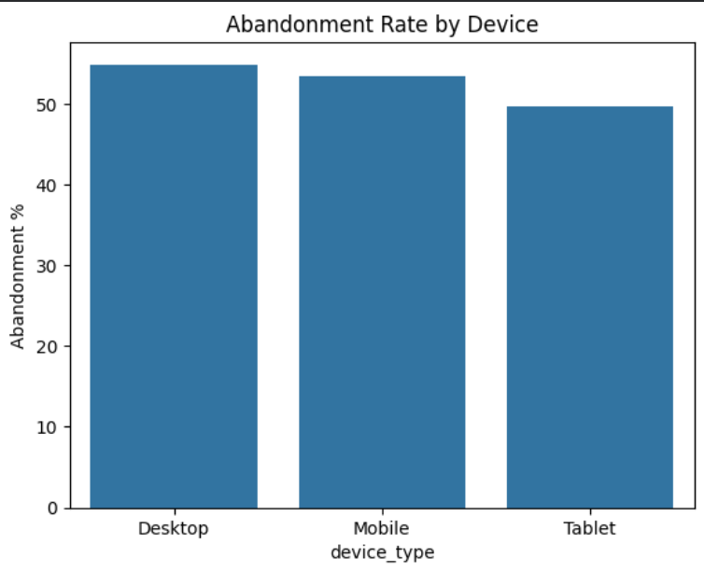
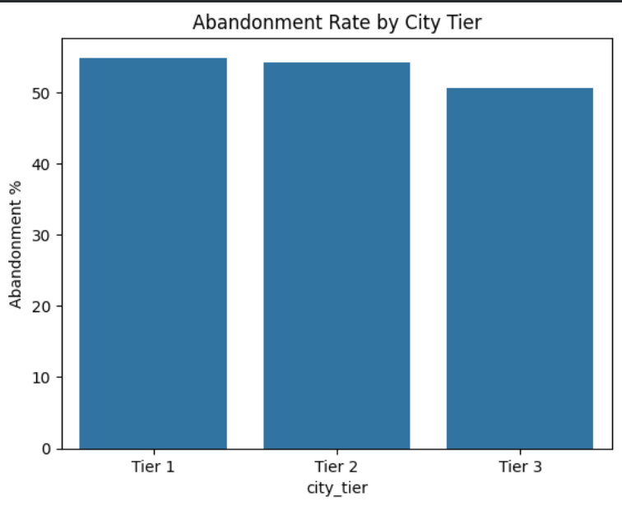
SEGMENT ANALYSIS
Who abandons most — and what patterns tell us

Slide 6
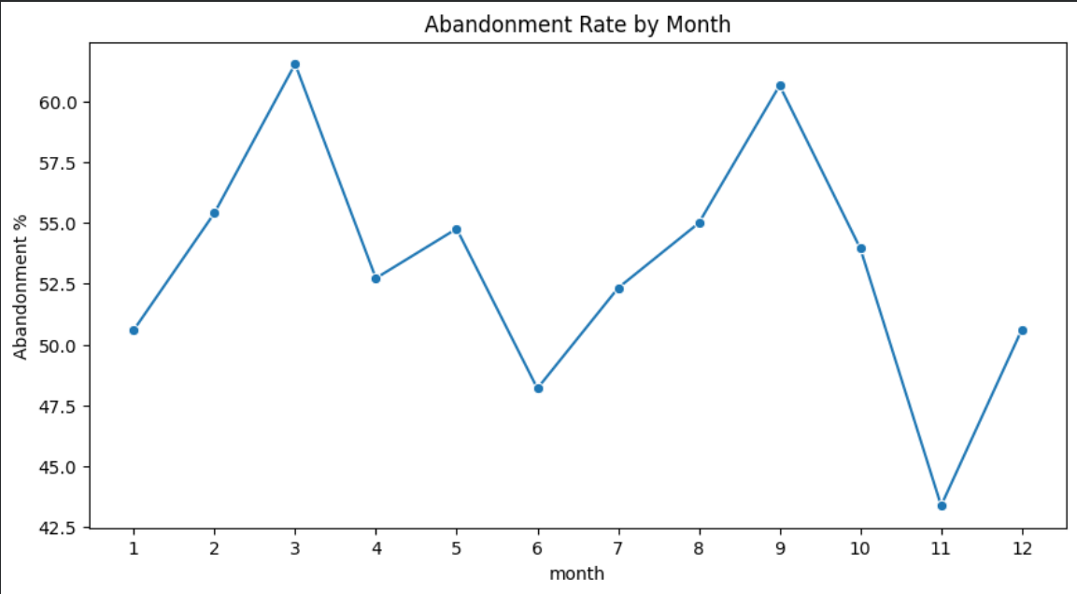
SEASONALITY
Abandonment rate follows a predictable annual pattern

Slide 7
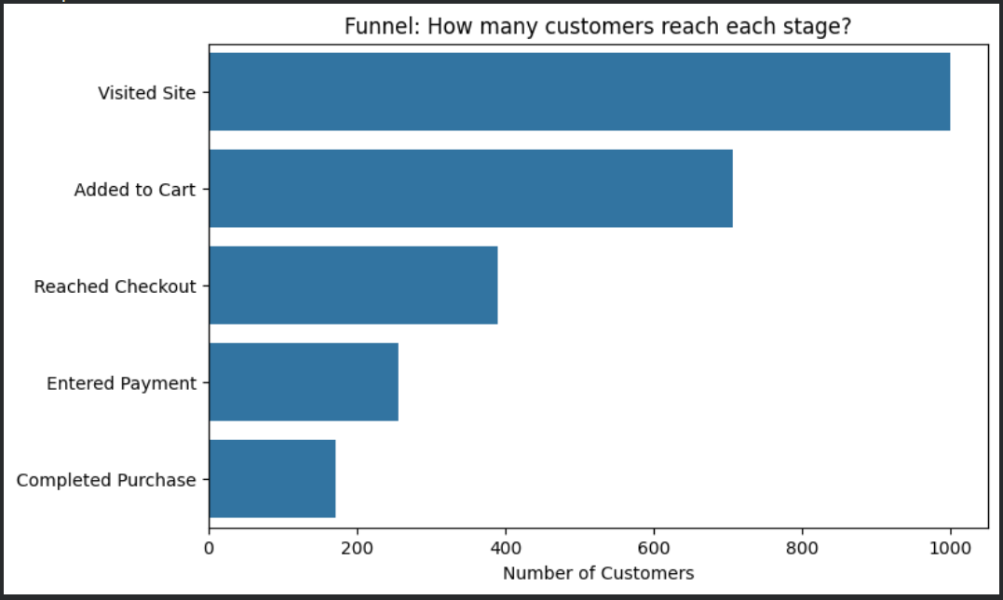
FUNNEL RESULTS
Where customers leave the purchase journey

Slide 8
MODEL RESULTS
What predicts whether a customer will abandon?
Increases abandonment
Reduces abandonment
Page load +0.0158 Weekend +0.2298 Page views +0.0191
Entered payment -3.3527 Previous purchases -0.0056

Slide 9
MODEL PERFORMANCE
How accurately can we identify abandoners?
Accuracy
Precision
Recall
62.5%
68.9%
62.3%
Recall is the key metric because missed abandoners represent lost recovery opportunities.

Slide 10
RECOMMENDATIONS
Three actions your team can take starting this week
01 Fix checkout experience
Reduce friction at the largest drop-off point.
02 Launch predictive recovery campaigns
Target users based on abandonment probability.
03 Improve data capture
Add shipping, inventory and campaign information.

Slide 11
LIMITATIONS & NEXT STEPS
What would make the analysis stronger
Could not measure: • Shipping cost effect • Inventory availability • Campaign ROI Next steps: 1. Add missing business variables 2. Run A/B tests 3. Build monitoring dashboard

