Slide 1
Insecure Deserialization: What , How and Why?

Slide 2




Whoami?
Naveen / thevillagehacker
Security Researcher
Occasional Bug Bounty Hunter
https://thevillagehacker.github.io
@thevillagehackr
@thevillagehacker

Slide 3
Index
Serialization and Deserialization
What is Insecure deserialization?
What can go wrong?
Attack Surface and its Impacts
Demo Example
Reference

Slide 4

Serialization and Deserialization
Serialization:-
Serialization is the process of converting an object into a stream of bytes to store the object or transmit it to memory, a database, or a file. Its main purpose is to save the state of an object in order to be able to recreate it when needed.
Deserialization:-
Deserialization is the process of restoring this byte stream to a fully functional replica of the original object, in the exact state as when it was serialized.
Example:-
Computer games
Mobile games

Slide 5
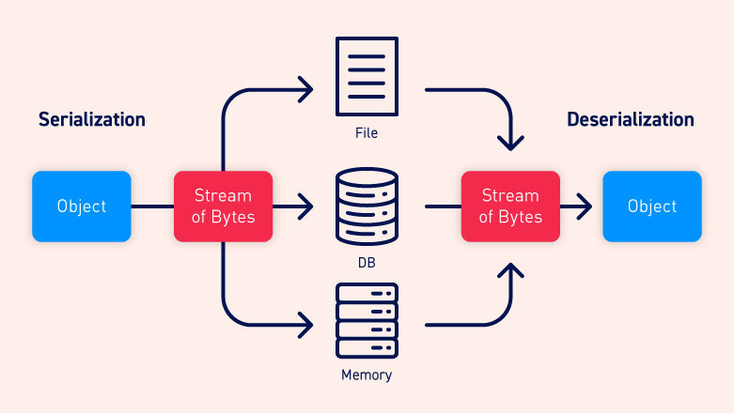
Basic Process

Slide 6
Insecure Deserialization
Insecure Deserialization is a vulnerability that occurs when untrusted data is used to abuse the logic of an application, inflict a denial of service (DoS) attack, or even execute arbitrary code upon it being Deserialized.
It also occupies the #8 spot in the OWASP Top 10 2017 list.
Exploitation of deserialization is a bit difficult, as off the shell exploits rarely work without changes or tweaks to the underlying exploit code.
Some tools can discover deserialization flaws, but human assistance is frequently needed to validate the problem.
Java Deserialization Scanner Burp Suite extension.
Ysoserial

Slide 7
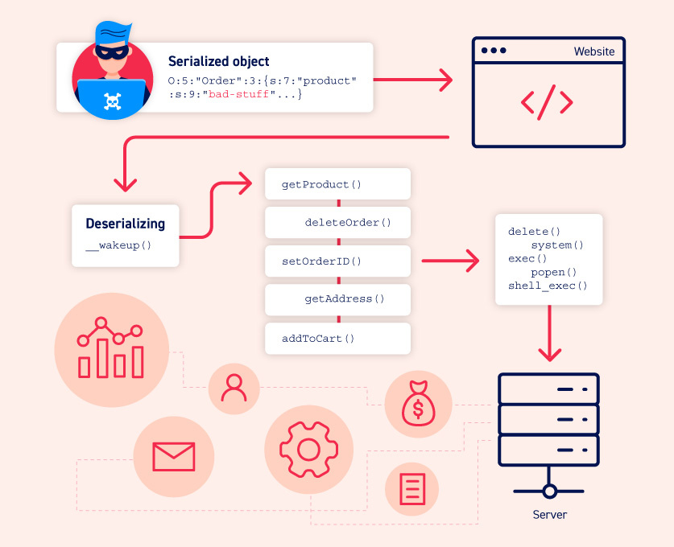
What can go wrong?

Slide 8
Attack Surface
Attack Surfaces and its Impacts
Impacts
Access-control-related attacks
HTTP cookies
HTML form parameters
API authentication tokens
Databases
cache servers
Remote Code Execution
Privilege Escalation
Arbitrary File Access
Denial-of-service attacks
Memory Consumption

Slide 9
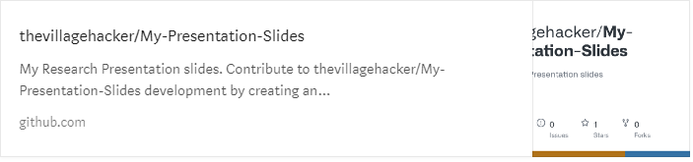
Demo Example Code for Serialization And Deserialization
Example vulnerable Java code:-
https://github.com/thevillagehacker/My-Presentation-Slides/tree/main/Insecure_Deserialization/Examples/java
Example vulnerable Python code:-
https://github.com/thevillagehacker/My-Presentation-Slides/tree/main/Insecure_Deserialization/Examples/python

Slide 10
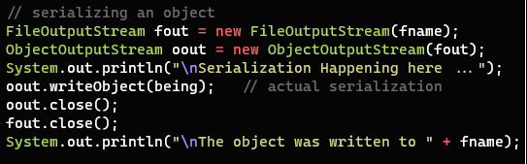
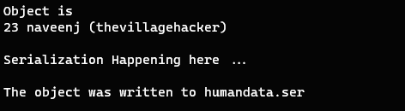
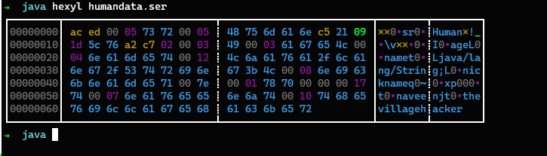
Serialization
The below shown image represents the serialization of objects into byte stream which is done using java native binary serialization libraries.
Serialization
Serialized data written to humandata.ser
The data streams stored in the computer memory

Slide 11
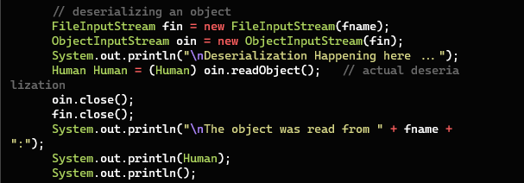
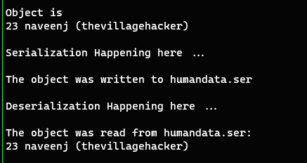
Deserialization
The below shown images represents the deserialization of byte streams into objects which is done using java native binary deserialization libraries.
Deserialization
Deserialized objects read from humandata.ser

Slide 12
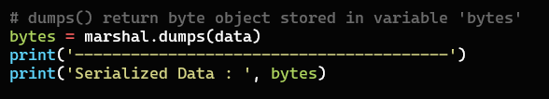

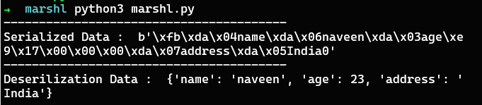
Python Serialization And Deserialization - Marshal
This module contains functions that can read and write Python values in a binary format.
Serialization
Deserialization
Serialized and Deserialized Data

Slide 13

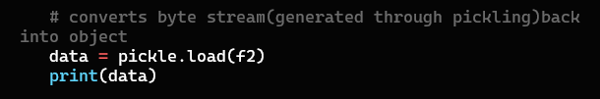
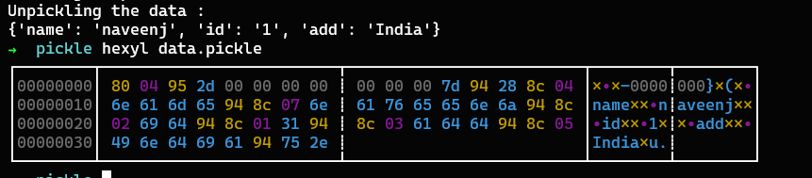
Python Pickle
Pickling” is the process whereby a Python object hierarchy is converted into a byte stream, and “unpickling” is the inverse operation, whereby a byte stream (from a binary file or bytes-like object) is converted back into an object hierarchy.
Serialization
Deserialization
Serialized and Deserialized Data

Slide 14



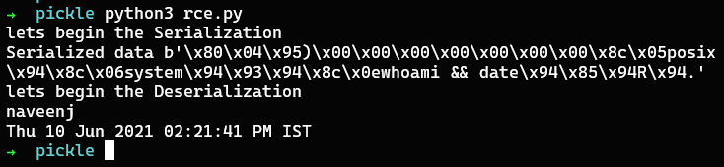
Achieve Remote Code Execution via Deserialization
The below shown python code is vulnerable to Remote Code Execution. The attacker controlled input is not verified by the developer at any place which leads to perform arbitrary code executions.
Class contains RCE payload
Serialization
Deserialization
Remote Code Execution

Slide 15
Reference
https://thevillagehacker.medium.com/insecure-deserialization-c2f0ae4a50f
https://www.acunetix.com/blog/articles/what-is-insecure-deserialization/#:~:text=Insecure%20Deserialization%20is%20a%20vulnerability,OWASP%20Top%2010%202017%20list.
https://portswigger.net/web-security/deserialization
https://owasp.org/www-project-top-ten/2017/A8_2017-Insecure_Deserialization
https://searchsecurity.techtarget.com/definition/insecure-deserialization
https://blog.cobalt.io/the-anatomy-of-deserialization-attacks-b90b56328766
https://youtu.be/jwzeJU_62IQ

Slide 16
Thank You

