Slide 1
Python Lists - Contents
Basic Properties of Lists
List Operations
Appending / Inserting an Element
Finding / Removing an Element
Sorting
Copying Lists
Slices of a List
Tuples

Slide 2
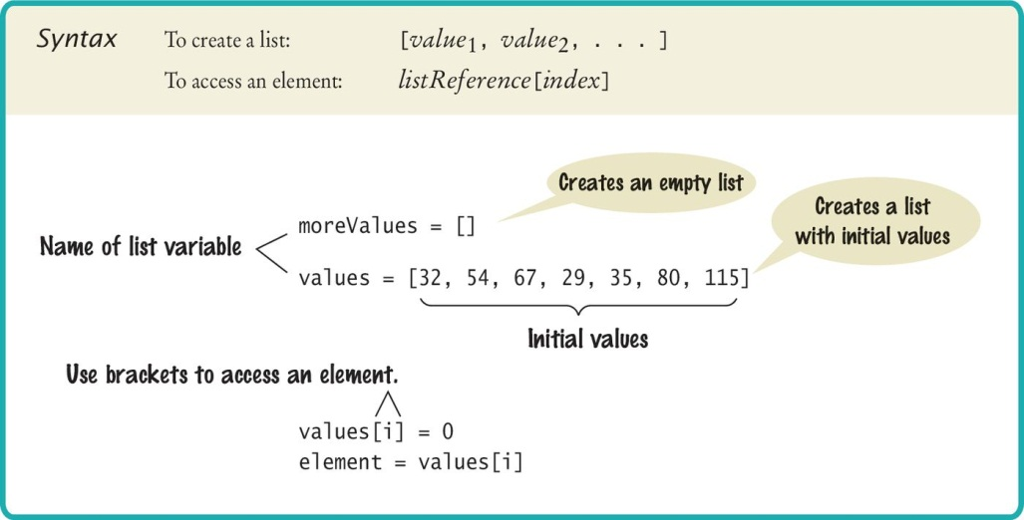
Creating a List
Specify a list variable with the subscript operator []

Slide 3
List Elements
A list is a sequence of elements, each of which has an index.
In a list, the elements can be any type.
[10, 20, 30, 40]
['apple', 'pear', 'banana']
And can be mixed type:
['spam', 2.0, 5, [10, 20]]
a string, a float, an integer, and another list
Lists inside lists are known as nested lists.

Slide 4
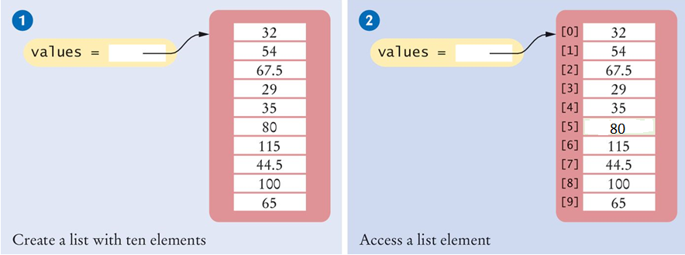
Creating Lists/Accessing Elements
# 1: Creating a list
values = [32, 54, 67.5, 29, 35, 80, 115, 44.5, 100, 65]
# 2: Accessing a list element
print(values[5])

Slide 5
Lists Vs. Strings
Both lists and strings are sequences, and the [] operator is used to access an element in any sequence
There are two differences between lists and strings:
Lists can hold values of any type, whereas strings are sequences of characters
Strings are immutable - you cannot change the characters in the sequence:
greeting = "Hello, world!"
greeting[0] = 'J' # ERROR!
Lists are mutable:
numbers = [42, 123]
numbers[1] = 5 # list is now [42, 5]

Slide 6
Out of Range Errors / List Length
Out-of-Range Errors:
Perhaps the most common error in using lists is accessing a nonexistent element – an IndexError:
If your program accesses a list through an out-of-range index, the program will generate an exception at run time
Determining List Length
You can use the len() function to obtain the length of the list; that is, the number of elements:
numElements = len(values) # 8
values = [2.3, 4.5, 7.2, 1.0, 12.2, 9.0, 15.2, 0.5]
values[8] = 5.4
# Error - values has 8 elements,
# and the index can range from 0 to 7

Slide 7
Loop Over the Index Values
Given the values list that contains 10 elements, we will want to set a variable, say i, to 0, 1, 2, and so on, up to 9.
# First version (list index used)
for i in range(10) :
print(i, values[i])
# Better version (list index used)
for i in range(len(values)) :
print(i, values[i])
# 3rd version: if index values not needed - traverse list elements
for element in values :
print(element)

Slide 8

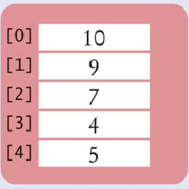
List References
Make sure you see the difference between the:
List variable: The named ‘alias’ or pointer to the list
List contents: Memory where the values are stored
values = [32, 54, 67.5, 29, 35, 80, 115, 44.5, 100, 65]
List variable
List contents
Reference
A list variable contains a reference to the list contents. The reference is the location of the list contents (in memory).
Values

Slide 9
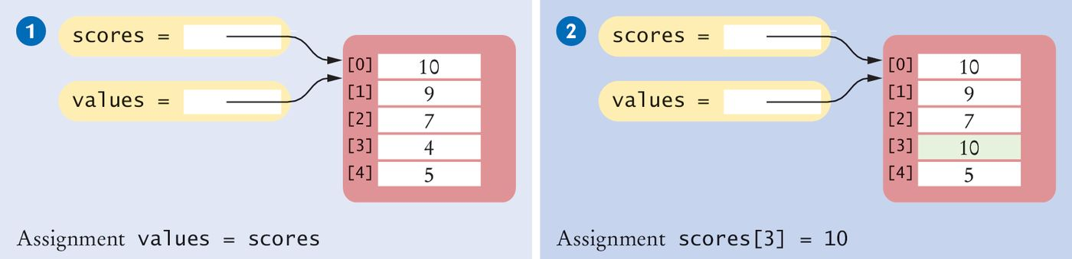
List Aliases
When you copy a list variable into another, both variables refer to the same list
The second variable is an alias for the first because both variables reference the same list
scores = [10, 9, 7, 4, 5]
values = scores # Copying list reference
List contents
A list variable specifies the location of a list. Copying the reference yields a second reference to the same list.
References

Slide 10
Modifying Aliased Lists
You can modify the list through either of the variables:
scores[3] = 10
print(values[3]) # Prints 10

Slide 11
Function Parameters are Aliases:
def f(a):
a[0] = 42
a = [2, 3, 5, 7]
f(a)
print(a)
The output of the above might surprise you..

Slide 12
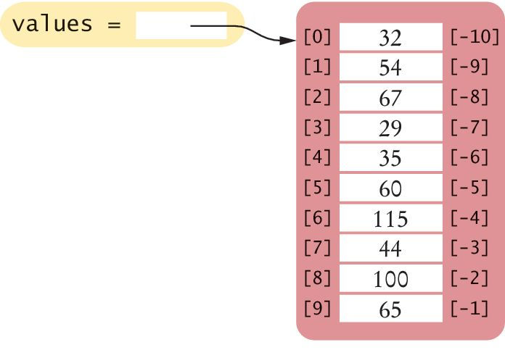
Reverse Subscripts
Python, unlike other languages, uses negative subscripts to provide access to the list elements in reverse order.
For example, a subscript of –1 provides access to the last element in the list:
Similarly, values[-2] is the second-to-last element.
last = values[-1]
print("The last element in the list is", last)

Slide 13
List Operations
Appending Elements
Finding an Element
Removing an Element
Inserting an Element at specific position
Sorting
Copying Lists
Slices of a List

Slide 14
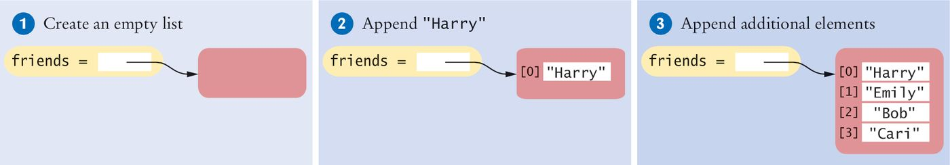
1. Appending Elements
Sometimes we may not know the values that will be contained in the list when it’s created
In this case, we can create an empty list and add elements to the end as needed
#1
friends = []
#2
friends.append("Harry")
#3
friends.append("Emily")
friends.append("Bob")
friends.append("Cari")

Slide 15
2. Finding an Element
in operator - to know whether an element is present in a list:
if "Cindy" in friends :
print("She's a friend")
Index() method - to know the position at which an element occurs
The index() method yields the index of the first match
friends = ["Harry", "Emily", "Bob", "Cari", "Emily"]
n = friends.index("Emily") # Sets n to 1

Slide 16
Self Check Question
The following code would cause an error:
friends = ["Harry", "Emily", "Bob", "Cari"]
n = friends.index("Donald") # Error!
What additional code could you use to ensure that an error is not displayed?

Slide 17
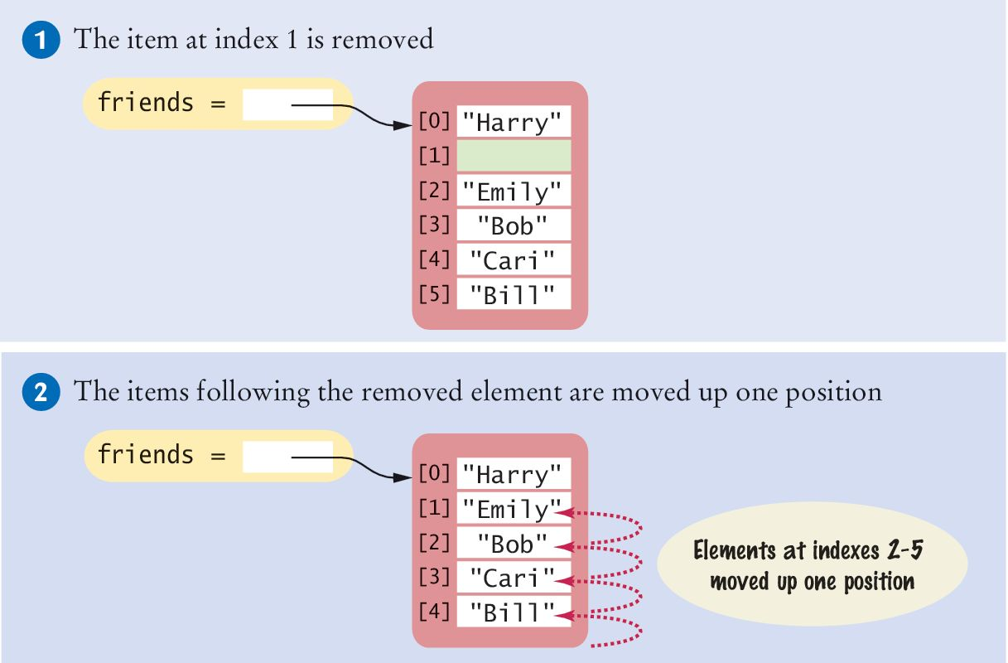
3. Removing an Element
The pop() method removes the element at a given position
friends = ["Harry", "Cindy", "Emily", "Bob", "Cari","Bill"]
friends.pop(1)
All of the elements following the removed element are moved up one position to close the gap. The length of the list is reduced by 1.
Note: friends.pop() with an empty parameter will remove the last element

Slide 18
pop() and remove()
Several ways to delete elements from a list.
q = ['a', 'b', 'c']
pop() if you know the index of the element.
Returns the element removed.
Used without an index - it deletes the last element.
q.pop(1)
print(q) # ['a', 'c']
print(q.pop(0)) # a
remove() if you know the element but NOT the index. Return value from remove is None.
q.remove('b')
print(q) # ['a', 'c']
print(q.remove('a')) # None

Slide 19
3. pop() review
pop() returns the value removed.
What is printed by the following?
alist = [4, 2, 8, 6, 5]
alist.pop(2)
alist.pop()
print(alist)
alist = alist.pop(0)
print(alist)

Slide 20
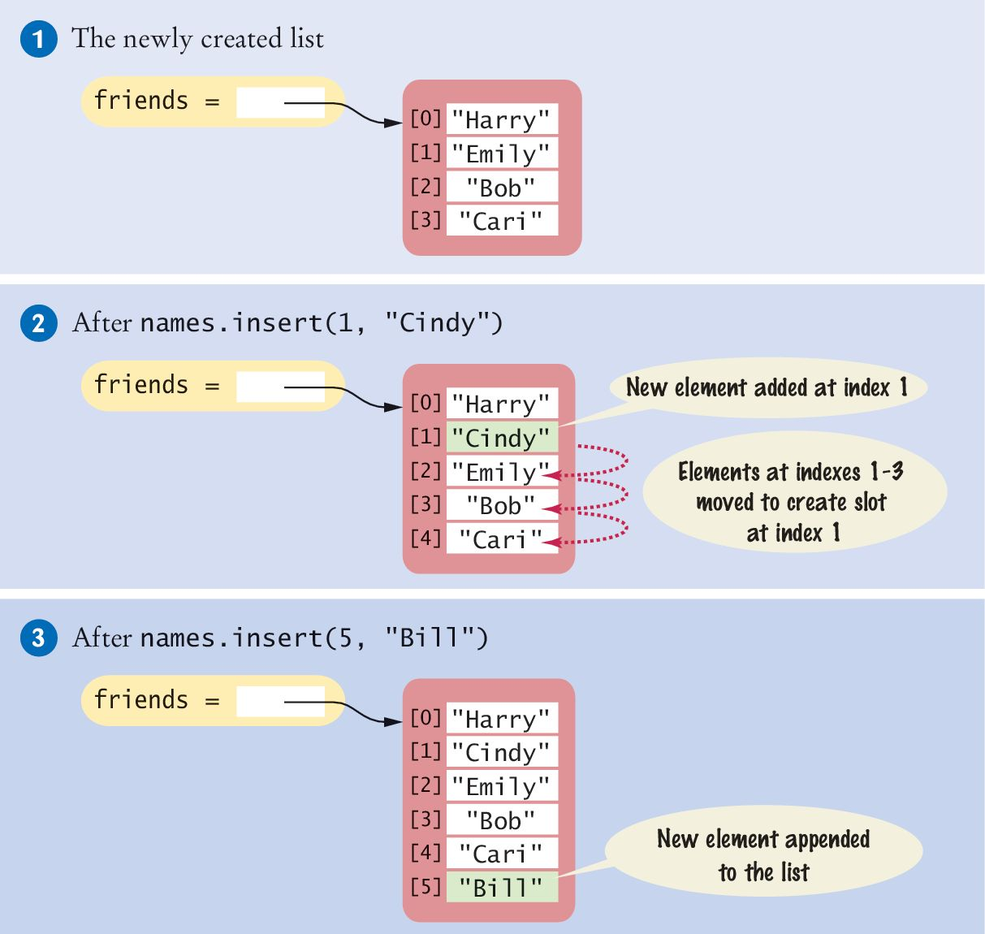
4. Insert an Element at specific position
Sometimes the order in which elements are added to a list is important
A new element has to be inserted at a specific position in the list
#1
friends = ["Harry", "Emily", "Bob", "Cari"]
#2
friends.insert(1, "Cindy")

Slide 21
5. Sorting
The sort() method sorts a list of numbers or strings.
values = [1, 16, 9, 4]
values.sort() # Now values is [1, 4 , 9, 16]

Slide 22
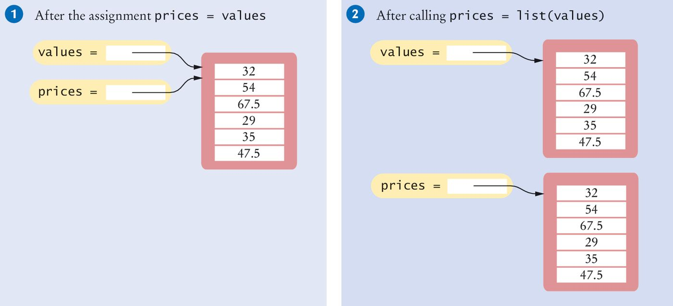
6. Copying Lists
List variables do not themselves hold list elements
They hold a reference to the actual list
If you copy the reference, you get another reference to the same list:
prices = values

Slide 23
Copying Lists (2)
Sometimes, you want to make a copy of a list; that is, a new list that has the same elements in the same order as a given list
Use the list() function:
prices = list(values)

Slide 24
7. Slices of a List
A list of temperatures, one per month:
temp = [18, 21, 24, 33, 39, 40, 39, 36, 30, 22, 18]
To obtain temperatures for the third quarter, with index values 6, 7, and 8 use the slice operator:
thirdQuarter = temp[6 : 9]
To replace the values in elements 6, 7, and 8:
temp[6 : 9] = [45, 44, 40]
# [18, 21, 24, 33, 39, 40, 45, 44, 40, 22, 18]
Which elements would the following slices obtain?
temp[ : 6]
temp[6 : ]

Slide 25
Exercises 1-6
Create a list "mylist" containing integers: 1, 2, 3, 4, 5
Print the second item in the list.
Print the second to last item in the list.
Use list slicing to print the second to the fourth item in the list.
Replace the first list item with the value 10.
Append the number 11 to the list.

Slide 26
Tuples
A tuple is similar to a list, but once created, its contents cannot be modified (a tuple is an immutable version of a list).
A tuple is created by specifying its contents as a comma-separated sequence. You can enclose the sequence in parentheses:
triple = (5, 10, 15)
If you prefer, you can omit the parentheses:
triple = 5, 10, 15

Slide 27
Tuples
We can process the tuple in the same ways as a list:
f i r s t = ( 1 , 2 , 3 )
second = ( 4 , 5 , 6 )
l e n ( f i r s t )
first + second
1 in first
5 not in second
However, tuple values are immutable. This is useful if you want to store data that you want to remain fixed during the course of a program.
Therefore, the following will create an error as you cannot change a value in a t u p l e.
first[2]=5

Slide 28
Summary (1) Lists
Lists are made up of elements, and each element has a position known as its index.
Lists are defined in Python using the square brackets with elements separated by commas.
We can refer to an individual element in a list by using the bracket syntax and specifying the index of the element we want.

Slide 29
Summary (2) Lists
Some built-In list operations
append() inserts a new element at the end of the list
in tests whether an element is in a list
index() to know the position of an element
pop() removes an element when the index is known.
remove() if you know the element but NOT the index.
insert() to insert a new element at a position in a list
sort() sorts a list of numbers or strings
list() function to copy lists
Tuple - comma-separated sequence enclosed in parentheses(). Immutable - useful if you want to store data that you want to remain fixed during the run of a program.

