Slide 1
Reading and Writing files with Python
Text files are very commonly used to store information
They are the most ‘portable’ types of data files
Examples of text files include files that are created with a simple text editor, such as Windows Notepad

Slide 2
File input/output
It is a common task to
read some input data ﬁle
do some processing with the data
write some output data ﬁle with results
Python distinguishes between
text ﬁles ('t')
binary ﬁles ('b')

Slide 3
Writing files: A three phase process
>>> f = open('test.txt', 'w') # Write
>>> f.write("first line\nsecond line")
>>> f.close()
creates a ﬁle test.txt that writes
first line
second line

Slide 4
Writing files: A three phase process
To write data, we need to open the ﬁle with 'w' mode:
f = open('test.txt', 'w')
By default, Python assumes text ﬁles or explicitly state a text ﬁle:
f = open('test.txt', 'tw')
If the ﬁle exists, it will be overridden with an empty ﬁle!
Use the ﬁle object method write()with string input argument.
f.write("first line\nsecond line")
Close the ﬁle at the end of writing process using close() method .
f.close().

Slide 5
Opening a text file for appending
If you do not want to overwrite the content of the file, you can open a file for appending with mode 'a'.
output = open('output.txt', 'a')

Slide 6
Reading a file
We create a ﬁle object f using
>>> f = open('test.txt', 'r') # Read
and have different ways of reading the data:
1. f.readlines() returns a list of strings (each being one line)
>>> f = open('test.txt', 'r')
>>> lines = f.readlines()
>>> f.close()
>>> lines
['first line\n', 'second line']

Slide 7
f.read()returns one long string for the whole ﬁle
>>> f = open('test.txt', 'r')
>>> data = f.read()
>>> f.close()
>>> data
'first line\nsecond line‘
Use text ﬁle f as an iterable object: process one line in each iteration (important for large ﬁles):
>>> f = open('test.txt', 'r')
>>> for line in f:
print(line, end='')
first line
second line
>>> f.close()

Slide 8
Opening and automatic ﬁle closing through context manager
Python provides context managers that we use using with.
>>> with open('test.txt', 'r') as f:
data = f.read()
>>> data
'first line\nsecond line'
If we use the ﬁle context manager, it will close the ﬁle automatically (when the control ﬂows leaves the indented block).
Once familiar with ﬁle access, this method is recommended.

Slide 9
Use case: Reading a ﬁle, iterating over lines
Often we want to process line by line. Typical code fragment:
f = open('myfile.txt', 'r')
lines = f.readlines()
f.close()
lines is a list of strings, each representing one line of the ﬁle.
It is good practice to close a ﬁle as soon as possible.
------------------------------------------------------------------------------------------------------
Equivalent example using the context manager:
with open('myfile.txt', 'r') as f:
lines = f.readlines()

Slide 10
What if the file does not exist?
A FileNotFoundError results if the file we try to read does not exist:
f = open('myfile.txt', 'r')
Python has a os (operating system) module that we can import. Returns a Boolean - os.path.exists()
import os
if os.path.exists('myfile.txt'):
f = open('myfile.txt', 'r')
lines = f.readlines()
f.close()

Slide 11
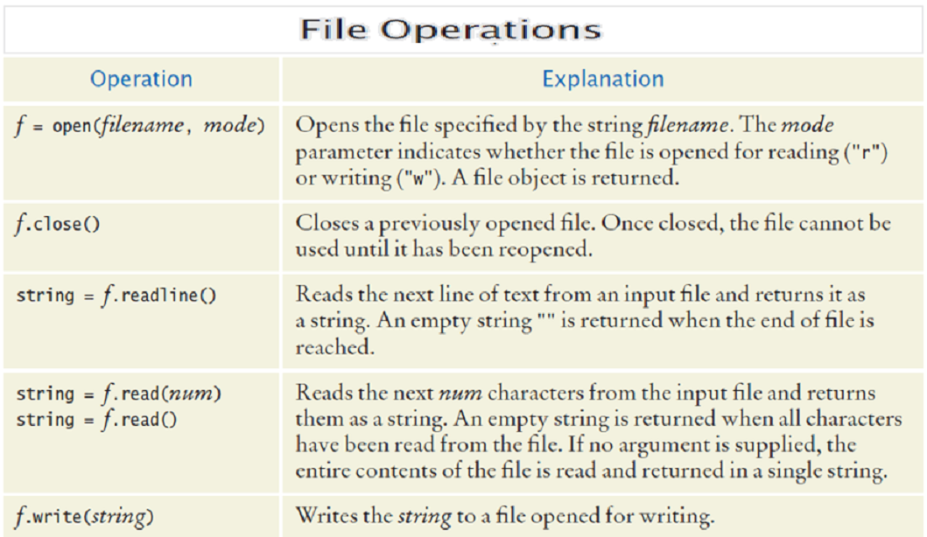

Slide 12
Splitting a string
We often need to split a string into smaller parts: use string method split():
Example: Take a string and display each word on a separate line:
>>> c = 'This is my string'
>>> c.split()
['This', 'is', 'my', 'string']
>>> c.split('i')
['Th', 's ', 's my str', 'ng']

Slide 13
Exercise – shopping list
Part 1 - Use Python to write the following items (item, quantity, price) to a text file shopping.txt(three items per line)
Bread 1 1.39
Tomatoes 6 0.26
Milk 3 1.45

Slide 14
Possible Solution – Part 1 a)
Part 1 a)- Use Python to write the following items (item, quantity, price) to a text file shopping.txt (three items per line)
Bread 1 1.39
Tomatoes 6 0.26
Milk 3 1.45
f = open('shopping.txt', 'w')
f.write("Bread 1 1.39\n Tomatoes 6 0.26\n Milk 3 1.45")
f.close()

Slide 15
Part 1 b) Create a function (write text to a file)
Part 1 a) – We could also write it this way:
text = "Bread 1 1.39\n Tomatoes 6 0.26\n Milk 3 1.45"
f = open('shopping.txt', 'w')
f.write(text)
f.close()
Part 1 b) - Define a function writeFile that has 2 parameters: fileName and textToWrite.
The text passed via textToWrite will be written to the file passed in fileName.

Slide 16
Exercise – shopping list
Part 2 - Write a program that reads and computes the total cost per item and writes this to shopping_cost.txt:
Bread 1 1.39
Tomatoes 6 1.56
Milk 3 4.35

Slide 17
fin = open('shopping.txt', 'r') # INput File
lines = fin.readlines()
fin.close() # close file
fout = open('shopping_cost.txt', 'w') # OUTput File
for line in lines:
words = line.split()
itemname = words[0]
number = int(words[1])
cost = float(words[2])
total = number * cost
fout.write("Total cost of %s is %.2f\n" % (itemname, total))
fout.close()

Slide 18
Exercise – shopping list
Part 3 - Write a program that reads and displays the contents of shopping_cost.txt.

Slide 19
Exercise – Student Data
The following file called studentdata.txt contains one line for each student in a class. The student’s name is the first thing on each line, followed by some exam scores. The number of scores might be different for each student.
joe 10 15 20 30 40
bill 23 16 19 22
sue 8 22 17 14 32 17 24 21 2 9 11 17
grace 12 28 21 45 26 10
john 14 32 25 16 89
Using the text file studentdata.txt write a program that prints out the names of students that have more than six quiz scores.

Slide 20
Possible Solution – Student Data
f = open('studentdata.txt', 'r')
for aline in f:
items = aline.split()
if len(items[1:]) > 6:
print(items[0])
f.close()

Slide 21
Summary
open() - You must open a file before you can read its contents.
close() - When you are finished with a file, you should close it.
read(n) - This method reads n number of characters from the file, or the entire file as a single string if n is not provided.
readline() - This method reads an entire line from the text file.
write() - Will add characters to the end of a file that has been opened for writing.
Use the split() method to split a string into individual words

