Slide 1
Week 4 – Python Iteration
while loops
Common errors
Sentinel Values
Common Loop Algorithms
Use of else with loops
for loops and range();
continue and break
Tutorial flowchart (Q1A)

Slide 2
Three basic programming constructs
Sequence - A list of instructions is carried out in order, one after the other.
Selection - An option of statements is provided and a condition is used to decide which option is chosen
Iteration – this week
A group of statements is executed repeatedly until a condition is met - while loop and for loop

Slide 3
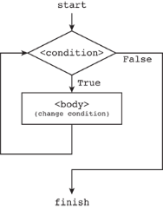
while loop
Condition controlled loops - flowchart

Slide 4
Condition controlled loop
E.g., print out the value of a number.
number = 0
while number < 10 :
print(number)
number = number + 1
This first variable is the number variable and you should initialise it before starting your while loop (e.g., give it a value).
If the condition is true (in this case if the variable is less than 10) then execute the next two lines of code.
Update number variable within loop

Slide 5
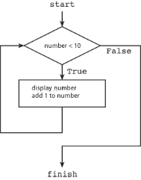
number = 0 while number < 10 : print(number) number = number + 1
Code with Flowchart

Slide 6
Python’s use of indentation
The Python indentation for the while “block” is not cosmetic. A sequence of lines that have the same indentation forms a block. Here, both lines get run or neither of them do. The block is ended by the first line that follows it with no indentation.
number = 0
while number < 10 :
print(number)
number = number + 1
print(‘Done!’)
The indentation indicates a “block” of code.
The first non-indented line marks the end of the block.

Slide 7
Common Error - Infinite Loops
counter = 1
while (counter <= 10) : # Executes 5 passes
print(counter)
counter = counter + 2
counter = 1
while (counter != 10) : # Runs forever
print(counter)
counter = counter + 2
counter = 1
while (counter != 10) : # Runs forever
print(counter) # counter not updated
counter = counter + 2 # in loop body

Slide 8
Common Error – Off-by-One Error
counter = 0
while (counter < 10) : # Q1.How many passes?
<do something>
counter = counter + 1
counter = 1
while (counter <= 10) : # Q2.How many passes?
<do something>
counter = counter + 1
counter = 1
while (counter < 10) : # Q3.How many passes?
<do something>
counter = counter + 1
counter = 0
while (counter <= 10) : #Q4. How many passes?
<do something>
counter = counter + 1

Slide 9
while Loop Review
Initialize variables before you test
The condition is tested BEFORE the loop body
Something inside the loop should change a variable used in the test
Watch out for common errors:
Infinite loops, Off-by-One Errors,
_________________________________
We will now look at using sentinel values to denote the end of a data set
Preventing divide by zero (why?)
Common Loop Algorithms

Slide 10
Processing Sentinel Values
A sentinel value can guarantee termination of a loop when processing sequential data. The sentinel value can detect the end of the data when there is no other means to do so.
It denotes the end of a data set, but it is not part of the data.
What value will end this loop?
salary = 0.0
while salary >= 0 :
salary = float(input())
if salary >= 0 :
total = total + salary
count = count + 1

Slide 11
Averaging a Set of Values
Declare and initialize a ‘total’ variable to 0.0
Declare and initialize a ‘count’ variable to 0
Declare and initialize a ‘salary’ variable to 0.0
Prompt user with instructions
Loop until sentinel value is entered
Save entered value to input variable (‘salary’)
If salary is not -1 or less (sentinel value)
Add salary variable to total variable
Add 1 to count variable
Make sure you have at least one entry before you divide!
Divide total by count and output.

Slide 12
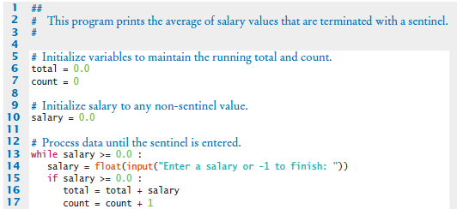
Sentinel.py (1)
Outside the while loop: declare and initialize variables to use
Since salary is initialized to 0, the while loop statements will execute at least once
Input new salary and compare to sentinel
Update running total and count (to calculate the average later)

Slide 13

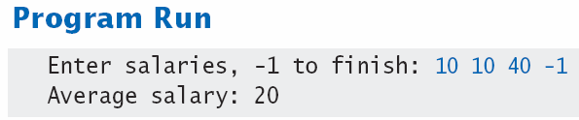
Sentinel.py (2)
Prevent divide by 0
Calculate and output the average salary using the total and count variables
Question - What is the importance of line 15?

Slide 14
Priming Read
Some programmers don’t like the “trick” of initializing the input variable with a value other than a sentinel.
# Set salary to a value to ensure that the
# loop executes at least once.
salary = 0.0
while salary >= 0 :
An alternative - change the variable with a read before the loop.
salary = float(input("Enter salary or -1 to exit "))
while salary >= 0 :

Slide 15
Modification Read
The input operation at the bottom of the loop is used to obtain the next input.
# Priming read
salary = float(input("Enter salary or -1 to exit "))
while salary >= 0.0 :
total = total + salary
count = count + 1
# Modification read
salary = float(input("Enter salary or -1 to exit "))

Slide 16
Boolean Variable as Flag
A boolean variable can be used to control a loop
Sometimes called a ‘flag’ variable
done = False
while not done :
value = float(input("Enter salary or -1 to exit "))
if value < 0.0:
done = True
else :
# Process value
Initialize done so that the loop will execute
Set done to True if sentinel value found

Slide 17
Common Loop Algorithms 1
Sum Values: Write a program that contains a while loop that will sum the float values entered by a user until the user enters a number less than zero. Then print the total.
Here is part of the code:
total = 0.0
value = float(input("Enter value: "))
while (1)____________
(2)_______________
(3)______________
(4)__________

Slide 18
Common Loop Algorithms 2
Average of Values
Total the values
Initialize count to 0
Increment per input
Check for count greater than 0 before divide!
Exercise - Fill in missing code: (1) , (2) and (3)
total = 0.0
count = 0
value = float(input("Enter value"))
while value >= 0 :
total = (1)______________
count = (2)______________
value = float(input("Enter value"))
if count > 0 :
(3)______________
else :
average = 0.0
print(average)

Slide 19
Dry run a program to find the problem
There is a problem with this program. Track down where the problem is by tracing your program’s execution.
health = 10
trolls = 0
damage = 3
while health != 0:
trolls += 1
health -= damage
print("Hero defeats a troll, but takes", damage, "damage points.")
print("Hero lost but defeated ", trolls, " trolls.")
Trace this program to find where the problem is and then re-write the program so that it works as intended

Slide 20
else used with loops
Python, unlike many other languages, allows the use of else for while and for loops. When the loop condition of a loop statement fails then code part in "else" is executed.
#Prints: 0,1,2,3,4 count reached
count=0
while(count<5):
print(count)
count +=1
else:
print("count reached")

Slide 21
While loop Summary
Name two common while loop errors:
1.______________ 2.________________
We reviewed the following.
How to use sentinel values such as negative numbers to denote the end of a data set.
Using a Boolean to control the loop.
How to check for divide by zero to prevent errors.
How to use loops to sum and average entered values.
Use of else with loops.

Slide 22
for loops
A for loop is also known as a count controlled loop.
A for loop repeats part of a program for a stated number of times.
A for loop repeats its loop body for each element of the sequence in order.
When it reaches the end of the sequence (the number of times it was set to loop) the loop ends.

Slide 23
Counting with For loops
In Python, for loops are constructed like this:
for [iterating variable] in [sequence]:
[do something]
The for and in are key words that are inbuilt commands.
The iterating variable will hold the values of the generated sequence which is stepped through.

Slide 24
For loops - range()
range() Iterating through a sequence of numbers.
Use 1, 2 or 3 numbers (arguments) inside the brackets.
for i in range(10):
print(i)
The number passed to the range function tells the program how many times to loop. The sequence generated is: 0, 1, 2, 3, 4, 5, 6, 7, 8, 9
The sequence automatically starts at 0. The end point (10) is never part of the generated sequence.

Slide 25
For loops - range()
Example: range() function with 2 arguments
To let the range start at another number.
for i in range(5, 10):
print(i)
The sequence generated will be: 5, 6, 7, 8, 9.
Remember, the end point (10) is never part of the generated sequence.

Slide 26
For loops - range()
Example: range() function with 3 arguments
print ("counting in fives")
for i in range (0,50,5):
print(i)
With the three numbers the first number is the start number
Second number is the finish number
Third number is what to increment the numbers by
Sequence generated:
0,5,10,15,20,25,30,35,40,45

Slide 27
For loops - range()
print("Counting Backwards")
for i in range (10, 0, -1):
print(i)
As well as positive numbers you can also program the computer to loop backwards
Look at the third number in the range argument.

Slide 28
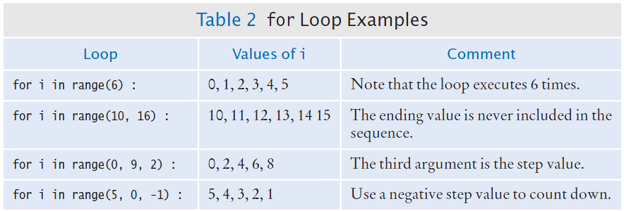
Good Examples of for Loops
Keep the loops simple

Slide 29
While loop vs for loop
Which is the best solution?
i = 1
while i < 10 :
print(i)
i = i + 1
while version
for i in range(1, 10) :
print(i)
for version

Slide 30
Self-check : Questions 1, 2, 3 & 4 What integer sequence will the following generate?
Question 1 range(8)
Question 2 range(1, 6)
Question 3 range(3, 10, 2)
Question 4 range(10, 3, -2)

Slide 31
Breaking the loop
If you need to break out of a loop there are two important keywords: continue and break.
Continue
when it gets executed the loop will stop the current iteration where it is without executing anything after the continue statement and go on to the next iteration of the loop.
Break
when it gets executed it will break out of the loop and continue executing from the first instruction after the loop.

Slide 32
break & continue
break What will this example print?
count = 0
while True:
print(count)
count += 1
if count >= 5:
break
continue What will this print?
for x in range(10):
if x % 2 == 0:
continue
print(x)

Slide 33
Tutorial Exercise 1 - Part A
Create the flowchart for the following
Initialise variable hidden with a value of 6.
Ask user to guess a number between 1 and 20.
Loop while the guess is not the hidden number. Within the loop:
state guess is not correct,
ask user for next guess (between 1 and 20).
If the guess is correct the loop will no longer run.
Let the user know their guess was correct.

