Slide 1

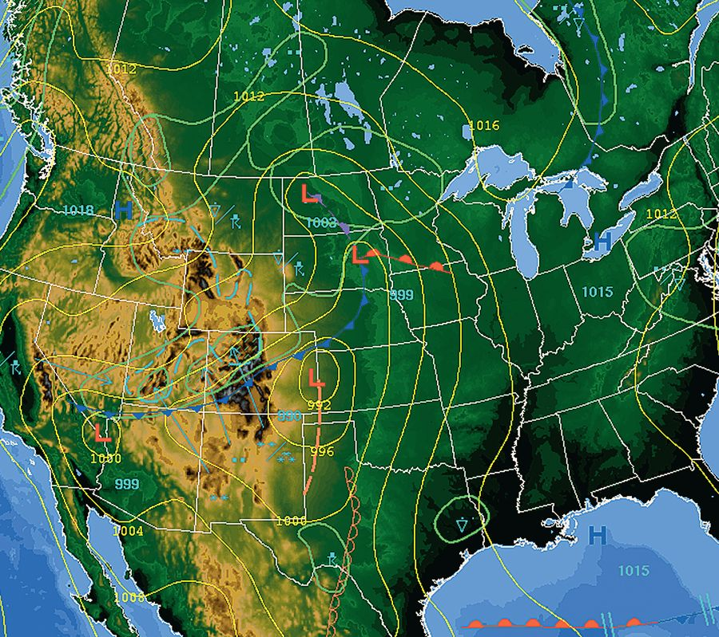
13
Functions of Several Variables
Copyright © Cengage Learning. All rights reserved.

Slide 2
Introduction to Functions of Several Variables
13.1
Copyright © Cengage Learning. All rights reserved.

Slide 3
Objectives
Understand the notation for a function of several variables.
Sketch the graph of a function of two variables.
Sketch level curves for a function of two variables.
Sketch level surfaces for a function of three variables.
Use computer graphics to graph a function of two variables.

Slide 4
Functions of Several Variables

Slide 5

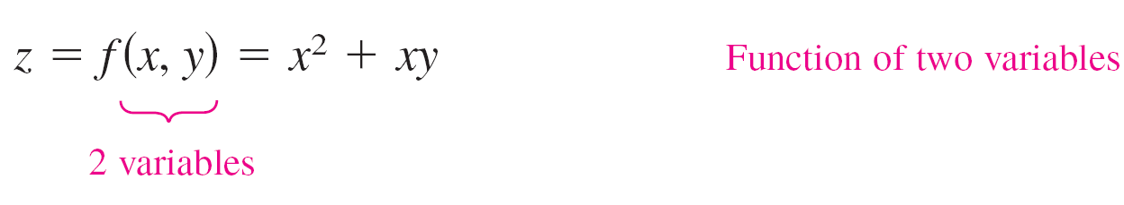
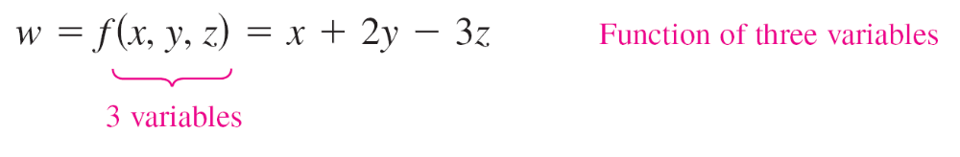
Functions of Several Variables
The work done by a force (W = FD) and the volume of a right circular cylinder (V = ) are both functions of two variables. The volume of a rectangular solid (V = lwh) is a function of three variables.
The notation for a function of two or more variables is similar to that for a function of a single variable. Here are two examples.
and

Slide 6
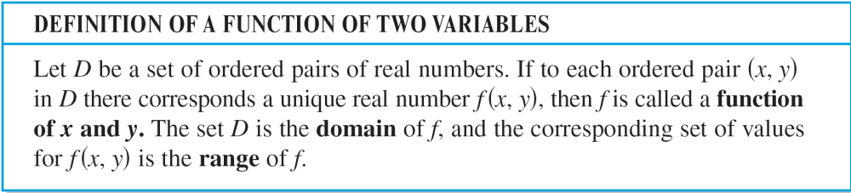
Functions of Several Variables
For the function given by z = f(x, y), x and y are called
the independent variables and z is called the
dependent variable.

Slide 7
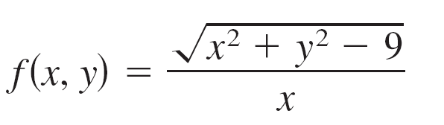
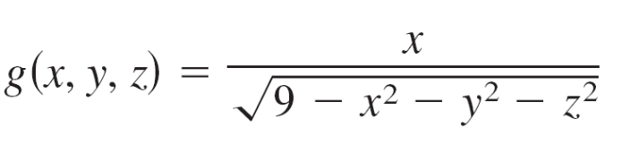

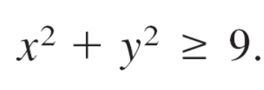
Example 1 – Domains of Functions of Several Variables
Find the domain of each function.
a. b.
Solution:
a. The function f is defined for all points (x, y) such that
x 0 and

Slide 8

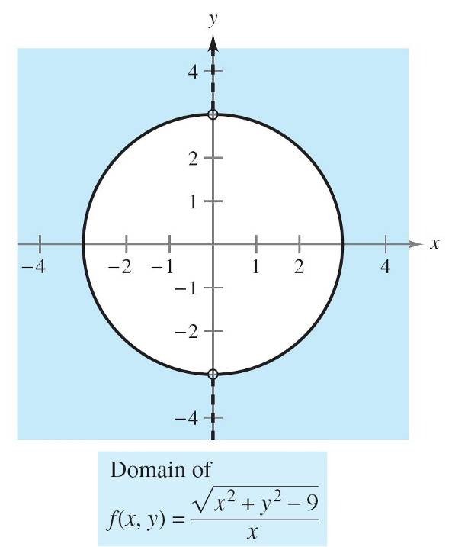
Example 1 – Solution
cont’d
So, the domain is the set of all points lying on or outside
the circle , except those points on the y-axis,
as shown in Figure 13.1.
Figure 13.1

Slide 9
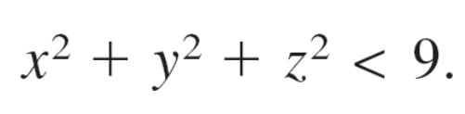
Example 1 – Solution
cont’d
b. The function g is defined for all points (x, y, z) such that
Consequently, the domain is the set of all points (x, y, z)
lying inside a sphere of radius 3 that is centered at the
origin.

Slide 10
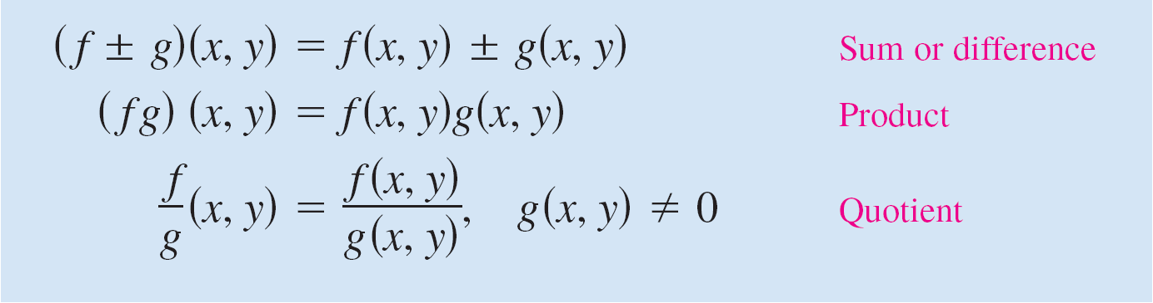
Functions of Several Variables
Functions of several variables can be combined in the same ways as functions of single variables.
For instance, you can form the sum, difference, product,
and quotient of two functions of two variables as follows.

Slide 11

Functions of Several Variables
You cannot form the composite of two functions of several variables.
However, if h is a function of several variables and g is a
function of a single variable, you can form the composite
function as follows.

Slide 12
Functions of Several Variables
A function that can be written as a sum of functions of the form cx^{m}y^{n} (where c is a real number m and n are nonnegative integers) is called a polynomial function of two variables.
For instance, the functions given by
are polynomial functions of two variables.
A rational function is the quotient of two polynomial functions.
Similar terminology is used for functions of more than two variables.

Slide 13
The Graph of a Function of Two Variables

Slide 14
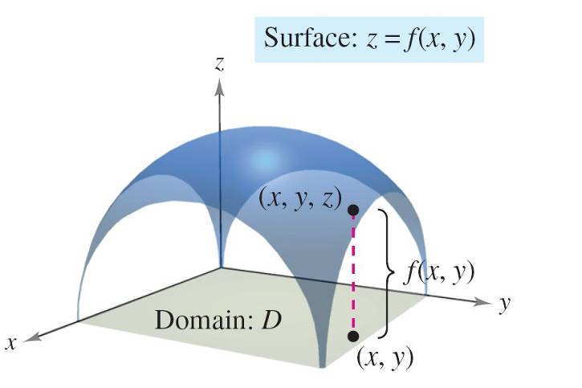
The Graph of a Function of Two Variables
The graph of a function f of two variables is the set of all points (x, y, z) for which z = f(x, y) and (x, y) is in the domain of f.
This graph can be interpreted
geometrically as a surface
in space. In Figure 13.2,
note that the graph of z = f (x, y)
is a surface whose projection
onto the xy-plane is the D,
the domain of f.
Figure 13.2

Slide 15
The Graph of a Function of Two Variables
To each point (x, y) in D there corresponds a point (x, y, z)
on the surface, and, conversely, to each point (x, y, z) on
the surface there corresponds a point (x, y) in D.

Slide 16


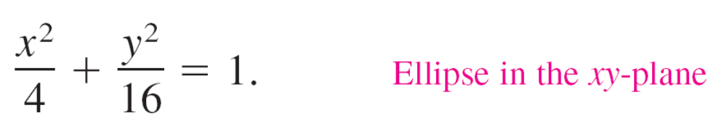
Example 2 – Describing the Graph of a Function of Two Variables
What is the range of Describe the
graph of f.
Solution:
The domain D implied by the equation of f is the set of all
points (x, y) such that
So, D is the set of all points lying on or inside the ellipse
given by

Slide 17
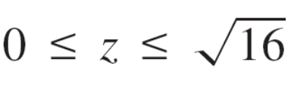
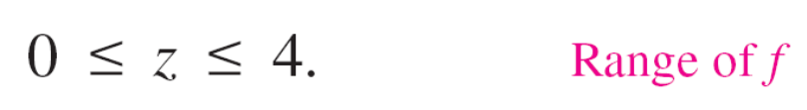



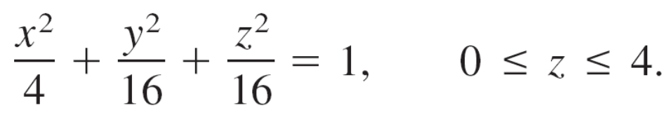
Example 2 – Solution
cont’d
The range of f is all values z = f(x, y) such that
or
A point (x, y, z) is on the graph of f if and only if

Slide 18
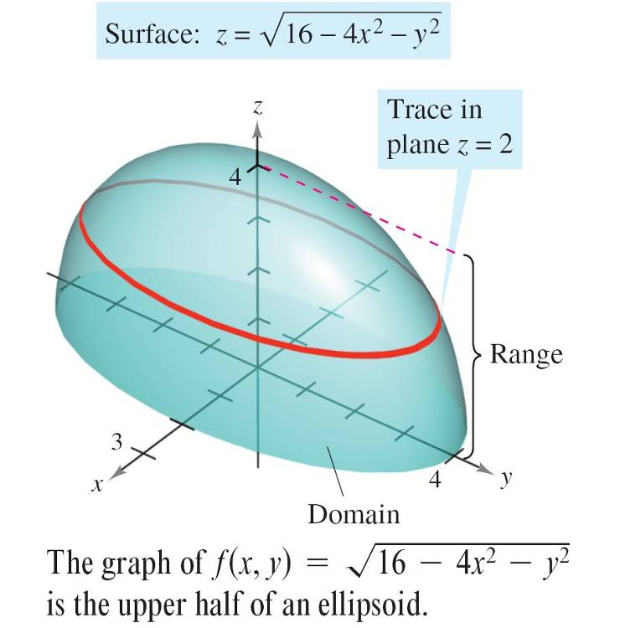
Example 2 – Solution
cont’d
You know that the graph of f is the upper half of an ellipsoid,
as shown in Figure 13.3.
Figure 13.3

Slide 19
Level Curves

Slide 20
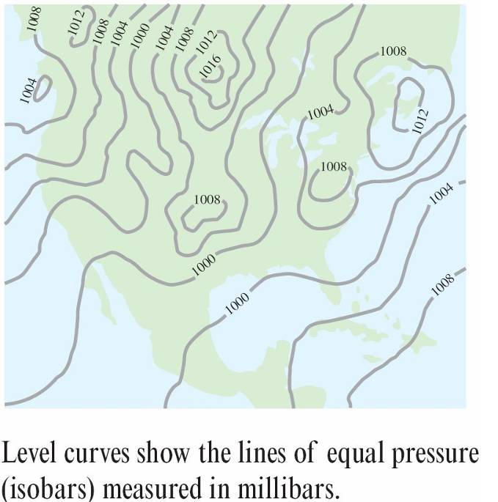
Level Curves
A second way to visualize a function of two variables is to use a scalar field in which the scalar z = f(x, y) is assigned to the point (x, y).
A scalar field can be characterized by level curves (or contour lines) along which the value of f(x, y) is constant.
For instance, the weather map
in Figure 13.5 shows level curves
of equal pressure called isobars.
Figure 13.5

Slide 21
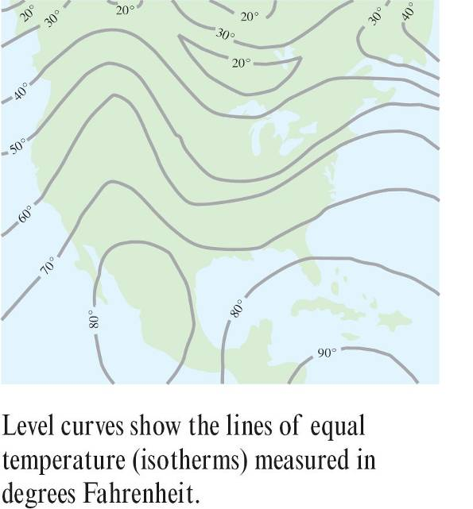
Level Curves
In weather maps for which the level
curves represent points of equal
temperature, the level curves are
called isotherms, as shown in
Figure 13.6.
Another common use of level curves
is in representing electric potential fields.
In this type of map, the level curves are called equipotential lines.
Figure 13.6

Slide 22
Level Curves
Contour maps are commonly used to show regions on Earth’s surface, with the level curves representing the height above sea level. This type of map is called a topographic map.

Slide 23
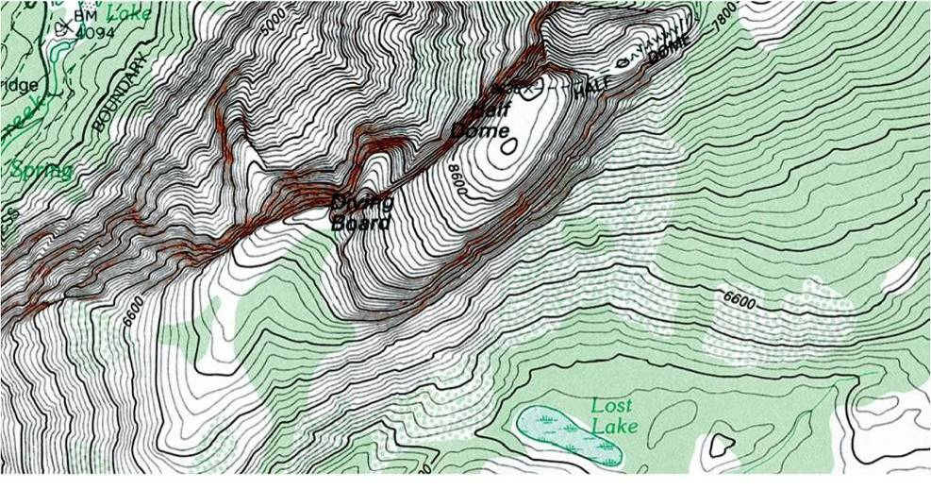
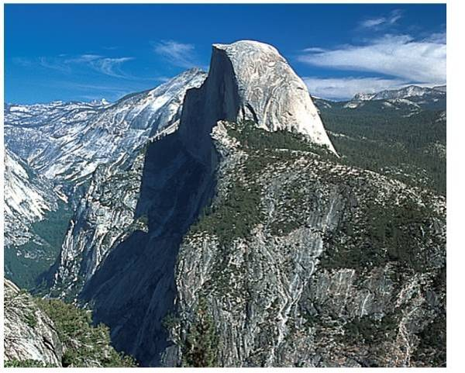
Level Curves
For example, the mountain shown in Figure 13.7 is represented by the topographic map in Figure 13.8.
Figure 13.7
Figure 13.8

Slide 24
Level Curves
A contour map depicts the variation of z with respect to
x and y by the spacing between level curves.
Much space between level curves indicates that z is changing slowly, whereas little space indicates a rapid change in z.
Furthermore, to produce a good three-dimensional illusion in a contour map, it is important to choose c-values that are evenly spaced.

Slide 25
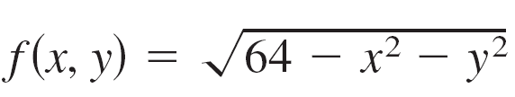
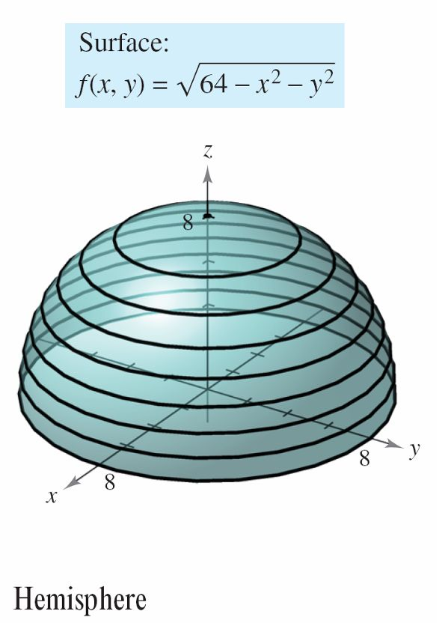
Example 3 – Sketching a Contour Map
The hemisphere given by is shown in Figure 13.9. Sketch a contour map of this surface using level curves corresponding to c = 0, 1, 2,…, 8.
Figure 13.9

Slide 26
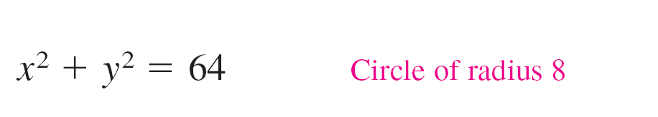
Example 3 – Solution
For each value of c, the equation given by f(x, y) = c is a circle (or point) in the xy-plane.
For example, when c₁= 0, the level curve is
which is a circle of radius 8.

Slide 27
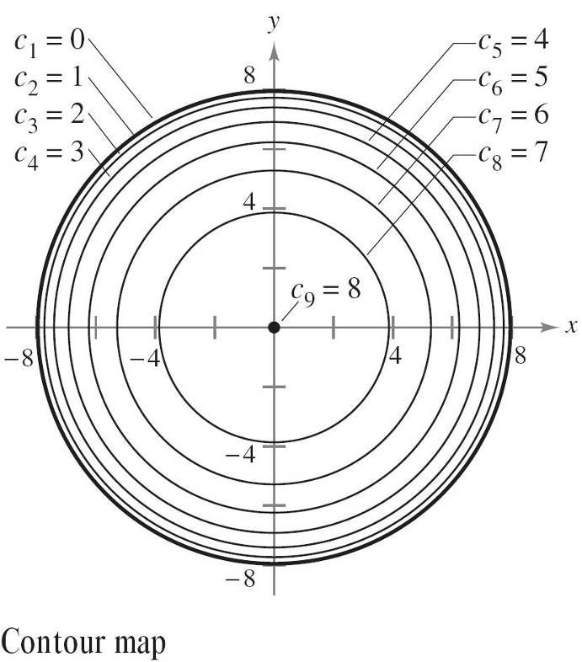
Example 3 – Solution
cont’d
Figure 13.10 shows the nine level curves for the hemisphere.
Figure 13.10

Slide 28
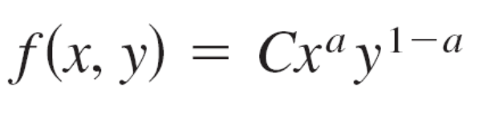
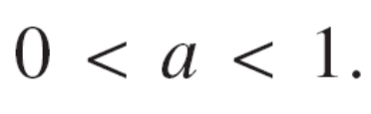
Level Curves
One example of a function of two variables used in economics is the Cobb-Douglas production function.
This function is used as a model to represent the numbers of units produced by varying amounts of labor and capital.
If x measures the units of labor and y measures the units of capital, the number of units produced is given by
where C and a are constants with

Slide 29
Level Surfaces

Slide 30
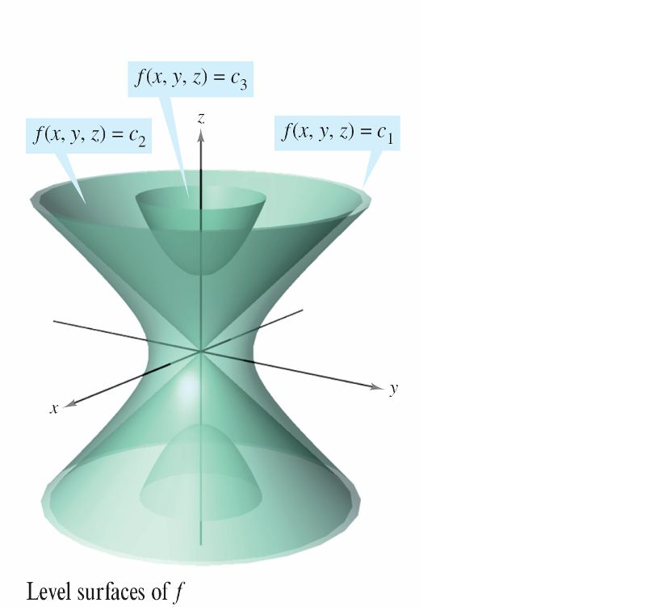
Level Surfaces
The concept of a level curve can be extended by one dimension to define a level surface.
If f is a function of three variables
and c is a constant, the graph of the
equation f( x, y, z) = c is a
level surface of the function f,
as shown in Figure 13.14.
Figure 13.14

Slide 31
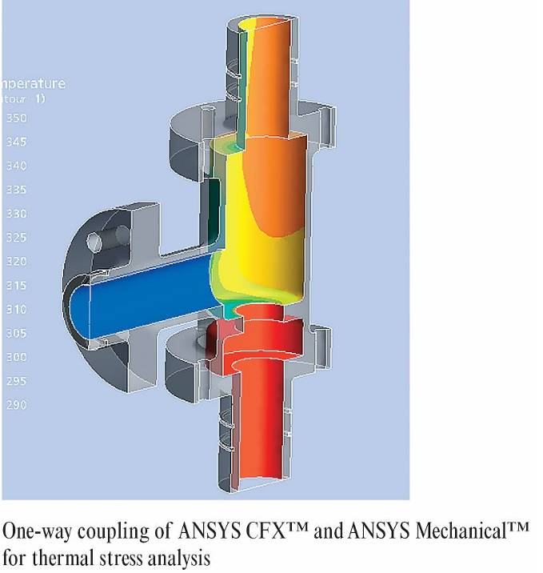
Level Surfaces
With computers, engineers and scientists have developed other ways to view functions of three variables.
For instance, Figure 13.15
shows a computer simulation
that uses color to represent
the temperature distribution
of fluid inside a pipe fitting.
Figure 13.15

Slide 32

Example 6 – Level Surfaces
Describe the level surfaces of the function
Solution:
Each level surface has an equation of the form
So, the level surfaces are ellipsoids (whose cross sections parallel to the yz-plane are circles).
As c increases, the radii of the circular cross sections increase according to the square root of c.

Slide 33
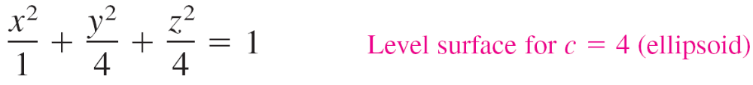
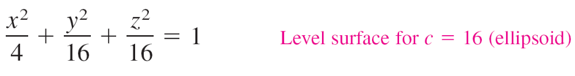
Example 6 – Solution
cont’d
For example, the level surfaces corresponding to the
values c = 0, c = 4, c = 16 and are as follows.

Slide 34
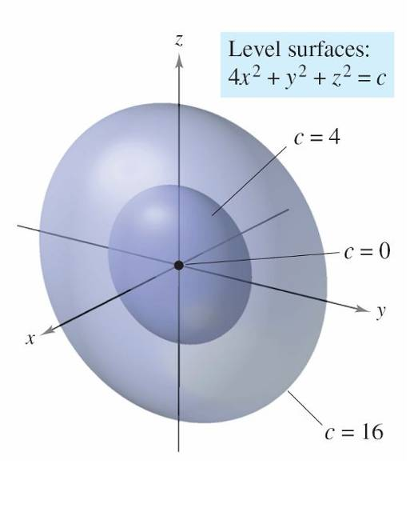
Example 6 – Solution
cont’d
These level surfaces are shown in Figure 13.16.
If the function represents the temperature at the point
(x, y, z), the level surfaces shown in Figure 13.16 would be
called isothermal surfaces.
Figure 13.16

Slide 35
Computer Graphics

Slide 36
Computer Graphics
The problem of sketching the graph of a surface in space can be simplified by using a computer.
Although there are several types of three-dimensional graphing utilities, most use some form of trace analysis to give the illusion of three dimensions.
To use such a graphing utility, you usually need to enter the equation of the surface, the region in the xy-plane over which the surface is to be plotted, and the number of traces to be taken.

Slide 37



Computer Graphics
For instance, to graph the surface given by
you might choose the following bounds for x, y, and z.

Slide 38
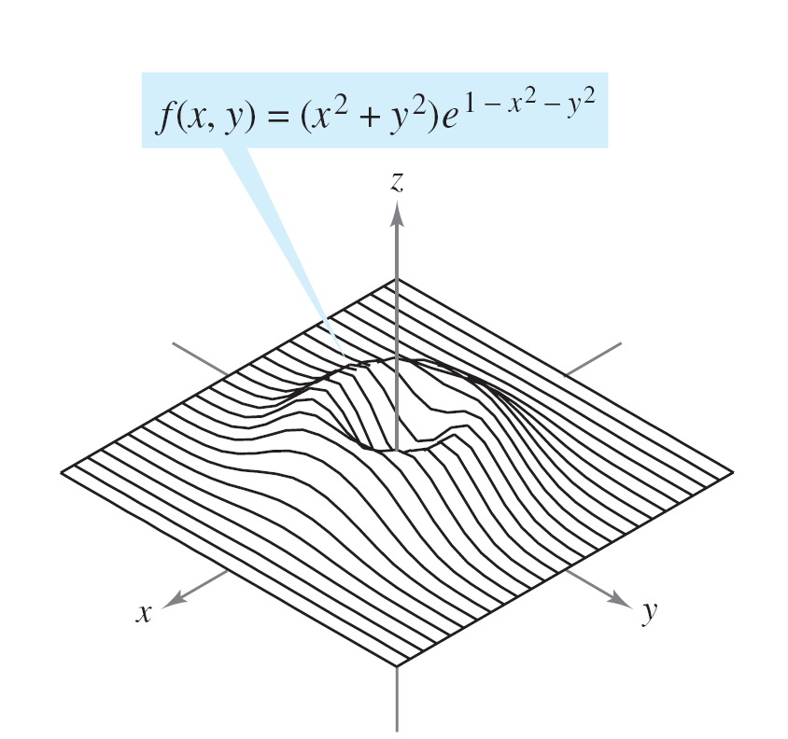
Computer Graphics
Figure 13.17 shows a computer-generated graph of this surface using 26 traces taken parallel to the yz-plane.
To heighten the three-dimensional effect, the program uses a “hidden line” routine.
Figure 13.17

Slide 39
Computer Graphics
That is, it begins by plotting the traces in the foreground (those corresponding to the largest x-values), and then, as each new trace is plotted, the program determines whether all or only part of the next trace should be shown.
The graphs show a variety of surfaces that were plotted by computer.
If you have access to a computer drawing program, use it to reproduce these surfaces.
Remember also that the three-dimensional graphics in this text can be viewed and rotated.

Slide 40
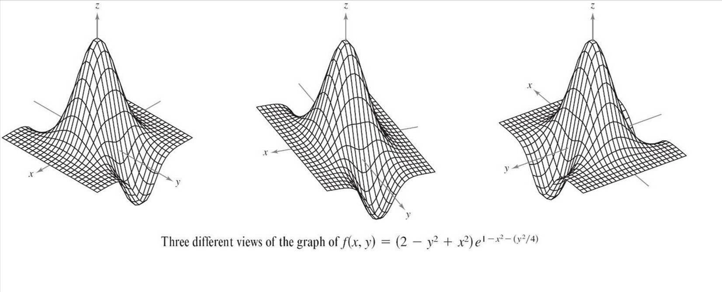
Computer Graphics

Slide 41
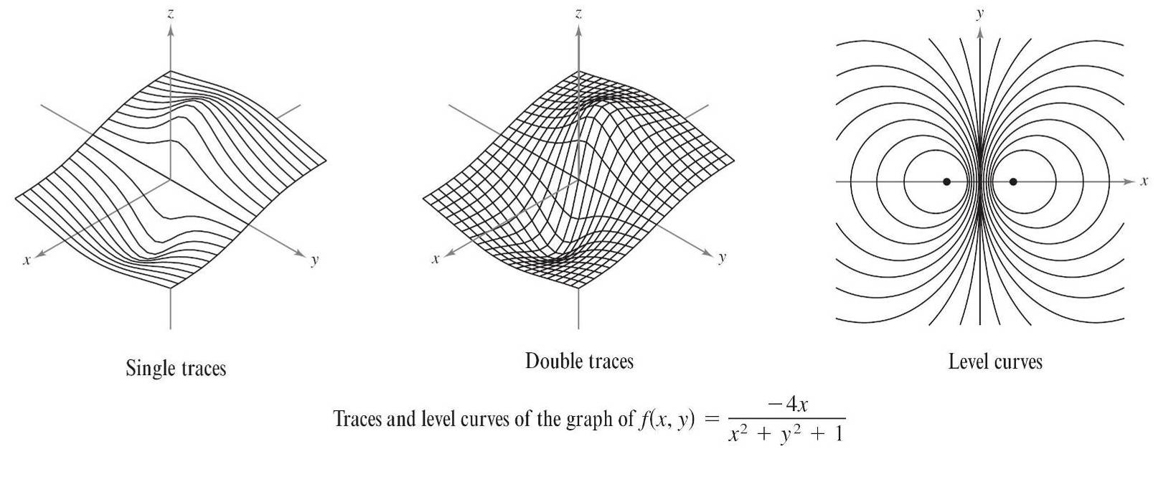
Computer Graphics
cont’d

Slide 42
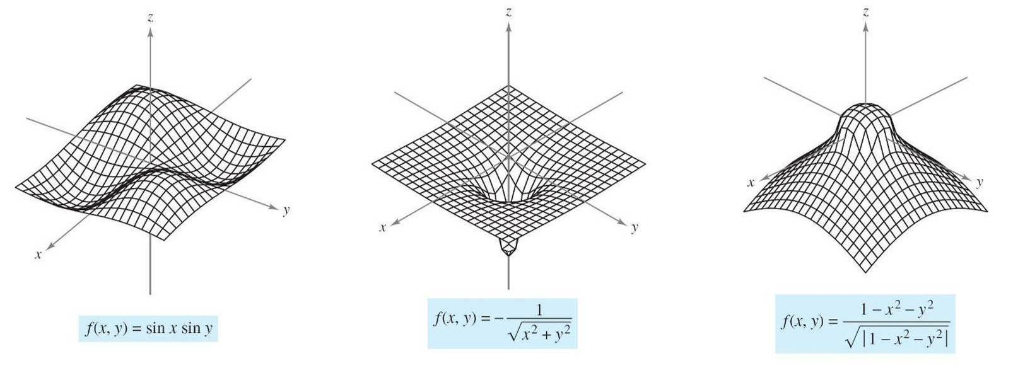
Computer Graphics
cont’d

