Slide 1

ODF (OPEN DISCUSSION FORUM)
Supervisor:
Mr. Amol Sharma
Asst. Professor
Notes:
NOTE:
To change the image on this slide, select the picture and delete it. Then click the Pictures icon in the placeholder to insert your own image.

Slide 2
Team 5
Neeraj Kumar(1329210050)
Pragya Rajvanshi(1329210057)
Shivika Tyagi(1329210069)
Vasu Garg(1329210078)
Vishal Chauhan(1329210079)

Slide 3
CONTENTS
INTRODUCTION
SCOPE & SIGNIFICANCE
FEATURES
PROCESS DESCRIPTION
RESOURCE REQUIREMENTS
CONCLUSION
REFERENCES

Slide 4


INTRODUCTION
Open Discussion Forum
A website which helps to resolve doubts, queries related to any field by having discussions with other registered users.
This will help the students to improve their skills according to their desired technologies by interacting with their teachers and colleagues.

Slide 5
SCOPE & SIGNIFICANCE
Education Purpose.
Query Solutions for everyone.
Interaction with Other students and Faculties.
Education as per your domain.

Slide 6
FEATURES
Registration, Verification and Login
Questions
Upvote Questions
Answers
Like Answers
Assignment
Subscribing domain
Notification

Slide 7
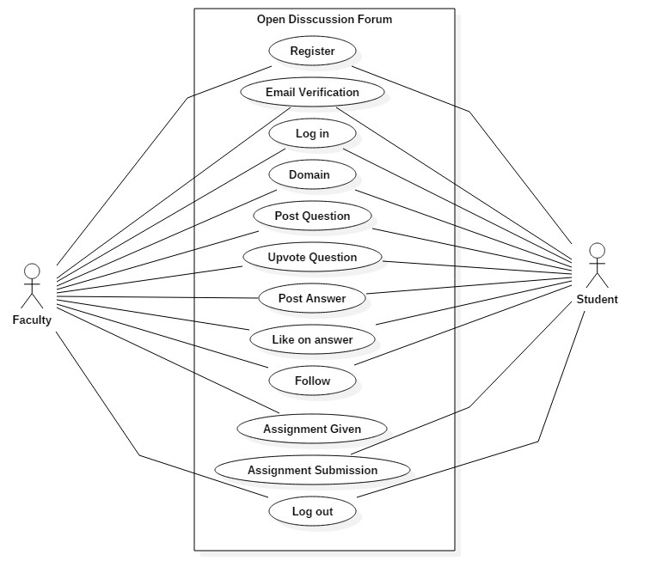
USE CASE DAIGRAM

Slide 8
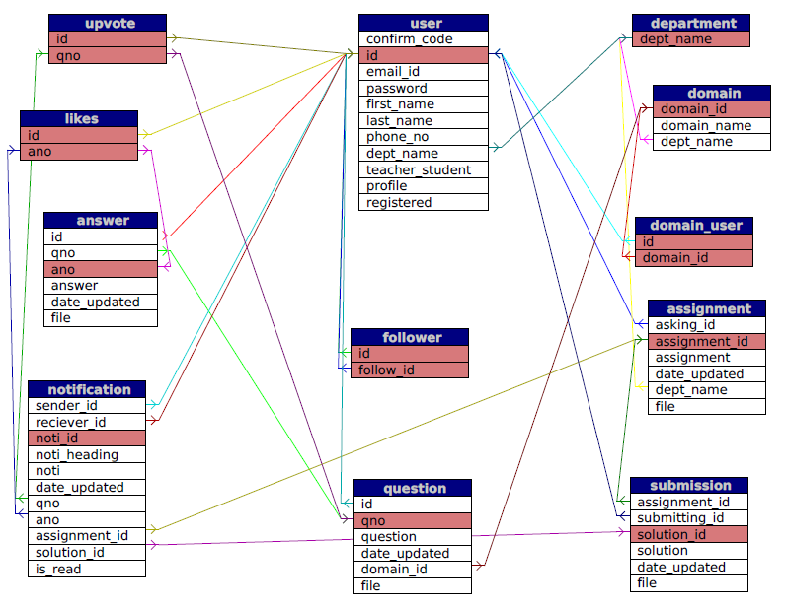
RELATION MODEL DAIGRAM

Slide 9
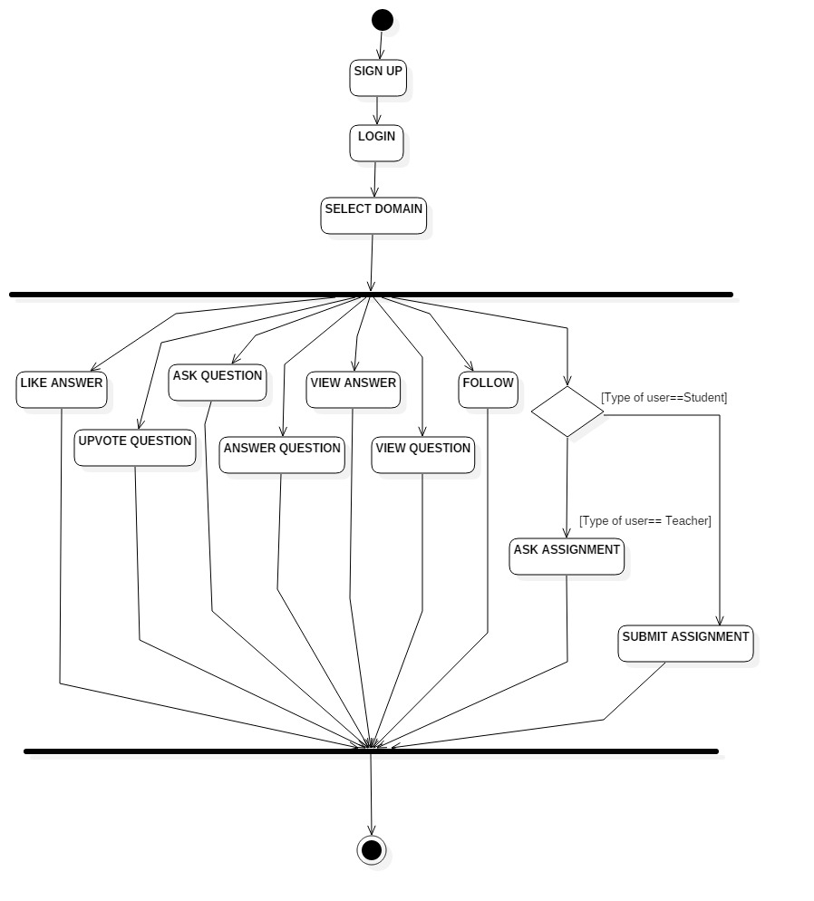
ACTIVITY DIAGRAM

Slide 10
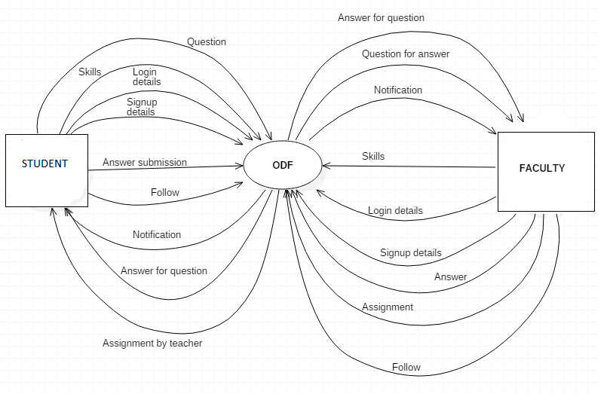
0 LEVEL DFD

Slide 11
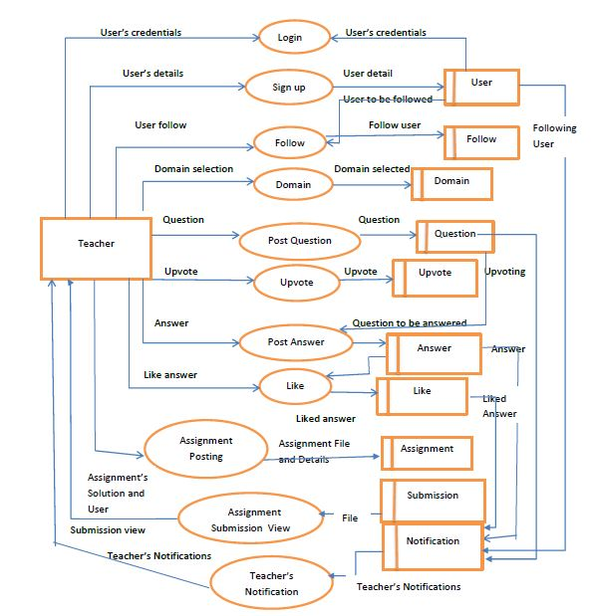
1- LEVEL DFD (Teachers)

Slide 12
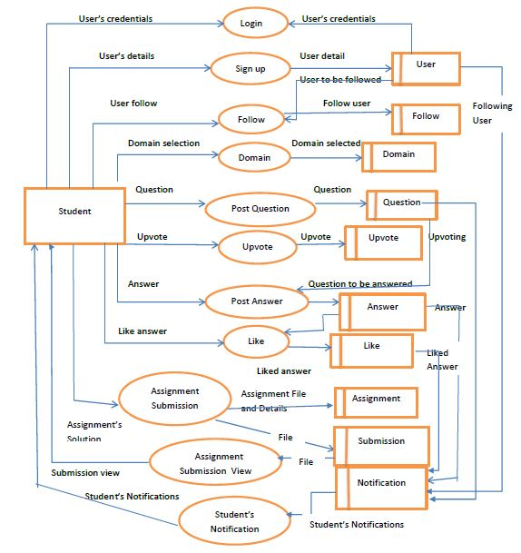
1- LEVEL DFD (Students)

Slide 13
RESOURCE REQUIREMENT
HARDWARE REQUIRMEMENT
Processor(minimum PENTIUM III 866 MHz)
RAM (minimum 128 MB SD )
Storage(minimum 20 GB)
Keyboard
Mouse
Monitor
NIC
SOFTWARE REQUIREMENT
XAMPP(Apache version 2.4.10)
Browser(any enabled with java script)
PHP(version 5.6.3)
HTML
CSS
Java Script

Slide 14
CONCLUSION
This Project basically is a Question and Answers website which every student can efficiently use for clearing his or her doubts.
Future Scope:
Every application has its own merits and demerits. The project has covered almost all the requirement . Further requirements and improvements can easily be done since the coding is mainly structured and modular in nature .Changing the existing module or adding new modules can append improvements .Further enhancement can be made to the application, so that website function very attractive and useful manner than the present one.
Some of the ideas of the improvements are-
Build the search engine for the website.
Build a chat system for the website.
Introduce some visualization based on the interest in technologies etc.

Slide 15
REFERENCES
https://www.w3schools.com/html/
https://www.w3schools.com/css/default.asp
https://www.w3schools.com/php/default.asp
https://www.w3schools.com/w3css/default.asp
https://thenewboston.com/videos.php?cat=11

Slide 16


Slide 17


