Slide 1
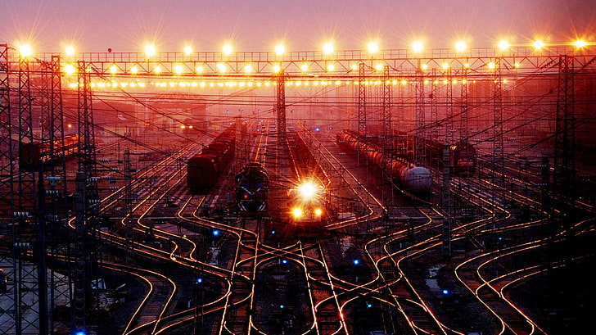
RAILWAY TRAFFIC MANAGEMENT

Slide 2

Railway traffic management is essential for:
Coordinating and optimizing train schedules to ensure efficient movement.
Managing track utilization and signaling systems to prevent accidents and minimize delays.
Leveraging advanced technologies for enhancing operational efficiency.
Reducing congestion and improving overall transportation reliability.
Facilitating smooth passenger and cargo transportation through strategic planning and implementation.
INTRODUCTION

Slide 3

Safety
Efficient traffic management ensures the safety of passengers and cargo during rail transportation.
Importance of Efficient
Traffic Management in Railways
Operational Efficiency
Smooth traffic flow reduces delays and optimizes the use of railway infrastructure and resources.
Economic Impact
Efficient traffic management contributes to cost savings and overall economic productivity in railway sector.
Customer Satisfaction
Well-managed traffic leads to improved service reliability and customer satisfaction.

Slide 4

Data Collection
Analysis and Planning
Implementation of Solutions
Gathering information on train schedules, routes, and passenger traffic.
Utilizing the collected data to identify potential bottlenecks and optimize traffic flow.
Deploying strategies to improve efficiency and ensure smooth railway operations.
METHODOLOGY

Slide 5
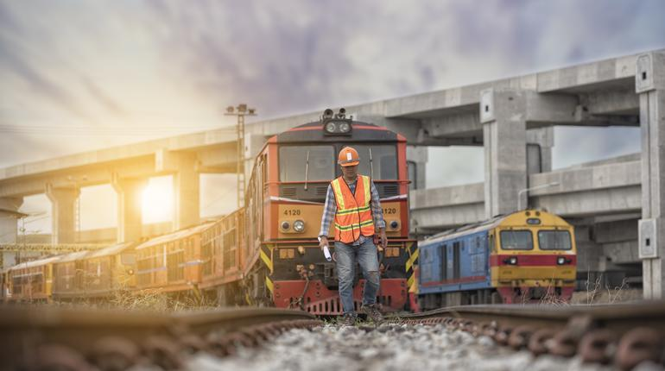
CHALLENGES
Infrastructure maintenance: Overcoming aging infrastructure, ensuring safety and reliability.
Capacity constraints: Managing increasing demand while addressing limited capacity.
Regulatory compliance: Adhering to complex and evolving rail regulations.

Slide 6

IMPLEMENTATION
Training & Deployment
Conduct training and deploy necessary resources for the successful execution of traffic management strategies.
Planning
Develop a comprehensive plan for railway traffic management implementation.

Slide 7
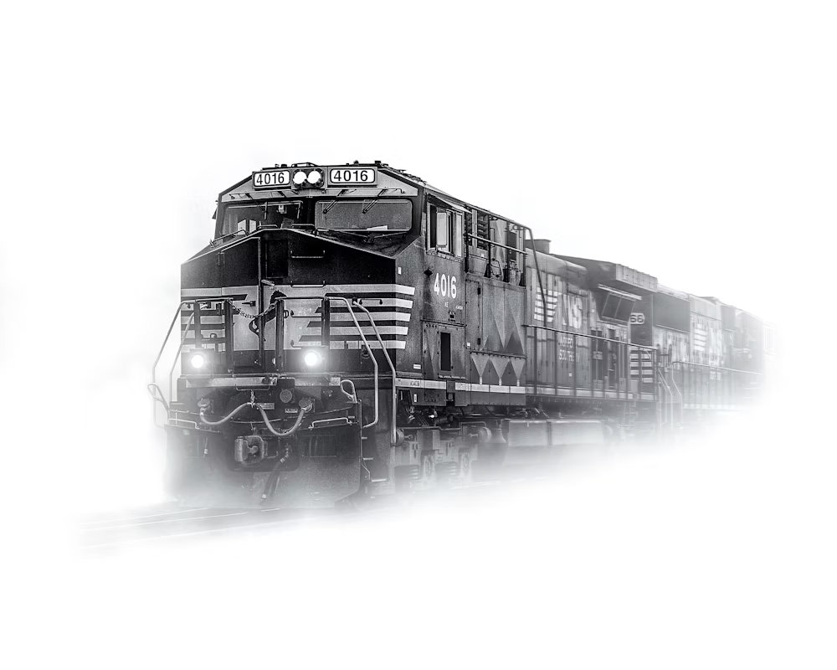
Initial Collisions
Final Collisions
The initial analysis revealed collisions between trains, indicating potential conflicts in the scheduled timings.
After adjusting the schedules to avoid collisions, the final analysis showed a reduction or elimination of collisions, indicating successful management of train timings.
RESULTS
&
DISCUSSIONS
Efficiency Improvement
Safety Enhancement
Operational Optimization
The project's approach to managing train schedules and mitigating collisions demonstrates the potential for operational optimization in railway traffic management systems.
By avoiding collisions, the system significantly improved safety standards, reducing the risk of accidents and ensuring passenger and cargo transportation safety.
The implemented train scheduling and collision management algorithms effectively reduced or eliminated collisions, enhancing the overall efficiency of railway traffic management.

Slide 8

In conclusion, the railway traffic management system presented here demonstrates the importance of efficient coordination and optimization in ensuring smooth train operations and minimizing collisions. By leveraging Python programming and database management techniques, we have successfully generated, analyzed, and adjusted train schedules to mitigate collisions and improve overall system reliability. However, further enhancements could be made to address limitations such as scalability and real-time data processing. Moving forward, continued research and development in this area are crucial for advancing railway traffic management and enhancing transportation safety and efficiency.
CONCLUSION

Slide 9
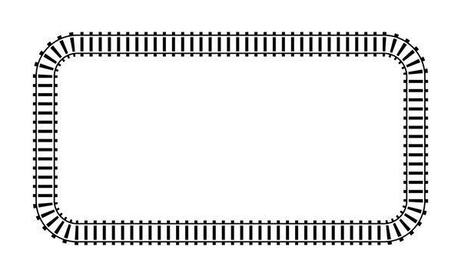
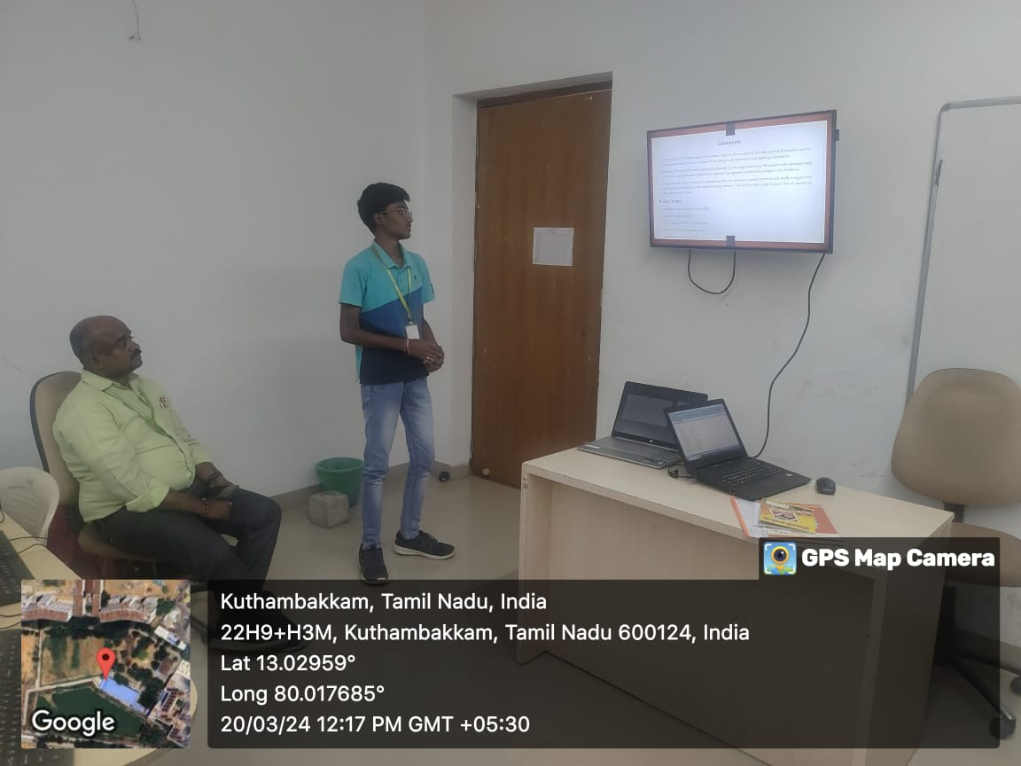

Slide 10
