Slide 1

BLACK FRIDAY DATA ANALYSIS AND EXPLORATION team 16
DONE BY
SAI VIGNESH-19BCE1389
VINOD-19BCE1574

Slide 2
PROBLEM STATEMENT
Black Friday has routinely been the busiest shopping day of the year in United States and many other countries around the world since at least 2005 . Many people buy the products which they get at a cheaper rate at this black friday. Over millions of people buy products on this black friday sale.In this project we are going to make a detailed analysis of the black friday sales and derive some conclusions from it.

Slide 3
OBJECTIVE
In this project we will perform a detailed analytics on black friday sales and derive some conclusions out of it.
EXPLORATORY CONCLUSIONS:
Analyzing the data set completely and arriving into few conclusions like no of male and female, Maximum age range, average costs of purchase
Products which is most bought by the customers
Products which are least bought by the customers
Age Range who actively participate in the sale
find the highest average sale city
Average year a person lives in the city
product vs gender

Slide 4
OBJECTIVE
PREDICTIVE ANALYSIS:
to predict the purchase amount from the given data:
The models which we are planning to predict the purchase amount include
1.Linear regression
2. Polynomial Regression
3. Random Forest regression
we will find the Root mean square error for each model and the models with the least RMSE value will be considered for further evaluation

Slide 5
PROJECT FLOW
Downloaded the dataset
https://www.kaggle.com/sdolezel/black-friday
Data preprocessing
To prepare the dataset by removing unwanted value and replace null values so that we can continue further processing for accurate design
Data visualization
Exploratory analysis
Data prediction
Predictive analysis

Slide 6
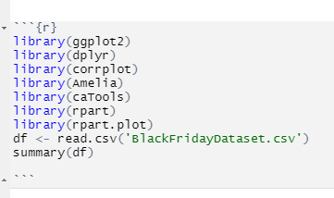
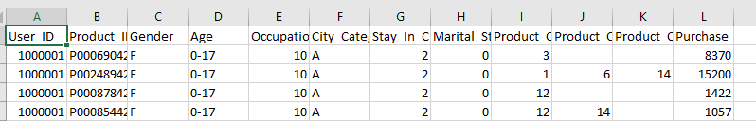
READING THE DATASET

Slide 7

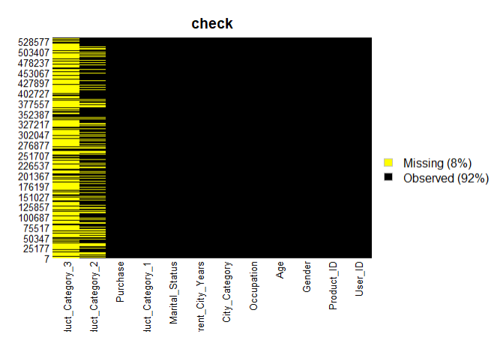
CHECKING FOR MISSING VALUES USING HEATMAP

Slide 8
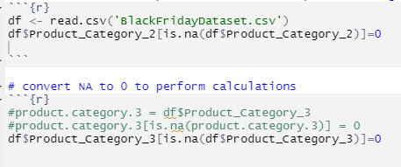
Data Cleaning There are NAs in product category 2 & 3, to do operations we convert NAs to 0 so that operations can be performed Convert NA to 0 to perform calculations product.category.2 = Product_Category_2

Slide 9
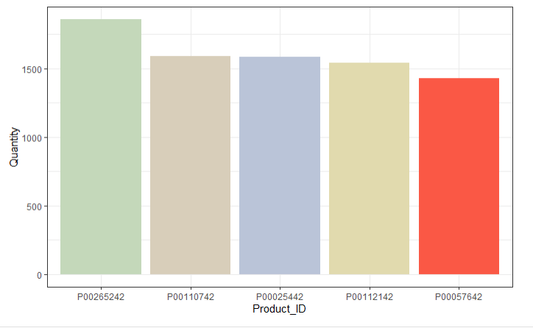
Top 5 purchased product ID

Slide 10
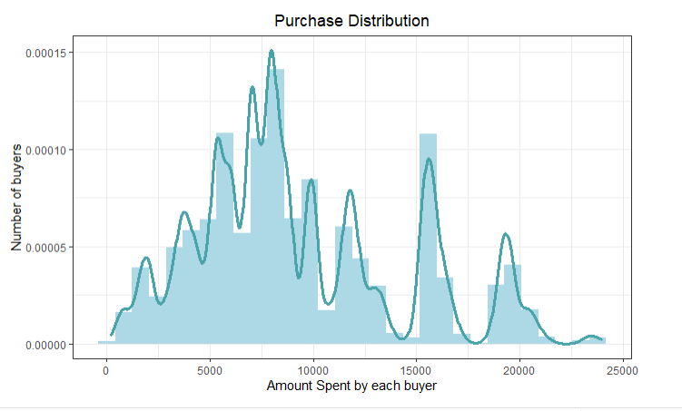
Univariate and Bivariate Analysis ->Purchase Distribution
Inference:
From this graph we can conclude that very few of them bought things for more than 25000

Slide 11
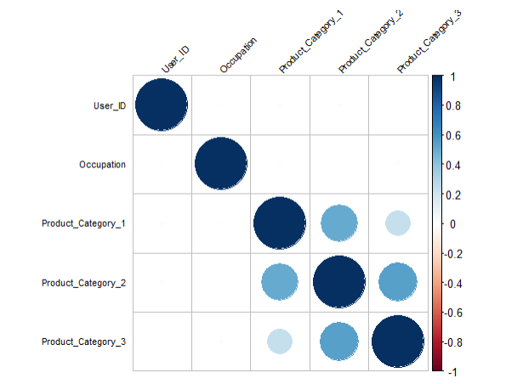
Correlation between num predictors and purchase

Slide 12
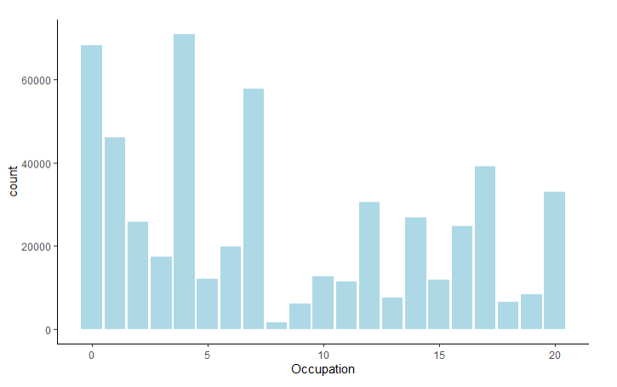
Occupation

Slide 13
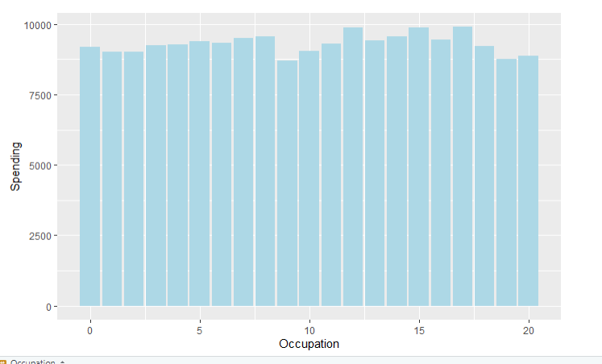
Occupation

Slide 14
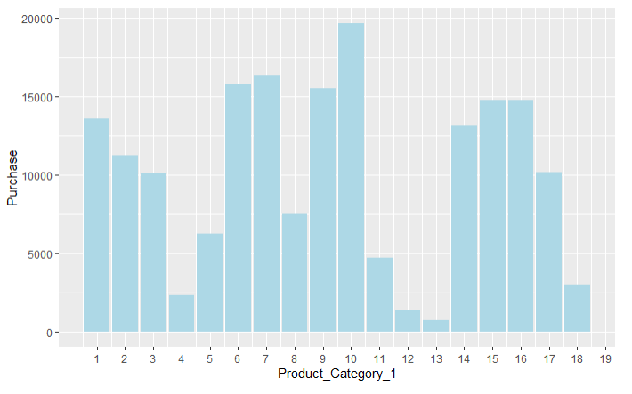
Product Category1

Slide 15
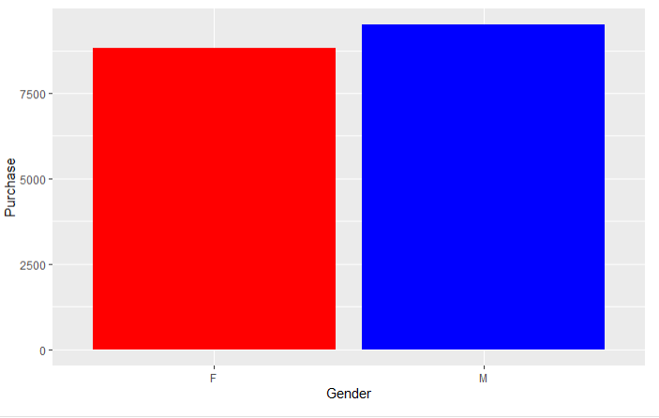
Gender

Slide 16
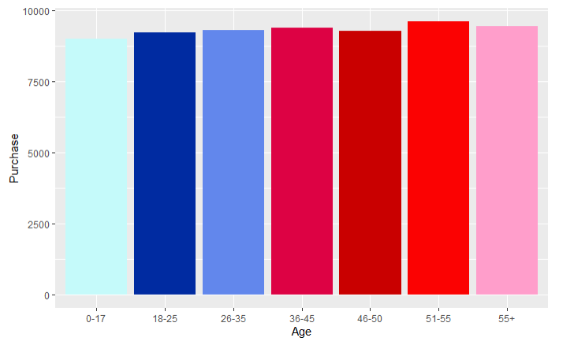
Age

Slide 17
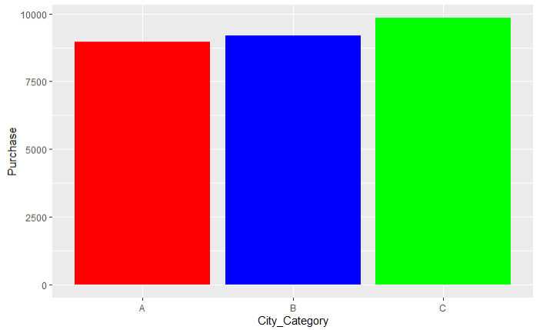
City Category

Slide 18
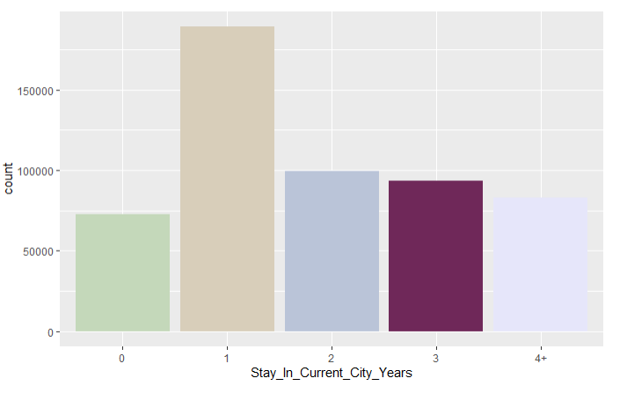
Number of years customer lived in the city that they are buying.

Slide 19

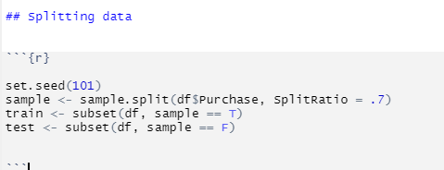
Data splitting

Slide 20

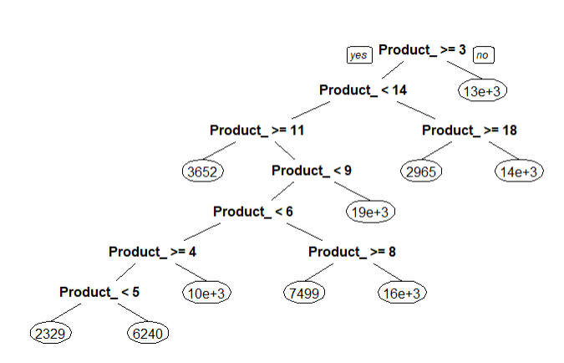
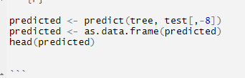
Decision Tree

Slide 21
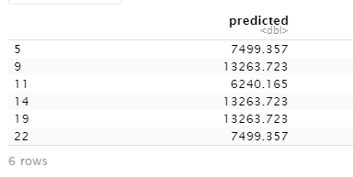
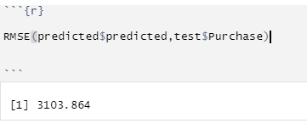
Decision Tree

Slide 22
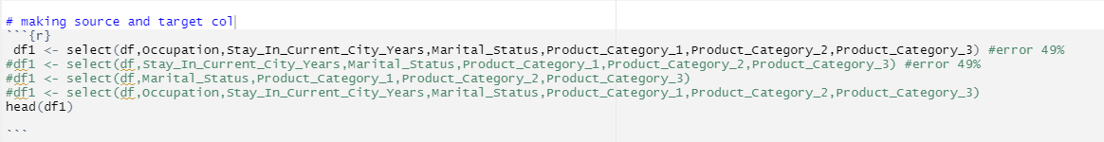
Multiple linear regression

Slide 23
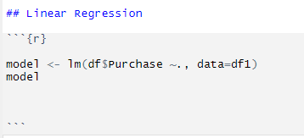
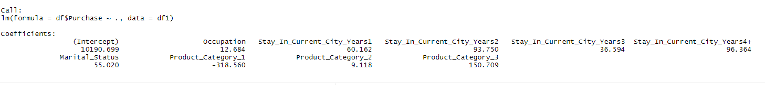

Slide 24
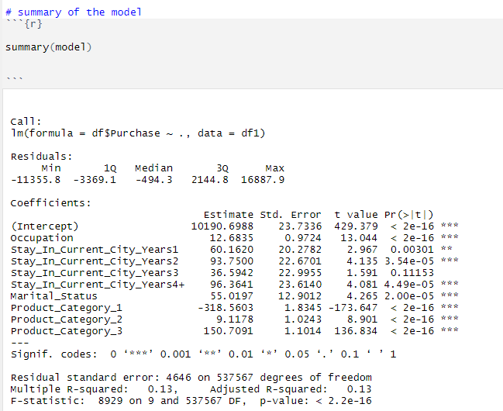
Summary of linear regression

Slide 25
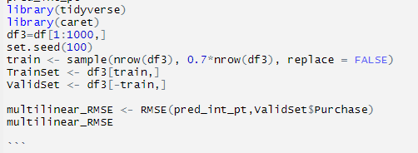

prediction interval on a particular outcome of a multiple regression

Slide 26
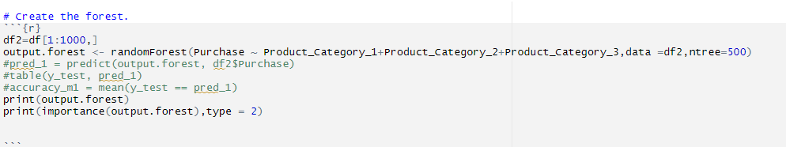
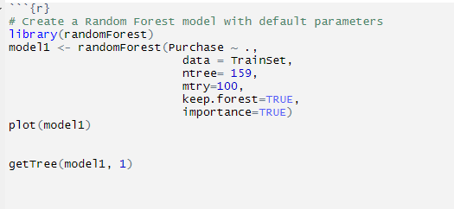
RANDOM FOREST

Slide 27
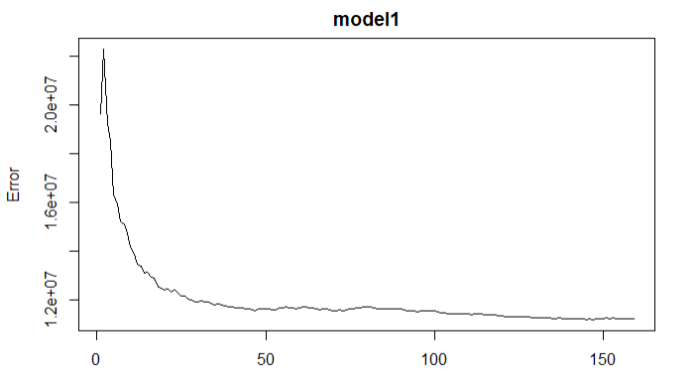
RANDOM FOREST

Slide 28
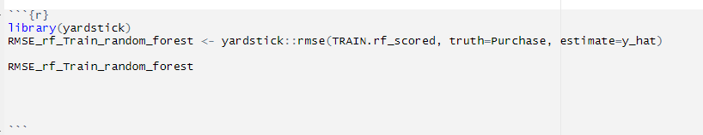
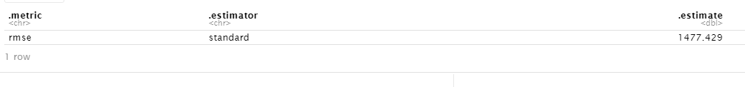
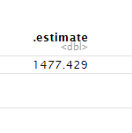
RANDOM FOREST RMSE VALUE

Slide 29
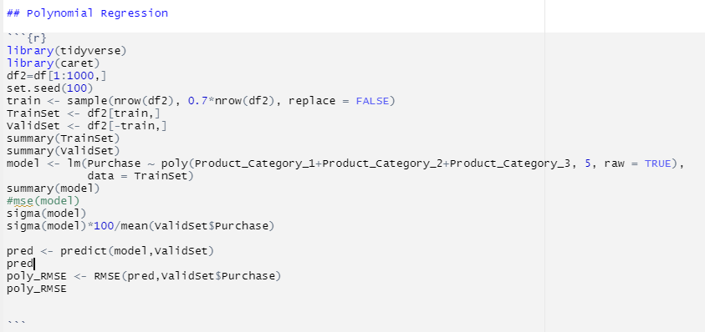
Polynomial Regression

Slide 30

Polynomial Regression

Slide 31
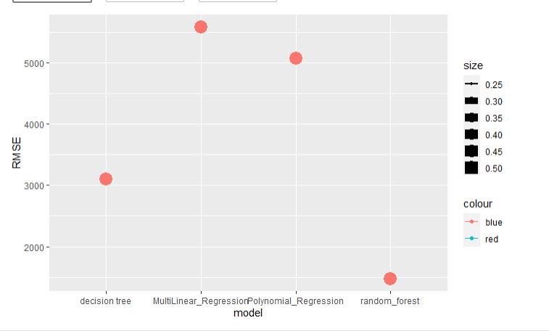
CONCLUSION

