Slide 1

Stock Market Trend Analysis
Shubham Patil (22106047)
Shravan Thakur (22106086)
Vedant Vethekar (22106090)
Project Guide
Mr. Viki Patil

Slide 2
Outline
Introduction
Literature Survey of the Existing Systems
Limitations of the Existing Systems
Problem Statement
Proposed System Design
Framework/Algorithm
Technologies Stack for Proposed System
Details of Database / Input to the System
Implementation(Partial)
Conclusion
References

Slide 3
Introduction
Problem Domain :
Challenges: High volatility, unpredictability, and reliance on outdated analysis methods.
Current Solutions: Basic technical analysis tools and complex machine learning models that are not accessible to all.
Persisting Issues: Inaccurate predictions and lack of user-friendly, reliable tools for everyday investors.
Motivation:
High financial risks for retail investors using inadequate analysis methods.
Need for advanced, accessible tools that provide accurate predictions and insights.

Slide 4
Objectives
Enhance prediction accuracy with machine learning.
Simplify complex market data for user accessibility.
Provide real-time stock trend analysis and alerts.
Integrate comprehensive risk assessment features.
Offer customizable dashboards for personalized insights
Support decision-making with actionable insights.
Enable historical and real-time data integration.
Improve accessibility for novice and experienced investors.

Slide 5
Literature Survey of the existing system
Sr no | Paper Title | Author | Summary | Limitation
1. | STOCK MARKET ANALYSIS USING MAPREDUCE AND PYSPARK Volume:03, Issue:07/July-2021,Impact Factor- 5.354 | P.Kavya, S.Saagarika, R.T.Subavarsshini, C.G.Nivetheni , Dr. M. Marimuthu, Dr. P. Velvadivu | Analyses various stocks by using various Big Data frameworks like Hadoop, PySpark. | Model can't account for external factors and may lead to financial losses.
2. | A Survey on Stock Market Prediction Using Machine Learning Techniques (Springer Nature Singapore Pte Ltd. 2020) | Polamuri Subba Rao, K. Srinivas , and A. Krishna Mohan | It uses ML: Holt-Winters, ANN, HMM TS: ARIMA DL: TSLM, RNN | This model is suitable only for short term predictions due to use of ARIMA models.
3. | Machine Learning Stock Market Prediction Studies: Review and Research Directions (JITIM, Vol 28, Issue 4, 2020) | Troy J. Strader ,John J. Rozycki , Thomas H. Root , Yu-Hsiang John Huang | Review of machine learning techniques for stock market prediction. | Complex Ml algorithms make it’s inefficient for prediction.

Slide 6
Limitations of Existing Systems
One of the major limitations of this approach is the changing stock market prices. Although the model predicts the stock of the next prices, there are additional factors from nature that affect stock prices.
Using technical analysis to select stocks and increasing your investing potential to invest in which stock through algorithms, may lead to risk management and might tend to lose your money.
Accurate stock prediction models are usually not disclosed to public.

Slide 7
Problem statement
The project seeks to improve stock market trend predictions by addressing delays and inefficiencies in current methods. It aims to integrate real-time data projection and provide accurate, actionable insights through effective visualizations. This will enhance investment decisions and market understanding.

Slide 8
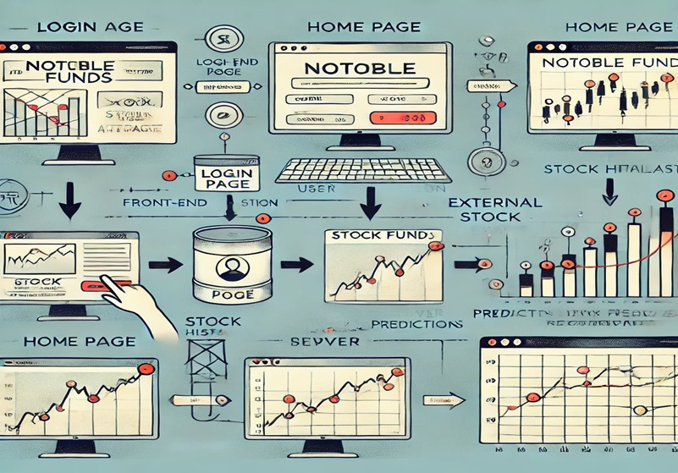




Proposed System Design
Fig. 1.1 System Design

Slide 9
ML Algorithm
Linear Regression Algorithm
Machine learning algorithms are performed by Scikit learn which has a function named Linear regression.
Linear Regression model to the training data set. Here the aim is to find the label values to determine the relationship between the independent variables and the dependent variable.
We have chosen this because it is a widely used and effective model for predicting continuous outcomes and it also helps to identify the most important features.
We have got a high coefficient of determination (R-squared) by implementing the Linear Regression algorithm.

Slide 10
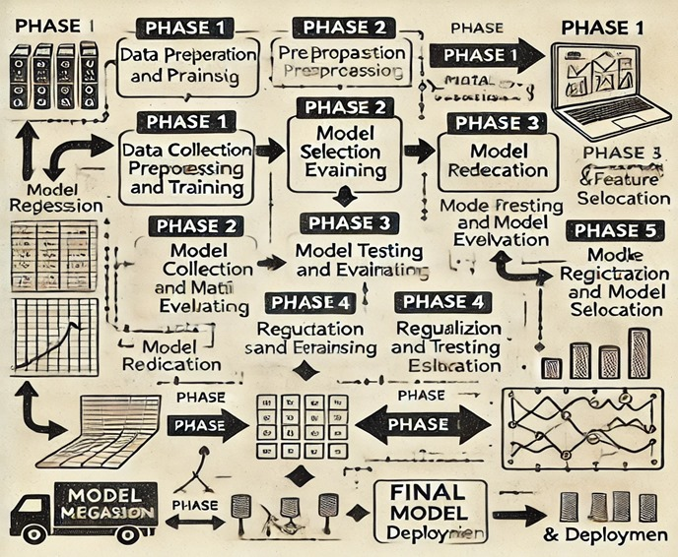
Linear Regression
Fig. 1.2 Flowchart Linear Regression

Slide 11




Technology Stack for Proposed System
Frontend : HTML , CSS , JavaScript
Backend : Python (Django)
ML Algorithm : Linear Regression
Database: SQLITE
Libraries used : Yfinance, Pandas , NumPy, Joblib, Scikit learning

Slide 12
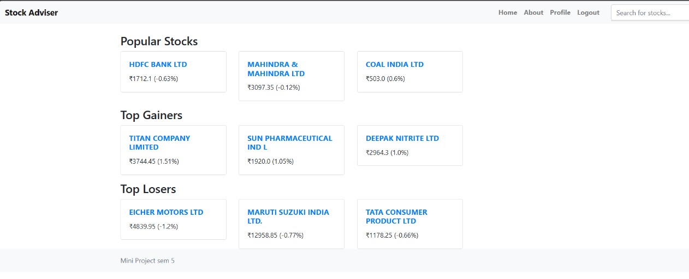
Implementation :
Fig. 1.3 Home Page

Slide 13
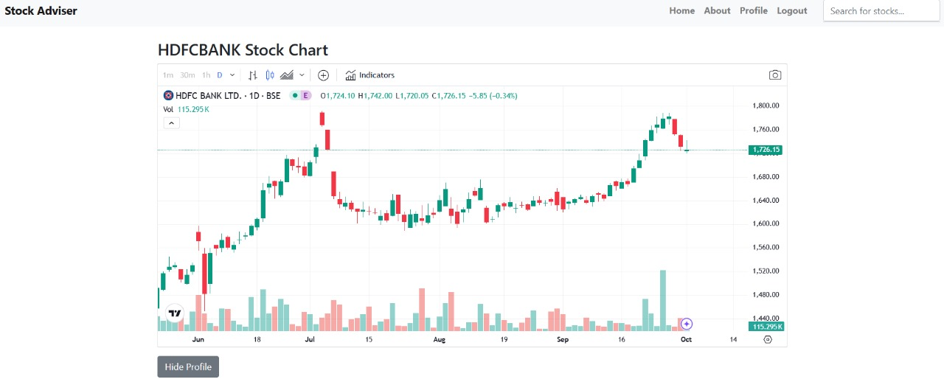
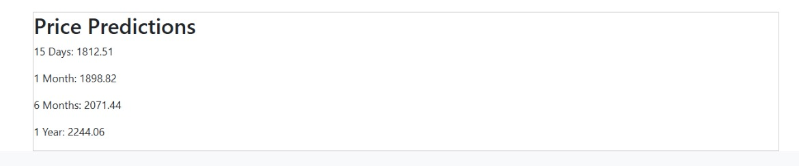
Implementation :
Fig. 1.4 Prediction Page

Slide 14
Conclusion
Implementing real-time data analysis and advanced predictive techniques will significantly enhance stock market trend accuracy and decision-making. The new system will provide timely, actionable insights, improving investment strategies. This approach addresses current inefficiencies and supports better financial planning.

Slide 15
References
P.Kavya, S.Saagarika, R.T.Subavarsshini, C.G.Nivetheni , Dr. M. Marimuthu, Dr. P. Velvadivu , STOCK MARKET ANALYSIS USING MAPREDUCE AND PYSPARK Volume:03, Issue:07/July-2021,Impact Factor- 5.354
Polamuri Subba Rao, K. Srinivas , and A. Krishna Mohan, A Survey on Stock Market Prediction Using Machine Learning Techniques,Springer Nature Singapore Pte Ltd. 2020
Troy J. Strader ,John J. Rozycki , Thomas H. Root , Yu-Hsiang John Huang , Machine Learning Stock Market Prediction Studies: Review and Research Directions (JITIM, Vol 28, Issue 4, 2020)
HTTPS://WWW.INVESTOPEDIA.COM/TERMS/S/STOCKMARKET.ASP
HTTPS://WWW.ANALYTICSVIDHYA.COM/BLOG/2021/01/IMAGE-CLASSIFICATION-USING-CONVOLUTIONAL-NEURAL-NETWORKS-A-STEP-BY-STEP-GUIDE/
HTTP://WWW.IRAJ.IN/JOURNAL/JOURNAL_FILE/JOURNAL_PDF/14-481-153485282984-86.PDF
HTTPS://ARXIV.ORG/FTP/ARXIV/PAPERS/1607/1607.01958.PDF
HTTPS://WWW.ANALYTICSVIDHYA.COM/BLOG/2019/12/STREAMING-DATA-PYSPARK-MACHINE-LEARNING-MODEL/

Slide 16
Thank You...!!

