Slide 1

LogiGear Corporation
InContact
Protractor
Tuan Dao

Slide 2
Content:
Some Knowledge to know
Protractor
Q and A

Slide 3
Some knowledge to know
Synchronous and Asynchronous
Overview about Javascript
Value of Type
Overview about Typescript
Overview about Selenium

Slide 4
Synchronous and Asynchronous
Synchronous | Asynchronous
Run task by task, the next task must wait for the previous task | Running simultaneously, do not wait for another task
Running synchronously will generate unnecessary and idle wait in some cases | Running asynchronously so it can handle many tasks at the same time , but it is easy to get a process error if it is not well controlled

Slide 5

Javascript
Javascript was invented by Brendan Eich (bren-duhn aik , co-founder of the Mozilla project, the Mozilla Foundation, and the Mozilla Corporation)
First appeared: 5/1995
Javascript ("JS" for short) is a dynamic programming language
JavaScript is used as client-side programming language by 97.1% of all the websites.
JavaScript is not a class-based object-oriented language like Java, C# etc
In its most basic form, JavaScript is a synchronous, blocking, single-threaded language. But web browsers define functions and APIs that allow us to register functions that should not be executed synchronously, and should instead be invoked asynchronously when some kind of event occurs (the passage of time, the user's interaction with the mouse, or the arrival of data over the network, for example) or NodeJs with backend APIs for server, database …

Slide 6
Javascript Reference
https://developer.mozilla.org/en-US/docs/Learn/Getting_started_with_the_web/JavaScript_basics
https://developer.mozilla.org/en-US/docs/Learn/JavaScript/Asynchronous/Introducing
https://w3techs.com/technologies/details/cp-javascript

Slide 7
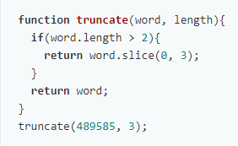
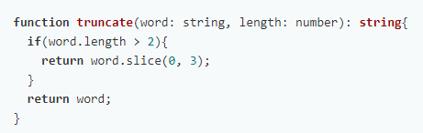
Value of type
Types are free documentation that increase understanding and improve developer's productivity
Strong type checking helps prevent errors and enhances reliability
Increase self-documented code

Slide 8

Typescript
Typescript was invented by Microsoft
Typescript is a open source project
First appeared: 10/2012
TypeScript is a language that is a superset of JavaScript, It is used to add additional static type and check type at compile time
TypeScript helps us prevent the most common error in JavaScript development
Ex:
- Avoiding classic error like 'undefined' is not a function.
- Large-scale systems is not a nightmare anymore
…
TypeScript is compile to Javascript

Slide 9
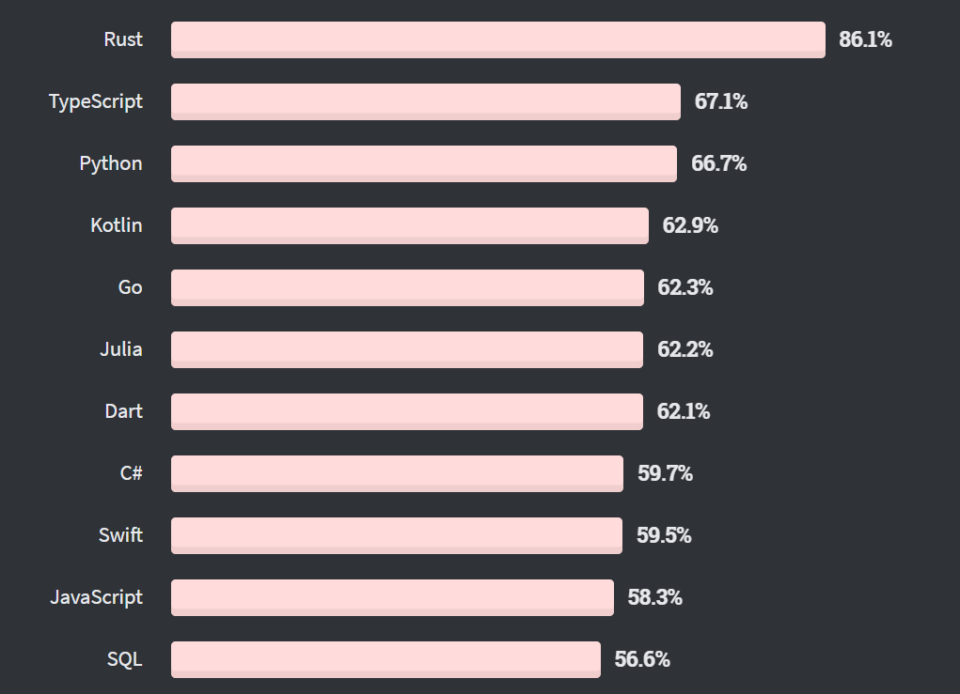
Typescript
Typescript are worth to learn
% of developers who are developing with the language or technology and have expressed interest in continuing to develop with it
https://insights.stackoverflow.com/survey/2020#technology-most-loved-dreaded-and-wanted-languages

Slide 10
Comparing some characteristic when coding in Typescript and Java
Typescript | Java
A superset of JavaScript, It is used to add additional static type and check type at compile time | A pure oriented object programming language
There is not access modifier for class | There is access modifier for class
Happening circular import problem because It don’t have access modifier for class | Circular import problem is not happened, because it have access modifier for class
Access modifier for instance variable and method: Having Public, Protected, Private access modifier ‘Public’ is default ‘Protected’ scope is within class and any objects that inherits from it | Access modifier for instance variable and method: Having Public, Protected ,Default , Private access modifier ‘Default’ is default ‘Protected’ scope is within package and any objects that inherits from it

Slide 11
Comparing some characteristic when coding in Typescript and Java
Typescript | Java
Declaring type: Declare type of variable and method following ‘:’ symbol Don’t have to declare type Use ‘let’, ‘const’ , or ‘var’ to declare variable EX: let xyz : string; | Declaring type: Declare type preceding variable and method Have to declare type Ex: int num;
A class can only have one constructor | A class can have multiple constructors
Compile to Javascript (ES5) | Compile to bytecode

Slide 12
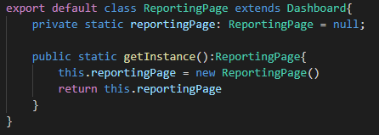
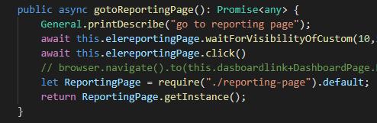
Solution of circular import problem
We have dashboard is a parent class , and we want a method return instance of child class without import so that we need a child class have a method return it’s instance
and parent use require instead of import to call child class

Slide 13
Typescript Reference
https://www.typescriptlang.org/docs/handbook/typescript-from-scratch.html
https://medium.com/@kgelpes/how-typescript-helps-us-prevent-the-most-common-error-in-javascript-development-2dbcb54cf12
https://stackoverflow.com/questions/12694530/what-is-typescript-and-why-would-i-use-it-in-place-of-javascript
https://channel9.msdn.com/posts/Anders-Hejlsberg-Introducing-TypeScript

Slide 14
Selenium
Selenium is a free (open-source) automated testing framework used to validate web applications across different browsers and platforms
Can use multiple programming languages like Java, C#, Python etc to create Selenium Test Scripts
Selenium Software is not just a single tool but a suite of software, each piece catering to different Selenium QA testing needs of an organization. Here is the list of tools:
Selenium Integrated Development Environment (IDE)
WebDriver
Selenium Grid

Slide 15
Selenium
Selenium WebDriver drives a browser natively, as a real user would, either locally or on remote machines.
Selenium IDE is a Chrome and Firefox extension that makes it easy to record and playback tests in the browser.
Selenium Grid takes WebDriver to another level by running tests on many machines at the same time, cutting down on the time it takes to test on multiple browsers and operating systems.

Slide 16
Senlenium Reference
https://www.selenium.dev/projects/
https://www.guru99.com/introduction-to-selenium.html

Slide 17
Protractor
Protractor Overview
Comparing some Characteristic of Protractor and Selenium

Slide 18
Protractor Overview
Protractor is an end-to-end test framework for Angular and AngularJS applications. Protractor runs tests against your application running in a real browser, interacting with it as a user would.

Slide 19
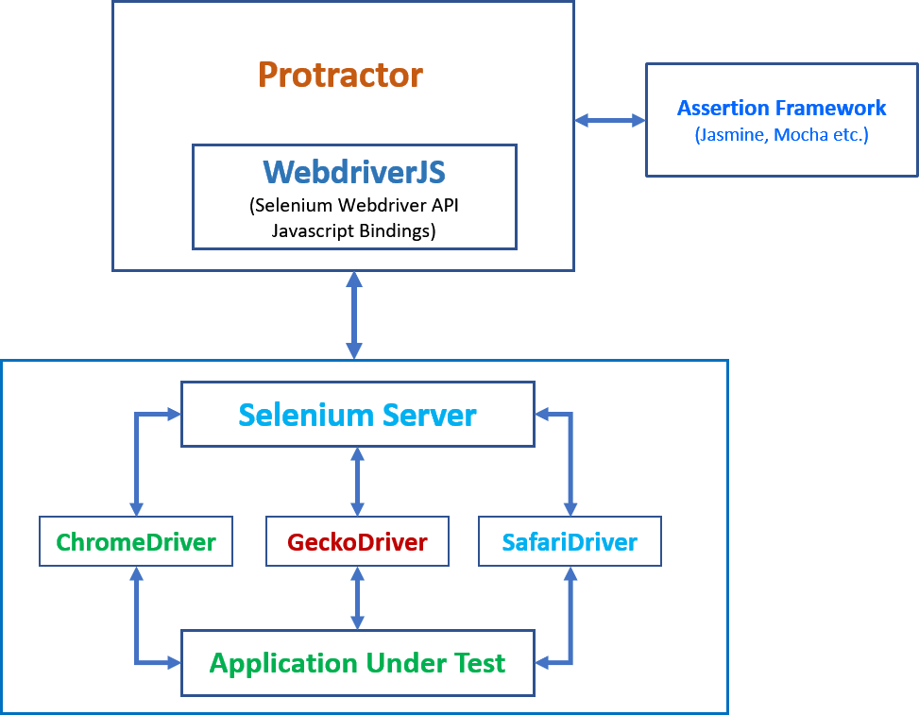
Protractor Overview

Slide 20
Comparing some Characteristic of Protractor and Selenium
Protractor | Selenium
Binding Language: Java, Python, Ruby, Javascript, C#... (almost common programming language in the world) | Binding Language: Javascript , Typescript
Application Under Test (AUT): Non-Angular : Good , Support many programming language, easy to learn , easy to use. Angular: Not good more than Protractor. Does not support automatic synchronization between tests and application. It needs to be explicitly synchronized using different waits. | Application Under Test (AUT): Non-Angular : Not good more than Selenium , complex learning and using more than Selenium, don’t have any additional support. Angular: Good, It’s created for Protractor, supports automatic wait
Unit Testing Framework support: JUnit, TestNG, NUnit, XUnit, MSTest, PyTest … | Unit Testing Framework support: Jasmine, Mocha, CucumberJs

Slide 21
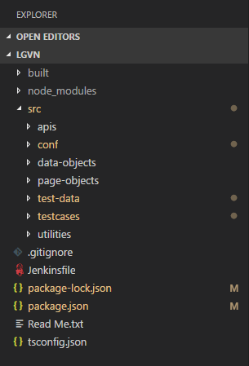
Protractor in Project
Structure
build
Contain all codes after transforming from typescript to JavaScript.
This is a place where we use to execute test script.
node_modules
Contain all required packages needed for project.
src
This is main place where we are working on.
apis: contain all classes related to API.
conf: configuration file use to run specs.
data-object: object use to get or set data in project (agent, employee, tenant, etc.)
page-object: contain locators and methods in one page (login page, employee page, etc.)
test-data: contain all data use in project
testcases: contain test cases
utilities: contain all general actions (methods) which is used in project
Others
package.json and package-lock.json: manage packages in project
tsconfig.json: typescript configuration file.

Slide 22
Protractor in Project
Page Object is definitely a must-have design pattern
Good coding conventions for page objects is must have
Files: Using snake case with dash “-” between words. Ex: employee-page.
Classes: Using Pascal case. Ex: LoginPage
Elements: Using camelCase. Ex: txtUsername
Deal with JavaScript’s (Typescript) asynchronous behavior using async & await (which is used to control flow of code’s execution)

Slide 23
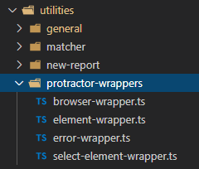
Protractor in Project
Wrap up Protractor element and browser original objects
XPath is the most stable locator

Slide 24
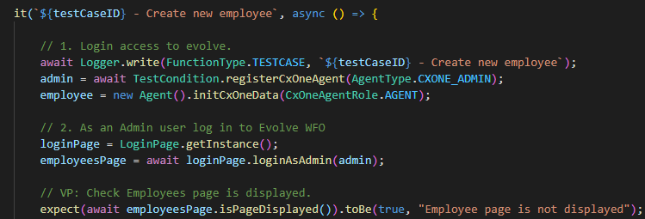
Protractor in Project
Test case should only call page object’s methods
Do not place assertions inside page object classes
Only push necessary things to code repository

Slide 25
Protractor Reference
https://www.protractortest.org/
https://www.toolsqa.com/protractor/what-is-protractor/
https://www.testbytes.net/blog/protractor-vs-selenium/
https://www.logigear.com/blog/test-automation/15-best-practices-for-building-an-awesome-protractor-framework/

Slide 26

Q and A
Question please.

Slide 27

Thank You!

