Slide 1

LogiGear Corporation
InContact
Protractor
Tuan Dao

Slide 2
Content:
Before Protractor
Sync and Async
Overview about Javascript
Scope and Type
Overview about Typescript
Overview about Selenium
Protractor
After Protractor
Q and A

Slide 3

Javascript
Javascript was invented by Brendan Eich (bren-duhn aik , co-founder of the Mozilla project, the Mozilla Foundation, and the Mozilla Corporation)
First appeared: 5/1995
Javascript ("JS" for short) is a dynamic programming language
JavaScript is used as client-side programming language by 97.1% of all the websites.
JavaScript is not a class-based object-oriented language like Java, C# etc
In its most basic form, JavaScript is a synchronous, blocking, single-threaded language. But web browsers define functions and APIs that allow us to register functions that should not be executed synchronously, and should instead be invoked asynchronously when some kind of event occurs (the passage of time, the user's interaction with the mouse, or the arrival of data over the network, for example) or NodeJs with backend apis for server, database …

Slide 4
Javascript Reference
https://developer.mozilla.org/en-US/docs/Learn/Getting_started_with_the_web/JavaScript_basics
https://developer.mozilla.org/en-US/docs/Learn/JavaScript/Asynchronous/Introducing
https://w3techs.com/technologies/details/cp-javascript

Slide 5

Typescript
Typescript was invented by Microsoft
Typescript is a open source project
First appeared: 10/2012
TypeScript is a language that is a superset of JavaScript, It is used to add additional static type and check type at compile time for Javascript
TypeScript helps us prevent the most common error in JavaScript development
Ex:
- Avoiding classic error like 'undefined' is not a function.
- Large-scale systems is not a nightmare anymore
…
TypeScript is compile to Javascript

Slide 6
Comparing some characteristic when coding in Typescript and Java
Typescript | Java

Slide 7
Typescript Reference
https://www.typescriptlang.org/docs/handbook/typescript-from-scratch.html
https://medium.com/@kgelpes/how-typescript-helps-us-prevent-the-most-common-error-in-javascript-development-2dbcb54cf12
https://stackoverflow.com/questions/12694530/what-is-typescript-and-why-would-i-use-it-in-place-of-javascript
https://channel9.msdn.com/posts/Anders-Hejlsberg-Introducing-TypeScript

Slide 8
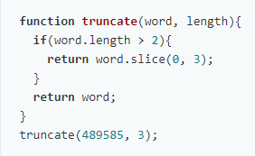
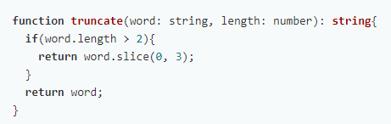
Type and Scope
Type (stactic type):
Types are free documentation that increase understanding and improve developer's productivity
Strong type checking helps prevent errors and enhances reliability
Increase self-documented code

Slide 9
Type and Scope
Scope:

Slide 10
Sync and Async
Sync | Async
Run task by task, the next task must wait for the previous task | Running simultaneously, do not wait for another task
Running synchronously will generate unnecessary and idle wait in some cases | Running asynchronously so it can handle many tasks at the same time , but it is easy to get a process error if it is not well controlled

Slide 11

Thank You!

