Slide 1

Protractor
e2e testing for Angular
Speaker: Thanh Le

Slide 2
Contents {
before_protractor()
protractor()
after_protractor()
q_and_a()
};

Slide 3
before_protractor()
Key technical items we should know.

Slide 4

before_protractor()
#1. JavaScript code is executed asynchronously.
Find a control

Slide 5
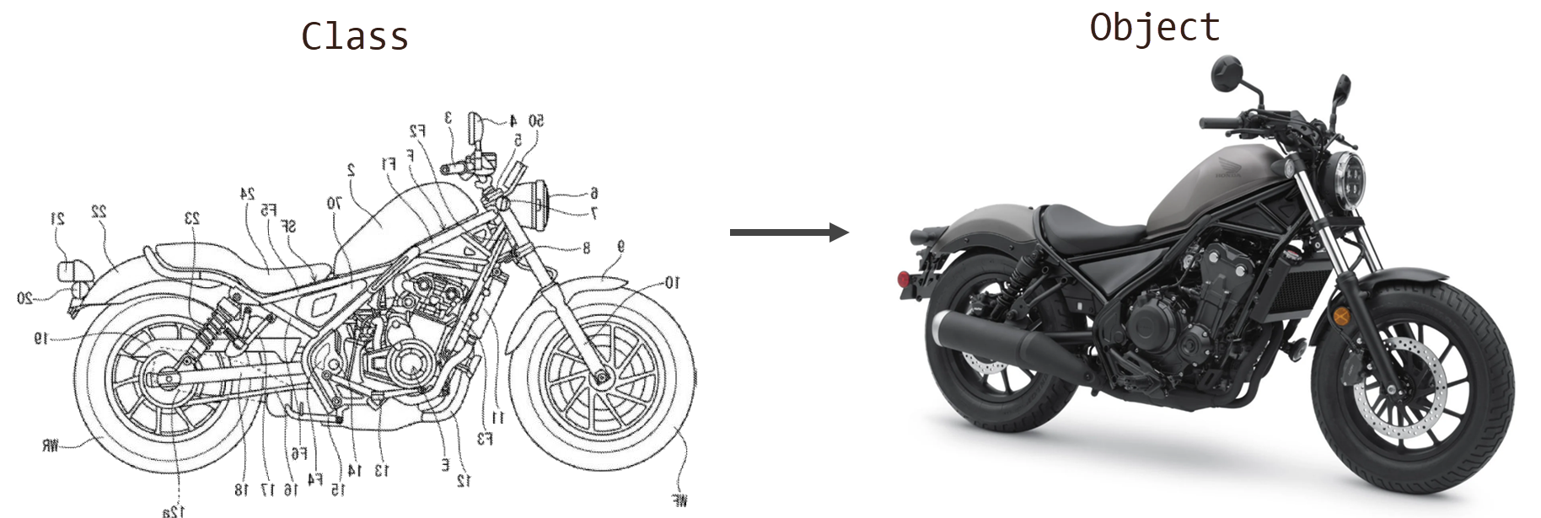
before_protractor()
#2. JavaScript is not a class-based object-oriented language like Java, C#, Python, etc.
Find a control
Honda Rebel

Slide 6
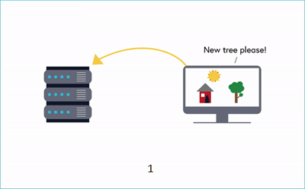
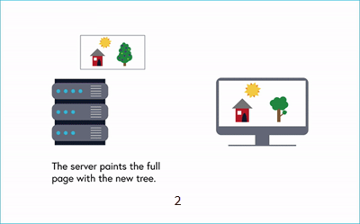
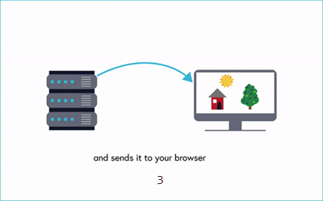
before_protractor()
#3a. Multi-page Web Application (Traditional Architecture).
The page is "ready" means all contents are fully loaded.

Slide 7
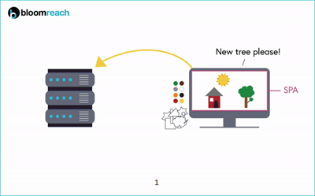
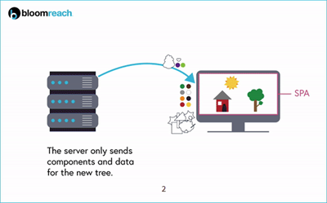
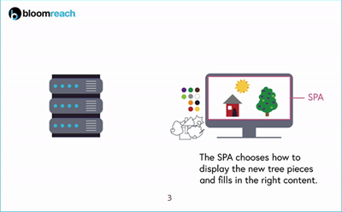
before_protractor()
#3b. Single-page Web Application (Modern Architecture).
The page is "ready" doesn't mean all contents are fully loaded.

Slide 8
before_protractor()
#3b. Single-page Web Application (Modern Architecture).
Top SPA frameworks:
Vue
Angular
React
Ember
…

Slide 9

before_protractor()
#4. Protractor always goes behind Selenium.
extends

Slide 10
before_protractor() is completed.
#1 | JavaScript code is executed asynchronously.
#2 | JavaScript is not a class-based object-oriented language like Java, C#, Python, etc.
#3 | Single-page Web Application (Angular).
#4 | Protractor always goes behind Selenium.

Slide 11
before_protractor() is completed.
#1 | JS Asynchronous.
#2 | Difficult JS Syntax.
#3 | Angular SPAs.
#4 | Protractor's Upgrades.

Slide 12
protractor()
Effectively using Protractor

Slide 13
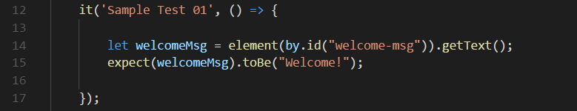
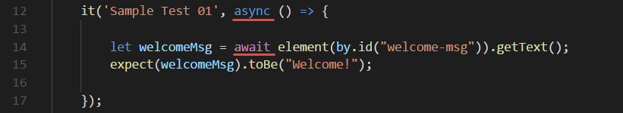
protractor()
#1. JS Asynchronous
Code that doesn't work.
Just works!
Use: Promise, async & await.
Attention: Do not use Callback!

Slide 14
protractor()
#2. Difficult JS Syntax
TypeScript extends JavaScript by adding types.
The return of the old friends: class, public, private, protected, static, enum, interface, import, export, string, number…
Eventually, TypeScript will be transpiled to JavaScript.
Use: TypesSript.
Attention: Visual Studio Code is a great IDE for TS!

Slide 15
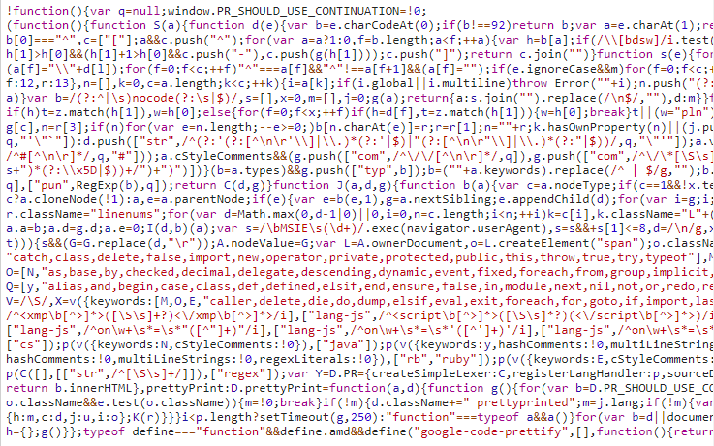
protractor()
#2. Difficult JS Syntax
JavaScript
Use: TypesSript.
Attention: Visual Studio Code is a great IDE for TS!

Slide 16
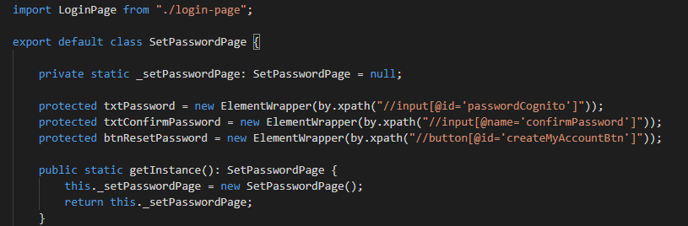
protractor()
#2. Difficult JS Syntax
TypeScript
Use: TypesSript.
Attention: Visual Studio Code is a great IDE for TS!

Slide 17
protractor()
#3. Angular SPAs
"Before performing any action, Protractor waits until there are no pending asynchronous tasks in your Angular application."
- https://www.protractortest.org/
Use: LG Protractor framework.

Slide 18

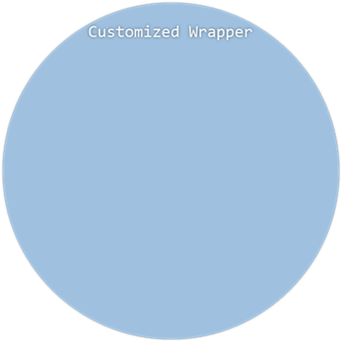
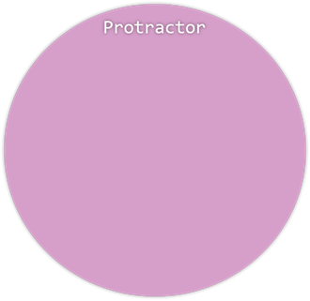
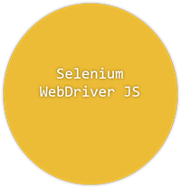
protractor()
#3. Angular SPAs
Do not use Protractor directly!
Do not use Protractor directly!
Use: LG Protractor framework.
Attention: Visual Studio Code is a great IDE for TS!

Slide 19
protractor()
#4. Protractor's Upgrades
You need to have an open-source mindset.
Issues cannot be fixed in a timely manner.
Selenium problems + Protractors problems
Latest version:
WebDriverJS | 3.6.0 | 36 months ago
Protractor | 7.0.0 | 5 months ago
Attention: Don’t worry about versions. We just simply need a stable tool.

Slide 20
protractor() is completed.
#1 | JS Asynchronous. | Promise, async & await
#2 | Difficult JS Syntax. | TypesSript
#3 | Angular SPAs. | LG Protractor framework.
#4 | Protractor's Upgrades. | Be aware of the problems you might have. And don’t worry about versions.

Slide 21
after_protractor()
From my point of view…

Slide 22
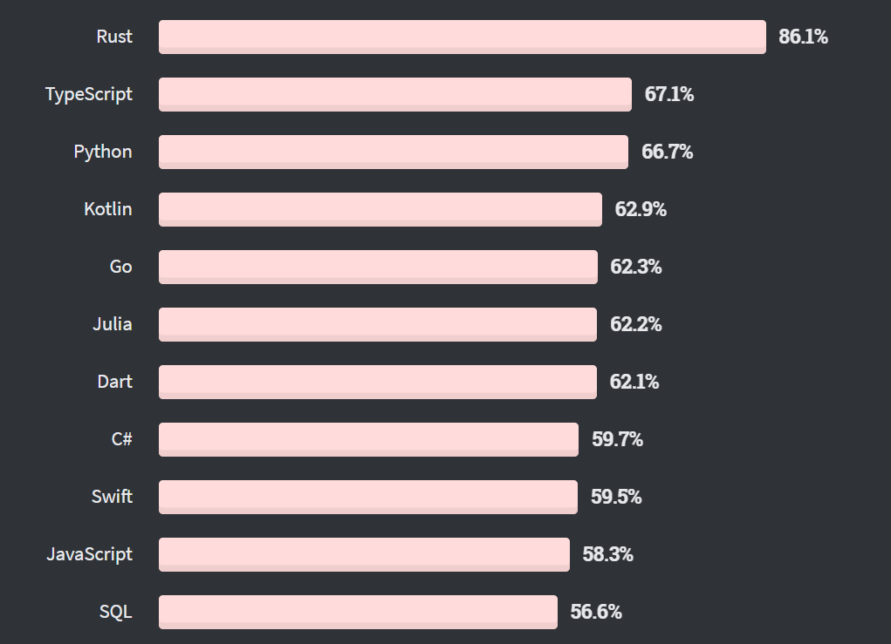
after_protractor()
JavaScript & Typescript are worth to learn.
Find a control
% of developers who are developing with the language or technology and have expressed interest in continuing to develop with it

Slide 23
after_protractor()
My recommended combination:
Protractor
TypeScript
Jasmine
Xpath
Visual Studio Code.
Jenkins
Bitbucket
Find a control

Slide 24
after_protractor() is completed.
Protractor is good! But I prefer Selenium.

Slide 25

q_and_a()
Question please.

Slide 26
References
https://www.bloomreach.com/en/blog/2018/07/what-is-a-single-page-application.html
https://www.testbytes.net/blog/protractor-vs-selenium/
https://developer.mozilla.org/en-US/docs/Learn/JavaScript/Asynchronous/Concepts
https://en.wikipedia.org/wiki/V8_(JavaScript_engine)
https://insights.stackoverflow.com/survey/2020#technology-most-loved-dreaded-and-wanted-languages-loved

Slide 27

Thank You!

