Slide 1
Unit 02
Instances of Classes

Slide 2
Overview

Slide 3
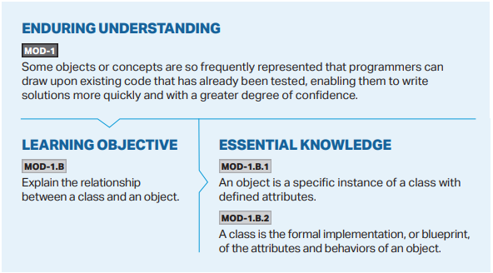

Slide 4
Objectives

Slide 6
Classes
public class
What does public class mean?
Notes:
In Unit 1, we discussed a little bit about the necessity for including public class at the very beginning of our code to make it work. We said that we would learn later what this is for and why it is necessary. We will begin discussing it today and fully discuss classes (and creating our own) in Unit 5.
So why does our code have public class at the very beginning? What does it mean?
Let’s talk about the word class.
Remember, Java is an object-oriented programming language that we can use to model objects in the real world.

