Slide 1
Unit 01
Getting Started, Primitive Types
Notes:
Welcome back

Slide 2
Day 2
Print Commands; errors; debugging; comments

Slide 3
Overview
Basic Print Commands
Print Commands w/ Escape Sequence
Syntax Errors
Runtime Errors
Debugging
Adding Comments
Notes:
Alright, onto our objectives for today.
First we will learn two print commands: print and println.
Next we will learn what an escape sequence is and how to use them with print commands.
Then we will go over two types of errors, syntax vs runtime errors. We will also learn the bane of every programmer’s existence – debugging.
Finally, we will continue to improve our best programming practices by learning what comments are and how to add comments to our code.

Slide 4
Basic Print Commands

Slide 5
Objectives
I can use print() and println() to display text to the screen.
I can explain the difference between print() and println().

Slide 6
Basic Print Commands
Command | Usage
print(x) | print x and stay
println(x) | print x and go to the next line

Slide 7
Basic Print Commands
Code:
System.out.print(“hi”);
System.out.print(“there”);
Output:
hithere

Slide 8
Basic Print Commands
Code:
System.out.print(“hi ”);
System.out.print(“there”);
Output:
hi there

Slide 9
Basic Print Commands
Code:
System.out.println(“hi”);
System.out.println(“there”);
Output:
hi
there

Slide 10
Basic Print Commands
Code:
System.out.print(“beep beep”);
System.out.print(“boop boop”);
Output:
beep beepboop boop

Slide 11
Basic Print Commands
Code:
System.out.println(“beep beep”);
System.out.println(“boop boop”);
Output:
beep beep
boop boop

Slide 12
Objectives
I can use print() and println() to display text to the screen.
I can explain the difference between print() and println().

Slide 13
Follow Up
Sample Code
SOP/SOPL Sample Code
Worksheet
SOP/SOPL Worksheet
Coding Practice
About Me
Scaffolding:
UIL Print Commands and Printf
Leave some Feedback/Questions:
Link: https://forms.gle/wRuj8Bzh3cTPFR4T6

Slide 14
Print Commands w/ Escape Sequences

Slide 15
Objectives
I can explain the special usage of \
I can use common escape sequences including the following:
\n
\t
\\
\”
\’

Slide 16
Print Commands w/ Escape Sequence
Command | Usage
\ | ‘back-slash’: treat the next character as an escape sequence
\n | move cursor to next line
\\ | one back-slash
\” | one double-quote
\’ | one single-quote
\t | tab

Slide 17
Print Commands w/ Escape Sequence
Code:
System.out.println(“beep beep\nboop boop”);
Output:
beep beep
boop boop

Slide 18
Print Commands w/ Escape Sequence
Code:
System.out.println(“beep beep bo\nop boop”);
Output:
beep beep bo
op boop

Slide 19
Print Commands w/ Escape Sequence
Code:
System.out.println(“beep\”beep boop boop”);
Output:
beep”beep boop boop

Slide 20
Print Commands w/ Escape Sequence
Code:
System.out.println(“beep\”beep bo/op boop”);
Output:
beep”beep bo/op boop

Slide 21
Print Commands w/ Escape Sequence
Code:
System.out.println(“beep\’beep bo/op boop”);
Output:
beep’beep bo/op boop

Slide 22
Print Commands w/ Escape Sequence
Code:
System.out.println(“b\teep bo\nop bo\”op”);
Output:
b eep bo
op bo”op

Slide 23
Objectives
I can explain the special usage of \
I can use common escape sequences including the following:
\n
\t
\\
\”
\’

Slide 24
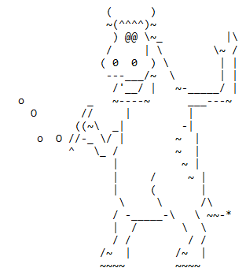
Follow Up
Sample Code
Escape Sequences Sample Code
Worksheet
Escape Sequences Worksheet
Coding Practice:
Project: ASCII Art
Scaffolding:
https://stackoverflow.com/questions/1367322/what-are-all-the-escape-characters
Leave some Feedback/Questions:
Link: https://forms.gle/wRuj8Bzh3cTPFR4T6
https://www.asciiart.eu/animals/cows

Slide 25
Errors and Debugging

Slide 26
Objectives
I can explain what a compiler/syntax error is and how to recognize it
I can explain what a runtime error is and how to differentiate it from a syntax error
I can explain what the term debugging means

Slide 27
Syntax Errors
Also known as a ‘Compiler Error’ for Java
“An error that pops up when you hit the compile button.”

Slide 28

Syntax Errors

Slide 29
Runtime Errors
“An error that occurs when you run your program”

Slide 30

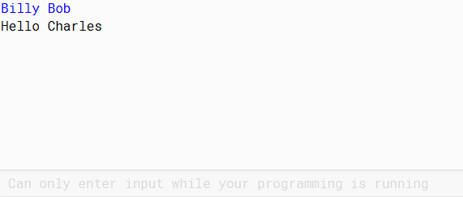
Runtime Errors

Slide 31
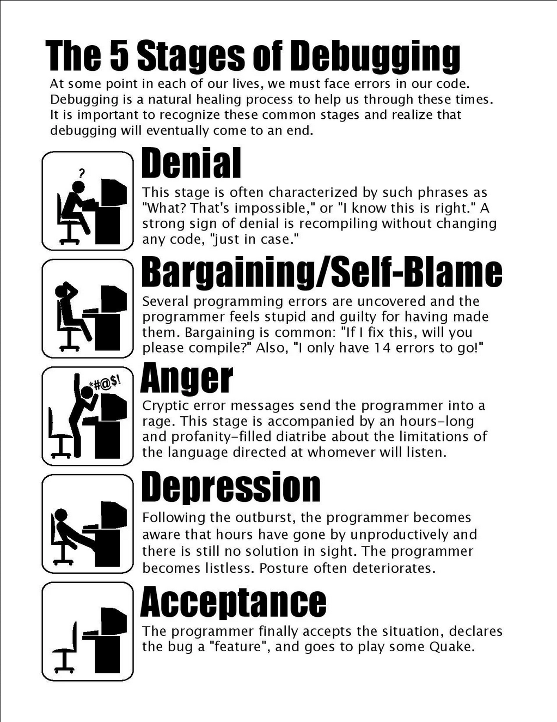
Debugging
You WILL have to debug.

Slide 32
Debugging
Fixing Errors
History of the term:
Admiral Grace Hopper – her team discovered a moth stuck in their system
https://en.wikipedia.org/wiki/Debugging

Slide 33
Objectives
I can explain what a compiler/syntax error is and how to recognize it
I can explain what a runtime error is and how to differentiate it from a syntax error
I can explain what the term debugging means

Slide 34
Follow Up
Sample Code
Errors and Debugging Sample Code
Worksheet
None
Coding Practice
None
Scaffolding:
Grace Hopper Reading: https://en.wikipedia.org/wiki/Grace_Hopper
Leave some Feedback/Questions:
Link: https://forms.gle/wRuj8Bzh3cTPFR4T6
*Make sure you have accounts and access to everything listed on the syllabus!

Slide 35
Adding Comments

Slide 36
Objectives
I can add single-line comments to my program
I can add block comments to my program
I can explain the benefits of adding comments to my program

Slide 37
Adding Comments
“Be kind to yourself. Be kind to others.”

Slide 38
Adding Comments
// single-line comments
/* */ block comments
// this is not considered code to java
/* if I want to write a comment on multiple lines of code, then I can use what is called a block comment to write it over multiple lines */

Slide 39
Adding Comments
// takes user’s name as input and greets them
Scanner kb = new Scanner(System.in);
System.out.println(“Welcome “ + kb.nextLine());

Slide 40
Adding Comments
/*
takes user’s name as input and greets them
*/
Scanner kb = new Scanner(System.in);
System.out.println(“Welcome “ + kb.nextLine());

Slide 41
Adding Comments
“Always code as if the person who ends up maintaining your code is a violent psychopath who knows where you live.”

Slide 42
Objectives
I can add single-line comments to my program
I can add block comments to my program
I can explain the benefits of adding comments to my program

Slide 43
Follow Up
Sample Code
Adding Comments Sample Code
Worksheet
None
Coding Practice
None
Scaffolding:
None
Leave some Feedback/Questions:
Link: https://forms.gle/wRuj8Bzh3cTPFR4T6

