Slide 1
Unit 01
Getting Started, Primitive Types
Notes:
Welcome back

Slide 2
Day 3
Primitive/object variables; declaring/naming variables

Slide 3
Overview
What is a Variable?
Declaring and Naming Variables
Assigning Values to Numbers
Primitive Variables Types – Integers and Decimals
Notes:
Alright, onto our objectives for today.
First we will learn two print commands: print and println.
Next we will learn what an escape sequence is and how to use them with print commands.
Then we will go over two types of errors, syntax vs runtime errors. We will also learn the bane of every programmer’s existence – debugging.
Finally, we will continue to improve our best programming practices by learning what comments are and how to add comments to our code.

Slide 4
What is a Variable?

Slide 5
Objectives
I can explain the concept of a variable as a storage location for some value.
I can create my own analogy to build my own understanding of a variable.

Slide 6
What is a Variable?
A variable is a storage location for a value.
Think of a variable like a box that contains something – a value.
int value = 54;
double valueTwo = 45.3;
boolean yes = true;
String whoaThere = “Hello!”;
value
valueTwo
yes
whoaThere
54
45.3
true
Hello!

Slide 7
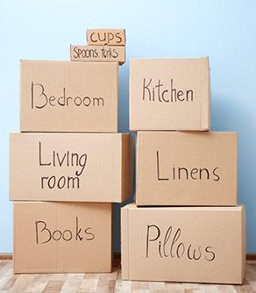
What is a Variable?
Have you ever moved?
How do you know what is inside of the box – YOU LABEL IT
Analogy
Box Label is to Variable Name as whatever is inside the box is to whatever is in the variable

Slide 8
What is a Variable?
Variable:
name: mySalary
type: decimal (double)
Box:
label: Kitchen
stuff: dishware

Slide 9
Objectives
I can explain the concept of a variable as a storage location for some value.
I can create my own analogy to build my own understanding of a variable.

Slide 10
Follow Up
Sample Code
None
Worksheet
None
Coding Practice
None
Scaffolding:
None
Leave some Feedback/Questions:
Link: https://forms.gle/wRuj8Bzh3cTPFR4T6

Slide 11
Declaring + Naming Variables

Slide 12
Objectives
I can declare variables as certain data types.
I can explain what makes a good variableName.

Slide 13
Declaring Variables
Syntax:
[Variable Type] [Variable Name] ;
Examples:
int blah;
short hi;
boolean what;
double hahah;
The variable blah will hold an int value.
The variable hi will hold a short value.
The variable what will hold a boolean variable.
The variable hahah will hold a double variable.

Slide 14
Declaring Variables
When you ‘declare’ a variable – think of it as taking out a box and labeling it with what the box will store.

Slide 15
Naming Conventions for Variables
Rule: Use a camelCase name that is related to what the purpose of the variable is.
Good Variable Names:
moneyInCheckingAccount
triangleSideLength
fallSemesterGrade
Bad Variable Names:
MyNameIs
IAMEXCITED!!!
1776DeclarationofIndependence
blah
x
y

Slide 16
Naming Conventions for Variables
Reserved Keywords – special words that can only be used for a very specific purpose in Java
class
int
double
any variable type
static
more

Slide 17
Objectives
I can declare variables as certain data types.
I can explain what makes a good variableName.

Slide 18
Follow Up
Sample Code
Declaring and Naming Variables Sample Code
Worksheet
None
Coding Practice
None
Scaffolding:
None
Leave some Feedback/Questions:
Link: https://forms.gle/wRuj8Bzh3cTPFR4T6

Slide 19
Assigning Values to Variables

Slide 20
Objectives
I can assign values to variables.
I know the syntax for assigning values to variables.

Slide 21
Assigning Values to Variables
Syntax:
[Variable Name] = [Value];
Examples:
int blah; // declare blah as an int variable blah = 40;
boolean yes; // declare yes as boolean yes = false;
double decNumber; decNumber = 55.7;
Before you can assign a value to a variable, you must declare the type of the variable.

Slide 22
Declare + Assign Values to Variables
Syntax:
[Variable Type] [varName] = [Value];
Examples:
int blah = 40;
boolean yes = false;
double decNumber = 55.7;
You can also declare variables and assign values on the same line.
Take whatever is on the right-side of the equals sign and assign it to the left.

Slide 23
Assigning Values to Variables
Question: Why would you ever declare a variable without assigning it a value?
Response: When you know you need a variable somewhere in your code, but you do not know yet know the value it needs to hold. We will see a lot more of this in Unit 5 when we create our own classes.

Slide 24
Objectives
I can assign values to variables.
I know the syntax for assigning values to variables.

Slide 25
Follow Up
Sample Code
Assigning Values to Variables Sample Code
Worksheet
None
Coding Practice
None
Scaffolding:
None
Leave some Feedback/Questions:
Link: https://forms.gle/wRuj8Bzh3cTPFR4T6

Slide 26
Primitive Variable Types
Integers and decimals

Slide 27
Objectives
I understand a primitive variable stores the actual value
I can explain the differences between the integer type variables: byte, short, int, long
I can explain the differences between the decimal type variables: float, double
I can explain what a char is and understand it is actually stored in memory as an integer
I can explain what a boolean value is

Slide 28
Primitive Variable Types
A primitive variable stores the actual value.

Slide 29
Primitive Variable Types
A primitive variable stores the actual value.
int number = 5;
number
5
Notes:
An int can only store integers.

Slide 30
Primitive Variable Types
Data Type | Memory Size | What it Stores
byte | 8 bits | integer: -128 to 127
short | 16 bits | integer: -32768 to 32767
int | 32 bits | integer: -2147483648 to 2147483647
long | 64 bits | integer: -2⁶⁴ to 2⁶⁴-1
float | 32 bits | decimal: -big to +big
double | 64 bits | decimal: -bigger to +bigger
char | 16 bits (unsigned) | 0 - 65535
boolean | 1 bit | true/false

Slide 31
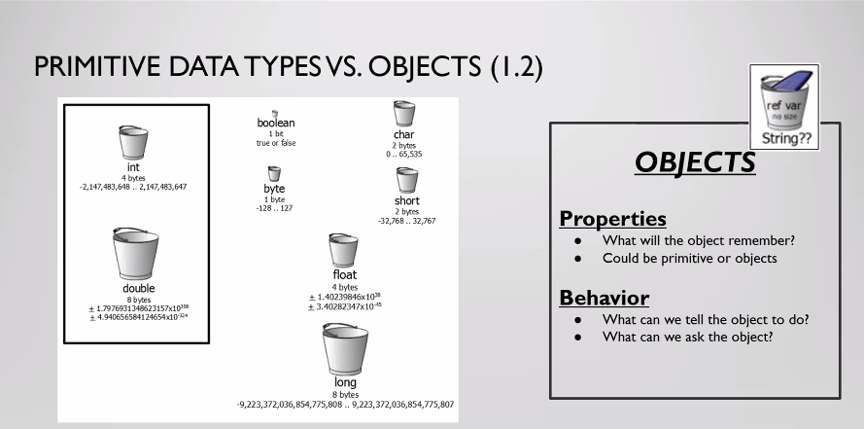
Primitive Variable Types

Slide 32
Primitive Variable Types - Integers
Code:
int a = 100; int two = 25680; long veryBig = 123456789; short shorter = 12345; byte onlyEight = 100;
System.out.println(a); System.out.println(two); System.out.println(veryBig); System.out.println(shorter); System.out.println(onlyEight);
Output:
100 25680 123456789 12345 100

Slide 33
Primitive Variable Types - Integers
int a = 100.0;
Output:
Error (What Kind?)
An integer type can only store integer values – they cannot store decimal values.
Notes:
A double only stores decimal values.

Slide 34
Primitive Variable Types - Decimal
A primitive variable stores the actual value.
double blah = 127.5;
blah
127.5
Notes:
A double only stores decimal values.

Slide 35
Primitive Variable Types - Decimal
A primitive variable stores the actual value.
double blah = 4;
blah
4.0
Notes:
A double only stores decimal values.

Slide 36
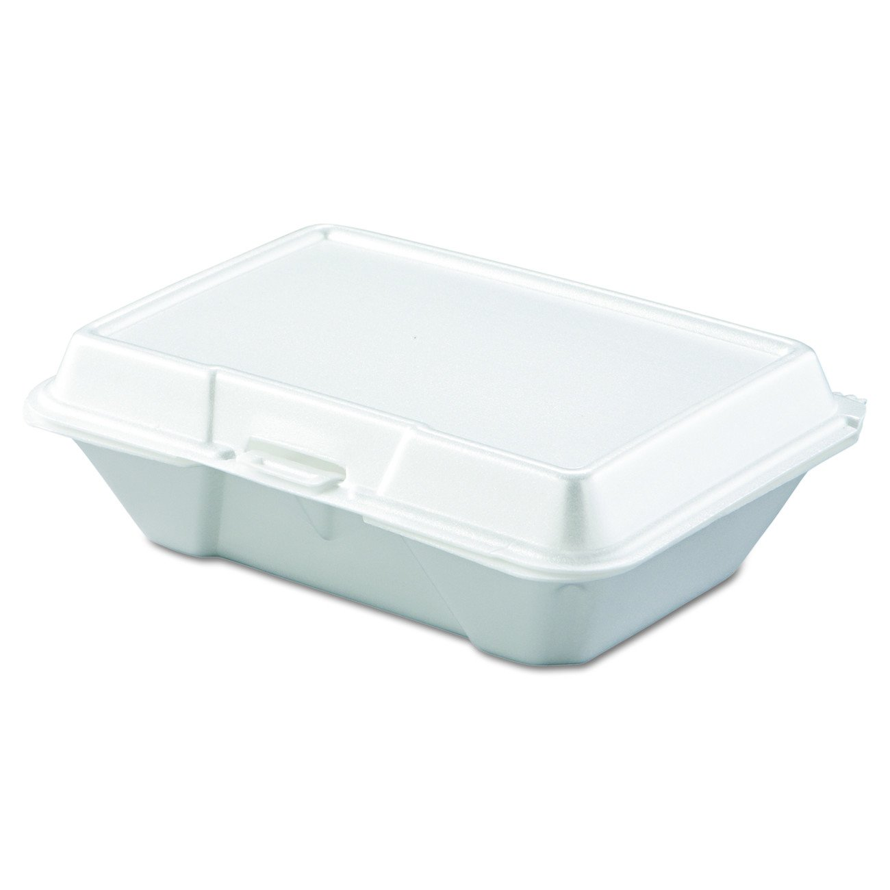
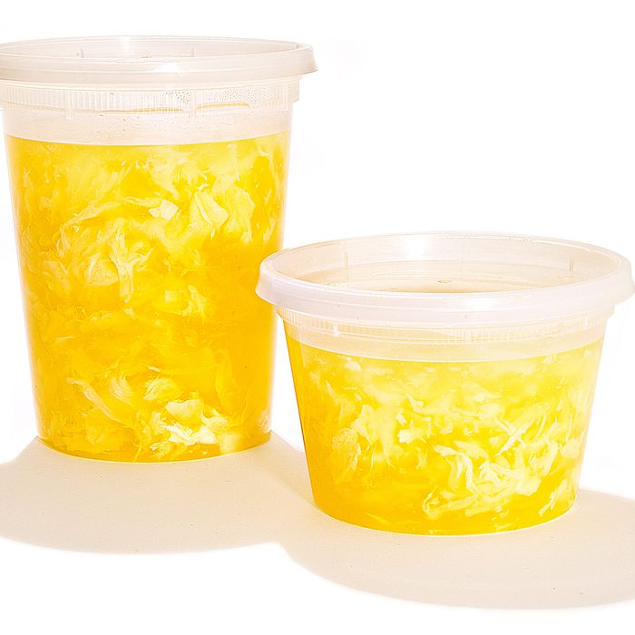
Primitive Variable Types – Integers and Decimals
int
Dry food takeout
Cannot hold decimals/doubles – will spill
double
Wet/soup takeout
Can also hold dry (int) food – treat like liquid

Slide 37
Primitive Variable Types – Integers and Decimals
A double-type variable can hold an integer-type variable.
An integer-type variable cannot hold a double-type variable.

Slide 38
Primitive Variable Types
Data Type | Memory Size | What it Stores
byte | 8 bits | integer: -128 to 127
short | 16 bits | integer: -32768 to 32767
int | 32 bits | integer: -2147483648 to 2147483647
long | 64 bits | integer: -2⁶⁴ to 2⁶⁴-1
float | 32 bits | decimal: -big to +big
double | 64 bits | decimal: -bigger to +bigger
char | 16 bits (unsigned) | 0 - 65535
boolean | 1 bit | true/false

Slide 39
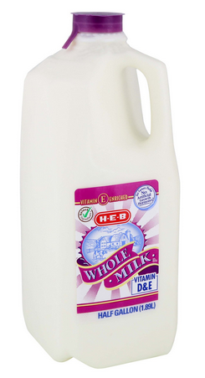
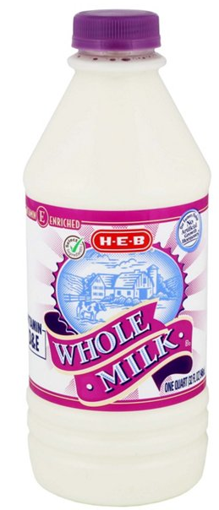
Primitive Variable Types – Integers and Decimals
float
32 bits
32 oz (1 quart)
double
64 bits
64 oz (1/2 gallon)
A smaller container cannot hold a larger container!

Slide 40
Primitive Variable Types – Integers and Decimals
A double-type variable can hold an integer-type variable.
An integer-type variable cannot hold a double-type variable.
A ‘smaller’ variable cannot hold a ‘larger’ variable.

Slide 41
Primitive Variable Types
Data Type | Memory Size | What it Stores
byte | 8 bits | integer: -128 to 127
short | 16 bits | integer: -32768 to 32767
int | 32 bits | integer: -2147483648 to 2147483647
long | 64 bits | integer: -2⁶⁴ to 2⁶⁴-1
float | 32 bits | decimal: -big to +big
double | 64 bits | decimal: -bigger to +bigger
char | 16 bits (unsigned) | 0 - 65535
boolean | 1 bit | true/false

Slide 42
Primitive Variable Types – Integers and Decimals
Question: Why would I ever use a byte/short when I could just use an int/long? Why would I ever use a float when could I use a double?
Response: Imagine you are writing code to bring aboard the International Space Station. There is very limited memory and storage capacity. When memory/storage is limited, you want to be very careful when how much memory you allocate to each variable. In this class, feel free to use only int/double. However please be aware of memory limitations in real-world applications.

Slide 43
Primitive Variable Types
Data Type | Memory Size | What it Stores
byte | 8 bits | integer: -128 to 127
short | 16 bits | integer: -32768 to 32767
int | 32 bits | integer: -2147483648 to 2147483647
long | 64 bits | integer: -2⁶⁴ to 2⁶⁴-1
float | 32 bits | decimal: -big to +big
double | 64 bits | decimal: -bigger to +bigger
char | 16 bits (unsigned) | 0 - 65535
boolean | 1 bit | true/false

Slide 44
Primitive Variables - boolean
Code:
boolean hi = true; boolean bye = false; System.out.println(hi); System.out.plrintln(bye);
Output:
true false
A boolean variable stores either a true or a false.

Slide 45
Primitive Variables - char
Think of char as short for ‘character’.
Use a single quote to designate a character.
Code:
char letter = ‘A’; char letterA = 65; System.out.println(letter); System.out.println(letterA);
Output:
A A

Slide 46
Primitive Variables - char
Question: What happened? Why did printing out the variable letterA which was assigned the value of 65 result in printing out an A?
Response: In Java, char variables are actually stored as integers. Look back at the other slide where char letter = ‘A’; this is actually storing the value of 65 in the variable letter. What Java does is when we println(letter) or println(letterA), it sees that we declared those variables as char type and so it converts the integer 65 into its character equivalent.

Slide 47
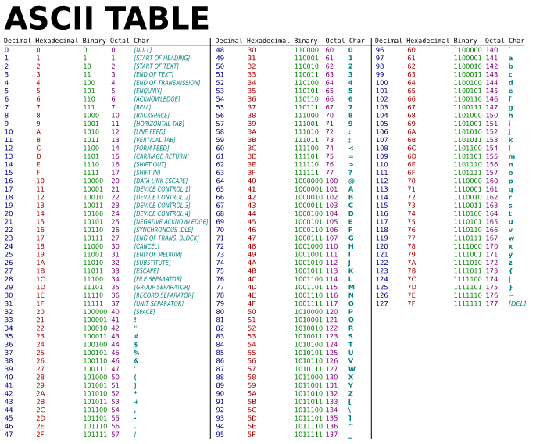
Primitive Variables - char
Question: How do you know ‘A’ is the character equivalent of 65?
Response: Search ASCII Table. Find the “decimal” heading and find the number 65. Follow the row and find the char equivalent.

Slide 49
Primitive Variables - char
Code:
char letter = ‘A’; char letterA = 65; char letterMystery = ‘A’ + 3; System.out.println(letter); System.out.println(letterA); System.out.println(letterMystery); System.out.println(‘A’ + 3); System.out.println(‘A’/5);
Output:
A
A
D
68
13

Slide 50
Objectives
I understand a primitive variable stores the actual value
I can explain the differences between the integer type variables: byte, short, int, long
I can explain the differences between the decimal type variables: float, double
I can explain what a char is and understand it is actually stored in memory as an integer
I can explain what a boolean value is

Slide 51
Follow Up
Sample Code
Primitive Variables Sample Code
Worksheet
Variables Worksheet
Coding Practice
Variables Assignment
Scaffolding
How decimal numbers are stored: https://en.wikipedia.org/wiki/Double-precision_floating-point_format
How numbers are stored: Youtube Video about Binary and Memory
Leave some Feedback/Questions:
Link: https://forms.gle/wRuj8Bzh3cTPFR4T6
*Make sure you have accounts and access to everything listed on the syllabus!

