Slide 1
Unit 2: Using Objects
Lesson 1:
Lesson 2:
Lesson 3:
Lesson 4:
Lesson 5:
Lesson 6:
Lesson 7:
Lesson 8:

Slide 2
Unit 02
Instances of Classes

Slide 3
Overview
What is a class and Object?
Object Exploration: Turtle object practice
Notes:
Alright, onto our objectives for today. As always, we start off the unit by discussing why learning about the unit matters. Next, we will write our first program, Hello World, with a little bit of help from a template. Then, we will discuss a good programming practice of standardizing what we refer to as “whitespace”. At the very end will be some exercises and suggested activities to help you!

Slide 4
Objectives
- I can explain the relationship between a class and an object
- I know a class is the formal implementation, or blueprint, of the attributes and behaviors of an object.
- I know an object is a specific instance of a class with defined attributes
- I know an object stores the memory address

Slide 5
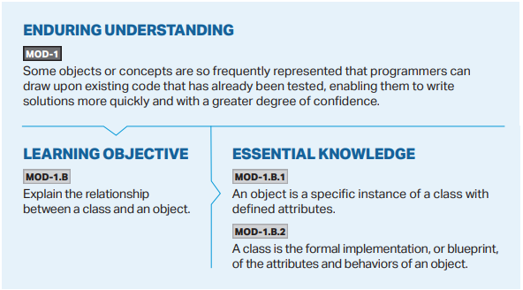

Slide 6
What is a class and Object?

Slide 7
We’ve seen this before…
Scanner kb = new Scanner(System.in);
String myName = “Mr. Wang”;

Slide 8
Class Introduction
class
class: Used to define a new blueprint for creating objects
Notes:
In Unit 1, we discussed a little bit about the necessity for including public class at the very beginning of our code to make it work. We said that we would learn later what this is for and why it is necessary. We will begin discussing it today and fully discuss classes (and creating our own) in Unit 5.
So why does our code have public class at the very beginning? What does it mean?
We’ll talk more about what public means later. For now, just think of it as the difference between your private parts and your public self. Other people (classes) can see your public self. We’ll come back to this later.
Let’s talk about the word class.
Remember, Java is an object-oriented programming language that we can use to model objects in the real world.

Slide 9
Class Introduction
Primitives come built-in with the Java programming language
int
double
boolean
etc.
What if we want a different type of variable?
Student?
3D Point?
Pixel?
BankAccount?

Slide 10
Checking Account
Let’s make a bank account for a single person using only primitive variables!
String name = “Charles Wang”;
int age = 9001;
double checkingAmount = -10.01;
String username = “thewangclass”;
String password = “theverybestpasswordthereeverwas”;

Slide 11
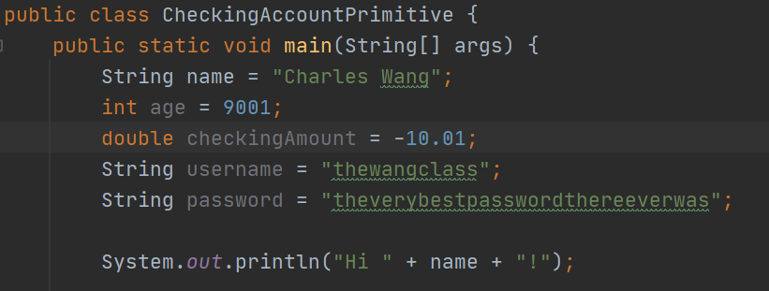
Checking Account

Slide 12
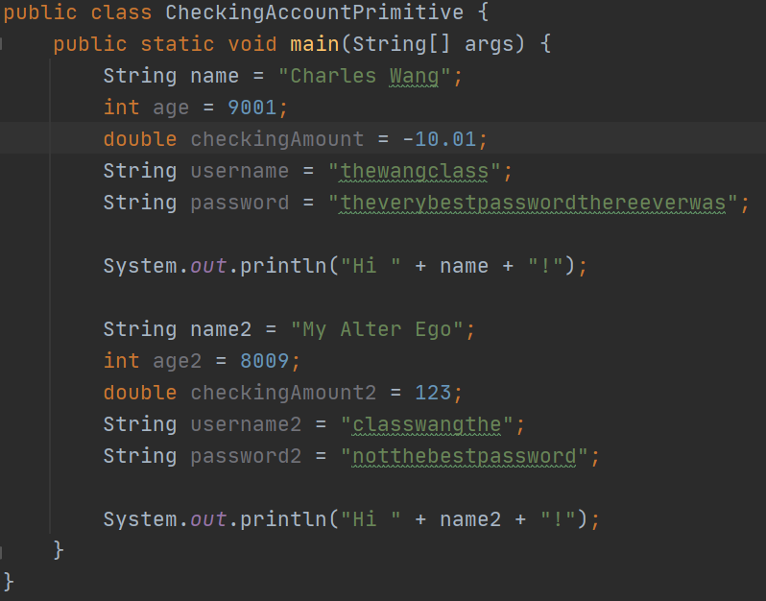
Checking Account
Let’s make another bank account for another person!

Slide 13
Checking Account
Problems/Issues
It makes sense to group everything for one person together
Error-prone
A lot to type
*Imagine creating 100 Checking Accounts!

Slide 14
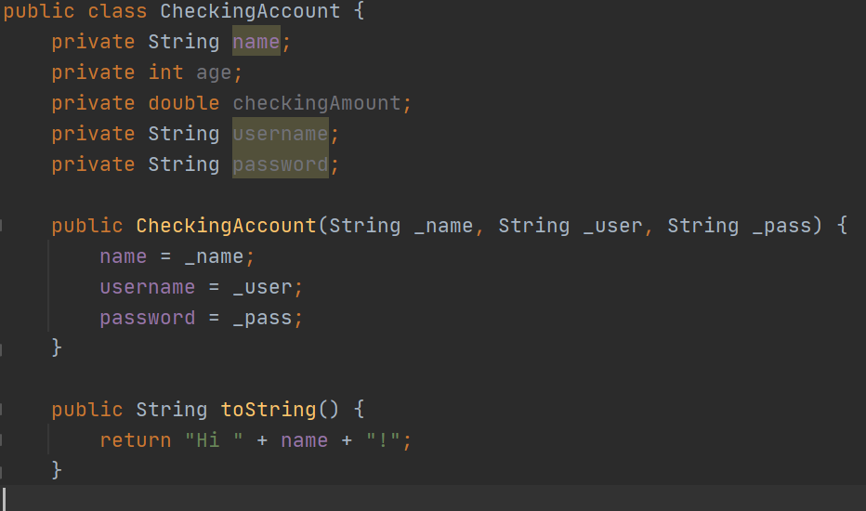
Checking Account Class

Slide 15
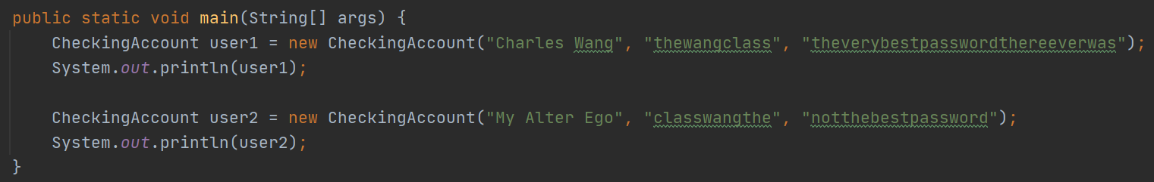
Checking Account Class

Slide 16
Checking Account Class
Before
Class Version
Problems/Issues
It makes sense to group everything for one person together
Error-prone
A lot to type
Solutions
Everything is grouped together for each user
Because everything is grouped together, less room for errors
Less to type when creating multiple accounts

Slide 17
Classes to Objects
Think of a class as a blueprint.
In the example before, we created a blueprint of a Checking Account.
We can use this blueprint to create multiple versions of the class – we call these ‘instances’ of the class, or an object.
Every ‘instance’ of CheckingAccount must have a name, an age, a checkingAmount, etc…

Slide 18

Aside: What is a blueprint?
Noun: “a design plan or other technical drawing”
Where have you heard of the word blueprint before?
House blueprint?
The blueprint is the “plan” of how to create the object.

Slide 19
Classes to Objects
There are two parts to a class blueprint:
Attributes (instance variables)
Behaviors (methods)

Slide 20
Attributes (instance variables)
Properties of the object

Slide 21
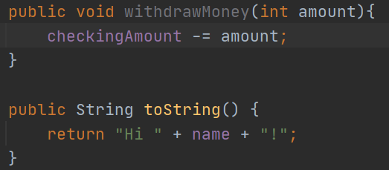
Behaviors (methods())
What an object can do

Slide 22
Why We Use Classes
We deal with objects in the real world. A computer, a person, a game, a school. We can consider all of these as objects. Therefore, it makes sense to create a ‘model’ (blueprint) of these objects instead of dealing with only primitive values.
tl;dr: We deal with objects in the real world.

Slide 23
Compare Objects w/ Primitives
primitives
objects
Start w/ a lower-case letter
int
double
boolean
etc.
Stores the actual value
5
2.0
Starts w/ a capital letter
Scanner
Object
Turtle
Student
Stores the memory address of where to find the object
0xAFEDBC

Slide 24
Object Exploration: Turtle object practice

Slide 25
Objectives
I can create Turtle objects.
I can give commands to Turtle objects using dot-notation.

Slide 26
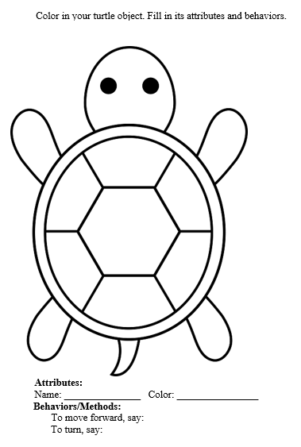
CS Awesome Unit 2.1.2
Worksheet

Slide 27
CS Awesome Unit 2.1.2
Link

Slide 28
Unit 02
Creating and Initializing Objects: Constructors

Slide 29
Overview
Instance Variables: Private
Constructors
Creating and Initializing Objects
Notes:
Alright, onto our objectives for today. As always, we start off the unit by discussing why learning about the unit matters. Next, we will write our first program, Hello World, with a little bit of help from a template. Then, we will discuss a good programming practice of standardizing what we refer to as “whitespace”. At the very end will be some exercises and suggested activities to help you!

Slide 30
Objectives
- I can explain why we set our instance variables to private and what that means
- I can identify the correct constructor that is being called by using its signature
- I can create objects by calling constructors…
With parameters
Without parameters (default)
- I know Java provides a default constructor behind-the-scenes IF AND ONLY IF no constructor is already provided

Slide 31
Instance Variables: Private

Slide 32
Class Introduction
public class
public: Other people (classes) can see your public self
private: Other people (classes) cannot see your private parts
class
class: Used to define a new blueprint for creating objects
Notes:
In Unit 1, we discussed a little bit about the necessity for including public class at the very beginning of our code to make it work. We said that we would learn later what this is for and why it is necessary. We will begin discussing it today and fully discuss classes (and creating our own) in Unit 5.
So why does our code have public class at the very beginning? What does it mean?
We’ll talk more about what public means later. For now, just think of it as the difference between your private parts and your public self. Other people (classes) can see your public self. We’ll come back to this later.
Let’s talk about the word class.
Remember, Java is an object-oriented programming language that we can use to model objects in the real world.

Slide 33
Class Introduction
public
private
All other classes can see and access.
Think of your smile – everyone can and should see it!
Other classes cannot see; only visible to the class it belongs in.
Think of your “private” parts – other people can’t (and shouldn’t) be able to see them!
For AP CS A – all instance variables should be made private.
Notes:
In Unit 1, we discussed a little bit about the necessity for including public class at the very beginning of our code to make it work. We said that we would learn later what this is for and why it is necessary. We will begin discussing it today and fully discuss classes (and creating our own) in Unit 5.
So why does our code have public class at the very beginning? What does it mean?
We’ll talk more about what public means later. For now, just think of it as the difference between your private parts and your public self. Other people (classes) can see your public self. We’ll come back to this later.
Let’s talk about the word class.
Remember, Java is an object-oriented programming language that we can use to model objects in the real world.

Slide 34
Constructors

Slide 35
Creating and Initializing Objects

Slide 36
Unit 02
Calling Methods Without Parameters (and returns nothing)

Slide 37
Overview
What is a method?
Method Header
Calling Methods Without Parameters

Slide 38
Objectives
I can identify, label, and explain every section of a method header
I can call non-static void methods without parameters

Slide 39
Unit 02
Calling Methods With Parameters

Slide 40
Overview
Method Header w/ Parameters
Calling Methods With Parameters
“Mutator” Methods

Slide 41
Objectives
I can identify, label, and explain every section of a method header
I can call non-static void methods with parameters
I know what a mutator method is and can write one to modify an instance variable

Slide 42
Unit 02
Calling Methods that Return Values

Slide 43
Overview
Method Header w/ Return Options
Calling Methods that Return Things
“Accessor” Methods

Slide 44
Objectives
I can identify, label, and explain every section of a method header
I can call non-static non-void methods with parameters that return a value
I know what an accessor method is and can write one to return the value of an instance variable

Slide 45
Unit 02
Strings

Slide 46
Overview
Constructing String objects
Calling String Methods

Slide 47
Objectives
I can create String objects
I know Strings are immutable
I can call String methods and utilize them in my code
substring(int start)
substring(int start, int end)
charAt(int index)
length()

Slide 48
Unit 02
String Methods

Slide 49
Overview
Calling String Methods (more)

Slide 50
Objectives
I can call String methods
indexOf(String str)
indexOf(char c)
lastIndexOf(String str)
lastIndexOf(char c)
equals(String s)
compareTo(String s)
I know to use .equals() when comparing Objects
== compares what is ‘inside the box’
.equals() compares what the address inside the box is pointing to
.equals() inherits from the granddaddy Object class and we have to ‘override’ it

Slide 51
Unit 02
Using the Math Class

Slide 52
Overview
What does static mean?
Calling static methods
Static/Instance Variables + Methods

Slide 53
Objectives
I can call static methods
I can evaluate expressions that use the Math class methods

Slide 54
Follow Up
Sample Code:
Worksheet
None
Coding Practice
None
Scaffolding:
See 02_Scaffolding
Leave some Feedback/Questions:
Link: https://forms.gle/wRuj8Bzh3cTPFR4T6

