Slide 1
Unit 02
Instances of Classes

Slide 2
Overview

Slide 3
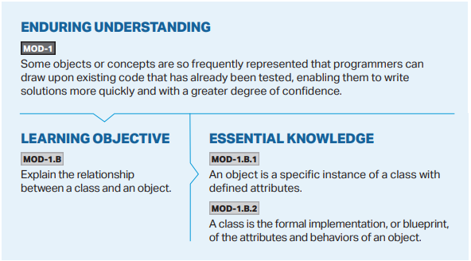

Slide 4
Overview
public class – What is a Class?
What is an object?
Turtle object practice
Notes:
Alright, onto our objectives for today. As always, we start off the unit by discussing why learning about the unit matters. Next, we will write our first program, Hello World, with a little bit of help from a template. Then, we will discuss a good programming practice of standardizing what we refer to as “whitespace”. At the very end will be some exercises and suggested activities to help you!

Slide 6
Classes
public class
Notes:
In Unit 1, we discussed a little bit about the necessity for including public class at the very beginning of our code to make it work. We said that we would learn later what this is for and why it is necessary. We will begin discussing it today and fully discuss classes (and creating our own) in Unit 5.
So why does our code have public class at the very beginning? What does it mean?
Let’s talk about the word class.
Remember, Java is an object-oriented programming language that we can use to model objects in the real world.

