Slide 1



Presenting project by, Name: Md Tyibor Rahman Id:22100080 Course-code: CSE 213 To, Naima Islam Nodi (Lecturer)

Slide 2


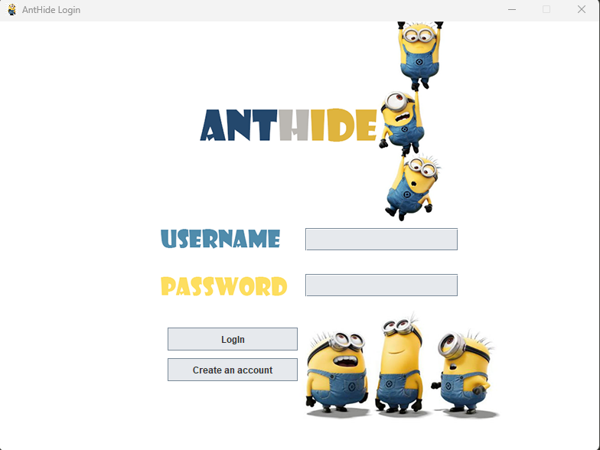





What Is Anthide?
Identity
Database
It’s Store your password
Locally hosted database on xampp
Tools
Limitation
Java Swing
It has limited slots for saving password
Security
Future
Password is encrypted with the changeable key
I have some future planning for this project

Slide 3

Any Question?

Slide 4

Thank You

