Slide 1
Structured programming language
A Presentation on
Presented By,
Badhan Das
ID-22100054
Batch-24
Department –CSE
Trimester –Spring 2022
Presented To,
MD. Mizanur Rahman
Assistant professor
Department of CSE
Ranada Prasad Shaha University

Slide 2
Introduction
Presenting a C program that finds the Sum and Average of three integers

Slide 3
Algorithm
Step 1: Start Step 2: Input a,b,c Step 3: Calculate Sum= a+b+c Step 4: Show the Sum Step 5: Calculate Average=Sum/3.0 Step 6: Show the Average Step 7: End

Slide 4
Flow Chart
Start
Input a,b,c
End
Sum = a+b+c
Show the sum show the average
Sum = a+b+c

Slide 5
Program
#include<stdio.h> int main() { int a,b,c; float avg; printf("\nInput three integer: "); scanf("%d%d%d",&a,&b,&c); sum=a+b+c; printf("\nSum=%d",sum); avg=(a+b+c)/3.0; printf("\nAvg = %.2f",avg); return 0; }

Slide 6
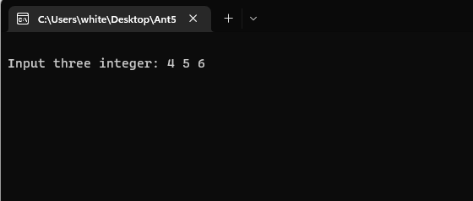
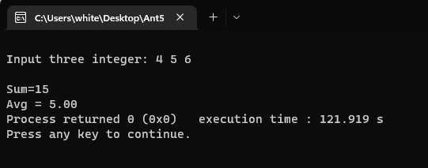
Input & Output
Input 4, 5, 6
Sum = 15
Avg = 5.00

