Slide 1

structure programming language
Presented By,
Md. Tyibor Rahman
ID: 22100080
Dept. CSE Batch 24th
Semester Spring 2022
Presented To,
Md. Mizanur Rahman (Asst. Professor)
Notes:
This template can be used as a starter file for presenting training materials in a group setting.
Sections
Right-click on a slide to add sections. Sections can help to organize your slides or facilitate collaboration between multiple authors.
Notes
Use the Notes section for delivery notes or to provide additional details for the audience. View these notes in Presentation View during your presentation.
Keep in mind the font size (important for accessibility, visibility, videotaping, and online production)
Coordinated colors
Pay particular attention to the graphs, charts, and text boxes.
Consider that attendees will print in black and white or grayscale. Run a test print to make sure your colors work when printed in pure black and white and grayscale.
Graphics, tables, and graphs
Keep it simple: If possible, use consistent, non-distracting styles and colors.
Label all graphs and tables.

Slide 2
Terminal Guessing Game
In This Program Person-1 set,
A number for guessing
Guessing Chance
Person-2 Try to guess the number
Score Is (chance*10)
Notes:
Give a brief overview of the presentation. Describe the major focus of the presentation and why it is important.
Introduce each of the major topics.
To provide a road map for the audience, you can repeat this Overview slide throughout the presentation, highlighting the particular topic you will discuss next.

Slide 3

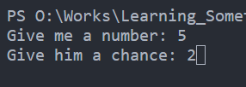
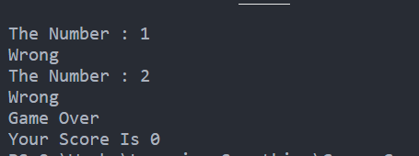
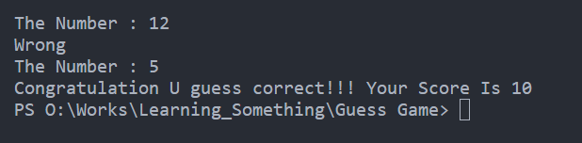
Input And Outputs
Person-1 Sector : Setup
Person-2 Sector : Guessing
If you Can’t Guess the number
If you guess

Slide 4


Let’s Play The Game

Slide 5
How I made this game .

Slide 6
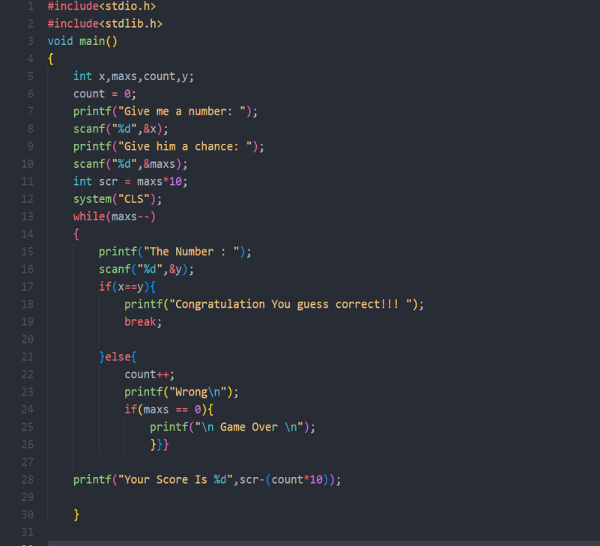
Guessing Game code
Notes:
This is another option for an Overview slides using transitions.

Slide 7
FlowChart
Start
1. Give me a number
2.Give him a chance
Score = chance*10
Wrong = 0
Clear screen

Slide 8
Count chance
Game Over
Chance = 0
The Number
End
Match the number
No , wrong++
Guess Correct
Your Score
Score = score - wrong
yes
Break

Slide 9
Thank You Guys
Anything To Ask ?

