Slide 1
Digital Signal Processing
Prof. Nizamettin AYDIN
naydin@yildiz.edu.tr
http://www.yildiz.edu.tr/~naydin

Slide 2
Digital Signal Processing
Lecture 8
Sampling & Aliasing

Slide 3
License Info for SPFirst Slides
This work released under a Creative Commons License with the following terms:
Attribution
    The licensor permits others to copy, distribute, display, and perform the work. In return, licensees must give the original authors credit.
Non-Commercial
    The licensor permits others to copy, distribute, display, and perform the work. In return, licensees may not use the work for commercial purposes—unless they get the licensor's permission.
Share Alike
    The licensor permits others to distribute derivative works only under a license identical to the one that governs the licensor's work.
Full Text of the License
This (hidden) page should be kept with the presentation

Slide 4
READING ASSIGNMENTS
This Lecture:
  Chap 4, Sections 4-1 and 4-2
    Replaces Ch 4 in DSP First, pp. 83-94
Other Reading:
  Recitation: Strobe Demo (Sect 4-3)
  Next Lecture: Chap. 4 Sects. 4-4 and 4-5

Slide 5
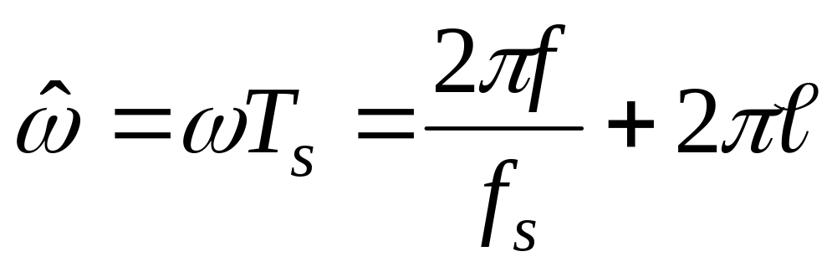
LECTURE OBJECTIVES
SAMPLING can cause ALIASING
  Sampling Theorem
  Sampling Rate > 2(Highest Frequency)
Spectrum for digital signals, x[n]
  Normalized Frequency
ALIASING

Slide 6
SYSTEMS Process Signals
x(t)
SYSTEM
y(t)
PROCESSING GOALS:
  Change x(t) into y(t)
    For example, more BASS
  Improve x(t), e.g., image deblurring
  Extract Information from x(t)

Slide 7
System IMPLEMENTATION
ANALOG/ELECTRONIC:
    Circuits: resistors, capacitors, op-amps
x(t)
ELECTRONICS
y(t)
DIGITAL/MICROPROCESSOR
    Convert x(t) to numbers stored in memory
x(t)
A-to-D
x[n]
COMPUTER
y[n]
D-to-A
y(t)

Slide 8
SAMPLING x(t)
SAMPLING PROCESS
    Convert x(t) to numbers x[n]
    “n” is an integer; x[n] is a sequence of values
    Think of “n” as the storage address in memory
UNIFORM SAMPLING at t = nT_{s}
    IDEAL: x[n] = x(nT_{s})
x(t)
C-to-D
x[n]

Slide 9
SAMPLING RATE, f_{s}
SAMPLING RATE (f_{s})
  f_{s} =1/T_{s}
    NUMBER of SAMPLES PER SECOND
  T_{s} = 125 microsec → f_{s} = 8000 samples/sec
      UNITS ARE HERTZ: 8000 Hz
UNIFORM SAMPLING at t = nT_{s} = n/f_{s}
  IDEAL: x[n] = x(nT_{s})=x(n/f_{s})
x[n]=x(nT_{s})
x(t)
C-to-D

Slide 10
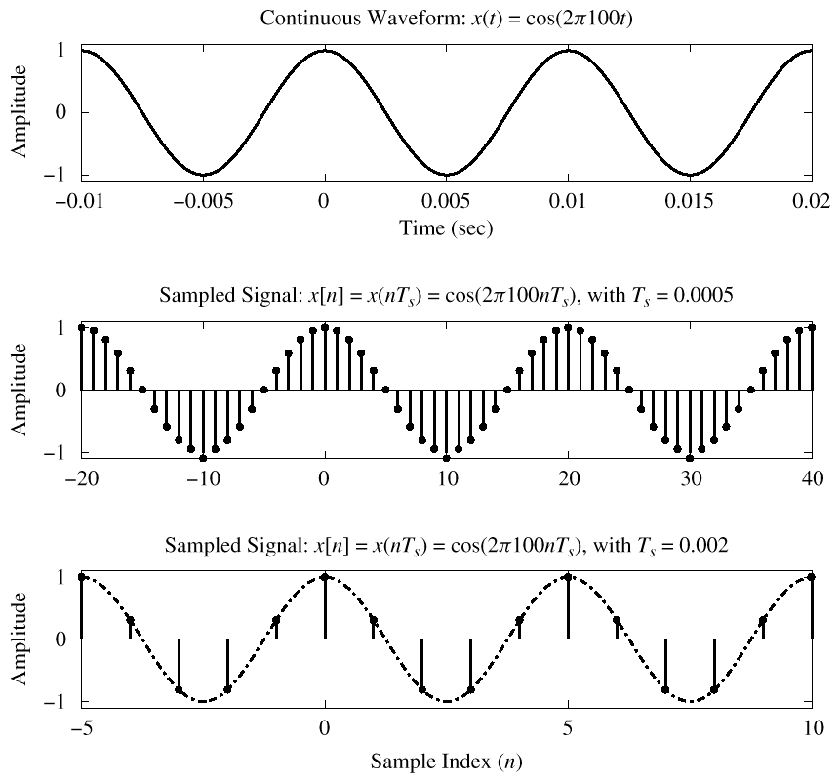




Slide 11
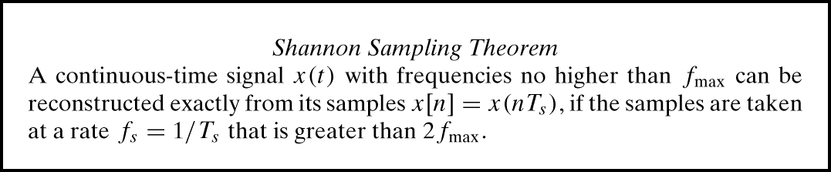
SAMPLING THEOREM
HOW OFTEN ?
  DEPENDS on FREQUENCY of SINUSOID
  ANSWERED by SHANNON/NYQUIST Theorem
  ALSO DEPENDS on “RECONSTRUCTION”

Slide 12
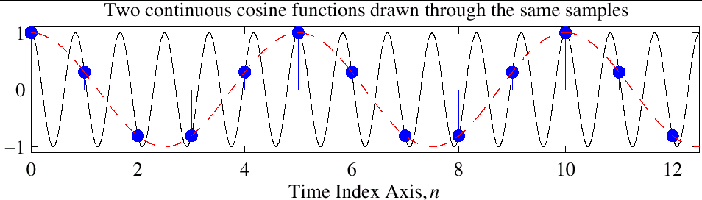
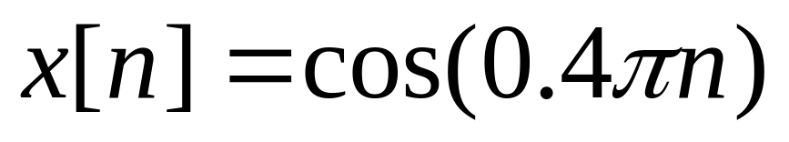
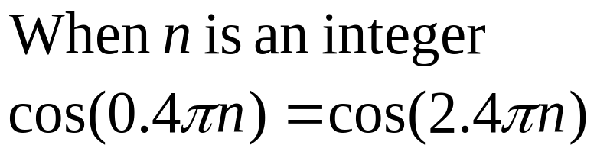
Reconstruction? Which One?
Given the samples, draw a sinusoid through the values

Slide 13
STORING DIGITAL SOUND
x[n] is a SAMPLED SINUSOID
  A list of numbers stored in memory
EXAMPLE: audio CD
CD rate is 44,100 samples per second
  16-bit samples
  Stereo uses 2 channels
Number of bytes for 1 minute is
  2 × (16/8) × 60 × 44100 = 10.584 Mbytes

Slide 14
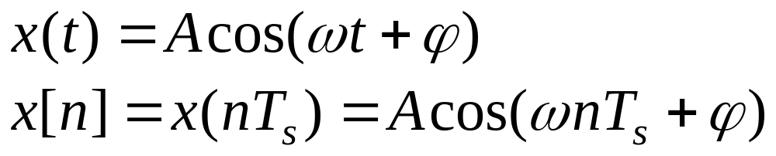
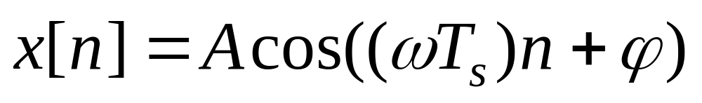
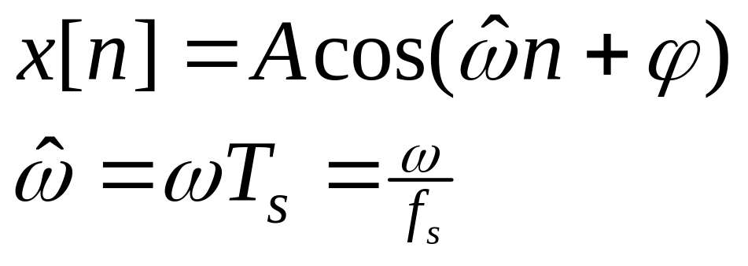
DISCRETE-TIME SINUSOID
Change x(t) into x[n] DERIVATION
DEFINE DIGITAL FREQUENCY

Slide 15


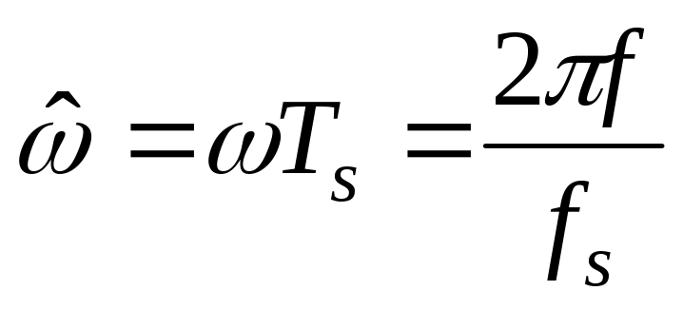
DIGITAL FREQUENCY
VARIES from 0 to 2π, as f varies from 0 to the sampling frequency
UNITS are radians, not rad/sec
  DIGITAL FREQUENCY is NORMALIZED

Slide 16
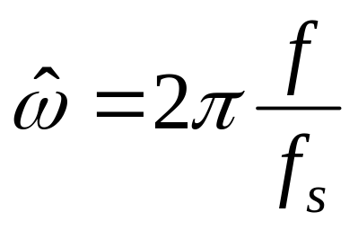
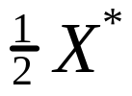

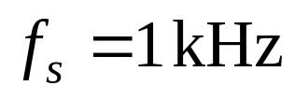

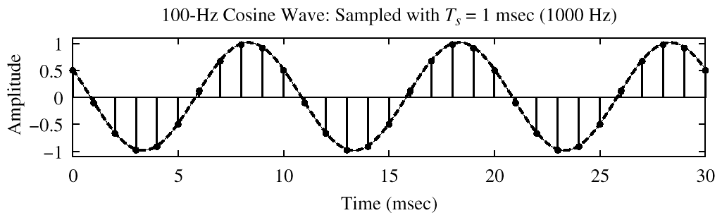
SPECTRUM (DIGITAL)
–0.2π
2π(0.1)

Slide 17
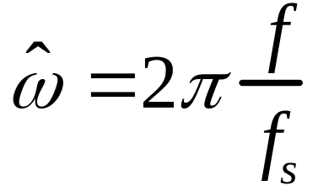

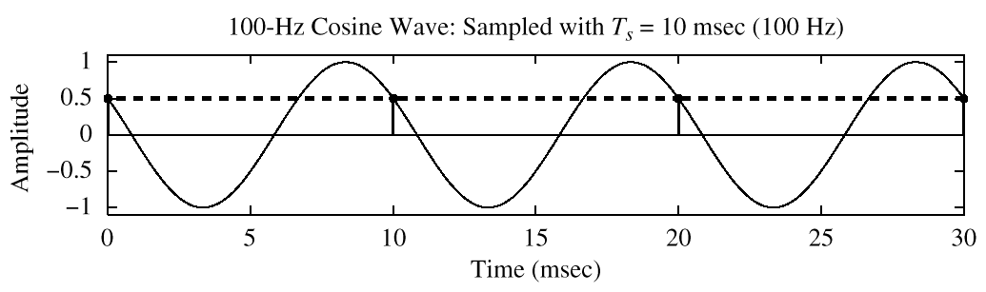
SPECTRUM (DIGITAL) ???
?
–2π
2π(1)
x[n] is zero frequency???

Slide 18
The REST of the STORY
Spectrum of x[n] has more than one line for each complex exponential
  Called ALIASING
  MANY SPECTRAL LINES
SPECTRUM is PERIODIC with period = 2π
  Because

Slide 19
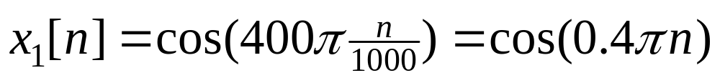
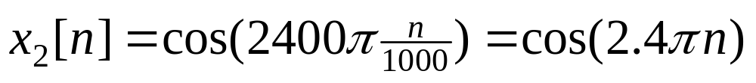
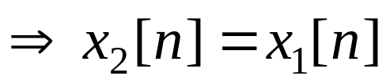

ALIASING DERIVATION
Other Frequencies give the same

Slide 20
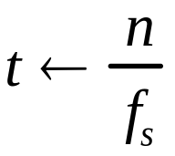
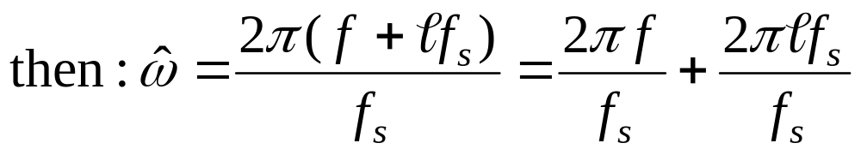
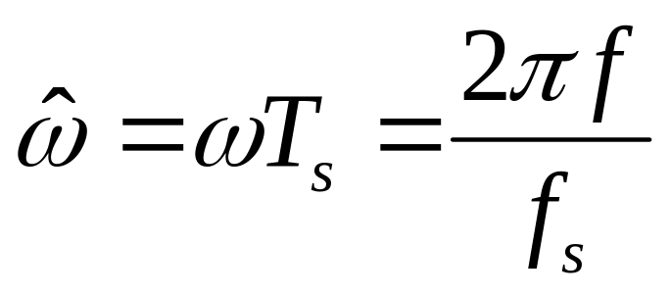
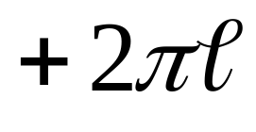
ALIASING DERIVATION–2
Other Frequencies give the same

Slide 21
ALIASING CONCLUSIONS
ADDING f_{s} or 2f_{s} or –f_{s} to the FREQ of x(t) gives exactly the same x[n]
  The samples, x[n] = x(n/ f_{s} ) are EXACTLY THE SAME VALUES
GIVEN x[n], WE CAN’T DISTINGUISH f_{o} FROM (f_{o} + f_{s} ) or (f_{o} + 2f_{s} )

Slide 22
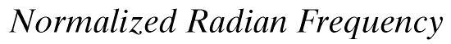

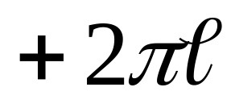
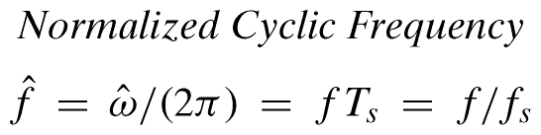
NORMALIZED FREQUENCY
DIGITAL FREQUENCY

Slide 23
SPECTRUM for x[n]
PLOT versus NORMALIZED FREQUENCY
INCLUDE ALL SPECTRUM LINES
  ALIASES
    ADD MULTIPLES of 2π
    SUBTRACT MULTIPLES of 2π
  FOLDED ALIASES
    (to be discussed later)
    ALIASES of NEGATIVE FREQS

Slide 24
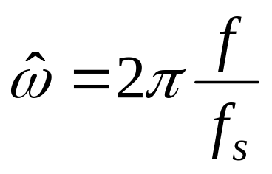
SPECTRUM (MORE LINES)
–1.8π
–0.2π
2π(0.1)
1.8π

Slide 25

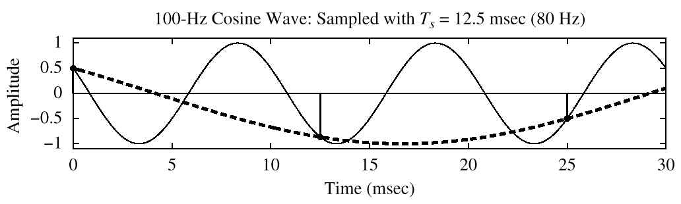
SPECTRUM (ALIASING CASE)
–2.5π
–1.5π
–0.5π
0.5π
1.5π
2.5π

Slide 26
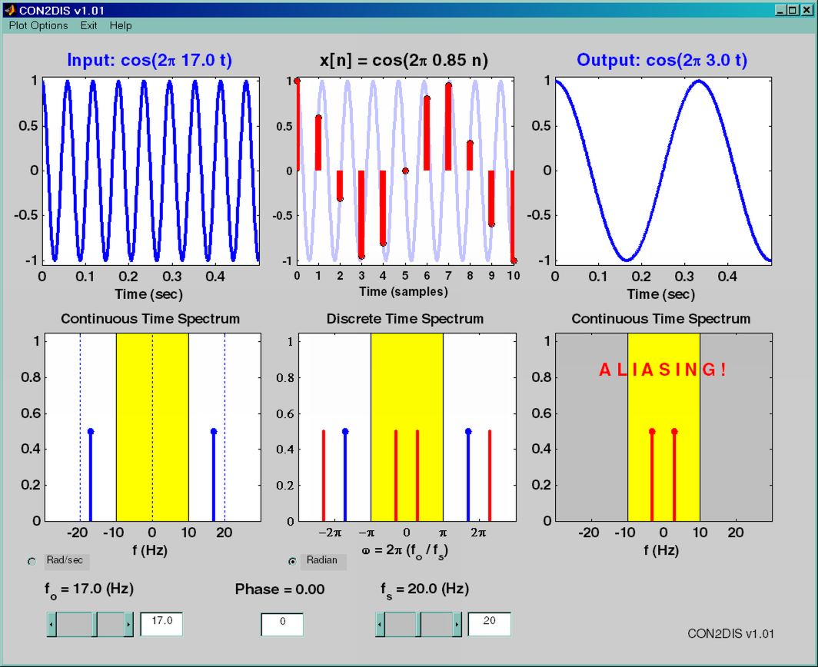
SAMPLING GUI (con2dis)

Slide 27

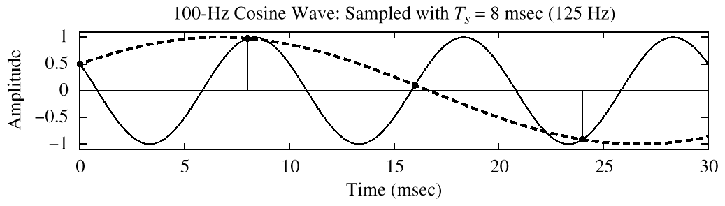
SPECTRUM (FOLDING CASE)
–1.6π
–0.4π
0.4π
1.6π

Slide 28
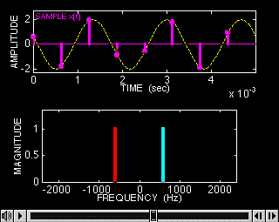
SAMPLING DEMO (Chap. 4)

Slide 29
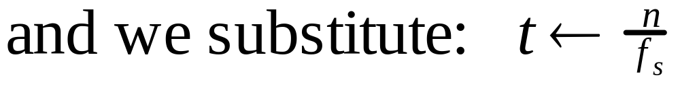
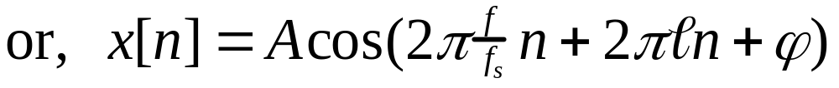
ALIASING DERIVATION
Other Frequencies give the same

Slide 30
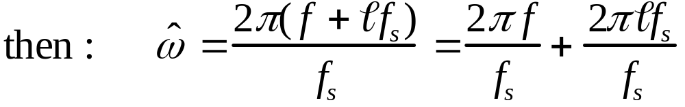
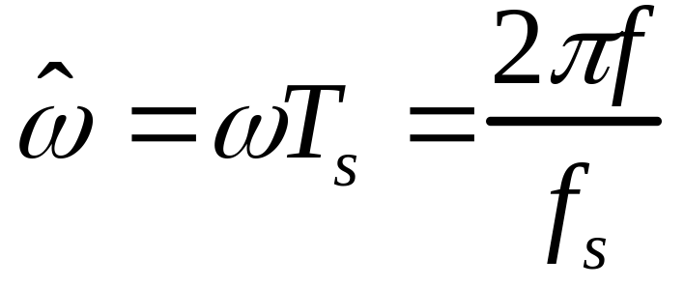
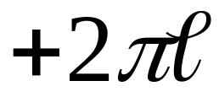
ALIASING DERIVATION–2
Other Frequencies give the same

Slide 31
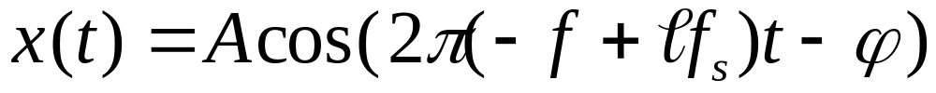

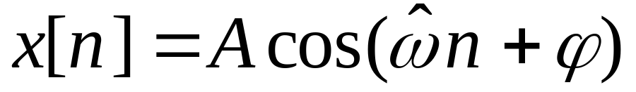
FOLDING DERIVATION
Negative Freqs can give the same
SAME DIGITAL SIGNAL

Slide 32

FOLDING (a type of ALIASING)
MANY x(t) give IDENTICAL x[n]
CAN’T TELL f_{o} FROM (f_{s}-f_{o})
  Or, (2f_{s}-f_{o} ) or, (3f_{s}-f_{o} )
EXAMPLE:
  y(t) has 1000 Hz component
  SAMPLING FREQ = 1500 Hz
  WHAT is the “FOLDED” ALIAS ?

Slide 33
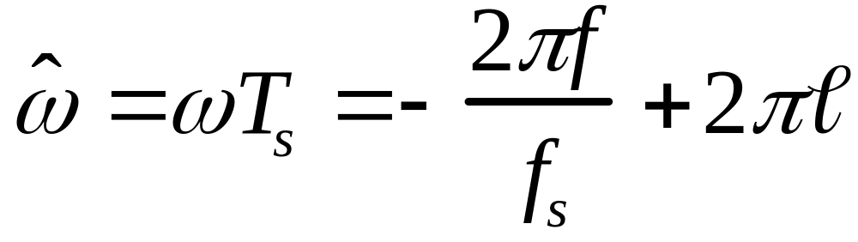
DIGITAL FREQ AGAIN
ALIASING
FOLDED ALIAS

Slide 34
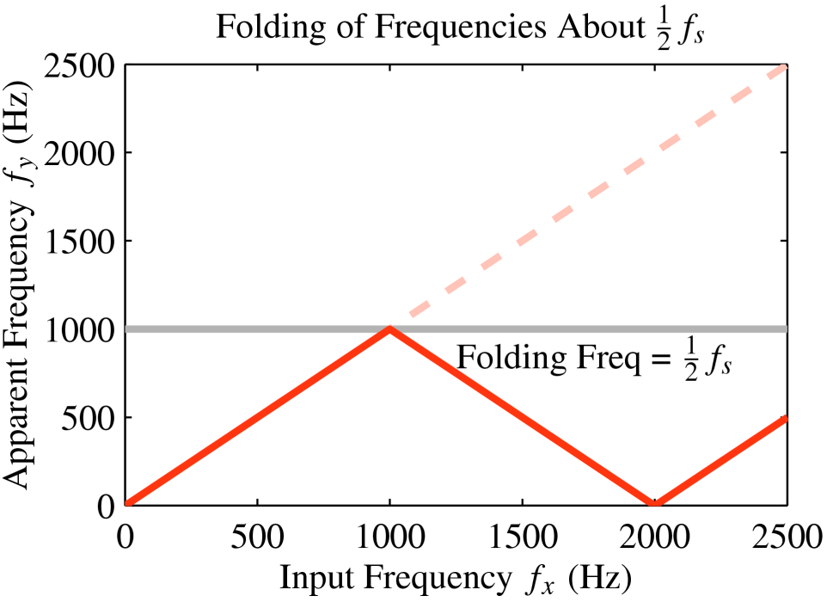
FOLDING DIAGRAM

Slide 35
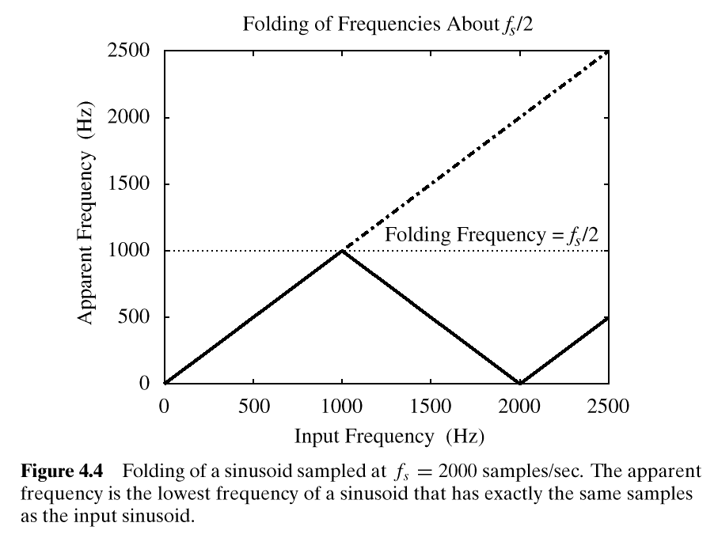
FOLDING DIAGRAM

Slide 36
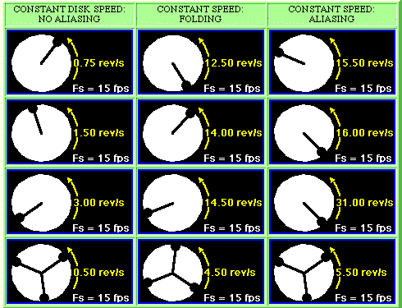
STROBE DEMO (Synthetic)

Slide 37
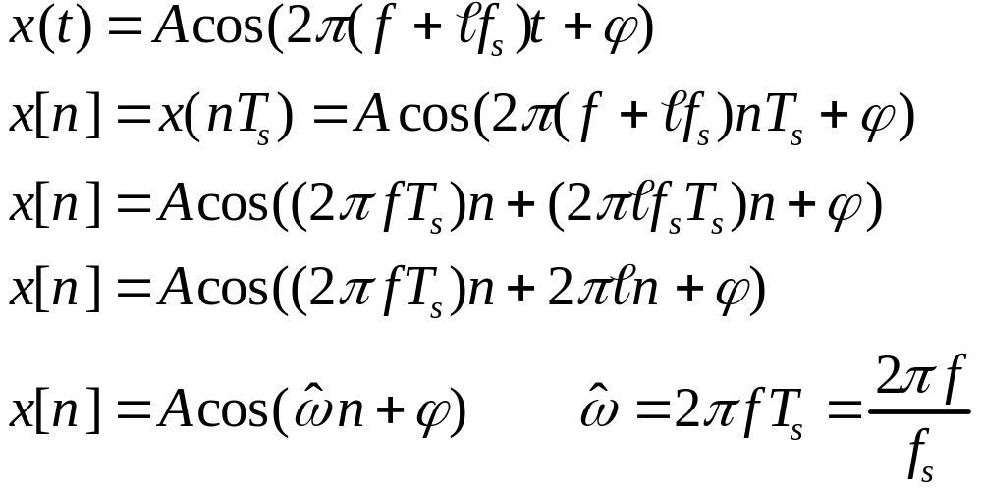
ALIASING DERIVATION
Other Frequencies give the same

