Slide 1
Communications
Crosslink scientific/housekeeping data (emitter & receiver sat)
G/S link scientific data (emitter sat)
G/S link housekeeping data (emitter sat)
G/S link housekeeping data (receiver sat)

Slide 2
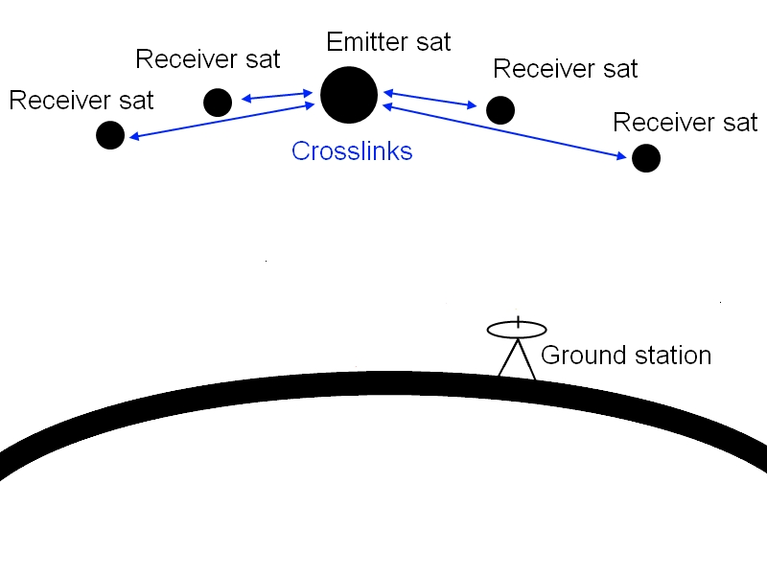
Crosslink scientific/housekeeping data
Design parameters
Two way links
Frequency: 2 GHz (S-band)
Max. data rate: 1.62 Mbps
Max. distance: 261 km
Modulation: QPSK

Slide 3
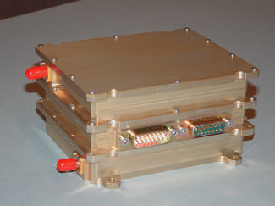
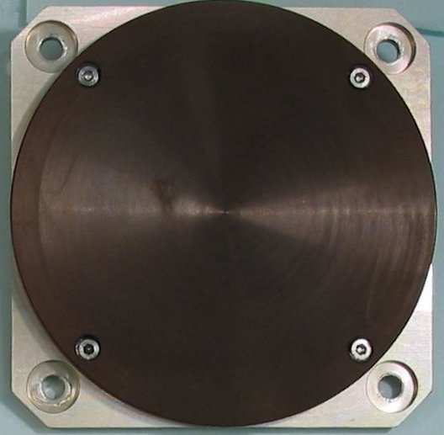
Crosslink scientific/housekeeping data
Hardware
S-band Transceiver
  10 Mbps
  Max. output 5 Watt
  1 kg
S-band patch antenna
  82x82x20mm
  80g
  4 dBi

Slide 4
Crosslink scientific/housekeeping data
Link budget
Input power transceiver: 12 W
Output power transceiver: 5W
Required Eb/N0 ratio: 9.6 dB
Margin: 1.76 dB

Slide 5
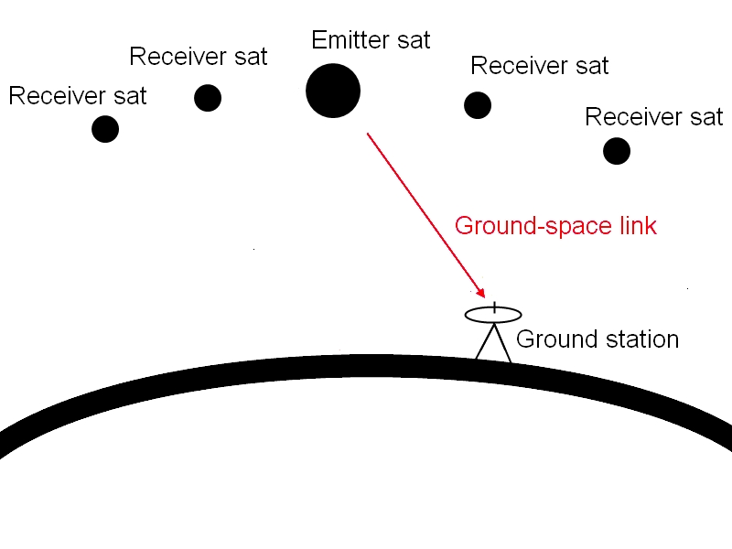
G/S link scientific data
Design parameters
One way link
Frequency: 8.2 GHz (X-band)
Max. data rate: 150 Mbps
Max. distance: 1000 km
Modulation: QPSK

Slide 6
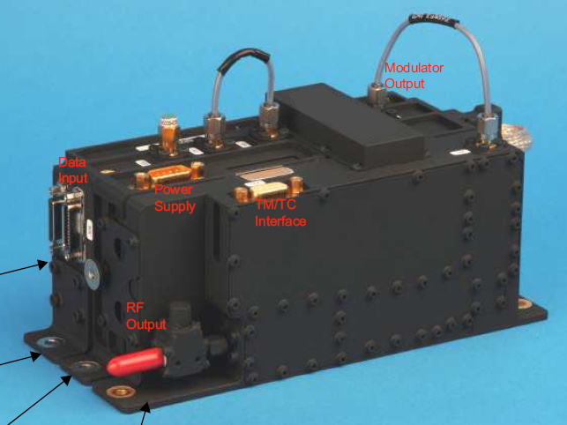
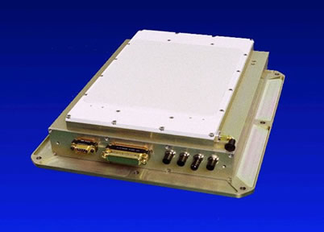
G/S link scientific data
Hardware
X-band Transmitter
  500 Mbps
  Max. output 6 Watt
  1.1 kg
X-band phased array
  330x305x74mm
  5.5 kg
  23.03 dBi

Slide 7
G/S link scientific data
Link budget
Input power transceiver: 30 W
Output power transceiver: 5W
Required Eb/N0 ratio: 9.6 dB
Margin: 29.3 dB

Slide 8
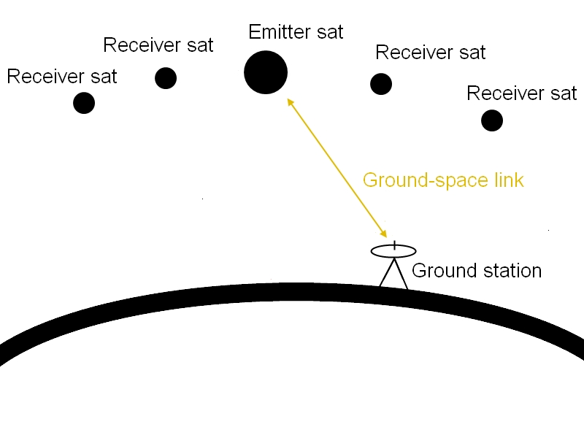
G/S link housekeeping data
Design parameters
Two way link
Frequency: 2 GHz (S-band)
Max. data rate: 20 kbps
Max. distance: 1000 km
Modulation: QPSK

Slide 9
G/S link housekeeping data
Hardware
S-band Transceiver
  10 Mbps
  Max. output 5 Watt
  1 kg
S-band patch antenna
  82x82x20mm
  80g
  4 dBi

Slide 10
G/S link housekeeping data
Link budget
Input power transceiver: 12 W
Output power transceiver: 5W
Required Eb/N0 ratio: 9.6 dB
Margin: 27.65 dB

Slide 11
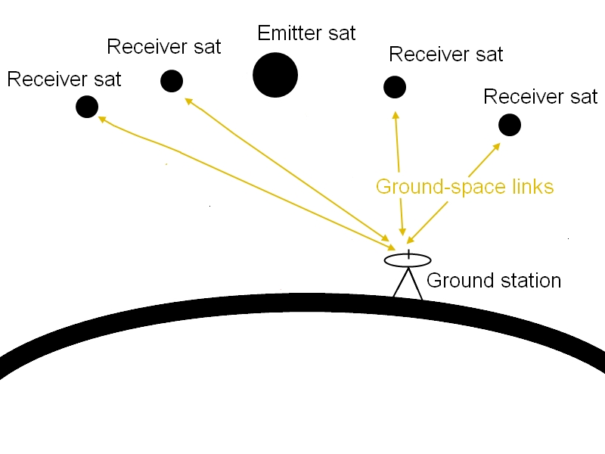
G/S link housekeeping data (backup)
Link budget
Input power transceiver: 12 W
Output power transceiver: 5W
Required Eb/N0 ratio: 9.6 dB
Margin: 27.65 dB

Slide 12
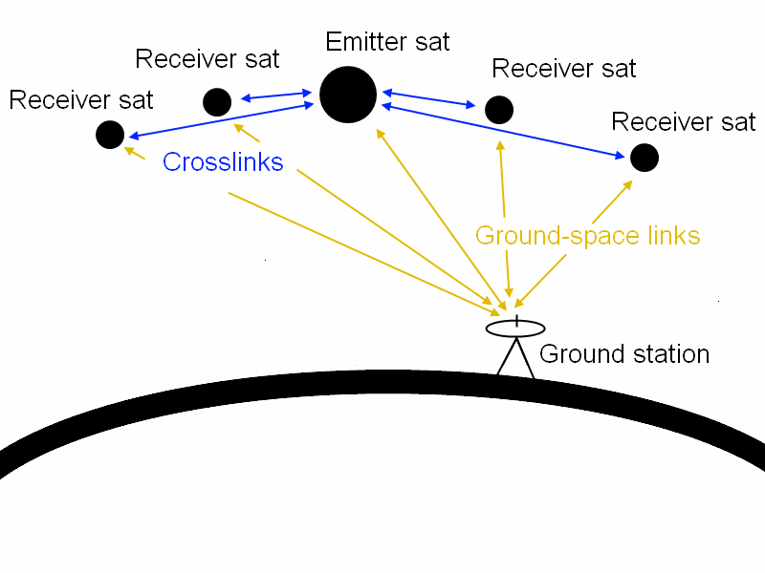
Total masses & Power consumption
 | Emitter | Receiver
Mass [kg] | 10.5 | 3
Power [W] | 42 | 12

