Slide 1

Laser Swarm
Final term review
Group 13, Aerospace Engineering

Slide 2
Laser Swarm
Swarm of 9 satellites
SPAD receiver
473nm Laser
Elevation modeling of the earth
BRDF modeling of the earth

Slide 3
Contents
Subsystems design
Orbital design
Software tool results
  Power Aperture tradeoff
  Elevation reconstruction
  BRDF reconstruction
Conclusions and recommendations

Slide 4
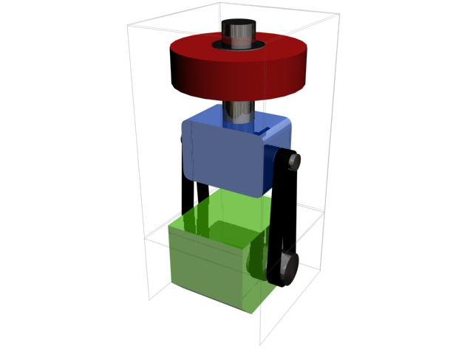
Fix me slide
These are bullet points:
Point a
Point b
Point c

Slide 5
1.
Subsystem Design

Slide 6
Attitude and Orbital Determination and Control Subsystem
Emitter
  Attitude determination
  Attitude control
  Orbit control
  Pointing
Receiver
  Attitude determination
  Attitude control
  Orbit control
  Pointing

Slide 7
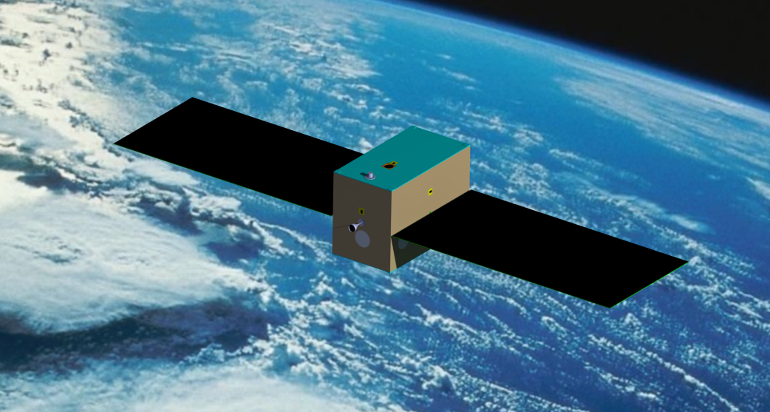
Emitter Satellite
afbeelding
I_{xx} = 2.407 kgm²
I_{yy} = 5.582 kgm²
I_{zz} = 6.542 kgm²

Slide 8



Disturbance Torques
Gravity gradient
Solar Radiation
Earth Magnetic Field
Aerodynamic Torques

Slide 9

Disturbance Torques Emitter
Gravity gradient
Solar Radiation
Earth Magnetic Field
Aerodynamic Torques

Slide 10
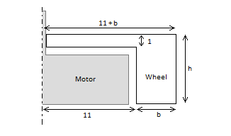
Reaction Wheels Emitter
Total disturbance torque 8.776·10⁻⁵ Nm
Safety margin of 2
Torque requirement 1.755·10⁻⁴ Nm
Angular acceleration 100 rad/s
h = 10 mm
b = 36 mm
m = 212 grams

Slide 11
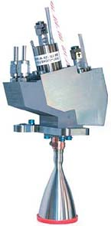
Thruster Emitter
ΔV requirement 225.38 m/s
Biproppelant thruster
I_{sp} = 291 s
Fuel mass 3.8 kg
  Monomethylhydrazine 2.88 L
  Dinitrogen Tetraoxide 1.32 L
Source: http://www.eads.com

Slide 12

Pointing Emitter

Slide 13
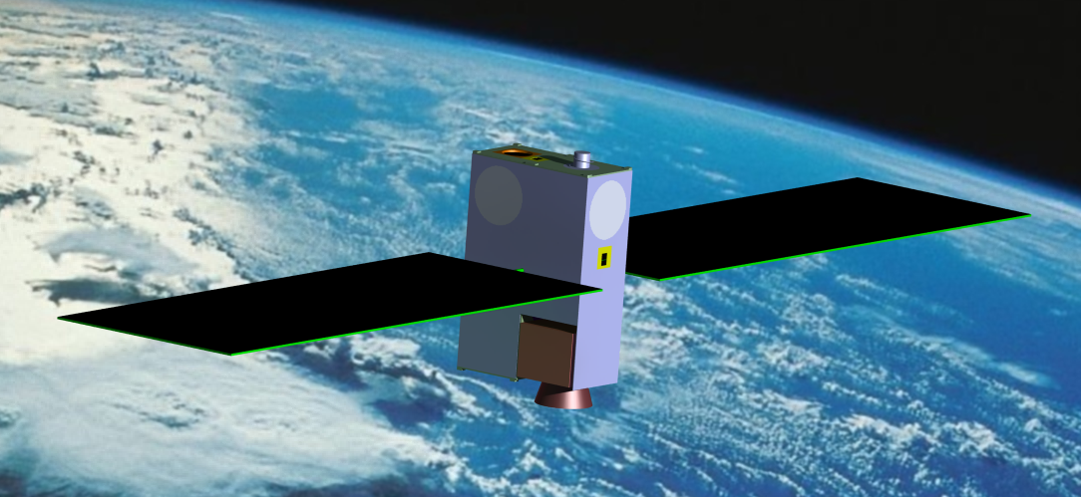
Receiver Satellite
I_{xx} = 1.307 kgm²
I_{yy} = 0.101 kgm²
I_{zz} = 1.316 kgm²

Slide 14

Disturbance Torques Receiver
Gravity gradient
Solar Radiation
Earth Magnetic Field
Aerodynamic Torques

Slide 15
Reaction Wheels Receiver
Total disturbance torque 1.65 ·10⁻⁵ Nm
Safety margin of 2
Torque requirement 3.31·10⁻⁵ Nm
Angular acceleration 100 rad/s
h = 10 mm
b = 11 mm
m = 36 grams

Slide 16
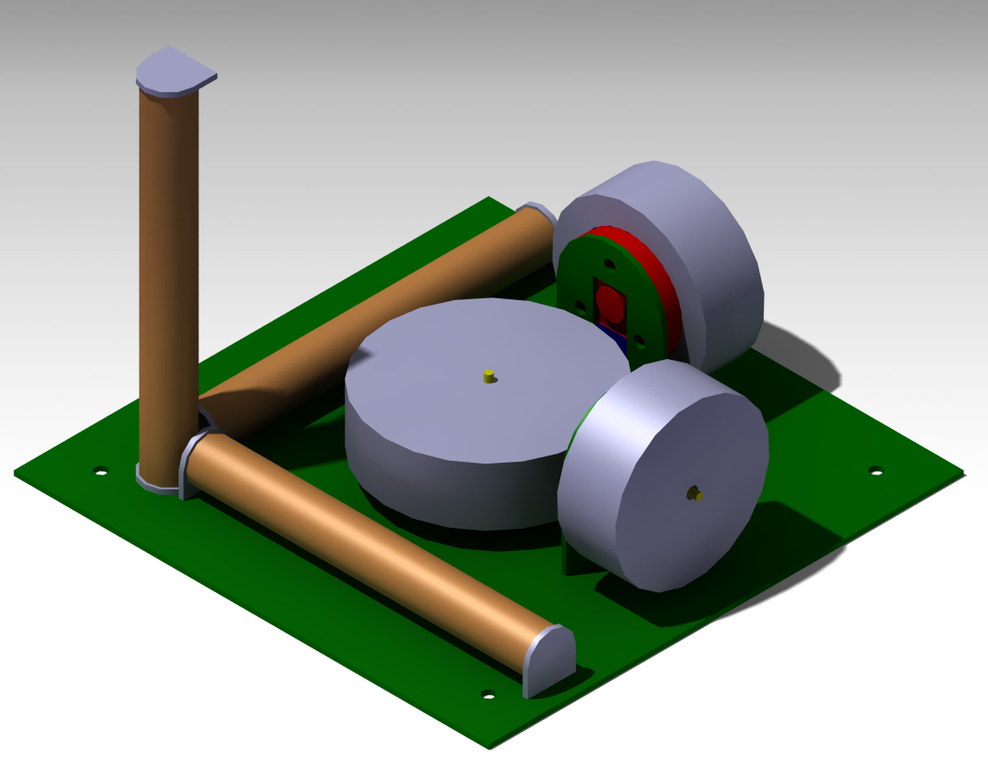
Attitude Control Receiver

Slide 17
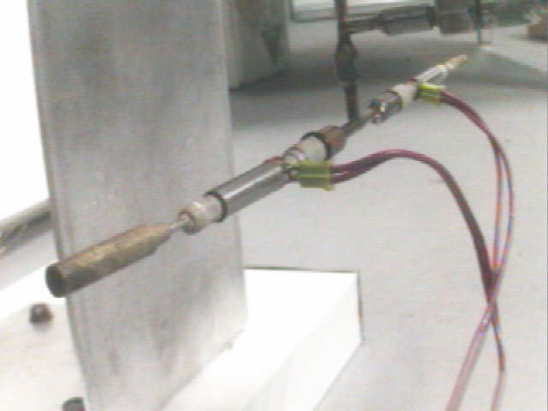
Thruster Receiver
ΔV requirement 165.14 m/s
Mono propellant thruster
I_{sp} = 120 s
Fuel mass 1.77 kg
  Hydrogen Peroxide 1.23 L
Source: http://www.micro-a.net

Slide 18
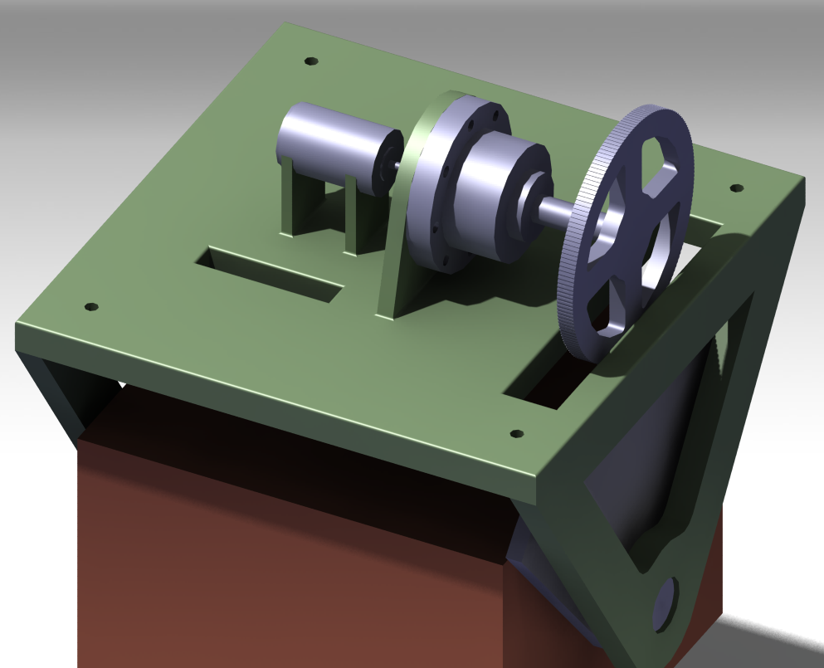
Pointing Receiver

Slide 19
Fix me slide
These are bullet points:
Point a
Point b
Point c

Slide 20
2.
Orbital Design

Slide 21
Fix me slide
These are bullet points:
Point a
Point b
Point c

Slide 22
3.
Software tool results

Slide 23
Simulation results overview
Optimization of Aperture and Power
Elevation modeling
BRDF reconstruction

Slide 24
Optimization sequence
These are bullet points:
Point a
Point b
Point c

Slide 25
Fix me slide
These are bullet points:
Point a
Point b
Point c

Slide 26
4.
Concluding remarks

Slide 27
Summary ? conclusions
The system is feasible with the following considerations:
9 Satellites at two altitude levels
ADCS?
COMS?
NAV?
EPS
6W Ns:YAG laser (573 nm) pumped with diodes ?
32x32 SPAD with matching optics ?

