Slide 1
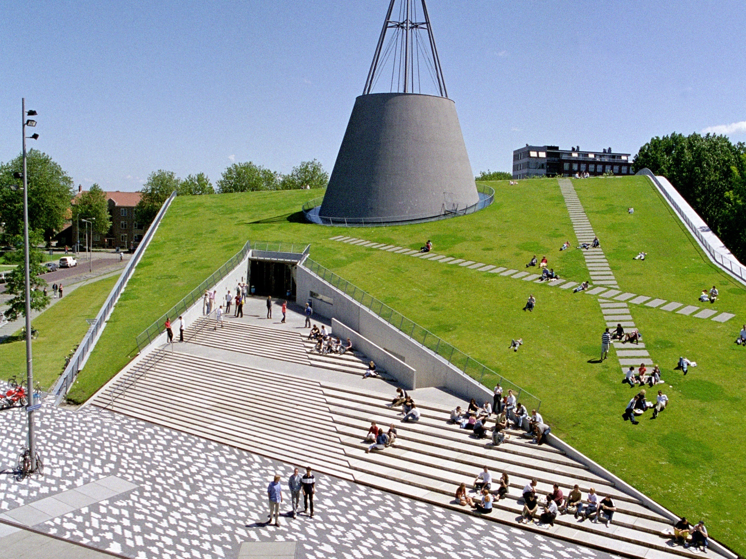
Laser Swarm
Mid term review
Group 13, Aerospace Engineering

Slide 2
Contents
Project plan
Key requirements
Trade-off method
Subsystem Trade-off
  Design options
  Trade-off
Software tool

Slide 3
1.
Project plan

Slide 4
Mission need statement
Demonstrate that a satellite constellation, consisting of a single emitter and several receivers, will perform superior (in terms of cost, lifetime and performance) to existing spaceborne laser altimetry systems.

Slide 5
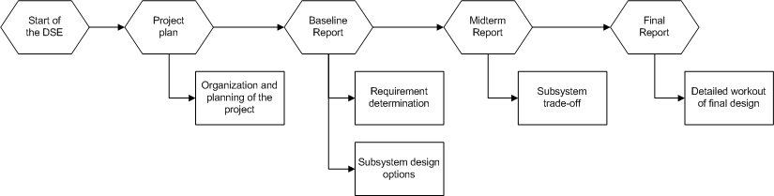
Project Organization

Slide 6
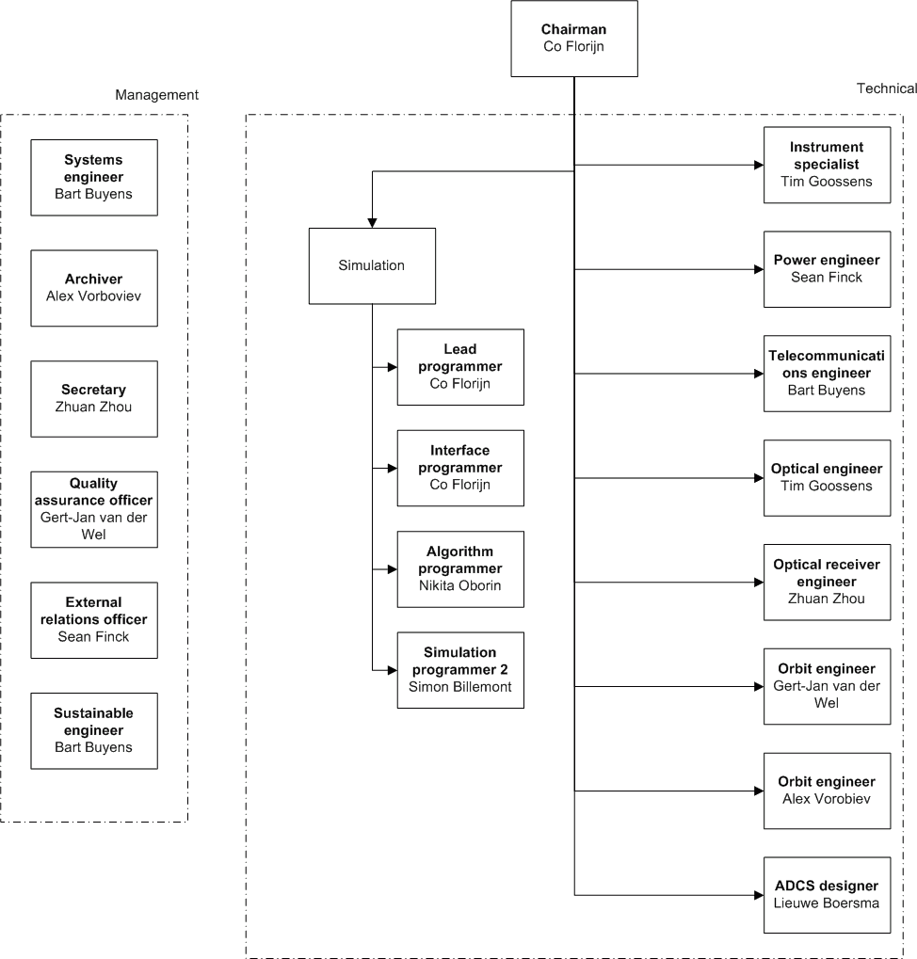
Work distribution

Slide 7
2.
Key requirements

Slide 8
Key Requirements
Low cost
Lifetime of ~ 5 yrs
Performance equivalent to IceSat

Slide 9
Additional Requirements
Mass ≤ existing spaceborne laser altimetry systems
No scanner may be used
Recreation of the DEM
Extraction of the BRDF

Slide 10
3.
Tradeoff method

Slide 11
Trade-off Method
A set of criteria are defined
Each criteria is assigned weight w.r.t. importance
Varies for each subsystem
Each subsystem is graded
Highest score wins

Slide 12
4.
Subsystem trade off
Notes:
Explain how you got from key requirements to specific Design Options

Slide 13
ADCS subsystem
eh

Slide 14
Communication
Mass budget must be below or equal to existing spaceborne laser altimetry systems.
No scanner may be used.

Slide 15
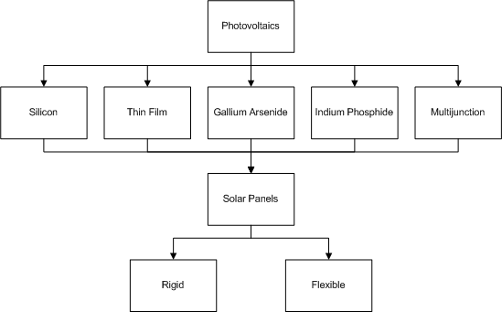
Electrical Power System
Pruned design option tree
Two candidates:
  Thin film
  Triple junction

Slide 16
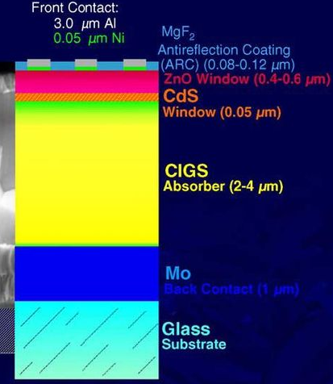
EPS – Thin Film CIGS
Multiple layers of thin photovoltaic material
Copper-Indium-Gallium-Selenium absorber
Low efficiency
Low production cost
High absorptance coefficient

Slide 17
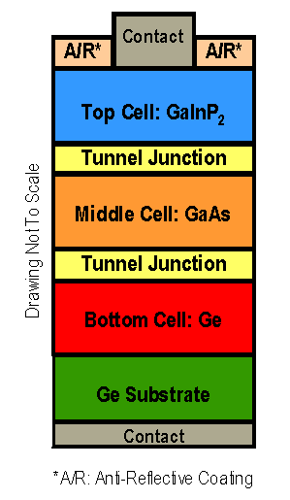
EPS – Triple Junction
Multiple pn-junctions
High efficiency
High production cost
Larger covering of the solar spectrum

Slide 18
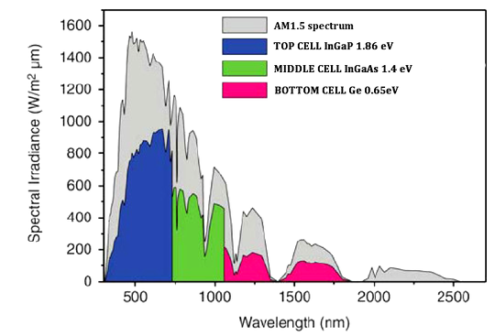
EPS – Triple-Junction

Slide 19
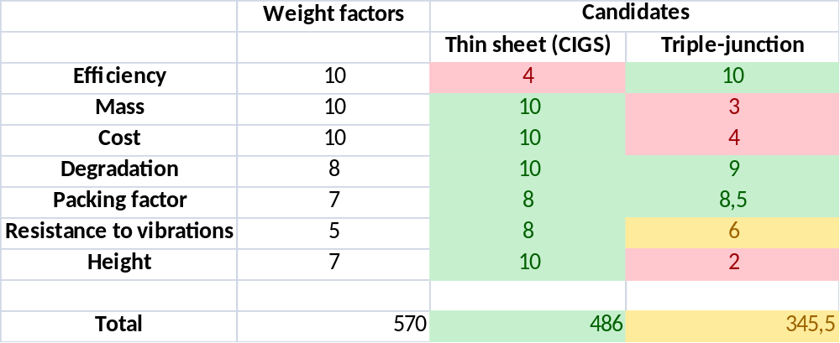
EPS – Trade-off

Slide 20
Orbit Architecture
Mass budget must be below or equal to existing spaceborne laser altimetry systems.
No scanner may be used.

Slide 21
Optical Emitting Payload
Mass budget must be below or equal to existing spaceborne laser altimetry systems.
No scanner may be used.

Slide 22
Optical Receiving Payload

Slide 23
5.
Software tool

Slide 24
Software tool
Two parts
Simulation
    Simulate the laser pulse photons and noise as received by the sensor.
Data analysis
    Reconstructing the digital elevation model and BRDF from the received time series.

Slide 25
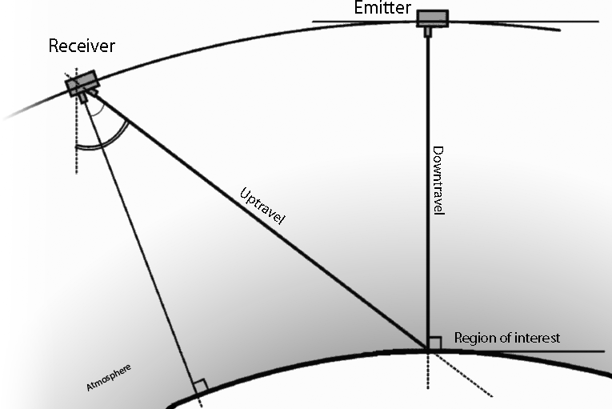
Simulation
Pulse cycle
Pulse emitted
Absorption in atmosphere
Scattering on the earth
Small fraction to each satellite
Absorption in atmosphere
Received by receiver

Slide 26
Noise
Noise is introduced into the system
Sources are the Earth and the Sun
In a selective wavelength band
Strong dependence on
  Receiver footprint area
  Receiver sensitivity band
  Constellation altitude

Slide 27
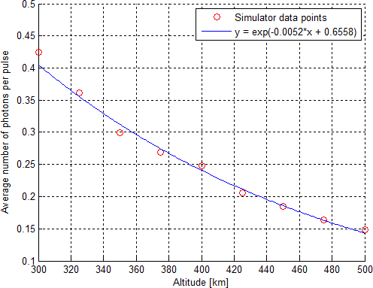
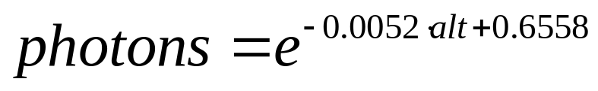
Photon count variation with altitude
Exponential decrease in photon count with altitude
Lower is better
Higher altitudes:
  larger receiver aperture
  higher emitter power

Slide 28
Solar noise photons fraction
Orbit at 450 km, 33W laser
Simulation results:
Pulses sent: 24989 (about 5s)
Photons from pulses received: 12289 (86.5%)
Sun noise photons received: 1930 (13.5%)
Total photons received: 14219
Majority of the photons from the emitter laser
Noise can be filtered out (constellation)

Slide 29
6.
Summary and conclusions

Slide 30
Summary
ACDS change me
COMS change me
EPS change me
ORBIT change me
OEP change me
ORP change me

