Slide 1
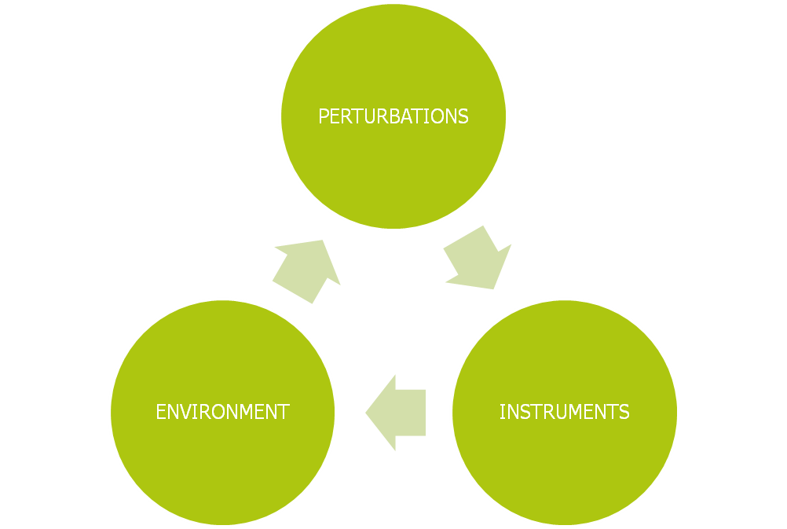
Orbit Altitude Analysis

Slide 2
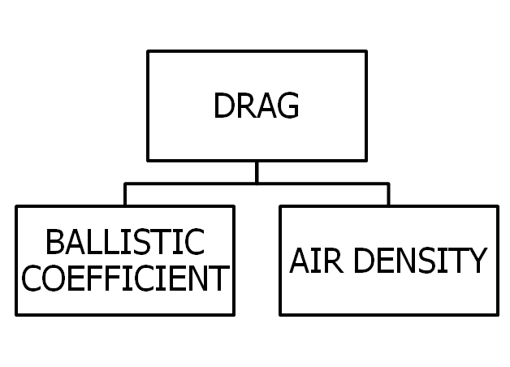
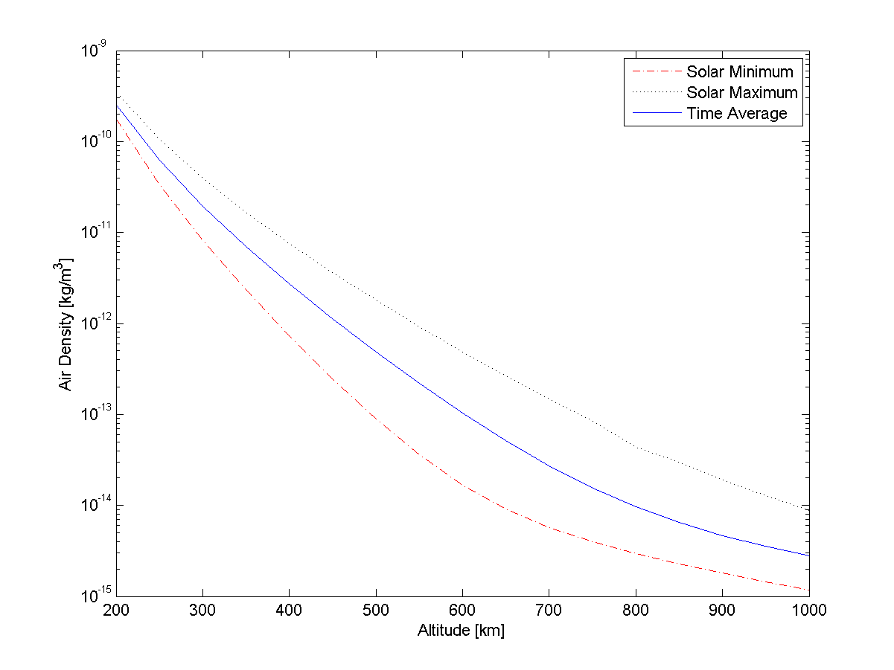
Orbit Altitude Analysis - Perturbations

Slide 3
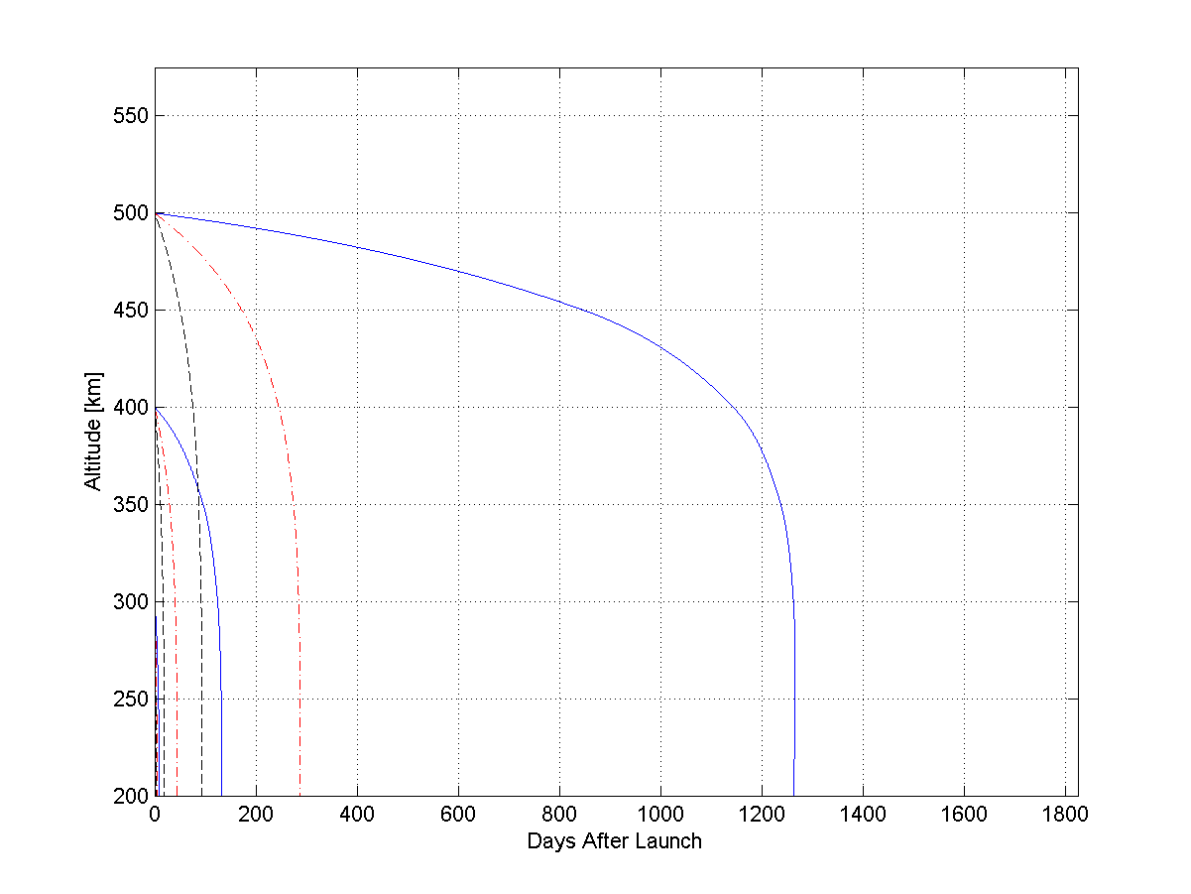
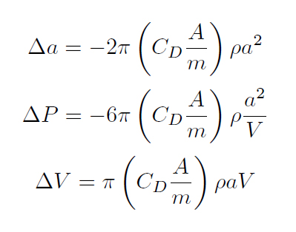
Drag

Slide 4
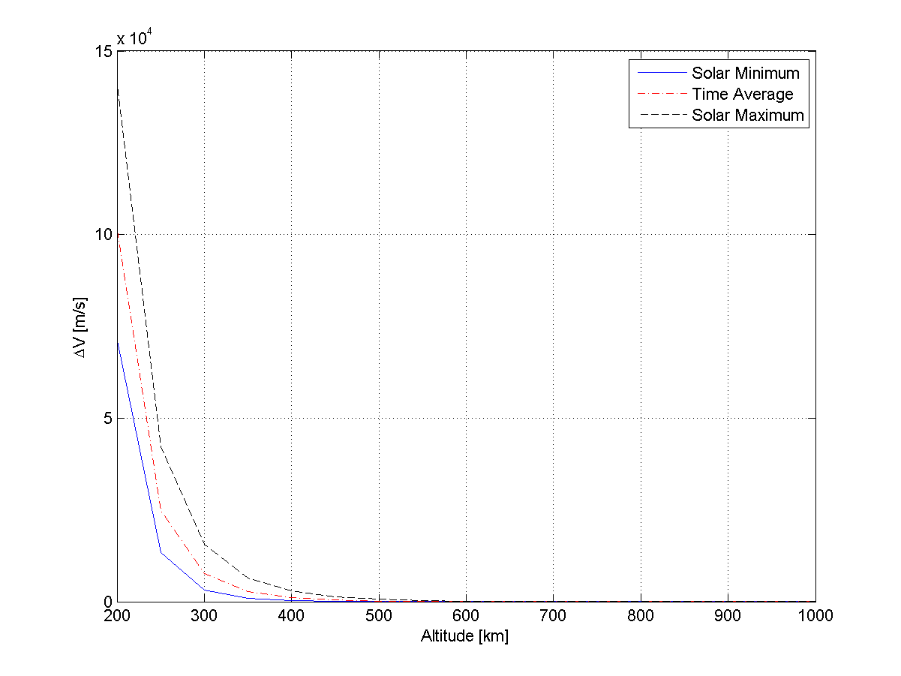
Drag - ΔV

Slide 5
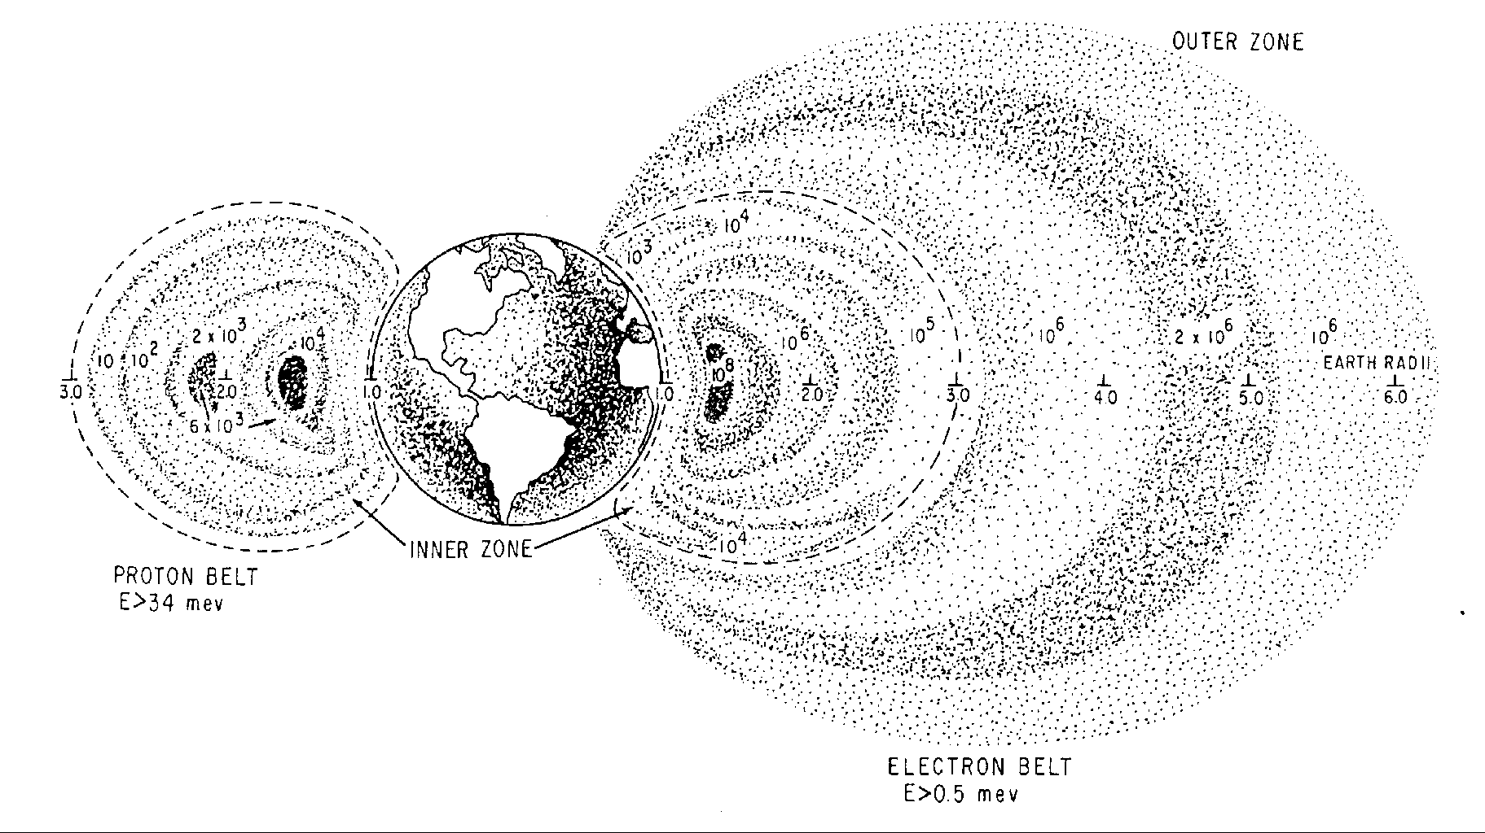
Environment
Trapped particle radiation

Slide 6
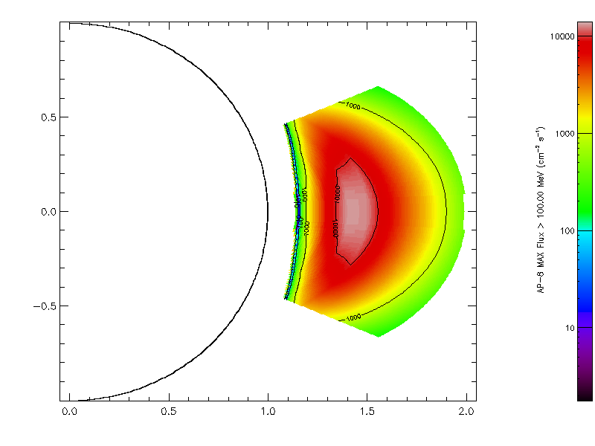
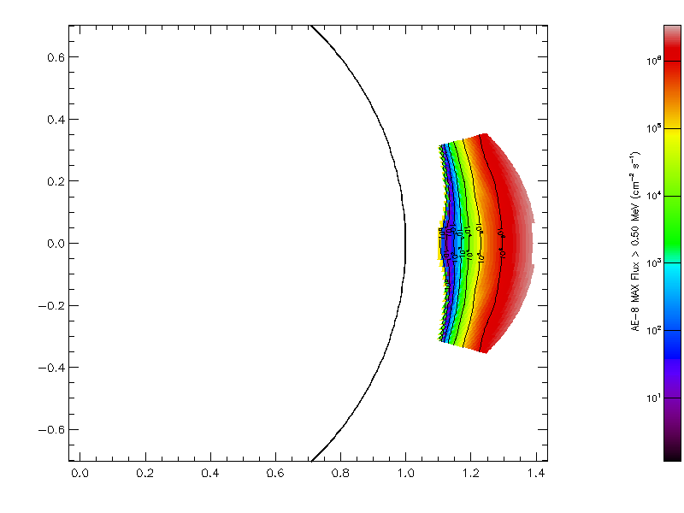
Environment
Trapped particle radiation

Slide 7
Orbit Altitude
Summary
As high as possible to reduce propellant mass
Mission timeframe is crucial – solar min/max
Keep ballistic coefficient close

Slide 8
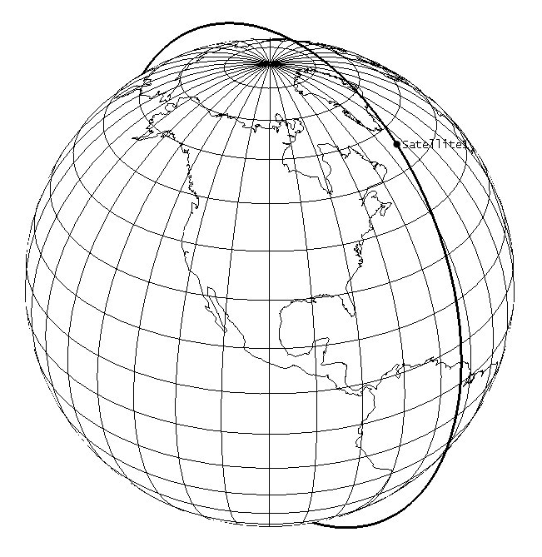
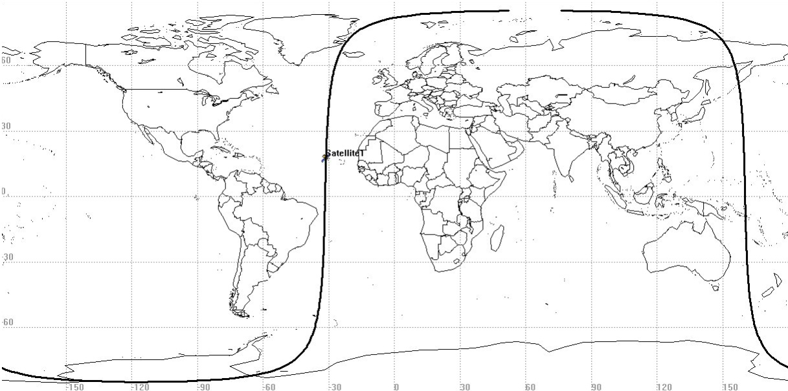
Orbit Altitude
Summary

Slide 9
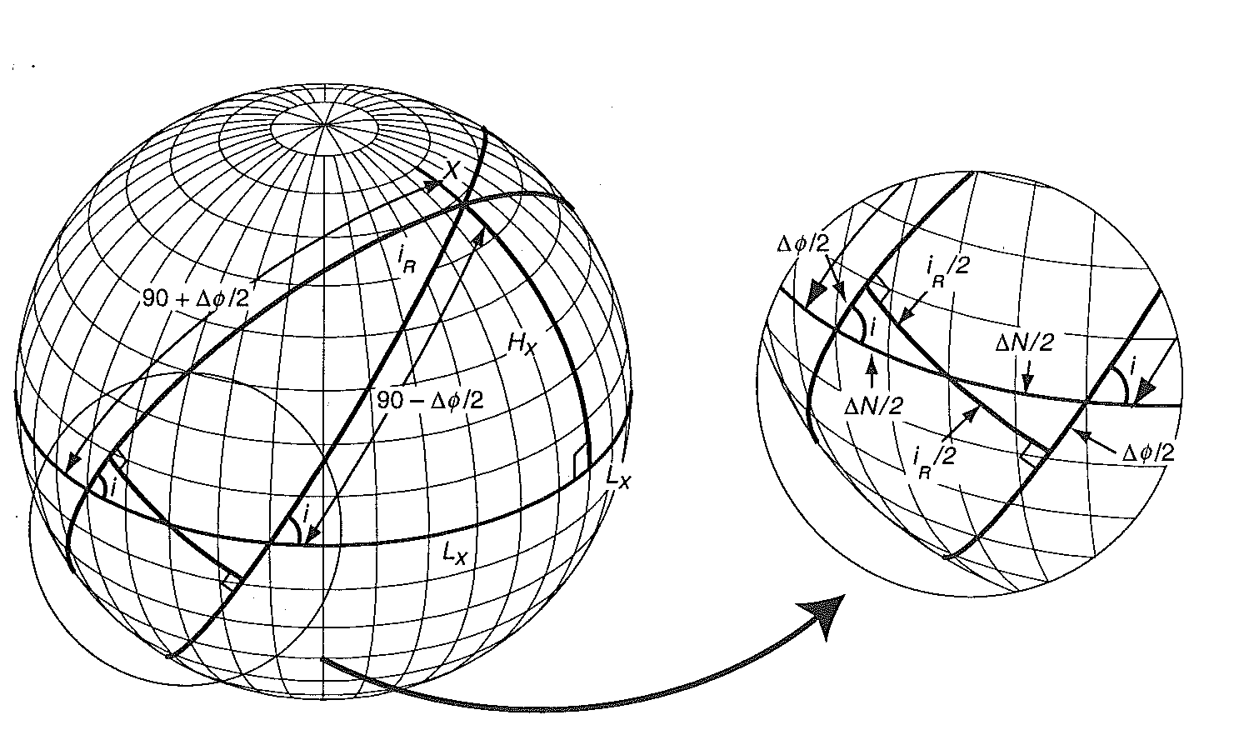
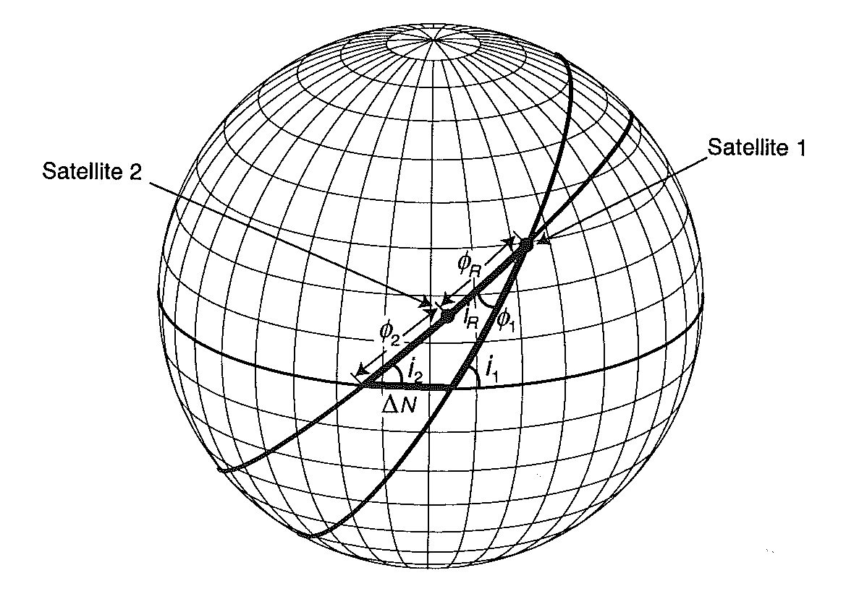
Formation Design
SWARM

Slide 10
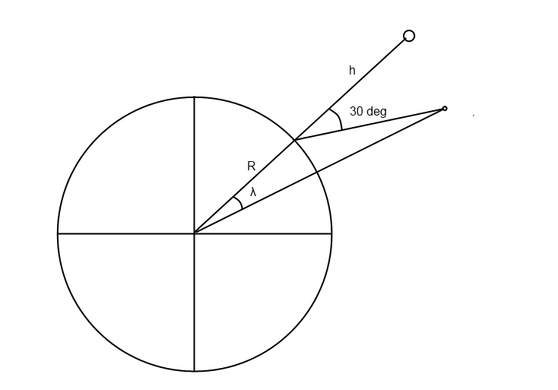
Formation Design
SWARM
λ = 2.18°
iR = 2.18°

Slide 11
Formation Design
Stationkeeping
Keeping the general constellation to insure better measurement data.
What affects it?
Perturbations
Differences in initial conditions

Slide 12
Formation Design
Stationkeeping
What can be done?
Nothing
Relative Stationkeeping
Absolute Stationkeeping

Slide 13
Formation Design
Collision Avoidance
Why is it important?
Loss of 2 satellites, possibly vital
Increased possibility of collision due to debris spread

Slide 14
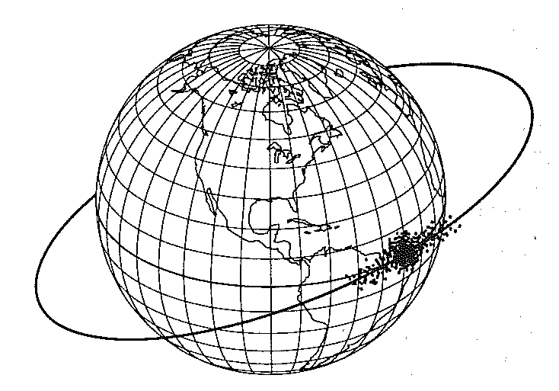
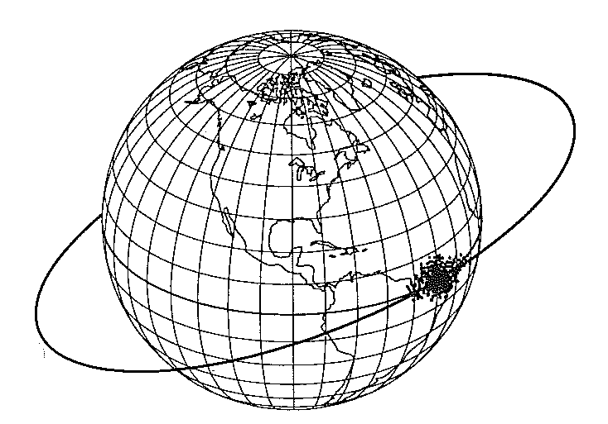
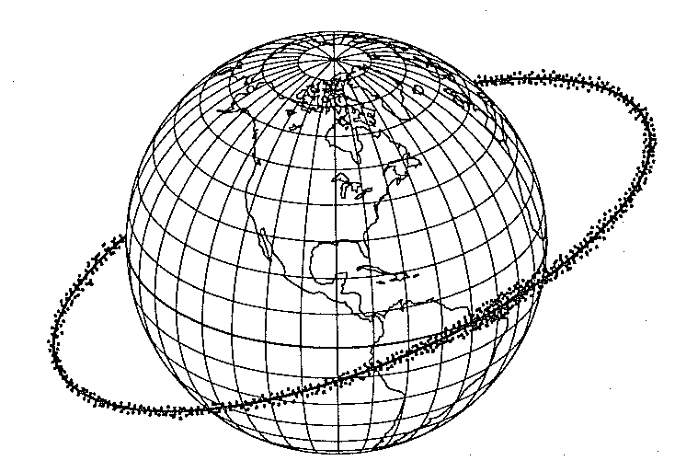
Formation Design
Collision Avoidance

Slide 15
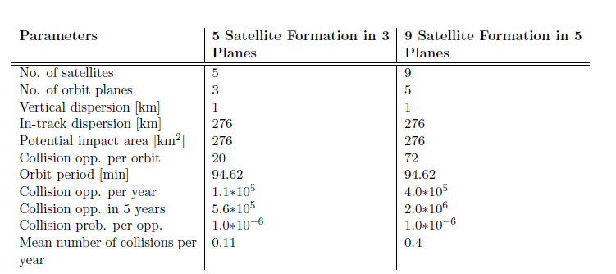
Formation Design
Collision Avoidance

