Slide 1
Optics Payload
Prism Design
  Optical filter
  Prism variables
  Angle calculation
Optical Focus
  Idea
  Results

Slide 2
Prism Design
Optical Filter
Simple
Accuracy in terms of 10nm (minimum 8nm)
Low transmittance for high accuracy (50%-60% for 10nm)

Slide 3
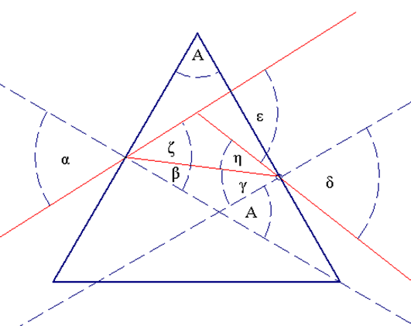
Prism Design
α = Incident angle
A = Apex angle
n = Index of refraction = f(λ)
ε = Deviation angle = f(α, A, λ)
Different λ leads to different ε
Maximize: dε/dλ

Slide 4
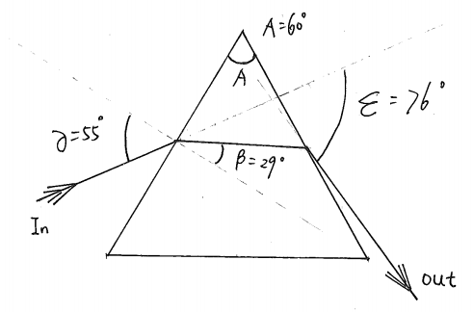
Prism Design
Glass SF11
Largest dε/dλ = 2.14[mrad]
1 mm beam width
467mm distance
Flat mirrors are still needed

Slide 5
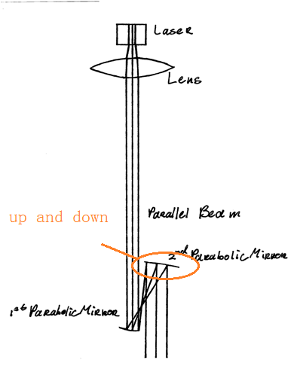
Laser Optical Focus

Slide 6
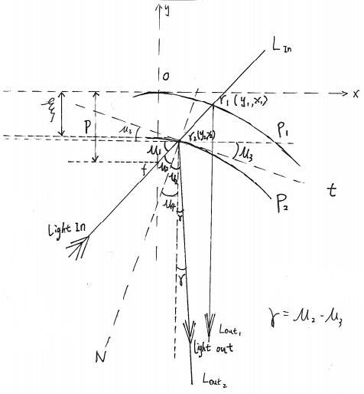
Laser Optical Focus
p = Focus length
γ = Divergence
ξ = Move length
Set p and incoming light leads to 20.4 [m/mm]

