Slide 1
Finding Elevation and Slope
Elevation
Windows
Algorithms
Tuning
Slope
Algorithm
Results

Slide 2
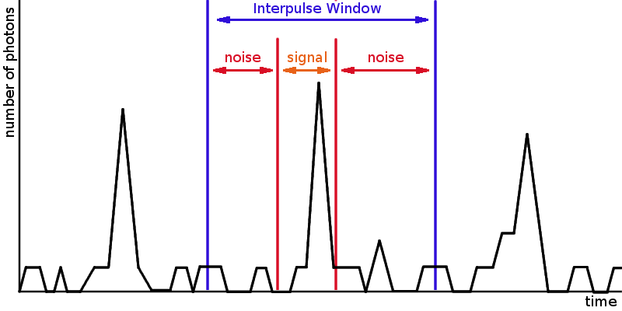
Elevation
Windows

Slide 3
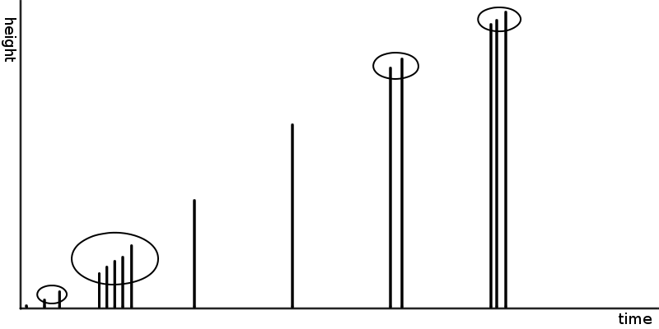
Elevation
Algorithm

Slide 4
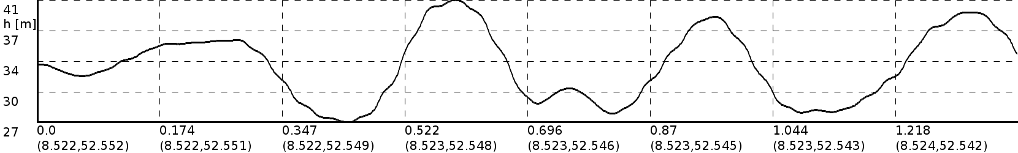
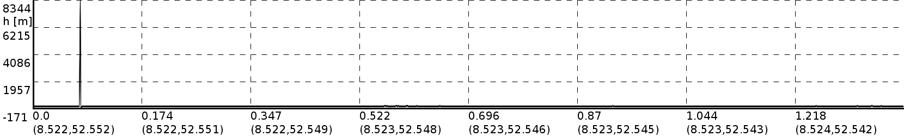
Elevation
Tuning

Slide 5
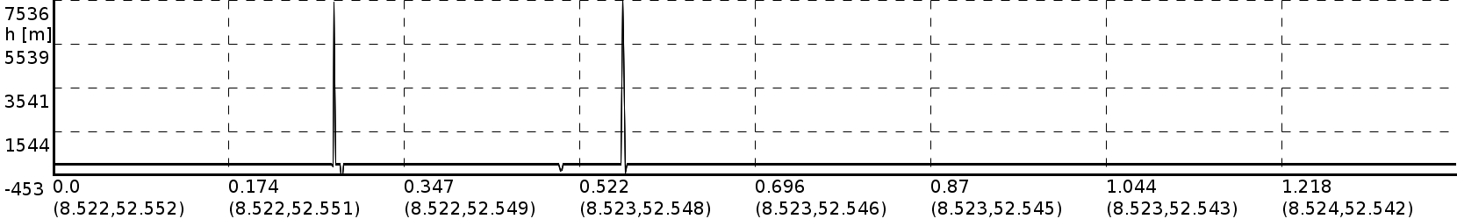
Elevation
Tuning

Slide 6
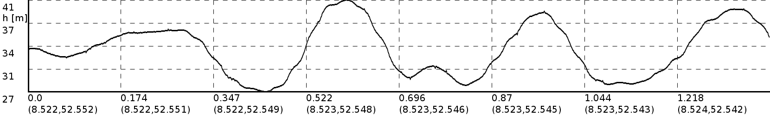
Elevation
Tuning

Slide 7
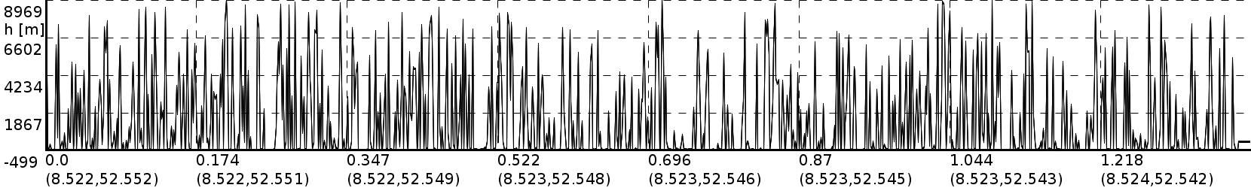
Elevation
Tuning

Slide 8

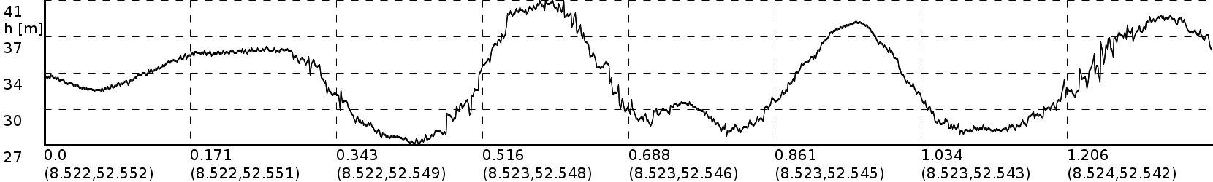
Elevation
Tuning – now with sloping

Slide 9
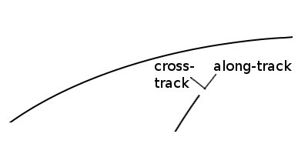
Slope
Algorithm
Along-track: determined by time derivative of elevation.
Total slope: determined from sub-footprint heights.

Slide 10
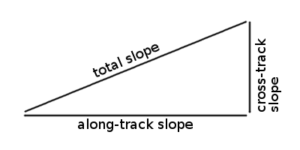
Slope
Algorithm
Cross-track: determined by Pythagoras.

Slide 11
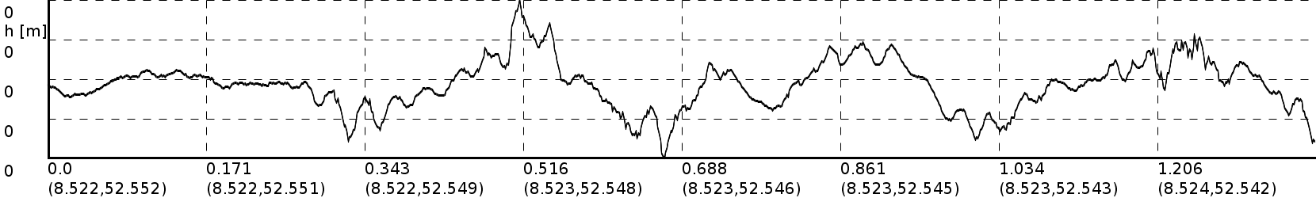
Slope
Result

