Slide 1
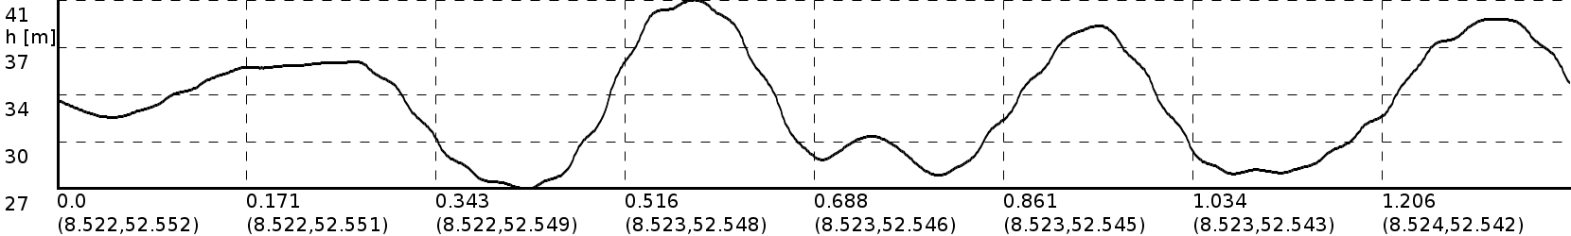
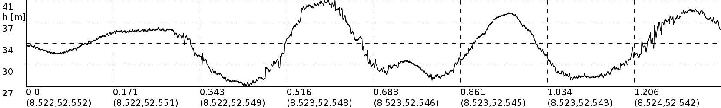
Elevation
Tuning – now with sloping

Slide 2
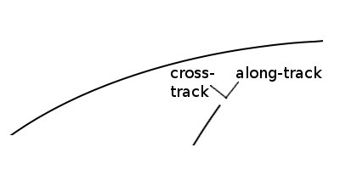
Slope
Algorithm
Along-track slope: determined by time derivative of elevation.
Total slope slope: determined from sub-footprint heights.

Slide 3
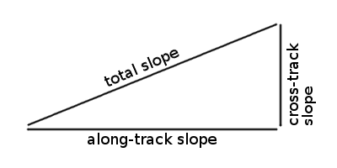
Slope
Algorithm
Cross-track slope: determined by Pythagoras.

Slide 4
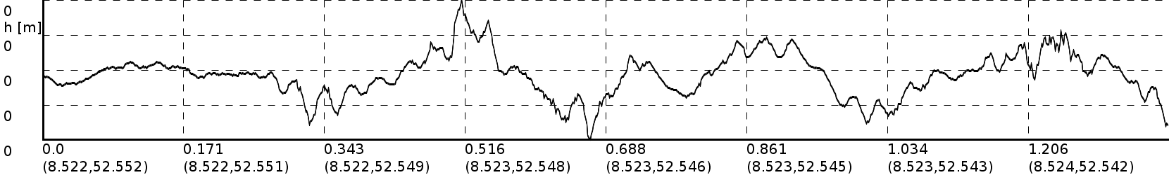
Slope
Result – along-track slope

