Slide 1
Optical Receiving Payload
Single-Photon Detection
-Photonmultiplier tube
-Single Photon Avalanche Diode(SPAD)
Wavelength Estimation

Slide 2
Optical Receiving Payload
Single-Photon Detection
- Convert light(photons) to measurable quanlity(electronical V or I)
Multiple ways
-Photonmultiplier tube
-SPAD
-Quantum dot(under developed)

Slide 3
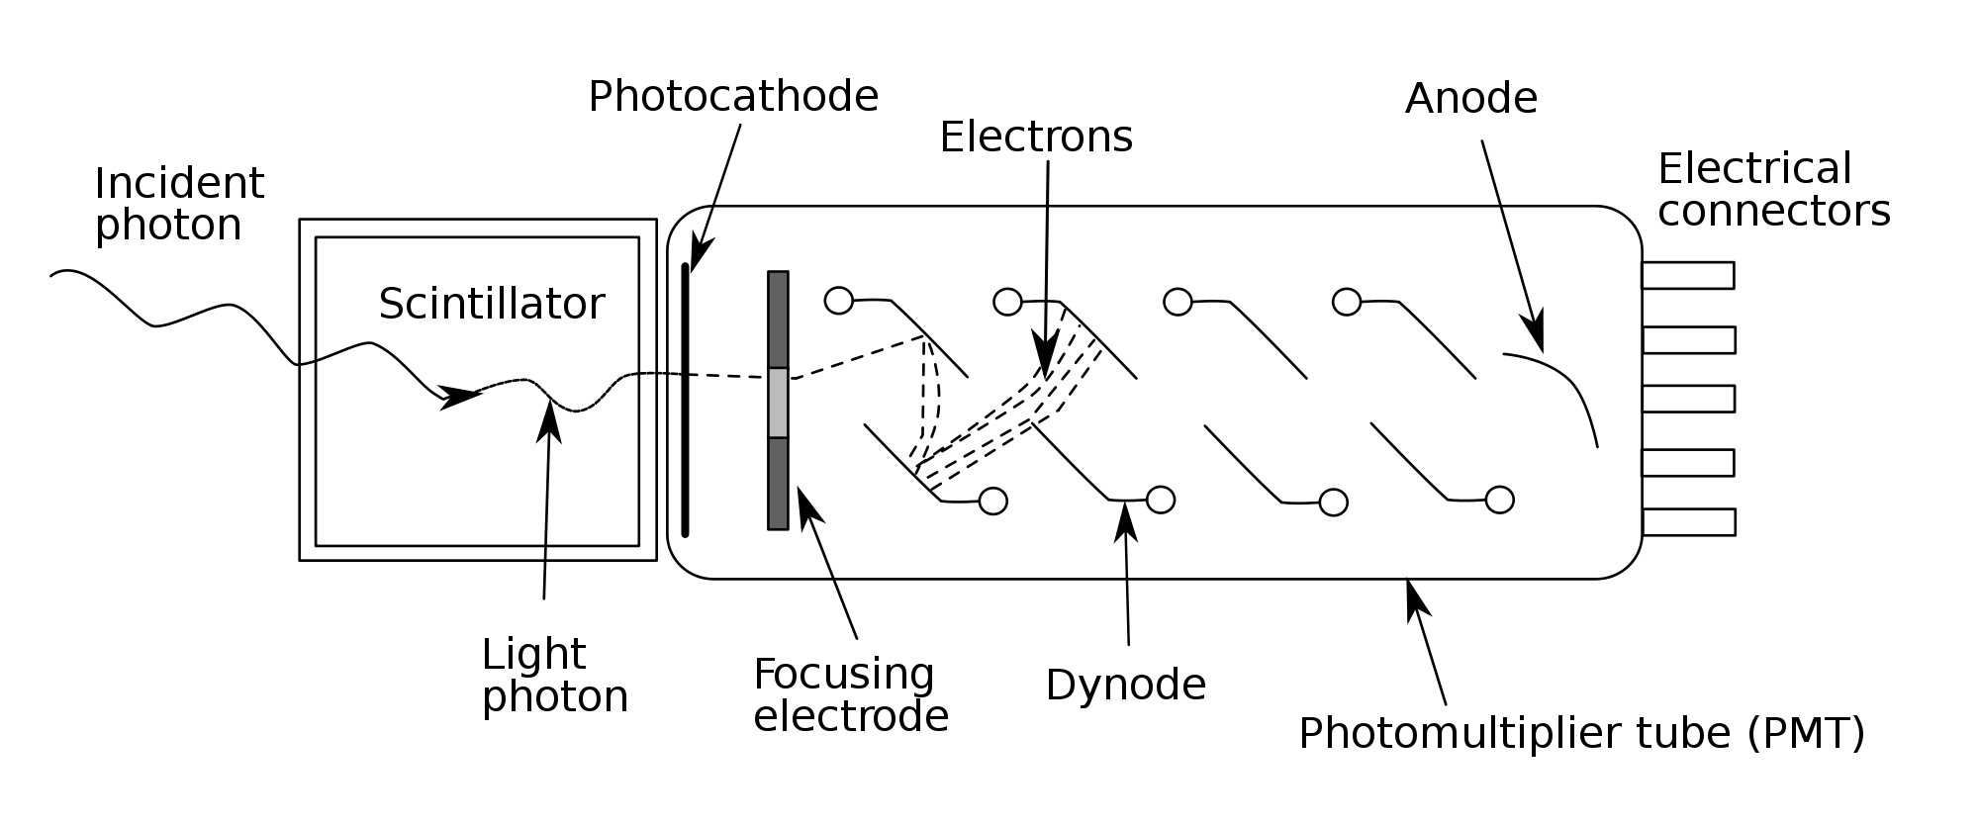
Photonmultuplier tube
Typically 1000 to 2000v used

Slide 4
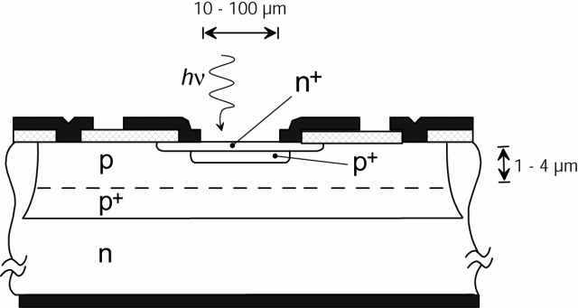
SPAD
Single Photon Avalanche Diode
-Based on p-n junction
-Reversed biased voltage
-Sensing avalanche current
-Small size, less power

Slide 5
Wavelength estimation
General sufficient wavelength range 400nm to 900nm
Atmospheric transmittance Vs. Photon detection efficiency
Ratio R = transmittance^2*efficiency

Slide 6
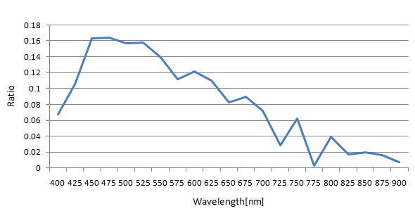
Wavelength estimation

