Slide 1
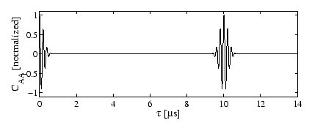
Optical Emitting Device
Performance characteristics set by simulation
Desired characteristics:
  Wavelength: 473 [nm]
  Pulsed wave form: (Repetition rate ~ 5,000 [Hz])
  Pulse energy: ~1 [mJ]
  Pulse length: ~1 [ns]

Slide 2
Laser Cavity
Starting from Nd:YAG 946 [nm] to 473 [nm]
From continuous to pulsed waveform
Initializing Nd:YAG population inversion (diode pumps)
Lifetime considerations

Slide 3
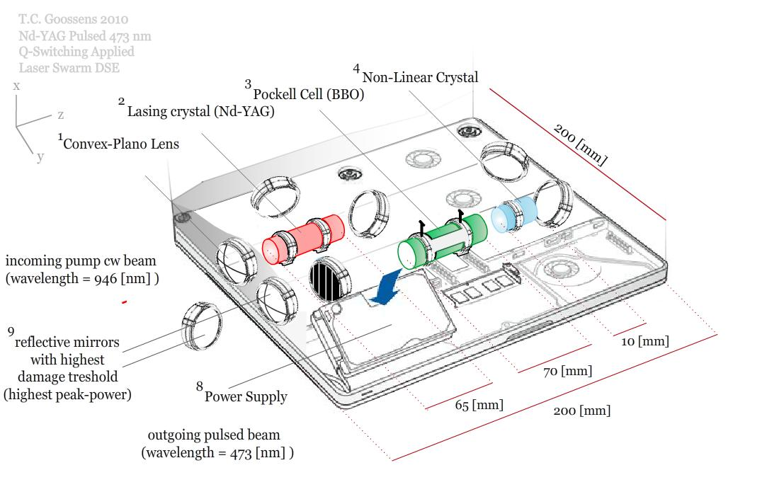
Diode pumped Nd:YAG Configuration
Configuration flown on NASA missions (GLAS, MOLA)
Wall plug efficiency ~ 12 [%] [2004]
~ 20 [%] [2015]
Total Power 40 [W]

Slide 4
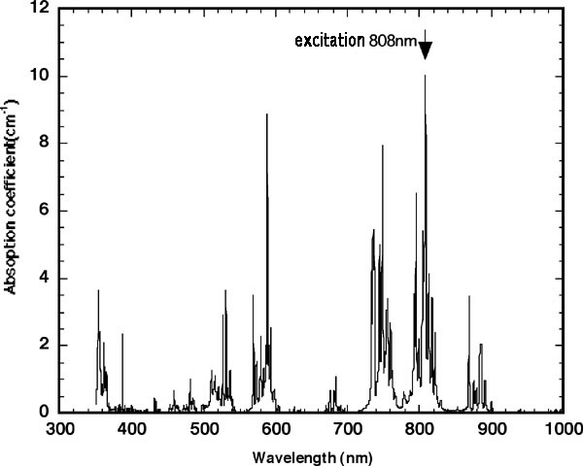
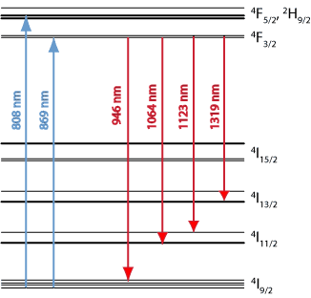
Diode pumped Nd:YAG Configuration
Desired wavelength Nd:YAG 946 [nm]
E = hv (inverse relation with wavelength)
Quantum level
trajectory: F_{5/2} >F_{3/2} > I_{9/2}
Lasing action: F_{3/2} > I_{9/2}
Nd ³⁺ ions exhibit large
absorption at 808 [nm]

Slide 5
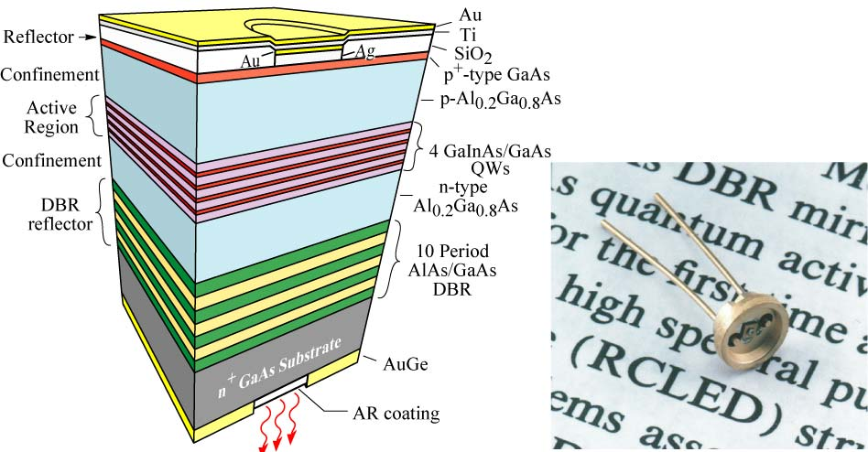
Diode Pumping (AlGaAs)
Used as pump medium (poor beam quality)
Diode lasers use Distributed Bragg Reflectors (DBR)
Power up to ~100 [W]; Wall plug efficiency ~ 51 [%]

Slide 6
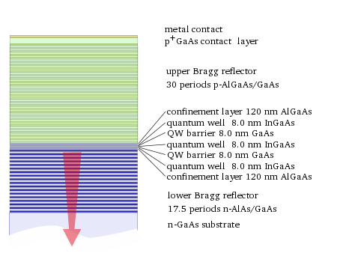
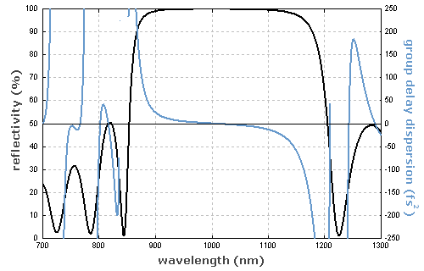
Distributed Bragg Reflectors
Designed For Specific Range of Wavelengths
High Optical Amplification On Small Area

Slide 7
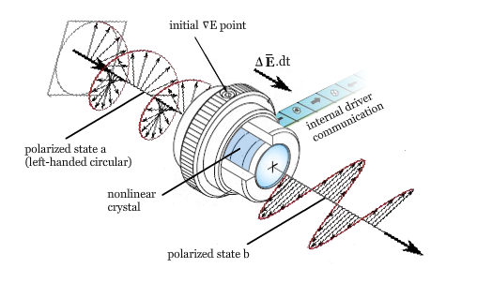
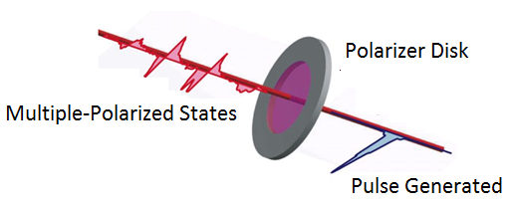
Pulse Generation (Q-Switching)
Pockel Cell + Polarizer Disk
General Pockel Cell Layout Polarizer Disk Acting As Filter To Create Pulses
Generation of pulses creates high peak powers ~ 100,000 [W]. Laser components should be designed to withstand high energetic loads.

Slide 8
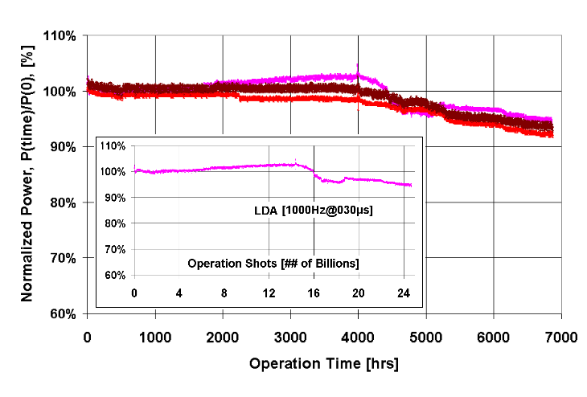
Expected Diode Laser Lifetime
With a repetition rate of 5,000 [Hz] 788.4 billion shots are needed

Slide 9
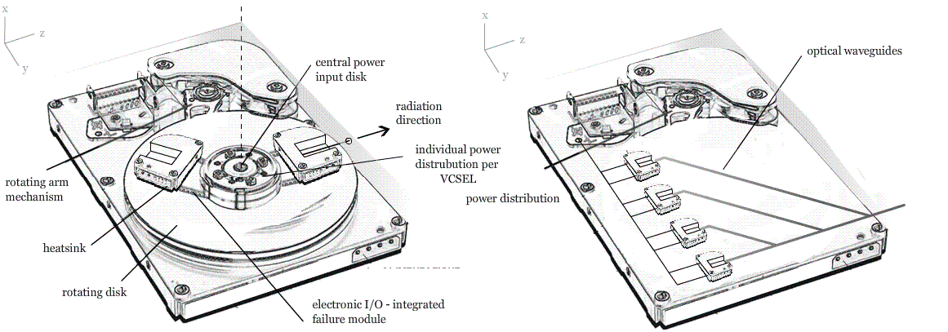
Multiple Laser Diodes : Laser Diode Arrays
5 year in-orbit means ~ 800,000,000,000 shots
1 laser diode array ~ 30,000,000,000 shots
Number of laser diode arrays on matrix = 800/30 ≈ 27

Slide 10
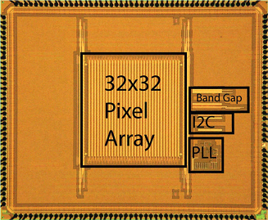
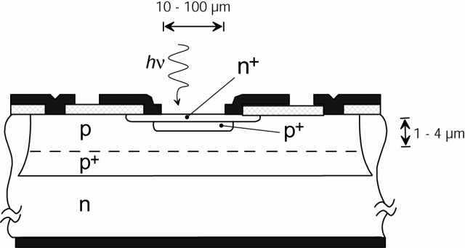
Single Photon Avalanche Diodes
Space-graded reversed biased PN-junction
Applied voltage (Va) above breakdown voltage (Vb)
Single photons create detectable current due to avalanche

Slide 11
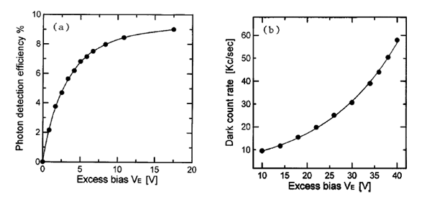
Single Photon Avalanche Diodes
Excess electrical field Ve determines characteristics
Ve = (Va – Vb)
Increase in temperature causes increase in dark count rate

