Slide 1
Laser Optics
To get the desired footprint.
Three options:
  No optics
  Two lenses
  Mirrors

Slide 2
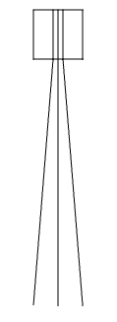
Laser Optics – No Optics
Advantages:
  Really simple
  No optics to get out of focus
  Dirt-cheap
Disadvantages:
  Footprint directly depends on:
    Laser beam divergence
    Satellite height
  These two dependencies severely limit design options
  Characteristics might not be optimal

Slide 3
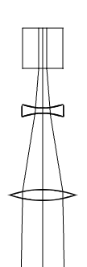
Laser Optics – Two lenses
Advantages:
  Technology is well-understood
Disadvantages:
  Very heavy (even with Fresnel lenses)
  Focal length of > 4 m, so:
  Need mirrors to add light path length
  Still limits the footprint a lot
  Limits the satellite height a little

Slide 4
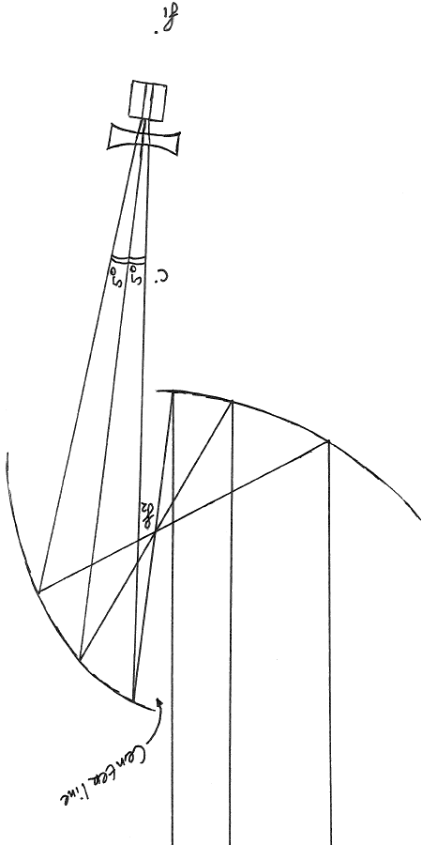
Laser Optics – Mirrors
Advantages:
  Much lighter than lenses
    Herschel: <4 mm thick mirror
  Any footprint, any satellite height
  Potentially tunable in flight
  Small (~20 cm)
  Lense optional for some lasers
Disadvantages:
  Most complicated system
  Assembly must remain rigidly fixed

Slide 5
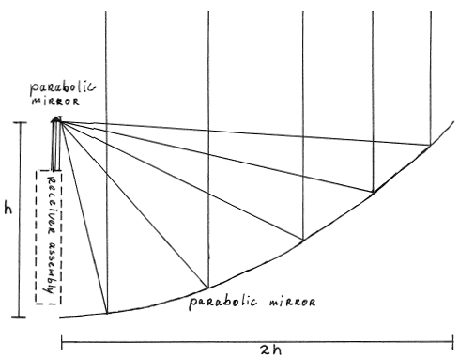
Receiver Optics – Common Part
Basically the reverse of the laser optics.
The secondary mirror is really small (mm range).
The difference is in the receiver assembly.

Slide 6
Receiver Optics – Fill Factor
Fill factor = ~2%.
Then fraction of light detected is:
QDE x FF = 37% x 2% = 0.74%
This is clearly inacceptable. Therefore, we need focusing optics after the main collector.

Slide 7
Receiver Optics – Noise
As the Sun bombards the Earth with photons, we need to filter the light, to prevent an unacceptable SNR.
Optical filters degrade fast and also filter put some of the wanted photons.
Therefore, we will use a prism to filter out unwanted noise.

Slide 8
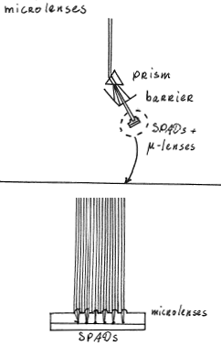
Receiver Optics – Microlenses
Advantages:
  Lightweight
  Conventional
Disadvantages:
  Only improves the fill factor to 10%
  This means: QDE x FF = 37% x 10% = 3.7%
  Needs to be rigidly fixed
  Still inacceptible

Slide 9
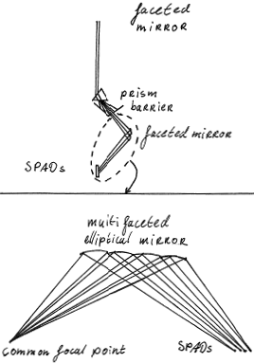
Receiver Optics – Faceted Mirror
Advantages:
  Improves the fill factor to over 80-95%
  This means: QDE x FF = 37% x 80-95% = 30-35%
  Is acceptable
Disadvantages:
  Manufacturing is complicated
  Needs to be rigidly fixed

Slide 10
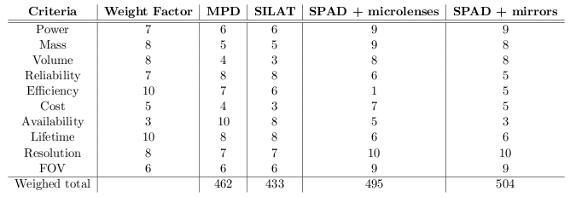
Receiver Trade-off

