Slide 1
BRDF Determination
About BRDF
Estimation
Determination in the Simulator

Slide 2
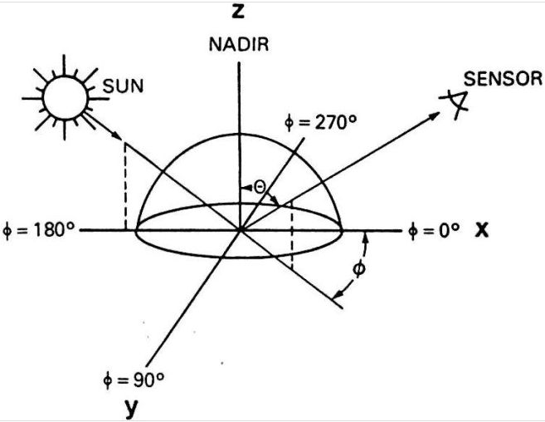
About BRDF
Bidirectional Reflection Distribution Function
Measure of irradiance
of surface in a specific direction

Slide 3
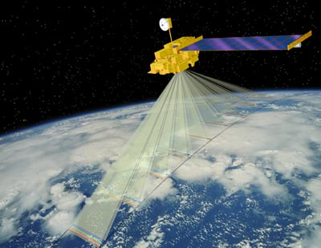
Practicality
Correction for anisotropy
Normalization
Aids in identification of VI

Slide 4
Estimation
Three general categories of BRDF models:
  Physical,
  Empirical,
  Semi-Empirical
Easier to inverse linear models
Semi-Empirical:
Empirical:

Slide 5
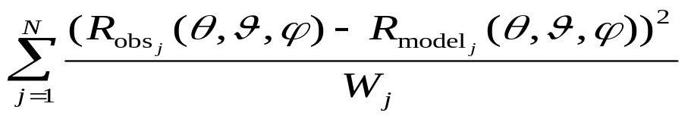
Determination of BRDF
Goal: Find BRDF from limited number of measurements
Photons equal irradiance
Least squares estimation

Slide 6
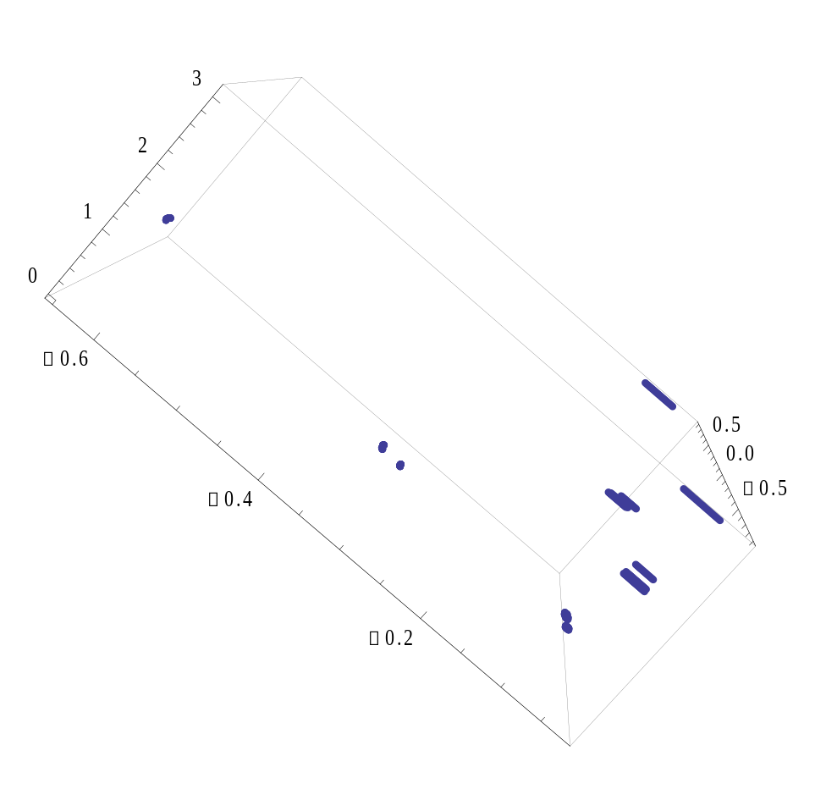
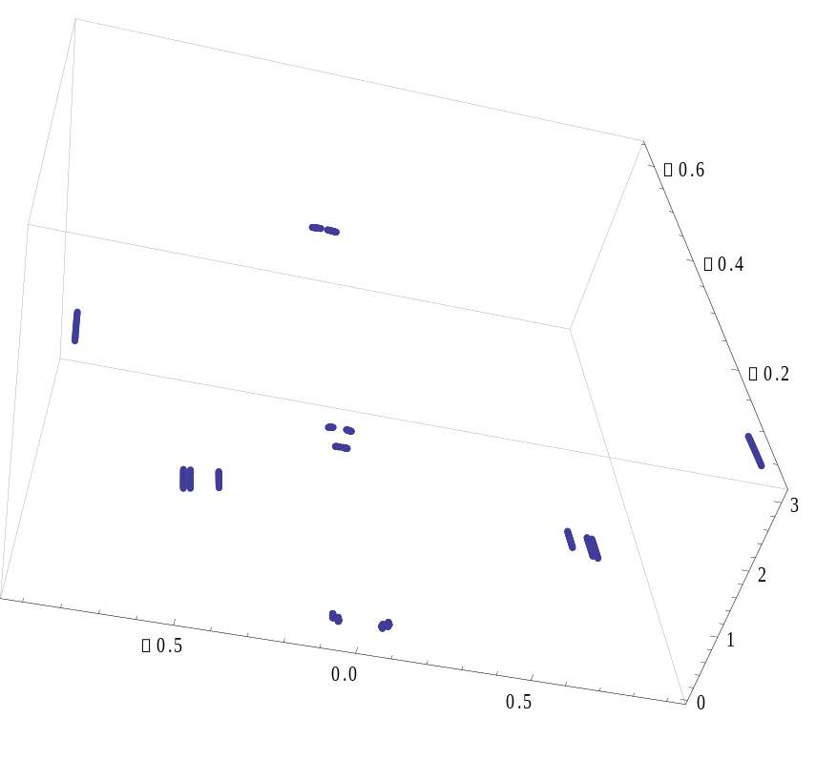
Calculated Points

