Slide 1
BRDF Determination
About BRDF
Estimation
Determination in the Simulator

Slide 2
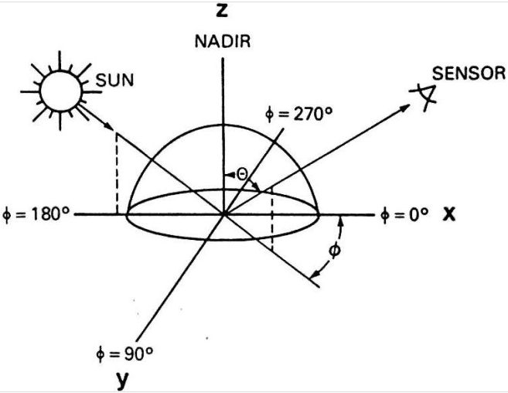
About BRDF
Bidirectional Reflection Distribution Function
Measure of reflectance
of surface

Slide 3
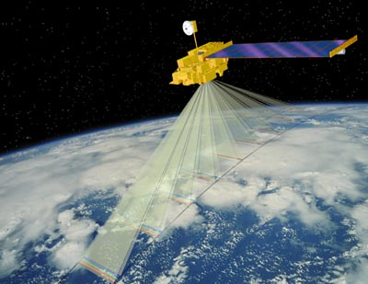
Practicality
Correction for anisotropy
Normalization
Aids in identification of VI

Slide 4
Estimation
Three general categories of BRDF models:
  Physical,
  Empirical,
  Semi-Empirical
Inversability
R = f_{iso} + f_{geo} k_{geo} + f_{vol} k_{vol}

Slide 5
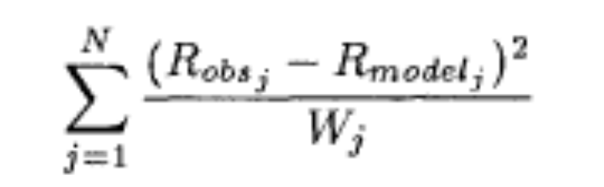
Determination of the BRDF
Find BRDF from minimal amount of points
Direction of observation
Least squares method

Slide 6
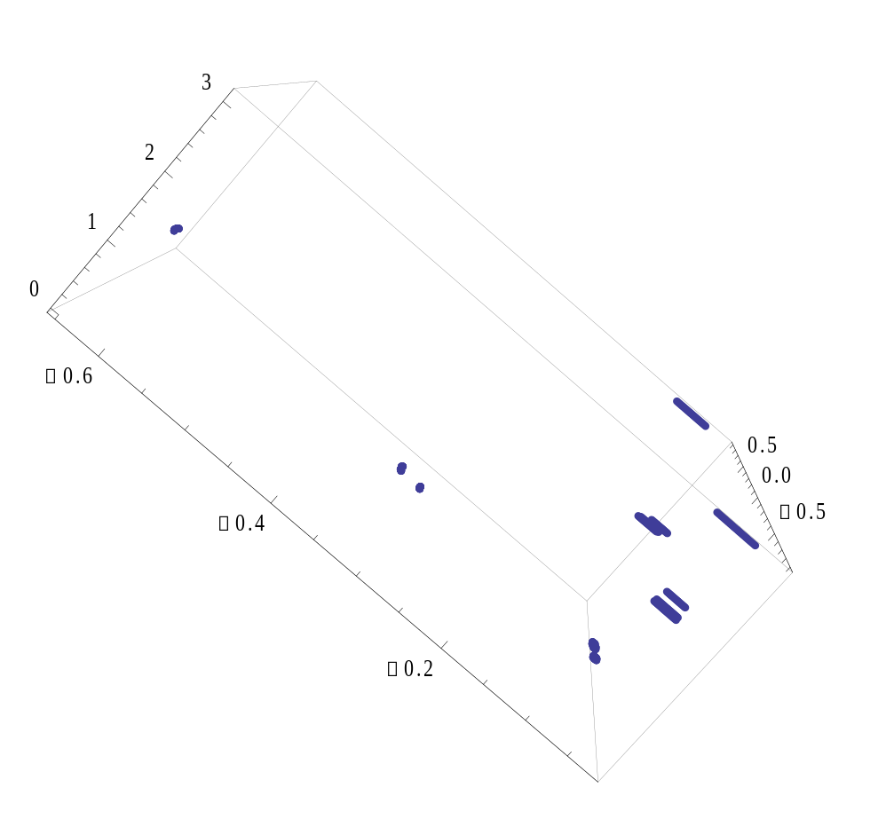
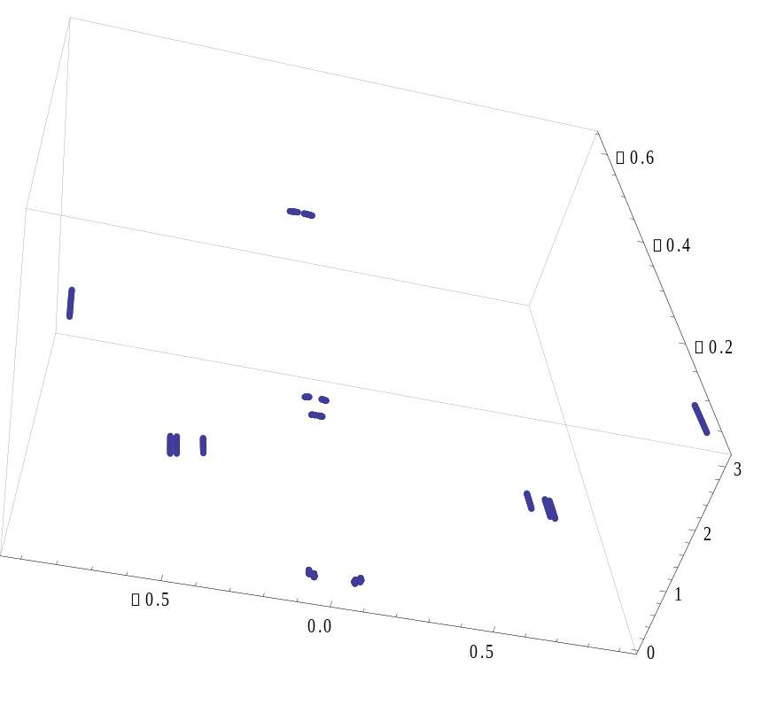
Calculated points

