Slide 1
Navigation
Overview
Possible options
Hardware
Accuracy

Slide 2
Navigation
The options
Utilize the attitude instruments
Hybrid communication/navigation system
GPS receiver on every satellite

Slide 3
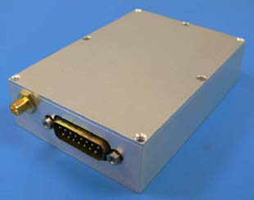
Navigation
Hardware
Weighs less than 200 grams
100 mm x 70 mm x 25 mm
Requires ~ 1 Watt
Cost per receiver $25,000

Slide 4
Navigation
Accuracy
What kind of accuracy can be reached?
~ 10 m readily available
~ 0.9 m after some calculations
~ 1.5 mm with post-processing

