Slide 1
Terrain Reconstruction Algorithm
Define time range
Find the peaks
Calculate altitudes
Find the most common altitude

Slide 2
Defining Range
Known:
  Time pulse sent
  Time SOME pulse received
Window : 1/5000 sec = 200 micro sec
Offset: 500km/c = 1.666 milliseconds travel time
Height range: 60 km

Slide 3
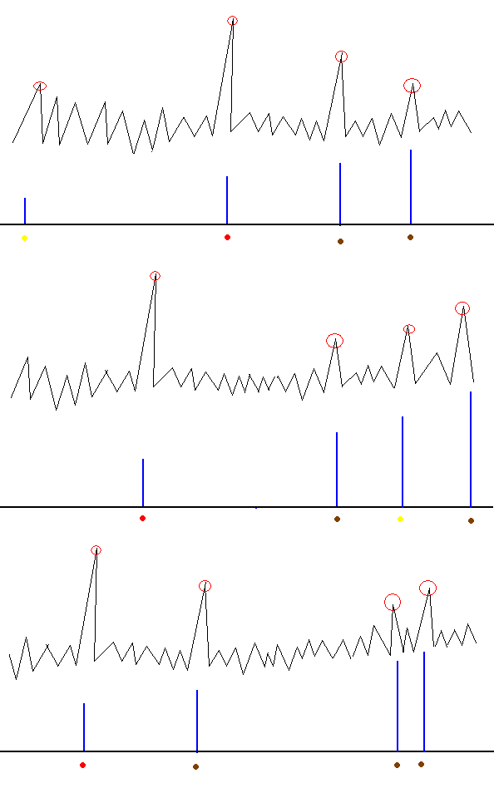
Find the Peaks
The peaks correspond to received pulses
Noise introduced creates “false” peaks
N*mean threshold
Intermediate step for BRDF determination

Slide 4
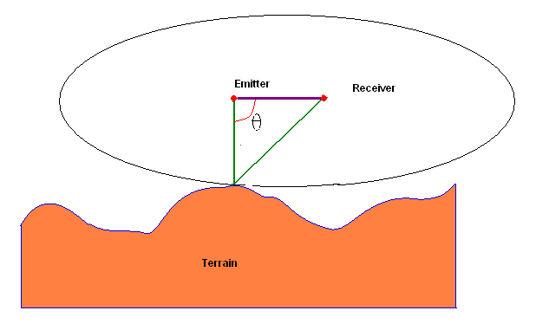
Calc altitudes
Required:
  Position of emitter
  Position of receiver
  Travel time

Slide 5
Finding most common altitude
Filtering noise
Peak = specific altitude
Least standard deviation configuration

