Slide 1
Astrodynamics
Launch Segment
Space Segment
Environment

Slide 2
Launch Segment
Launch vehicle
Payload mass capability
Payload space capability
Orbit insertion accuracy
Safety
Reliability

Slide 3
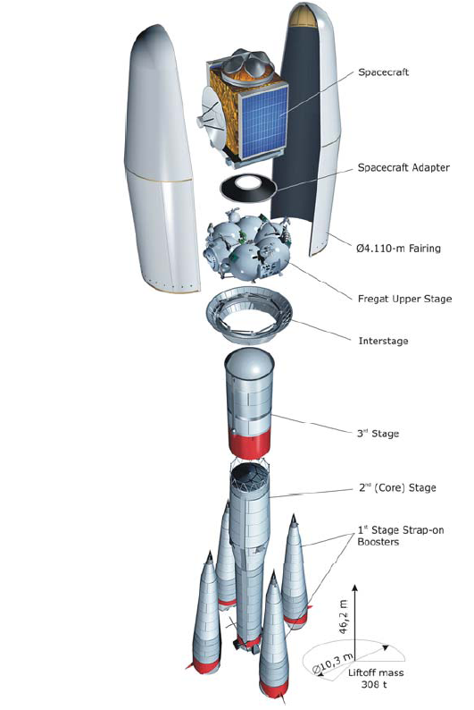
Launch Segment
Launch Segment
Launch vehicle
Launch vehicle
Soyuz ST
4000 kg to LEO
Large fairing to accommodate all satellites
Inclination at 0.03 degree accuracy
Low vibrations
Over 1700 successful launches
$ 13 million launch

Slide 4
Launch Segment
Launch vehicle
Availability of inclination
Compatibility with the LV
Accessibility and cost
Security and political situation

Slide 5
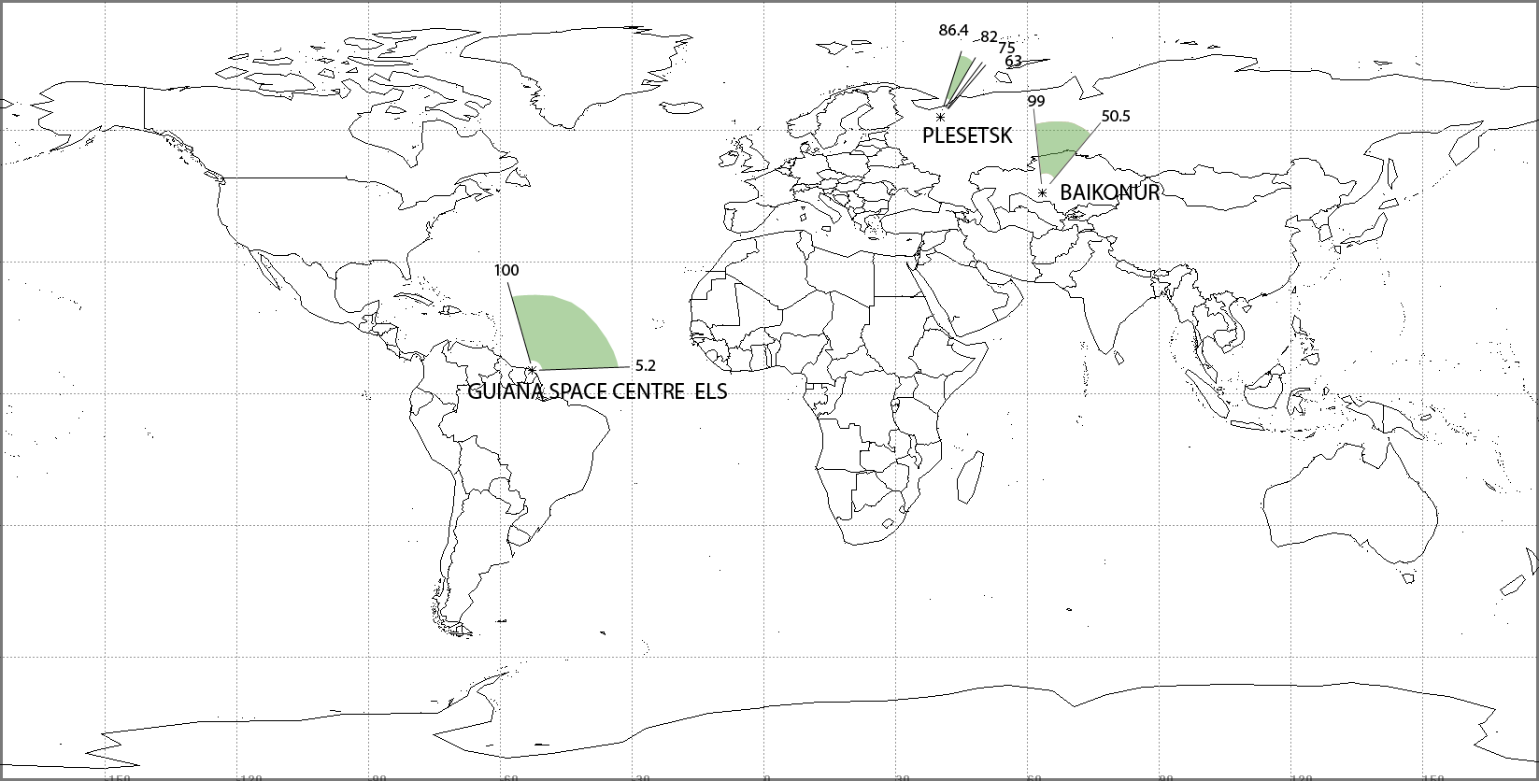
Launch Segment
Launch site

Slide 6
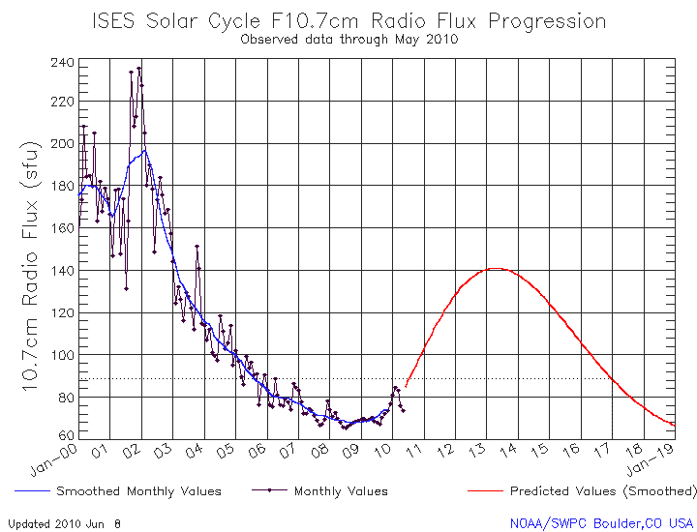
Launch Segment
Launch date

Slide 7
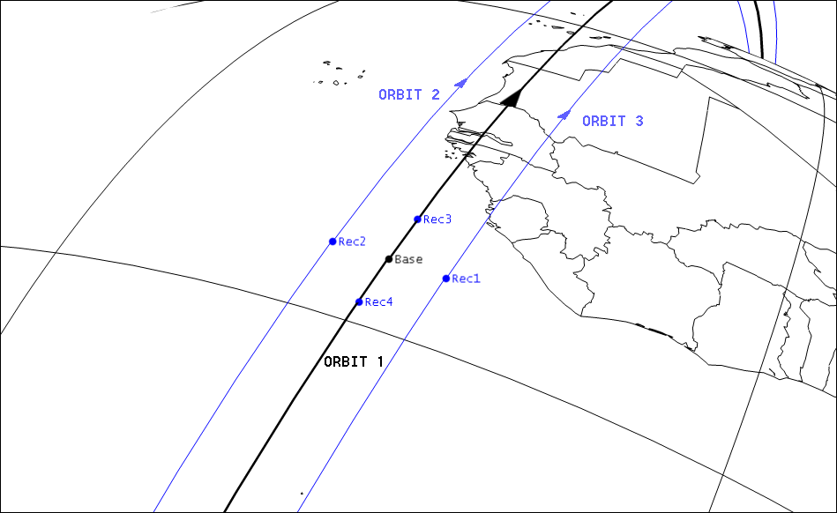
Space Segment
Configuration

Slide 8
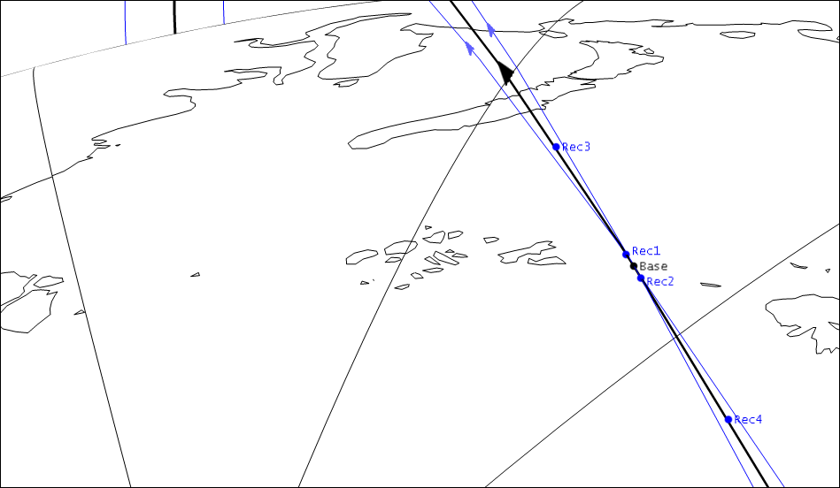
Space Segment
Configuration

Slide 9
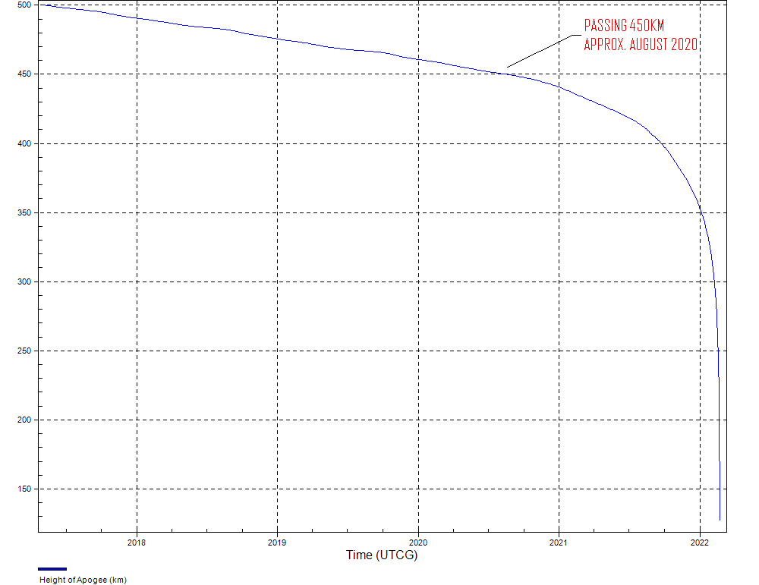
Space Segment
Configuration
C_{d} = 2.22
M_{orbit} = 53.1 kg
A = 1.05 m²
B.C. = 22.87 kg/m²

Slide 10
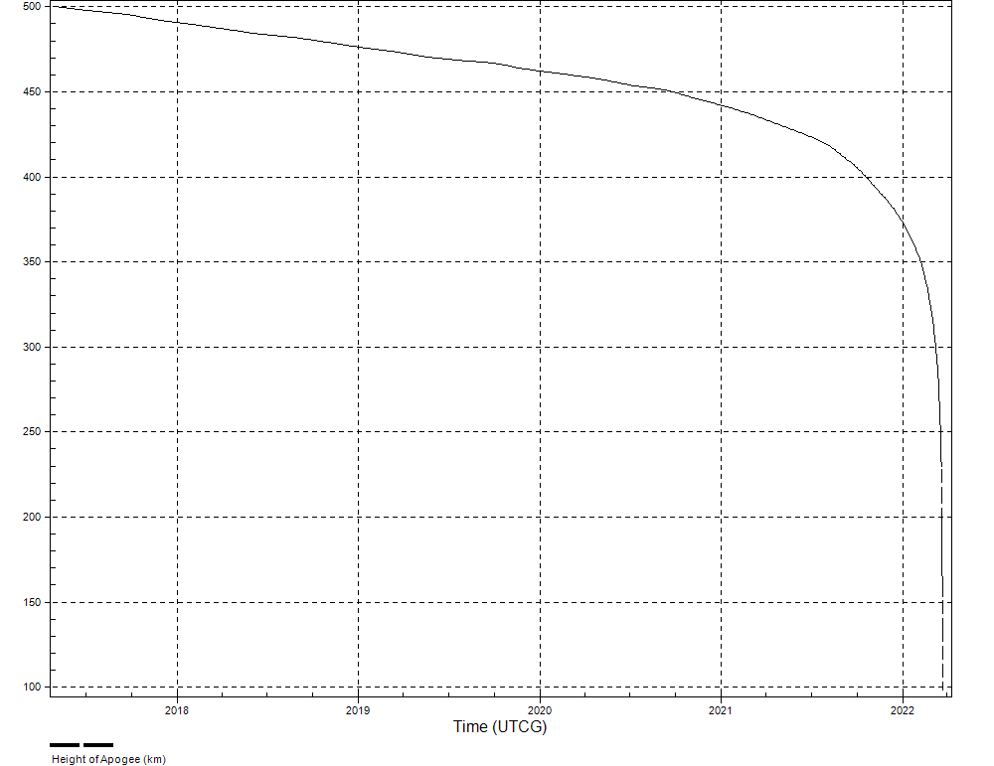
Space Segment
Configuration
C_{d} = 2.22
M_{orbit} = 14.92 kg
A = 0.3 m²
B.C. = 22.4 kg/m²

Slide 11
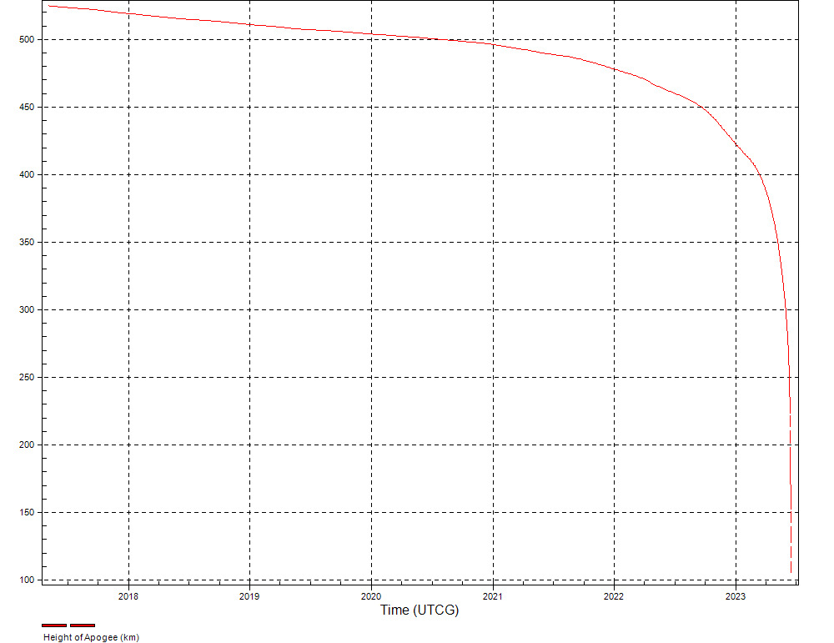
Space Segment
Configuration
C_{d} = 2.22
M_{orbit} = 14.82 kg
A = 0.3 m²
B.C. = 22.3 kg/m²

Slide 12
Space Segment
dV
Emitter - 225.4 m/s
Receiver
Primary: from 133.6 – 165.14 m/s
In Orbit: 128.73 ± 4 m/s
Secondary: from 105.75 – 137.28 m/s
In Orbit: 100.93 ± 4 m/s

Slide 13
Space Segment
Orbits
Primary Orbits:
Altitude:
500 km
Period:
94.61 min
Precession:
-0.6667 deg/day
Secondary Orbits:
Altitude:
525 km
Period:
95.12 min
Precession:
-0.6584 deg/day

Slide 14
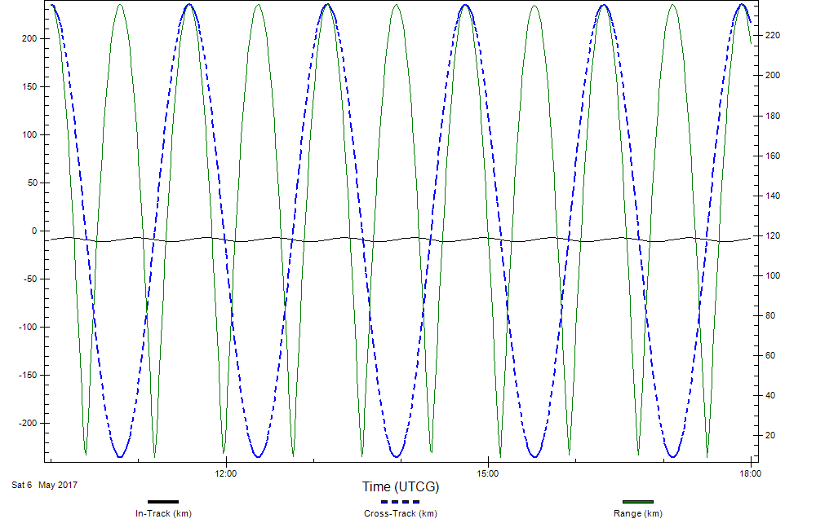
Space Segment
Orbits

Slide 15
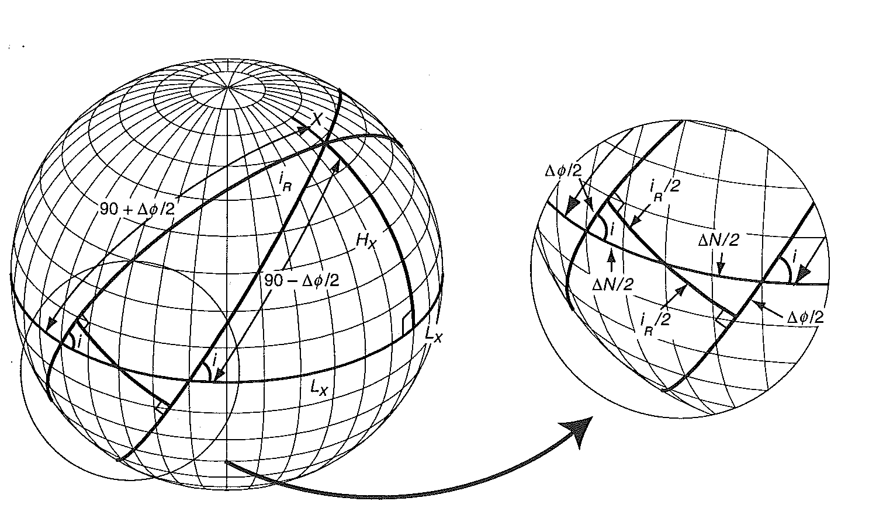
Space Segment
Orbits
L_{X} = 88.9 deg
H_{X} = 85 deg

Slide 16
Space Segment
Stationkeeping
Principle of differential drag.
  (Successfully demonstrated by the ORBCOMM constellation)
Automated systems are necessary.

Slide 17
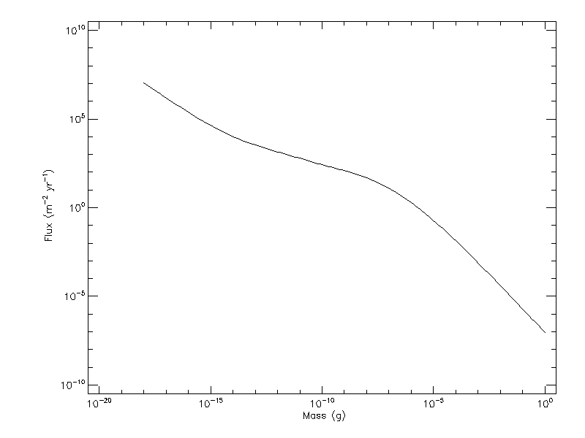
Space Segment
Collision avoidance

Slide 18
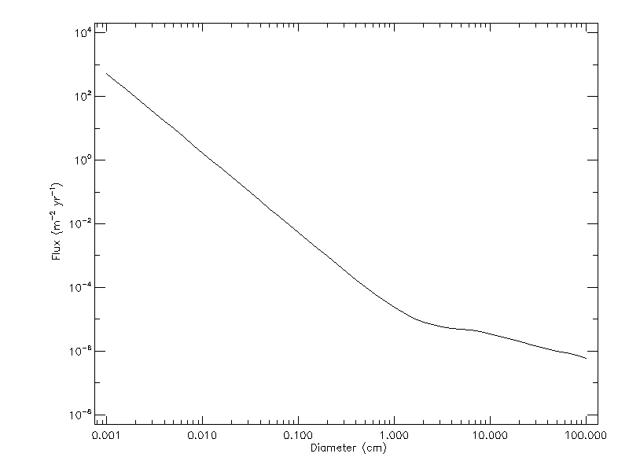
Space Segment
Collision avoidance

Slide 19
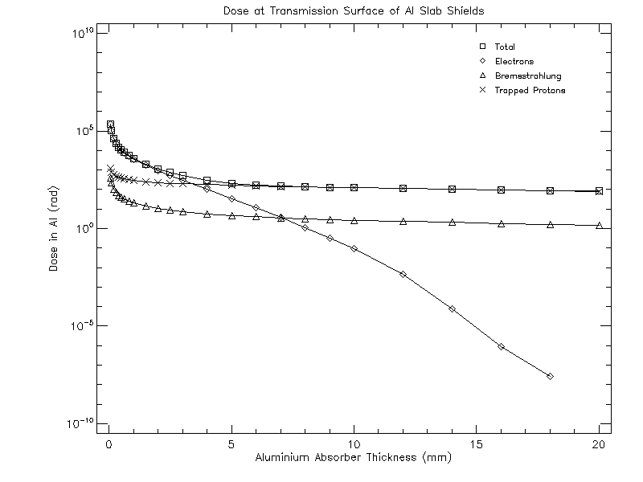
Environment
Radiation

