Slide 1
Communications
Aspects considered
Communications architecture
Frequency bands
  Ground-space link
  Intersatellite link
Antenna configuration
Tracking

Slide 2
Communications
Aspects considered
Communications architecture
Frequency bands
  Ground-space link
  Intersatellite link
Antenna configuration
Tracking

Slide 3
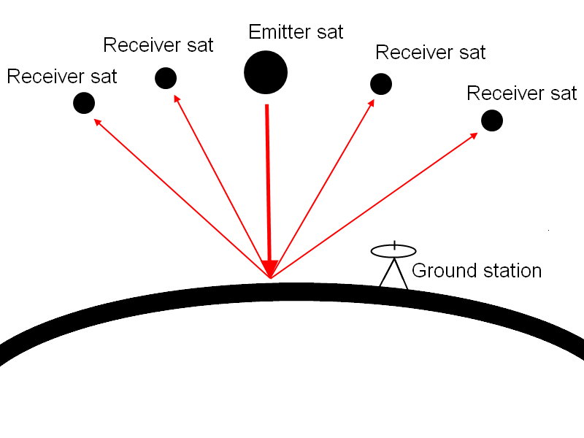
Communications
Communications architecture
Swarm elements:
  Emitter satellite (1)
  Receiver satellites (multiple)
  Ground station
Centralized architecture
  1 ground-space link for emitter sat.
  Intersatellite links between receiver sats & emitter sat
Decentralized architecture
  Ground-space link for emitter sat & each receiver sat
  Intersatellite links between receiver sats & emitter sat
Extremely decentralized architecture
  Ground-space link for emitter sat & each receiver sat
  No intersatellite links
Swarm elements

Slide 4
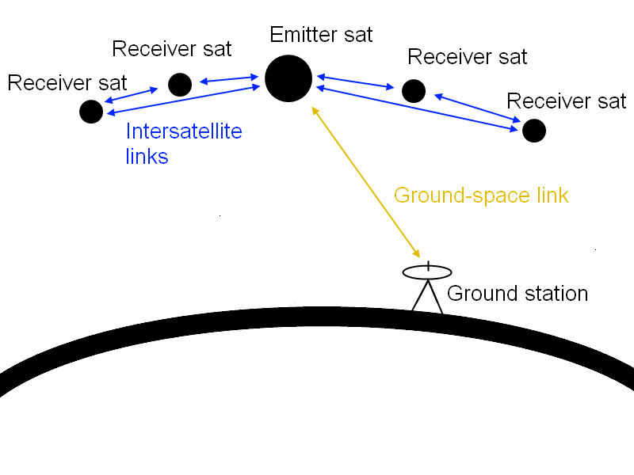
Communications
Communications architecture
Swarm elements:
  Emitter satellite (1)
  Receiver satellites (multiple)
  Ground station
Centralized architecture
  1 ground-space link for emitter sat.
  Intersatellite links between receiver sats & emitter sat
Decentralized architecture
  Ground-space link for emitter sat & each receiver sat
  Intersatellite links between receiver sats & emitter sat
Extremely decentralized architecture
  Ground-space link for emitter sat & each receiver sat
  No intersatellite links
Centralized

Slide 5
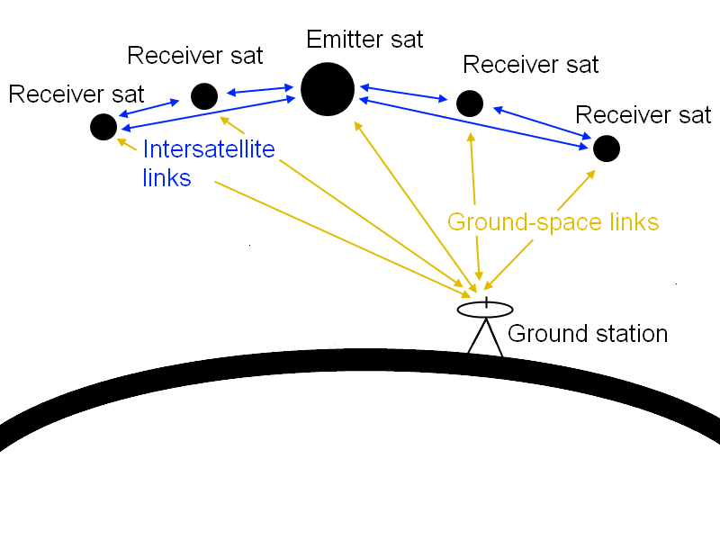
Communications
Communications architecture
Swarm elements:
  Emitter satellite (1)
  Receiver satellites (multiple)
  Ground station
Centralized architecture
  1 ground-space link for emitter sat.
  Intersatellite links between receiver sats & emitter sat
Decentralized architecture
  Ground-space link for emitter sat & each receiver sat
  Intersatellite links between receiver sats & emitter sat
Extremely decentralized architecture
  Ground-space link for emitter sat & each receiver sat
  No intersatellite links
Decentralized

Slide 6
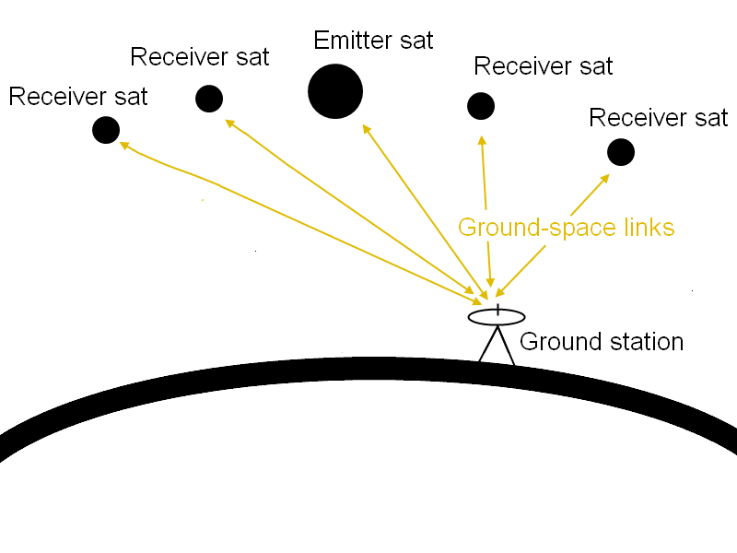
Communications
Communications architecture
Swarm elements:
  Emitter satellite (1)
  Receiver satellites (multiple)
  Ground station
Centralized architecture
  1 ground-space link for emitter sat.
  Intersatellite links between receiver sats & emitter sat
Decentralized architecture
  Ground-space link for emitter sat & each receiver sat
  Intersatellite links between receiver sats & emitter sat
Extremely decentralized architecture
  Ground-space link for emitter sat & each receiver sat
  No intersatellite links
Extremely decentralized

Slide 7
Communications
Communications architecture
Centralized architecture:
Advantages
  Low mass, power consumption & volume receiver sat
  Scientific data compressed before transmitting
  to the ground station
Disadvantages
  Less robust
  High mass, power consumption & volume emitter sat
  High data rate ground-space link
Centralized

Slide 8
Communications
Communications architecture
Decentralized architecture:
Advantages
  Low data rate ground space link
  More robust
Disadvantages
  Higher mass, power consumption & volume receiver sat
Decentralized

Slide 9
Communications
Communications architecture
Extremely decentralized architecture:
Advantages
  Low data rate ground space link
  No frequency allocation required for
  intersatellite links
Disadvantages
  Higher mass, power consumption & volume receiver sat
  Desynchronization
Extremely decentralized

Slide 10
Communications
Communications architecture
Winning architecture:
Centralized architecture
  No danger for synchronization
  Lower total mass
  Maximum use of allocated frequency
Centralized

Slide 11
Communications
Aspects considered
Communications architecture
Frequency bands
  Ground-space link
  Intersatellite link
Antenna configuration
Tracking

Slide 12
Communications
Frequency allocation
Ground space link:
Possible frequency bands
  C-band
  S-band
  X-band
  Ku-band
  Ka-band
  SHF/EHF-band

Slide 13
Communications
Frequency allocation
Ground space link:
Possible frequency bands
  C-band
  S-band
  X-band
    High data rate possible
    Most common for large Earth observation sats
  Ku-band
  Ka-band
  SHF/EHF-band

Slide 14
Communications
Frequency allocation
Ground space link:
Possible frequency bands
  C-band
  S-band
    Low data rate
    Good for house keeping data
  X-band
  Ku-band
  Ka-band
  SHF/EHF-band

Slide 15
Communications
Frequency allocation
Intersatellite link:
Possible frequency bands
  C-band
  S-band
  X-band
  Ku-band
  Ka-band
  SHF/EHF-band

Slide 16
Communications
Frequency allocation
Intersatellite link:
Possible frequency bands
  C-band
  S-band
  X-band
  Ku-band
    Lots of existing systems for reference during design
  Ka-band
  SHF/EHF-band
  V-band

Slide 17
Communications
Aspects considered
Communications architecture
Frequency bands
  Ground-space link
  Intersatellite link
Antenna configuration
Tracking

Slide 18
Communications
Antenna configuration
Ground space link:
Possible high gain antennas
  Parabolic reflector
    High volume
    Low mass
  Phased array
    Low volume
    High mass

Slide 19
Communications
Antenna configuration
Ground space link:
Possible high gain antennas
  Parabolic reflector
    High volume
    Low mass
  Phased array
    Low volume
    High mass

Slide 20
Communications
Antenna configuration
Intersatellite links
  Horn antenna
    Low gain
    >4 Ghz
  Helix antenna
    Low gain
    <2 Ghz

Slide 21
Communications
Antenna configuration
Intersatellite links
  Horn antenna
    Low gain
    >4 Ghz
  Helix antenna
    Low gain
    <2 Ghz

Slide 22
Communications
Tracking method
GPS
  High precision
  Provides time signal
TDRS
  High accuracy
  Requires TDRS tracking antenna
Satellite crosslinks
  Reuses communication hardware
  Only gives relative position
Ground tracking
  Well established
  Operations intensive

Slide 23
Communications
Aspects considered
Communications architecture
Frequency bands
  Ground-space link
  Intersatellite link
Antenna configuration
Tracking

Slide 24
Communications
Tracking method
GPS
  High precision
  Provides time signal
TDRS
  High accuracy
  Requires TDRS tracking antenna
Satellite crosslinks
  Reuses communication hardware
  Only gives relative position
Ground tracking
  Well established
  Operations intensive

Slide 25
Communications
Summary
Communications architecture
  Centralized
Frequency bands
  X-band and S-band for ground-space link
  Ku-band for intersatellite link
Antenna
  Phased array for ground-space link
  Horn antenna for intersatellite link
Tracking
  Combination GPS and crosslink method

