Slide 1
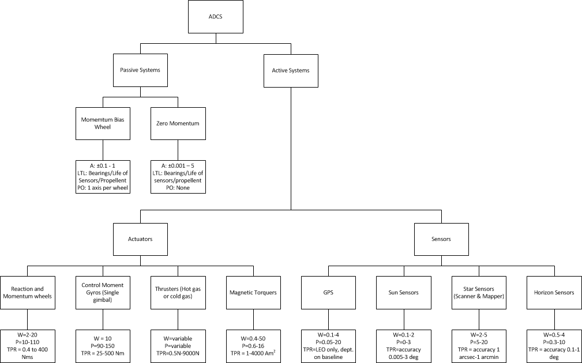
Pruned Design Option Tree ADCS

Slide 2
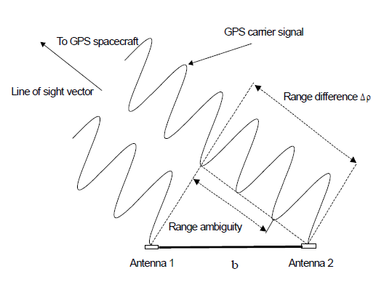
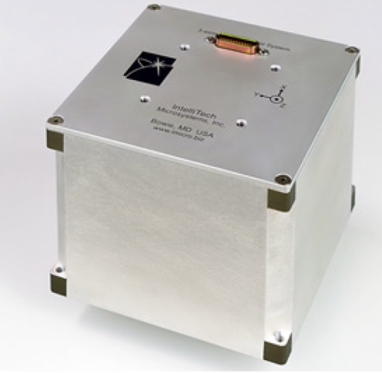
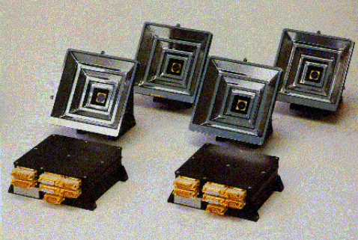
Selected ADS concepts
Maryland Aerospace Inc. IMI-100 ADACS
Sun Sensors and a Star Tracker
GPS based attitude control
Sources: http://www.cubesatkit.com/docs/datasheet/DS CSK ADACS 634-00412-A.pdf
Dr. Q.P. Chu. Spacecraft attitude dynamics and control, course notes

Slide 3
Trade-off ADS
Criteria | Weight Factor | Concept 1 | Concept 2 | Concept 3
Accuracy | 9 | 4 | 8 | 4
Size | 7 | 2 | 6 | 4
Power | 7 | 6 | 5 | 7
Price | 3 | 3 | 5 | 4
Development | 5 | 8 | 4 | 5
Weighted total |  | 141 | 184 | 150

Slide 4
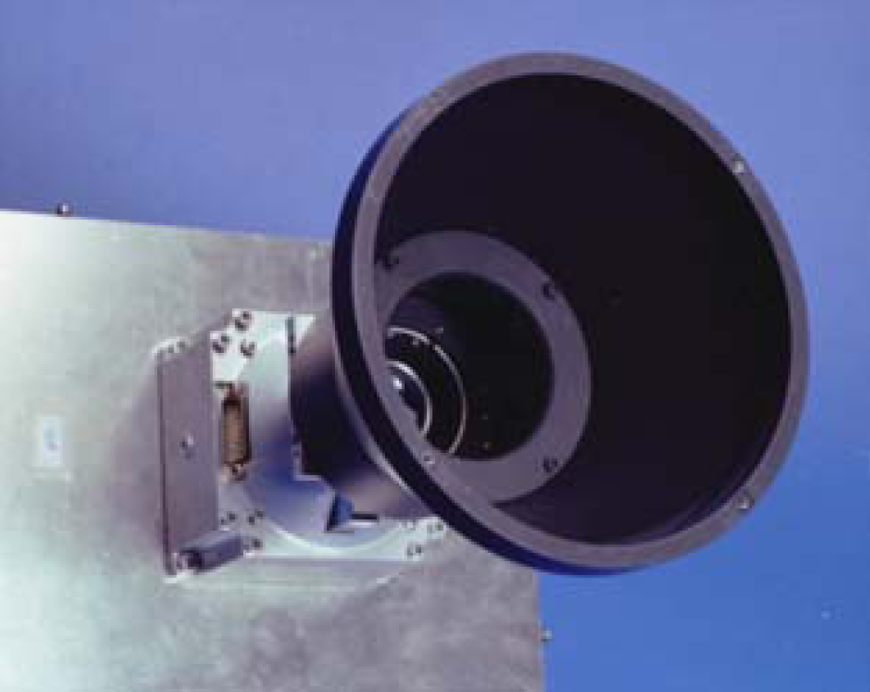
Winner ADS
Sources: Dr. Q.P. Chu. Spacecraft attitude dynamics and control, course notes

Slide 5
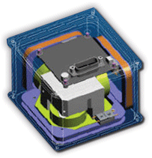

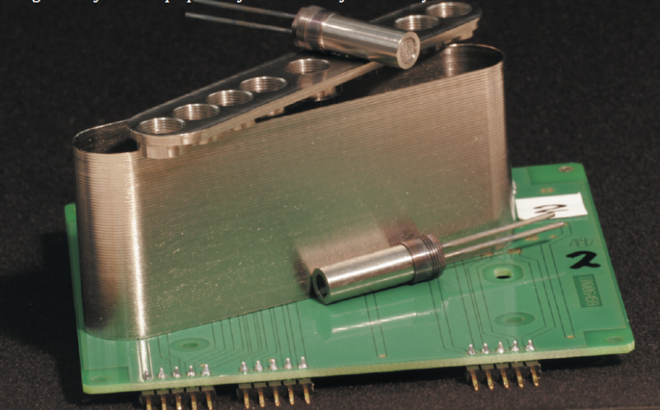
Selected ACS concepts
Thrusters
Reaction wheels and magnetic torquers
Maryland Aerospace Inc. IMI-100 ADACS
Sources: http://www.tno.nl
http://www.cubesatshop.com
http://www.cubesatkit.com/docs/datasheet/DS_CSK_ADACS_634-00412-A.pdf

Slide 6
Trade-off ADS
Criteria | Weight Factor | Concept 1 | Concept 2 | Concept 3
Rate | 5 | 8 | 6 | 6
Accuracy | 8 | 4 | 8 | 7
Size | 7 | 2 | 6 | 5
Power | 7 | 3 | 6 | 6
Price | 3 | 2 | 8 | 7
Development | 5 | 4 | 6 | 8
Weighted total |  | 133 | 232 | 224

Slide 7
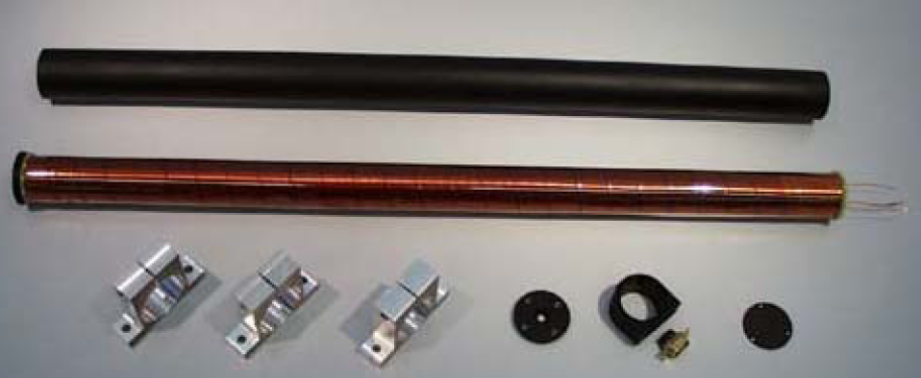
Winner ADS
Sources: Dr. Q.P. Chu. Spacecraft attitude dynamics and control, course notes

Slide 8
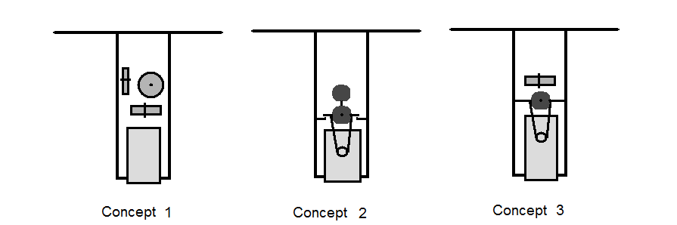
Selected Pointing Mechanism Concepts
Using the ADCS
Using two stepper motors
Using one axis reaction wheel and one stepper motor

Slide 9
Trade-off pointing mechanism
Criteria | Weight Factor | Concept 1 | Concept 2 | Concept 3
Pointing accuracy | 10 | 2 | 8 | 6
Pointing rate | 10 | 2 | 8 | 6
Added weight | 4 | 8 | 2 | 5
Power | 4 | 7 | 2 | 4
Influence | 6 | 2 | 3 | 7
Complexity | 6 | 8 | 2 | 6
Weighted total |  | 208 | 221 | 228

Slide 10
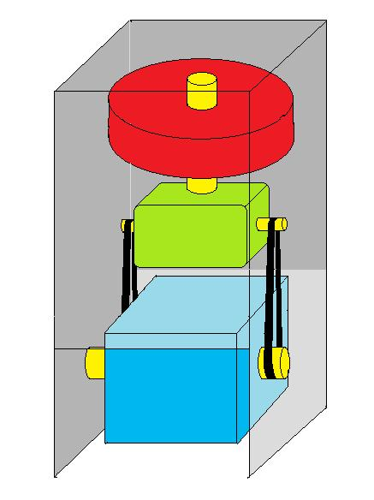
Winner Pointing Mechanism

