Slide 1
National Institute of Technology Patna (2018-2022)
A Project Report on
Selective speech encryption using Stream Cipher
By
Keshav Kumar Singh (1806113)
Ankit Kumar Choudhary (1806115)
Siddharth (1806118)
Under the guidance of Dr. Bhaskar Mandal

Slide 2
OUTLINE
Introduction
Background
Motivation
Objectives
Application and Consequences
Methodology
Result and analysis
Conclusion and future work
References

Slide 3
Introduction
This aim of this project is based on the transmission of the encrypted speech through the insecure channel.
The proposed technique is based on stream encryption where the original speech is pre-processed in order to select the relevant data for encryption.
In this work the problem of the secret key is approached by using pseudo-random sequences generated in the deterministic way from a short secret key which can be exchanged more easily between sender and receiver.
The pseudo-random generator consists of one 80-bit linear Feedback Shift Register (LFSR), one 80-bit Non-Linear Feedback Shift Register (NLFSR) and a nonlinear Boolean function g.
After the encryption, the encrypted speech could travelled through the different channel, internet or storage and reach to the its destination.
Decryption and denormalization take place at the receiver end.

Slide 4
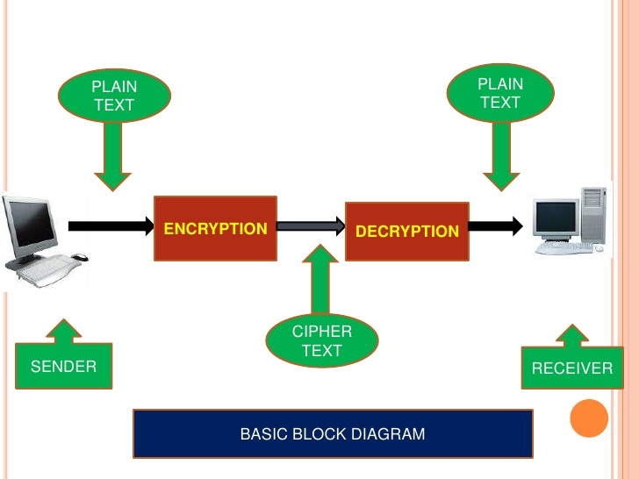
Process of Encryption and Decryption

Slide 5
Motivation
Nowadays, Data is the fuel for IT industry. That makes data a priceless and valuable pieces of information.
Audio plays an important role in our medium of communication and rising cyber attack makes encryption of audio file more necessary than before.
There are a lots of different type of encryption technique in the market, but stream cipher is one of the best and effective encryption technique.
There is lots of insecure channels which is not safe because of the presence of intruders, for these channels some strong encryption should be there.

Slide 6
OBJECTIVES
The objectives of this project is to encrypt and decrypt the audio file which should possess the following characteristics.
Encryption should be only on voiced part.
Computational power should be minimized.
Encryption should be done properly.
Encryption should be as safe as possible.

Slide 7
Applications and consequences of your work
Some important applications of encrypting speech safely and effectively are:-
This can be used in military bases where communication needs to be secured. Using this they can save their time of encrypting the data.
This can also be used in several governmental identities which work at the higher level, as they need these sort of encryption to protect data from intruders.
It can also be used in normal phone calls, but it’s downside is it’ll increase the cost of making the call.

Slide 8
Methodology
Initially we take the audio as an input and convert it into a text.
During conversion we leave the unvoiced part and extra noise and take only the useful information.
After that convert we convert that text into a cipher stream using 80 bit pseudo random generator that consists of LFSR and NLFSR.
After the encryption process we decrypt the cipher back to our original text and then convert it back to the audio using google speech recognition.

Slide 9
Cipher
In cryptography, a cipher is an algorithm for performing encryption or decryption.
Here we will discuss about the two types of Cipher
Stream Cipher
Block Cipher
Both cipher is used to convert plain text into cipher text.
1. Block Cipher
- In this, a block of plain text is treated as a whole and used to produce the ciphertext of equal length.
- Typically the block size is of 64 and 128 bits is used.
- Symmetry key cipher (1 key use only).

Slide 10
Stream Cipher
It is the one that encrypts a digital data stream one bit or 1 bytes at a time.
It is also a symmetric key cipher, it means that 1 key is required for encryption or decryption.
Why stream cipher is better than block cipher
Stream ciphers encrypt data as a stream of bits or bytes rather than dividing it into blocks.
stream ciphers are more efficient than block ciphers when the size of the data is unknown or sent in a continuous stream, such as when streaming audio and video over a network.

Slide 11
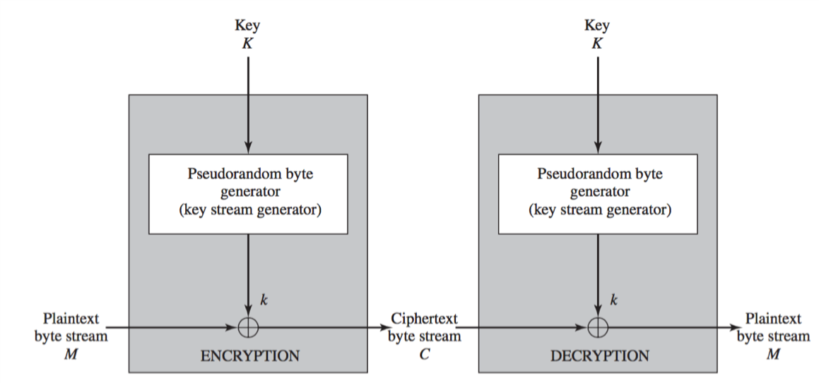
Stream cipher Diagram

Slide 12
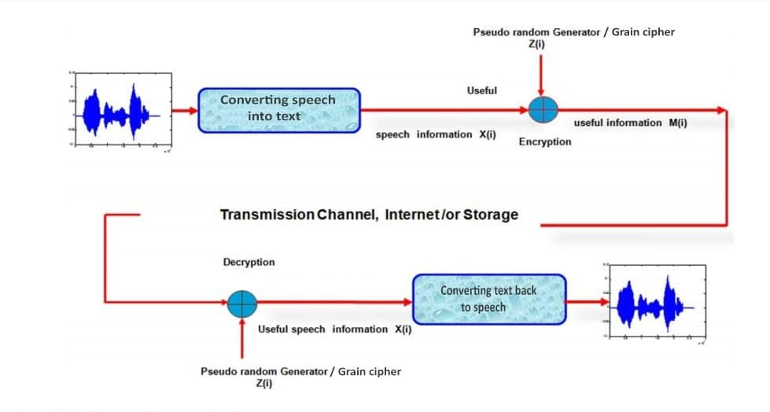
Block diagram of selective speech encryption

Slide 13
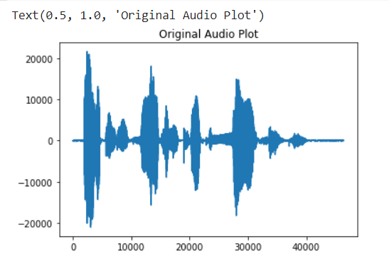
Converting speech into text
Input is taken in form of sound and converted into text using google speech recognition python library.
The speech recognition automatically senses the English dictionary words spoken in the audio and converts it back to text, therefore looses the extra noise and non-useful information.
Graph of input signal is plotted based on frequency as shown in the diagram below.
Input speech

Slide 14
Pseudo‑random generator/key stream generator
The production of a pseudo-random generator (PRG), which is as resilient as possible to known attacks, requires an adequate mathematical base which makes it possible to generate robust and unpredictable pseudo-random sequences.
The pseudo-random generator consists of one 80-bit linear Feedback Shift Register (LFSR), one 80-bit Non-Linear Feedback Shift Register (NLFSR) and a nonlinear Boolean function Hx. The content of both registers are denoted by lfsr(1), lfsr(2), ..., lfsr(80), for the LSFR and nfsr(1), nfsr(2), ..., nfsr(80) for NLSFR. The recurrence relationship for output of LFSR is given by:
Fx(80) = lfsr[62] ^ lfsr[51]^lfsr[38] ^ lfsr[23] ^ lfsr[13] ^ lfsr[0]. (LFSR EQUATION)
Gx(80) = nfsr[0] ^ nfsr[63] ^ nfsr[60] ^ nfsr[52] ^ nfsr[45] ^ nfsr[37] ^ nfsr[33] ^ nfsr[28] ^ nfsr[21] ^ nfsr[15] ^ nfsr[19] ^ nfsr[0] ^ nfsr[63] & nfsr[60] ^ nfsr[37] & nfsr[33] ^ nfsr[15] & nfsr[9] ^ nfsr[60] & nfsr[52] & nfsr[45] ^ nfsr[33] & nfsr[28] & nfsr[21] ^ nfsr[63] & nfsr[45] & nfsr[28] & nfsr[9] ^ nfsr[60] & nfsr[52] & nfsr[37] & nfsr[33] ^ nfsr[63] & nfsr[60] & nfsr[21] & nfsr[15] ^ nfsr[63] & nfsr[60] & nfsr[52] & nfsr[45] & nfsr[37] ^ nfsr[33] & nfsr[28] & nfsr[21] & nfsr[15] & nfsr[9] ^ nfsr[52] & nfsr[45] & nfsr[37] & nfsr[33] & nfsr[28] & nfsr[21]. (NLFSR EQUATION).
Hx = x1 ^ x4 ^ x0 & x3 ^ x2 & x3 ^ x3 & x3 ^ x0 & x1 & x2 ^ x0 & x2 & x3 ^ x0 & x2 & x4 ^ x1 & x2 & x4 ^ x2 & x3 & x4 (BOOLIAN FUNCTION). Where x0 = lfsr[0], x1 = lfsr[25], x2 = lfsr[46], x3 = lfsr[64], x4 = nfsr[63].
Where ^ means XOR.

Slide 15
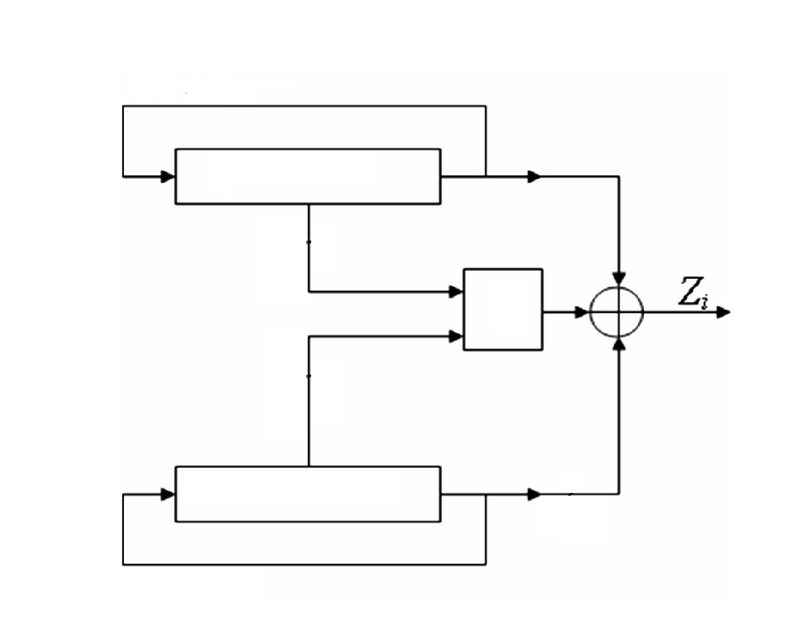
Structure of PRNG
Fx(80)
Key stream Z(i) = Fx ^ Gx ^ Hx.
We get our secret key as Z(i).
Now, it is xor-ed with input signal which forms the encrypted signal.
LFSR 80 bit
Hx
NLFSR 80 bit
Gx(80)

Slide 16
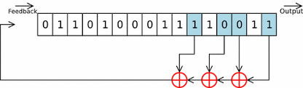
Linear feedback shift resister(LFSR)
A linear-feedback shift register (LFSR) is a register of bits that performs discrete step operations that:
shifts the bits one position to the left and
replaces the vacated bit by the exclusive or(xor) of the bit shifted off and the bit previously at a given tap position in the register.
It has been the workhorse for military encryption for as long as electronics (electromechanics) has existed
It is fast in hardware, but slow in software.

Slide 17
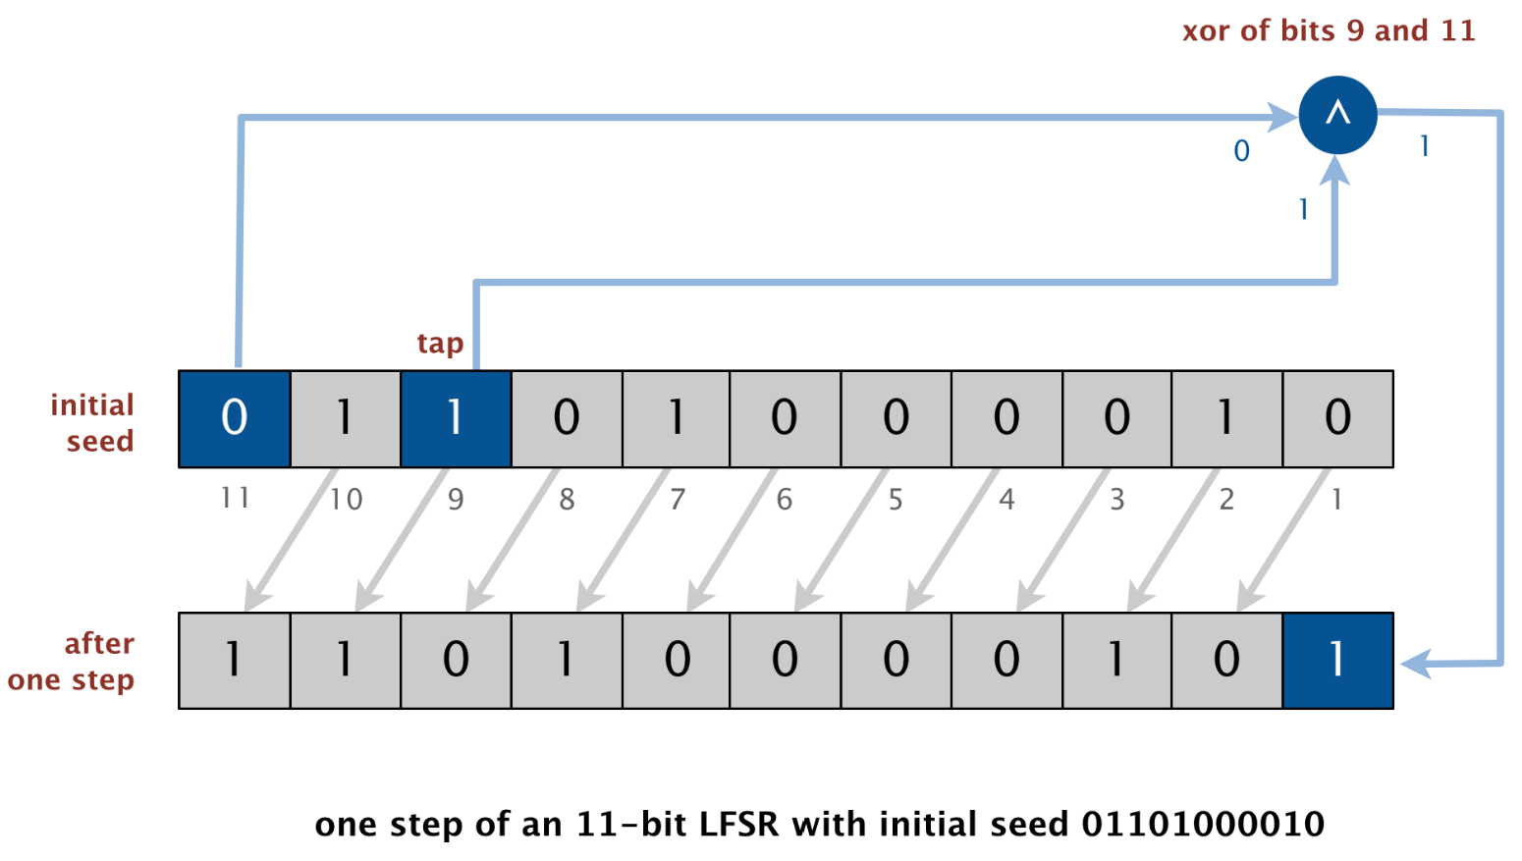
Structure of lfsr
A LFSR has three parameters that characterize the sequence of bits it produces: the number of bits n, the initial seed (the sequence of bits that initializes the register), and the tap position tap. As shown below an one step of an 11-bit LFSR with initial seed 01101000010 and tap positions 9.

Slide 18
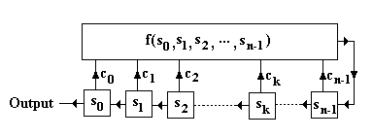
Working of lfsr
An LFSR of length n (n-stage) consists
of components which are shown in fig ->
Let n = 4, c₀ = c₂ = c₃ = 1, c₁ = 0 with initial state (0,1,1,0) then we have:
Time | LFSR States | Output
0 | 0,1,1,0 | -
1 | 1,1,0,1 | 0
2 | 1,0,1,0 | 1
3 | 0,1,0,0 | 1
4 | 1,0,0,0 | 0
5 | 0,0,0,1 | 1
6 | 0,0,1,1 | 0
7 | 0,1,1,0 | 0

Slide 19
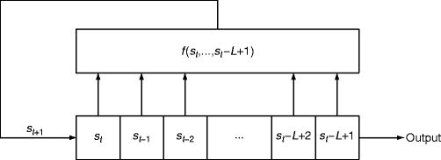
Non linear feedback shift resister(NLFSR)
A nonlinear-feedback shift register (NLFSR) is a shift register whose input bit is a non-linear function of its previous state.
It is very similar to lfsr.

Slide 20
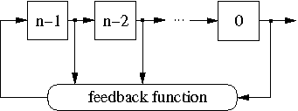
Structure of nlfsr
The general structure of an n-bit NLFSR is shown in below figure. It consists of n binary storage elements, called bits or stages, and a feedback function f(x₀,x₁,...x_{n−1}). For each i ∈ {0,1,...,n−1 }, the state variable x_{i} represents the value of the bit i. At each clock cycle, the content of the register is shifted one bit right. The value of the bit n−1 is updated according to the feedback function f.

Slide 21
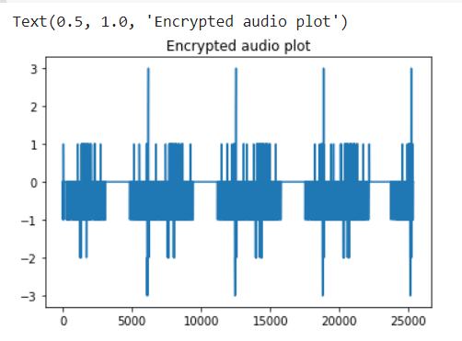
Encryption of speech signal
Write some words Siddharth I am falling asleep.

Slide 22
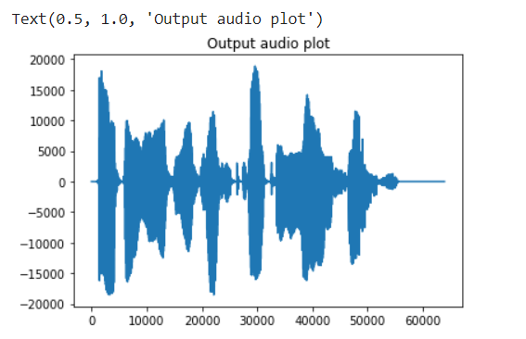
Decryption of speech signal
Whatever

Slide 23
Result :
Histogram analysis
It is clear that the histogram of the encrypted speech is almost uniformly distributed, and different from the histogram of the original speech. Thus, the encrypted speech provides no index that would facilitate the use of a statistical attack on the proposed scheme, making statistical attacks difficult. These properties indicate that the proposed scheme provides high security against statistical attacks.
Key sensitivity
The most important feature of a cryptosystem based on stream cipher is key sensitivity. For example, a small change in the secret key leads to different results during the encryption and decryption of data. Correct decryption needs complete and precise knowledge of all of the secret key bits; otherwise the data cannot be decrypted.

Slide 24
Conclusion
In this work, a novel approach for selective speech encryption based on stream cipher is elaborated. The speech signal is pre-processed to remove automatically the silent/unvoiced parts and produce the selected useful speech to be encrypted. This allows a drastic reduction in computing time and resources. The proposed pseudorandom generator allows a large key space which makes the system secure from brute force attack. The algorithm is computationally simple and highly secure and easy to implement for speech encryption and decryption.

Slide 25
Reference
Abd Elzaher, M. F., Shalaby, M., & El Ramly, S. H. (2016). Securing modern voice communication systems using multilevel chaotic approach. International Journal of Computer Applications, 135(9), 0975–8887.
Ashtiyani, M., Moradi Birgani, P., & Karimi Madahi, S. S. (2012). Speech signal encryption using chaotic symmetric cryptography. Journal of Basic and Applied Scientific Research, 2(2), 1668–1674.
Belmeguenai, A., Mansouri, K., & Lashab, M. (2015). Speech encryption using stream cipher. British Journal of Applied Science and Technology, 8(1), 107–125
Belmeguenai, A., Berrak, O. & Mansouri, K. (2015). Selective encryption of medical images, In Proceedings of the 10th International Conference on Computer Vision Theory and Applications (VISAPP-2015), pp. 93-99, ISBN: 978-989-758-091-8, Berlin.
Kulkarni, N. S., Raman, B., & Gupta, I. (2008). Selective encryption of multimedia images. NSC, 2008, 17–19.

Slide 26
https://www.cs.princeton.edu/courses/archive/spr19/cos126/assignments/lfsr/
https://link.springer.com/referenceworkentry/10.1007%2F978-1-4419-5906-5_361
Bhatnagar, G., & Jonathan Wu, Q. M. (2012). Selective image encryption based on pixels of interest and singular value decomposition. Digital Signal Processing, 22, 648–663.
Burileanu, D., Pascalin, L., Burileanu, C., & Puchiu, M. (2000). An adaptive and fast speech detection algorithm. Proceedings of the 3rd International Workshop on Text, Speech and Dialogue, p. 177182.
Wikipedia

