Slide 1
Welcome! If you want to follow along, borrow a flash drive, copy the contents to your drive, and see the README. Or, download from: thewoolleyweb.com/ ci_for_the_rails_guy_or_gal

Slide 2
Warning: If you are reading this from a handout or virtual machine, it may be outdated. See latest at: thewoolleyweb.com/ ci_for_the_rails_guy_or_gal

Slide 3
CI for the Rails
/G(uy|al)/

Slide 4
Obligatory
Boiler
Plate

Slide 5
Who

Slide 6
Chad Woolley thewoolleyman @ gmail.com thewoolleyweb.com

Slide 7


Slide 8
Who are YOU? CI? Linux? Virtualization? Javascript Testing? Selenium?

Slide 9
What

Slide 10
CI == Continuous Integration

Slide 11
Martin Fowler -
Seminal CI Article

Slide 12
Running all your tests on every commit

Slide 13
Automatically

Slide 14
How

Slide 15
Takahashi Method ==
Big Font!

Slide 16
Focused on how to install and make everything work together, not on details of how to use the tools

Slide 17
Just the basics, no obtuse shell tricks, won't use the latest extensions, wrappers, libraries, or plugins

Slide 18
But I encourage you to look into them, useful additions/ extensions will be mentioned later.

Slide 19
Well, maybe a few bleeding edge things, time permitting

Slide 20
Agenda:

Slide 21
1. Code: The simplest tutorial that could POSSIBLY work

Slide 22
Coding
Tasks
Outline

Slide 23
A. Install
Linux on
VMWare

Slide 24
B. Install Prereqs: ruby, java, mysql, svn, ant, alternate browser

Slide 25
C. Create sample Rails Project

Slide 26
D. cruisecontrol.rb setup

Slide 27
E. JsUnit Setup

Slide 28
F. Selenium Setup

Slide 29
Z. Git

Slide 30
2. Gettin' Fancier

Slide 31
3. Gotchas

Slide 32
4. Questions

Slide 33
Tools
Used

Slide 34
Cross-Platform, Mostly*
Free

Slide 35
* VMware is not free on all platforms

Slide 36
VMware

Slide 37
Parallels is a Virtualization Alternative

Slide 38
Or, you can skip Virtualization and install Ubuntu directly on a spare PC. Just burn the ISO image to a CD.

Slide 39
Ubuntu Linux

Slide 40
cruisecontrol.rb

Slide 41
JsUnit

Slide 42
Selenium

Slide 43
There is a lot of material in this presentation

Slide 44
We will move FAST

Slide 45
Maybe too fast for you to follow along during the preso (sorry!)

Slide 46
But it's all on the slides

Slide 47
Overachievers can yell “Bingo” if you finish it before I do.

Slide 48
Everyone else can pair up and help each other

Slide 49
Intended to be comprehensive, easily repeatable, generic, cross-platform

Slide 50
Contains everything* you need to try this on a real project

Slide 51
* “everything” except the stuff that doesn't work on your project or environment or latest versions. Error messages and Google are your friend :)

Slide 52
As a matter of fact, it almost certainly won't work perfectly for you. Integrating this stuff is hard, and new problems arise as tools and libraries evolve. Embrace the bleeding cutting edge, keep a positive attitude, and help fix bugs.

Slide 53
It's OK to sit back and watch

Slide 54
Try it at your home or workplace, at your own pace

Slide 55
You can try it on a mac, but slides target an Ubuntu VM for maximum portability and repeatability

Slide 56
Live!

Slide 57
No Hand Waving

Slide 58
(Warning: Obligatory lame attempt at humor coming up)

Slide 59
Their WILL be typos!

Slide 60
You down with OCD?

Slide 61
Then you'll know me!

Slide 62
Just please don't be “That Guy” (or Gal)!

Slide 63
You know, “That Guy” who stands up and wants to expound on irrelevant minutiae during the middle of a presentation...

Slide 64
Nitpicks, Flames and Hints Welcome...

Slide 65
...over beer, AFTER the tutorial

Slide 66
...but seriously, if you are a bit OCDish, you might make a good CI G(uy|al) - because there's a lot of moving parts that all have to integrate...

Slide 67
...Continuously!

Slide 68
1. Time to Code!

Slide 69
WARNING: If you try to cut and paste commands from the presentation (and you can, they're all there), use the OpenOffice doc. Pasting from PDF inserts bad line breaks

Slide 70
A. Install
Linux on
VMWare

Slide 71
No time to install Linux live, but VMWare and images are on USB Keys

Slide 72
My Barebones Linux VM Setup:
Base:
VMWare on Macbook Pro 17”
Ubuntu 7.10 desktop VM from ISO
VMware Tools installed
Optional:
Change resolution (System > Preferences > Screen Resolution)
Mouse Acceleration and Sensitivity
Terminal scrollback

Slide 73
Everything should work pretty much the same on any modern Unix platform

Slide 74
Following are screenshots and instructions to set up basic Ubuntu on VMware

Slide 75
We will skip them for now, but you can use them as a guide when you try it later

Slide 76
Exact steps may vary depending on your hardware

Slide 77
Original screenshots in /presentation /screenshots if these are too small to read

Slide 78
VMware Mac Setup:
/presentation
/screenshots
/01a_mac_vmware_ fusion_screenshots

Slide 79
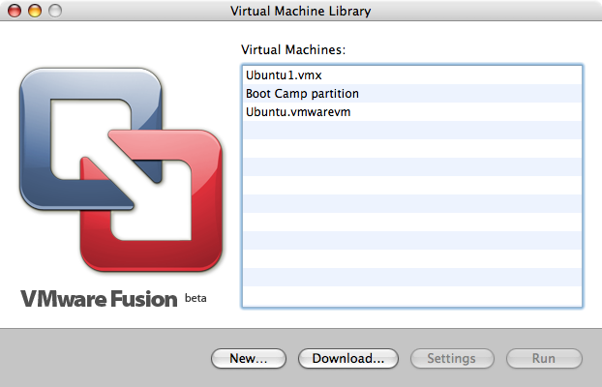
01_Virtual_Machine_Library.png

Slide 80
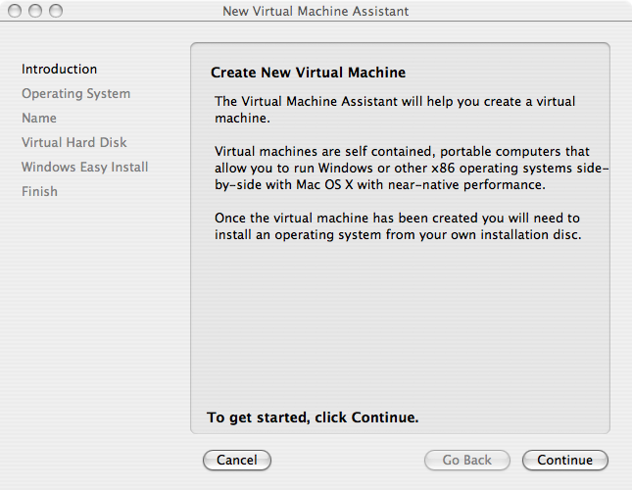
02_Create_New_Virtual_Machine.png

Slide 81
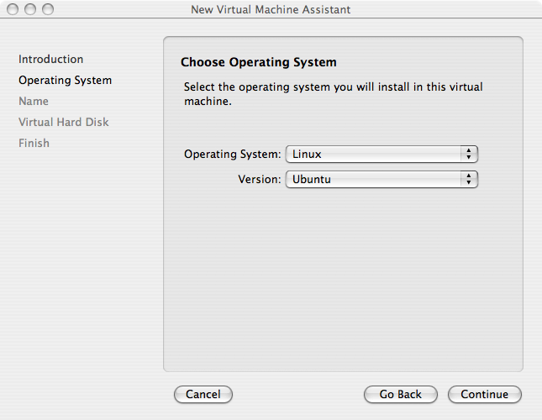
03_Choose_Operating_System.png

Slide 82
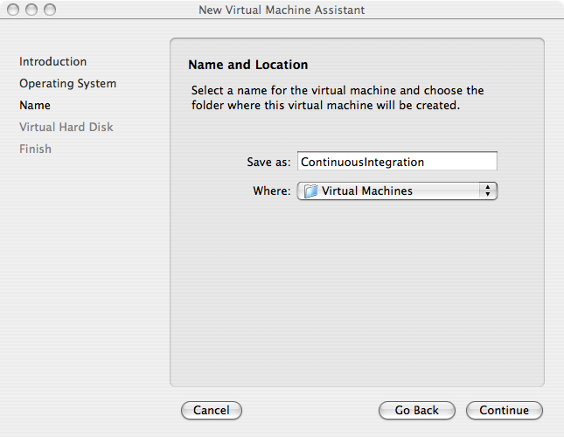
04_Name_and_Location.png

Slide 83
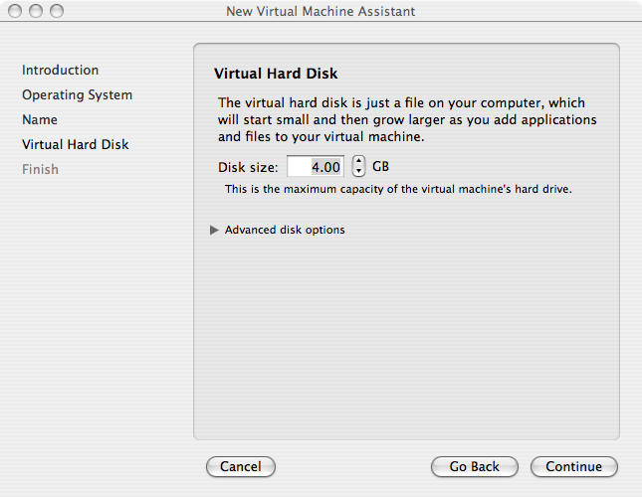
05_Virtual_Hard_Disk.png

Slide 84
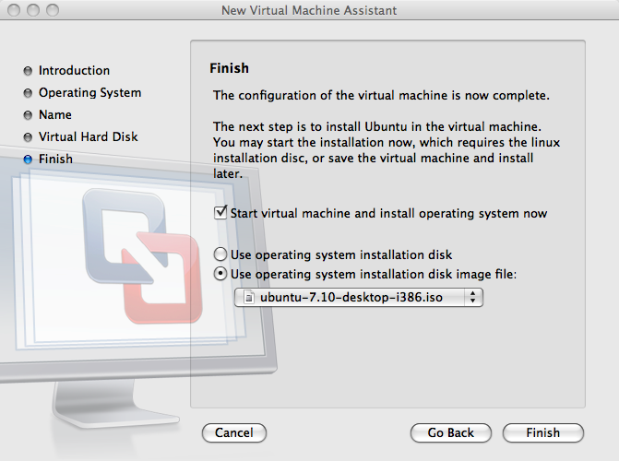
06_Finish.png

Slide 85
VMware Win Setup:
/presentation
/screenshots
/01b_win_vmware_ server_screenshots

Slide 86
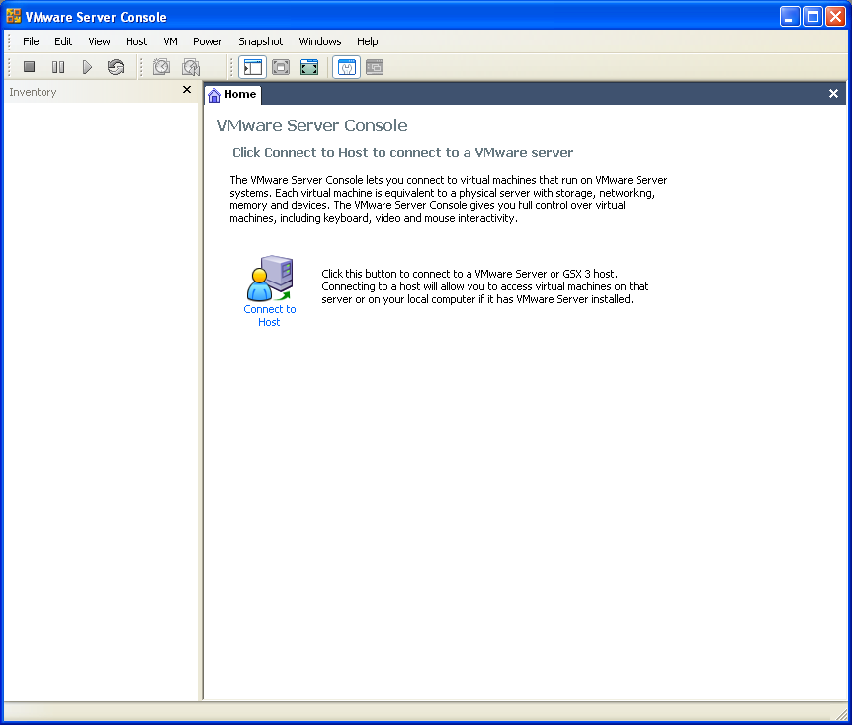
01_VMware_Server_Console.PNG

Slide 87
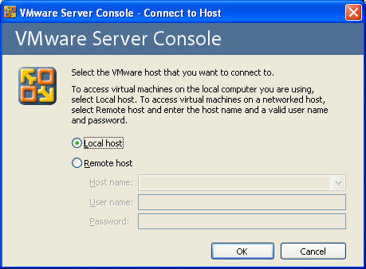
02_Connect_To_Host.PNG

Slide 88
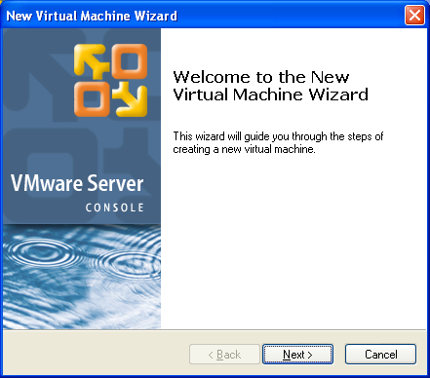
03_New_Virtual_Machine.PNG

Slide 89
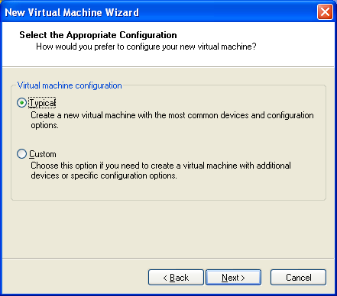
04_Virtual_Machine_Configuration.PNG

Slide 90
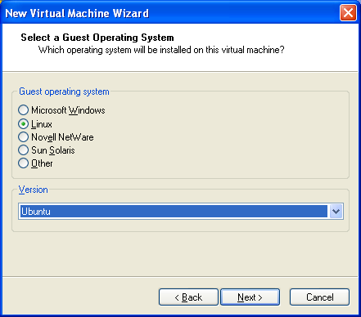
05_Select_a_Guest_Operating_System.PNG

Slide 91
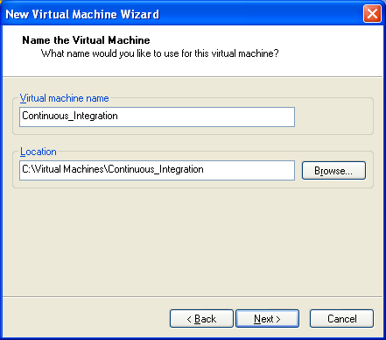
06_Name_the_Virtual_Machine.PNG

Slide 92
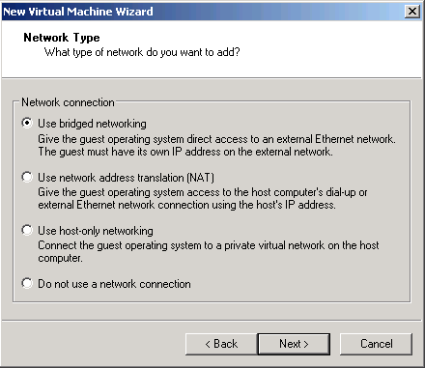
07_Network_Type.PNG

Slide 93
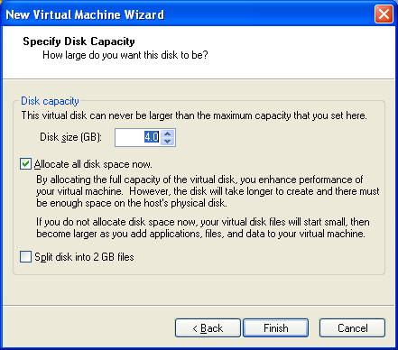
08_Specify_Disk_Capacity.PNG

Slide 94
Mac/Win Ubuntu VM Setup:
/presentation
/screenshots
/02_ubuntu_vm_ setup_screenshots

Slide 95
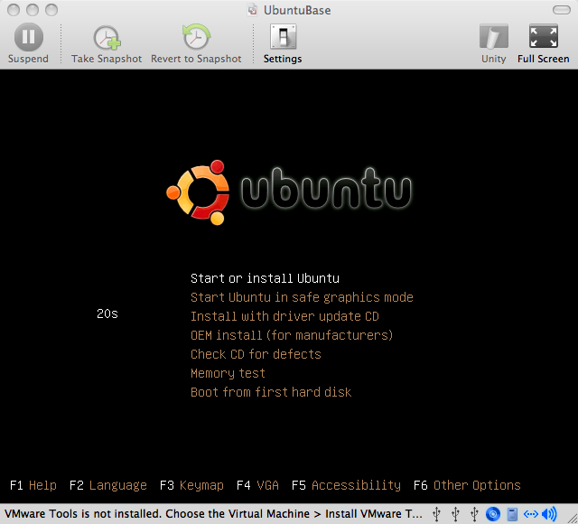
01_Start_or_Install_Ubuntu.png

Slide 96
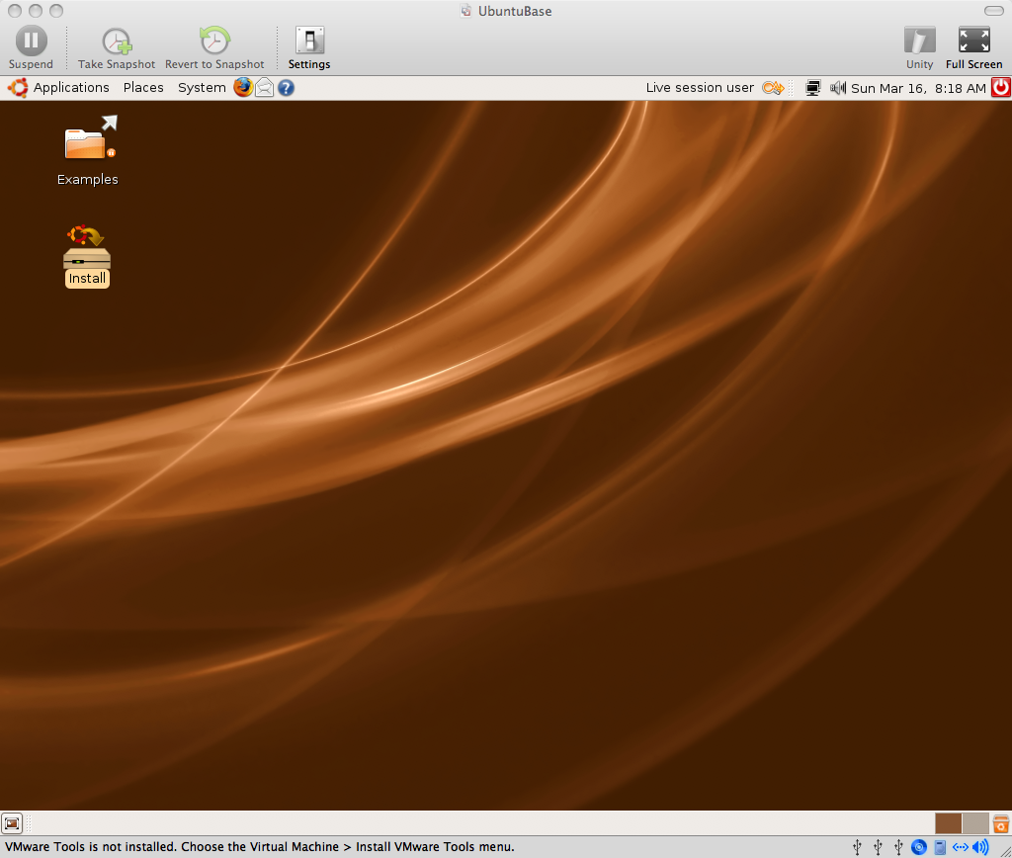
02_Install_Icon.png

Slide 97
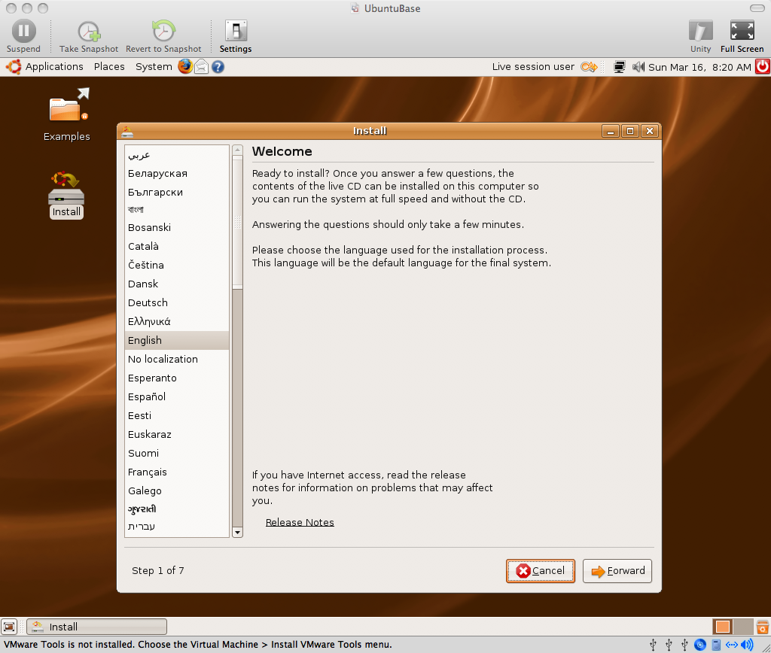
03_Welcome.png

Slide 98
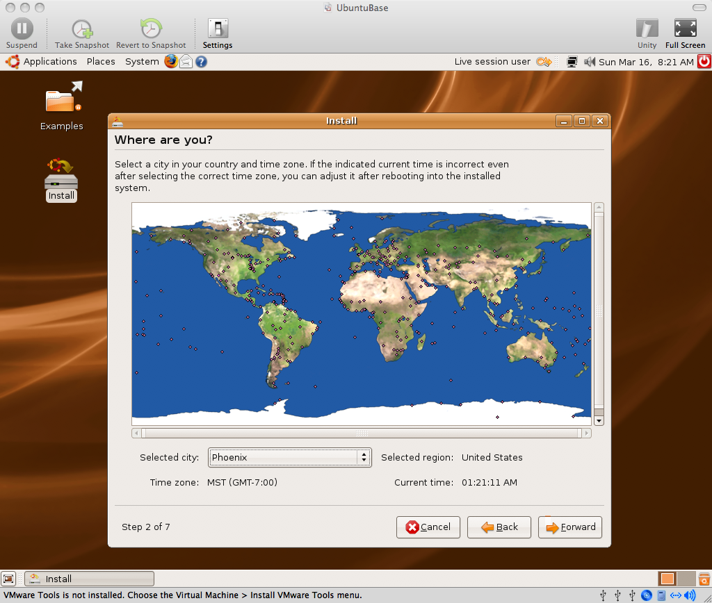
04_Where_are_you.png

Slide 99
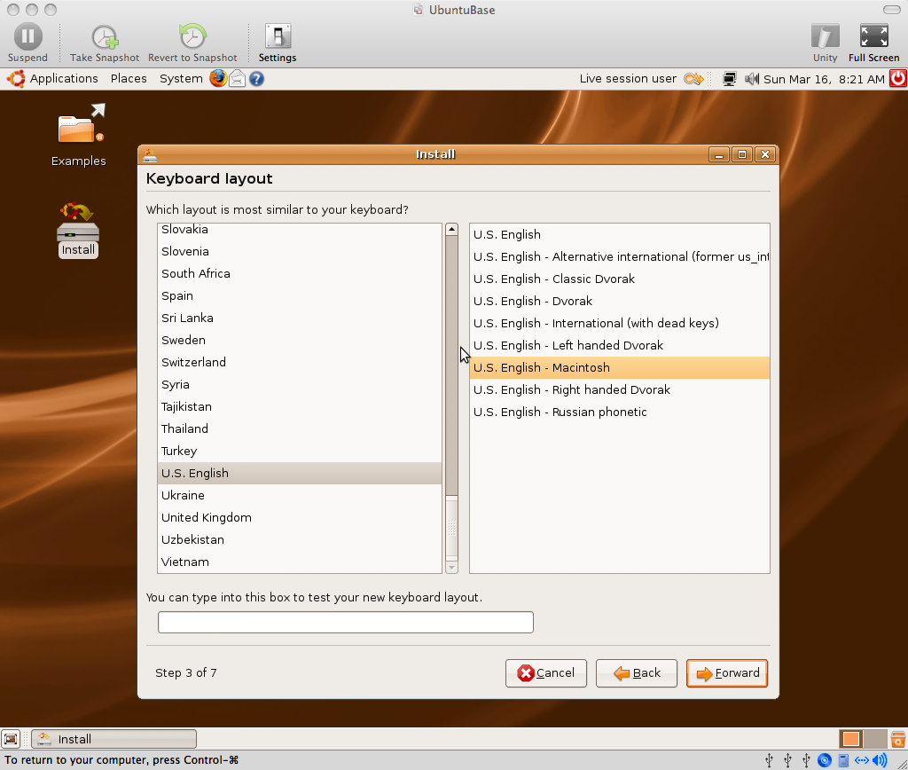
05_Keyboard_Layout.png

Slide 100
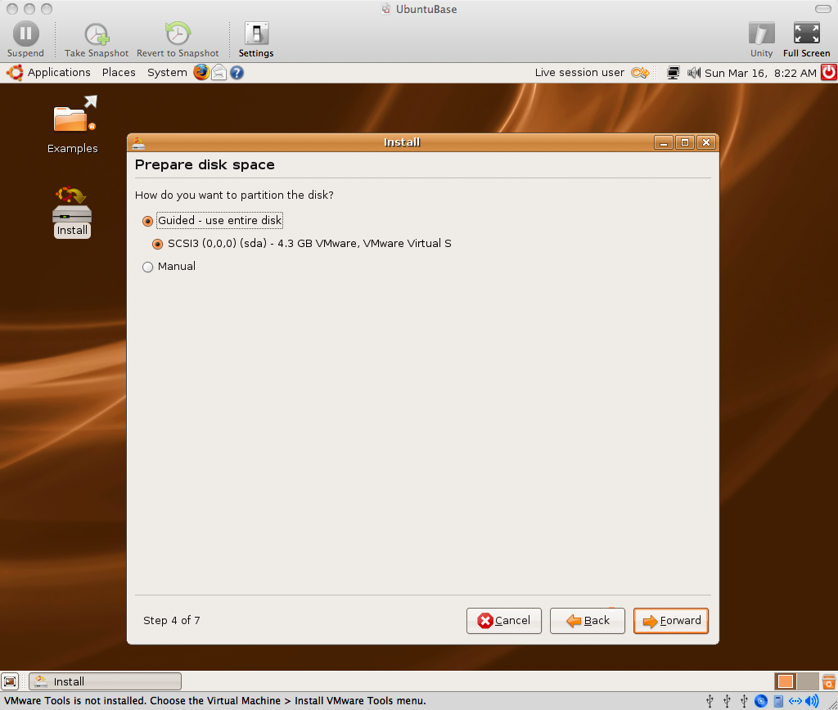
06_Prepare_disk_space.png

Slide 101
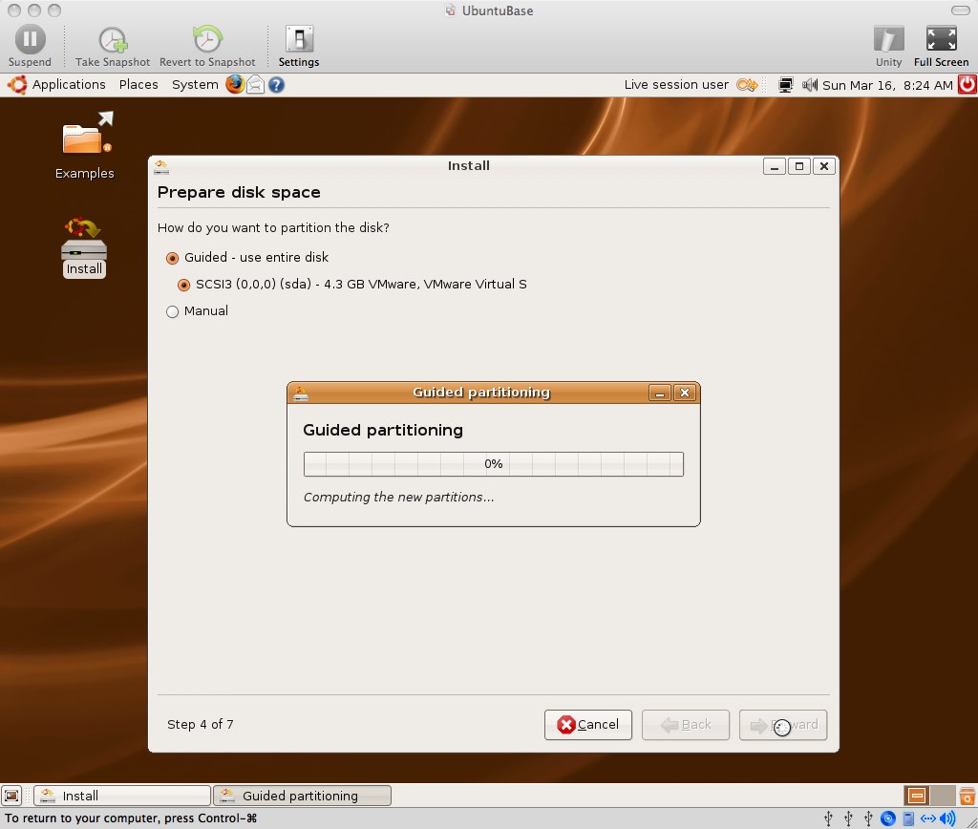
07_Guided_Partitioning.png

Slide 102
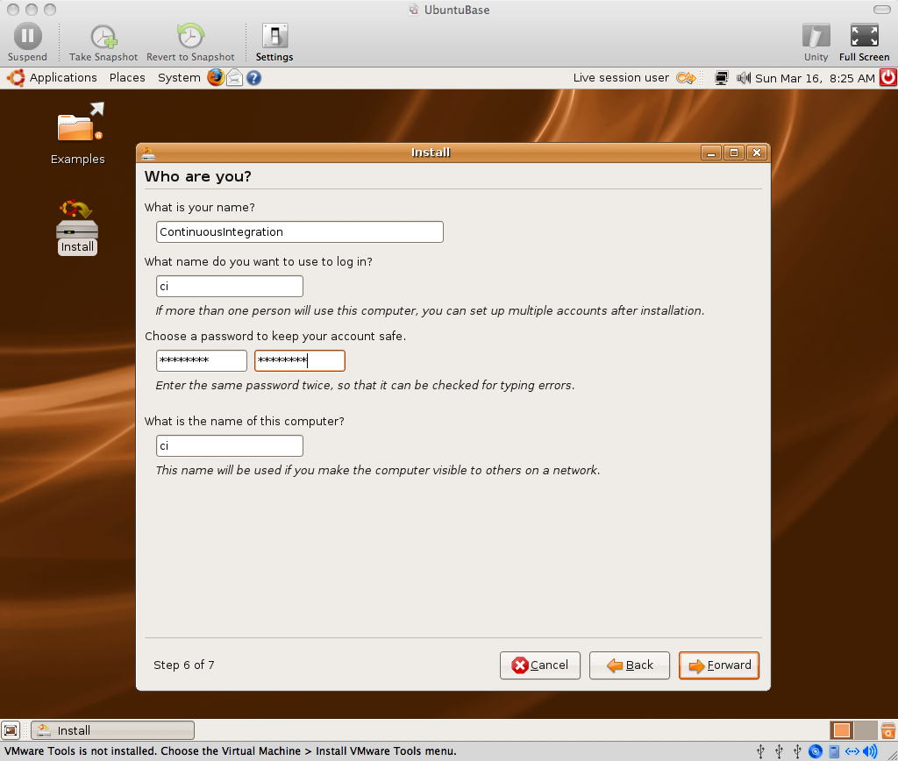
08_Who_are_you.png

Slide 103
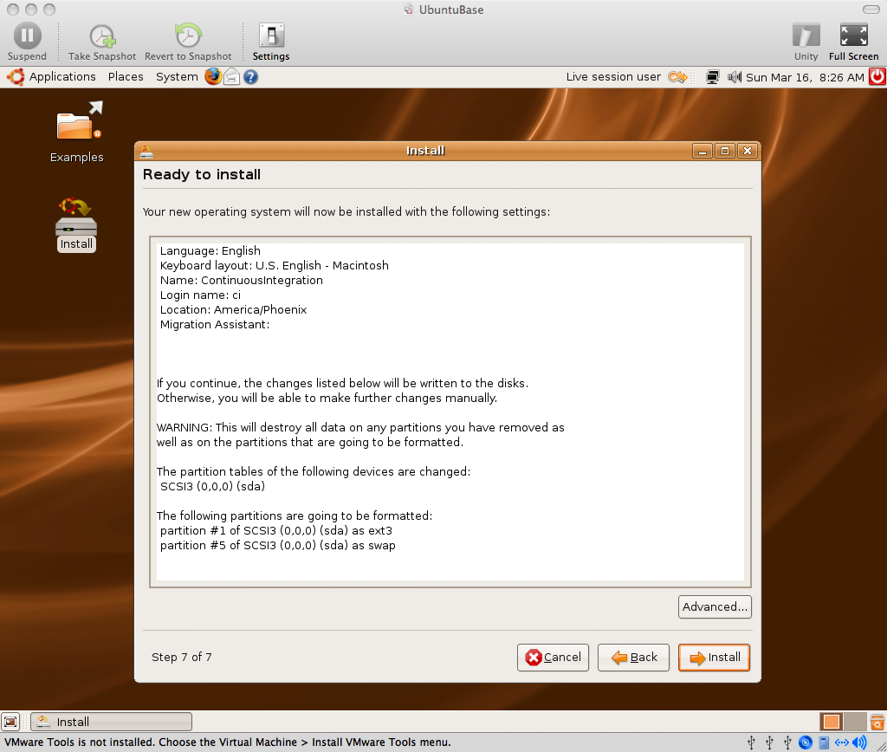
09_Ready_to_install.png

Slide 104
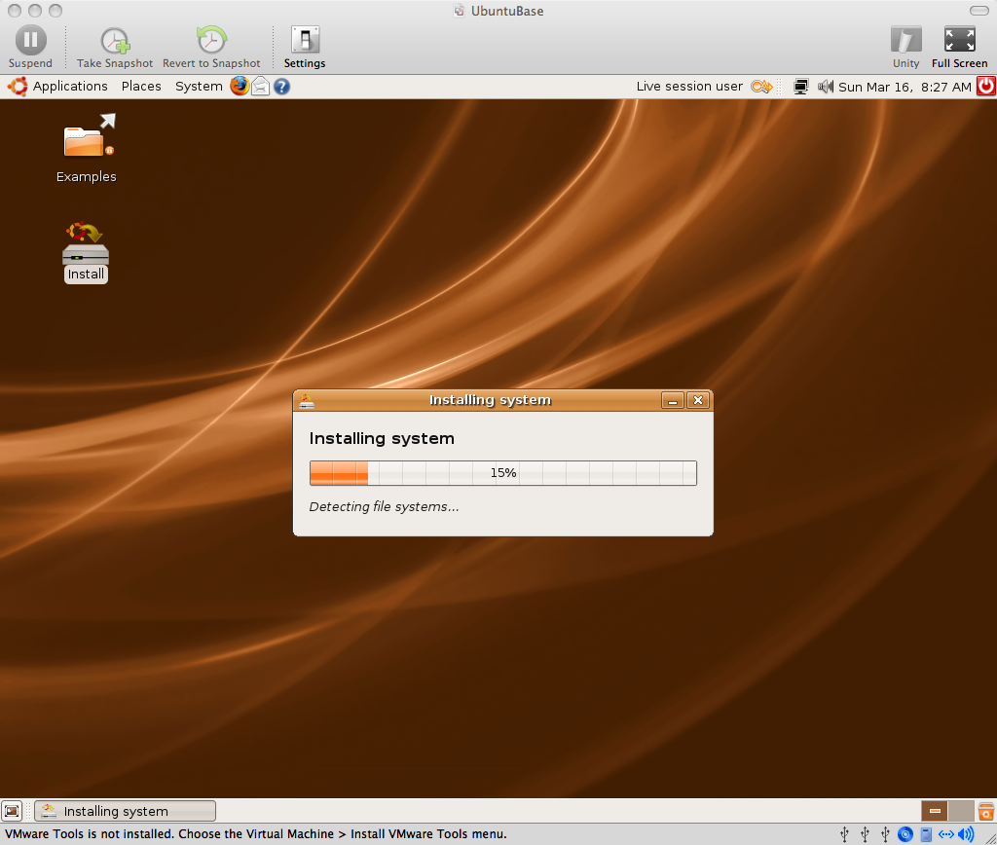
10_Installing_system.png

Slide 105
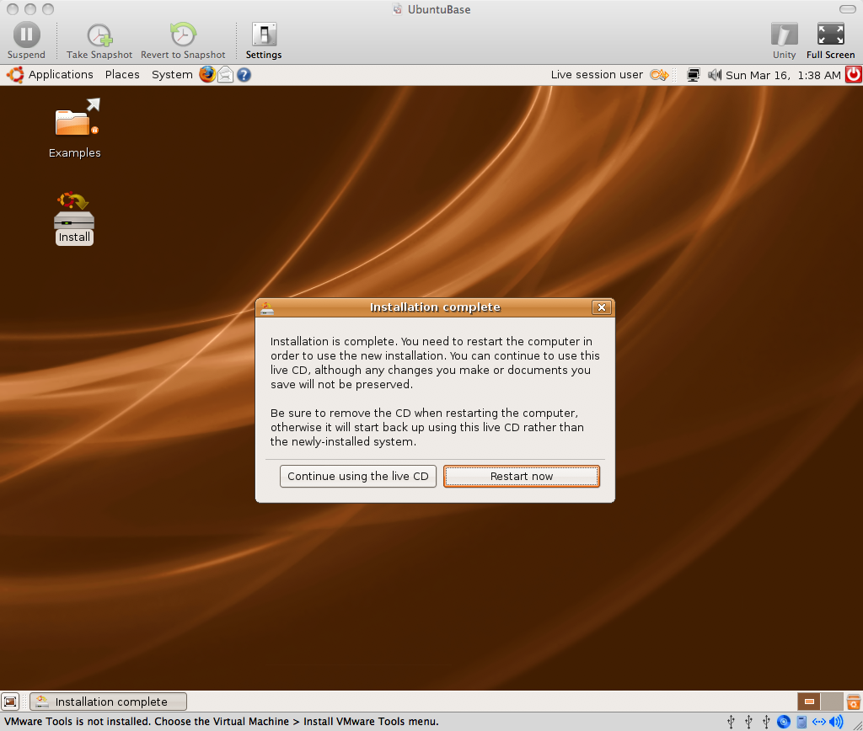
11_Installation_complete.png

Slide 106
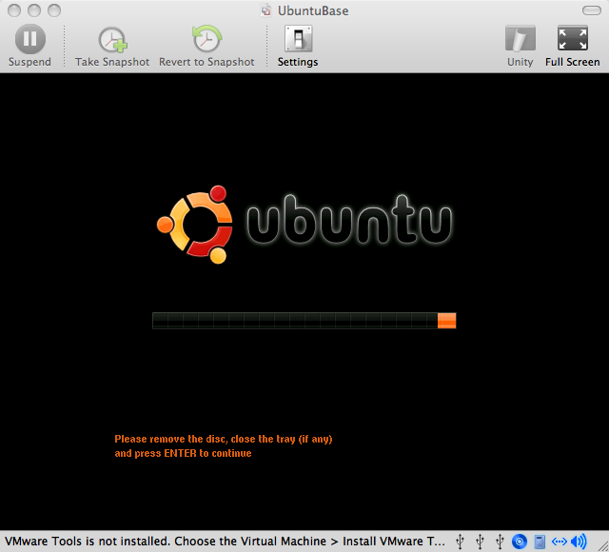
12_Please_Remove_The_Disk.png

Slide 107
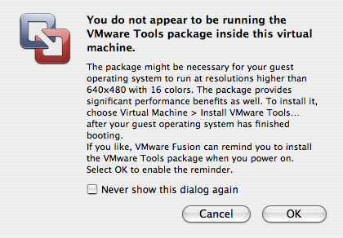
13_VMware_Tools_reminder.png

Slide 108
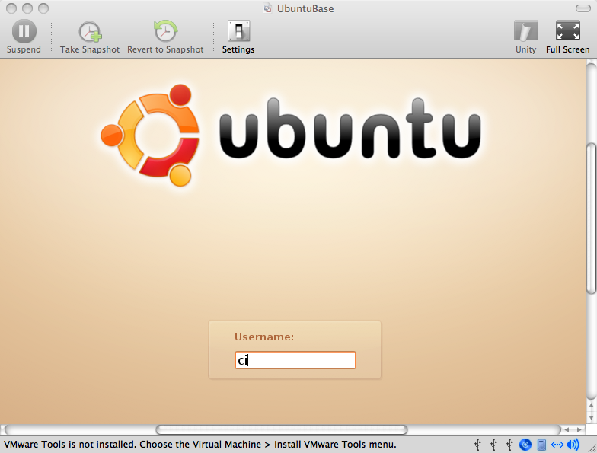
14_Login.png

Slide 109
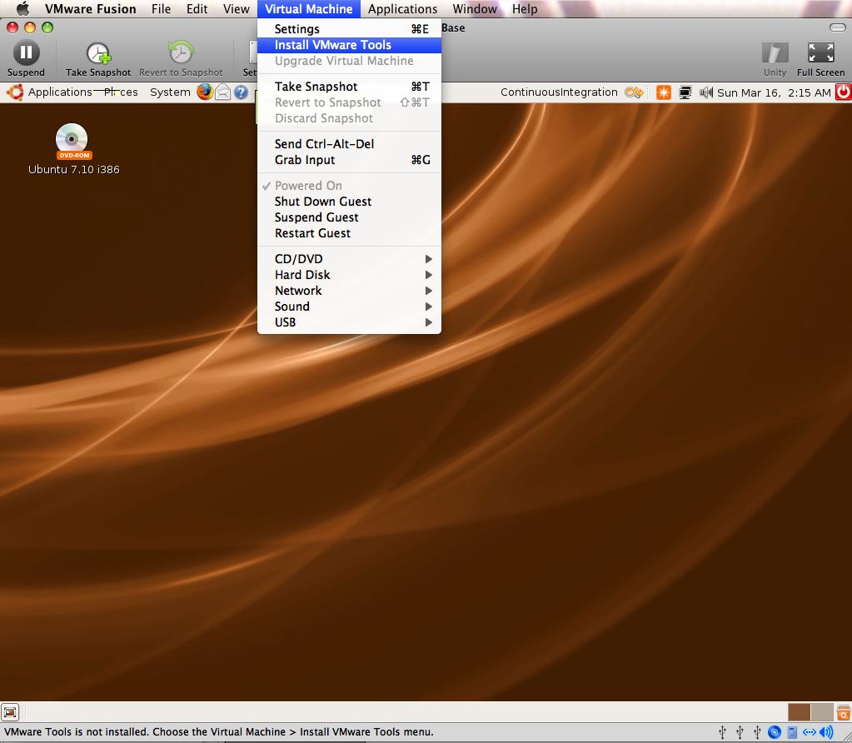
15_Virtual_Machine_Menu_Install_VMware_Tools.png

Slide 110
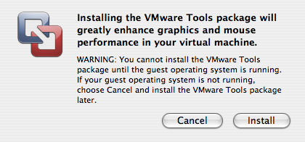
16_Installing_the_VMware_Tools_package.png

Slide 111
At this point, you may need to reboot (System -> Quit -> Restart) in order for the VMware Tools CD image to mount correctly, especially if you already have the Ubuntu ISO image mounted.

Slide 112
In fact, with Leopard/ VMWare Fusion 1.1.1/Ubuntu 7.10, the VMWare Tools image was corrupt until VM reboot. This didn't happen with Tiger/VMWare Fusion Beta/Ubuntu 7.04

Slide 113
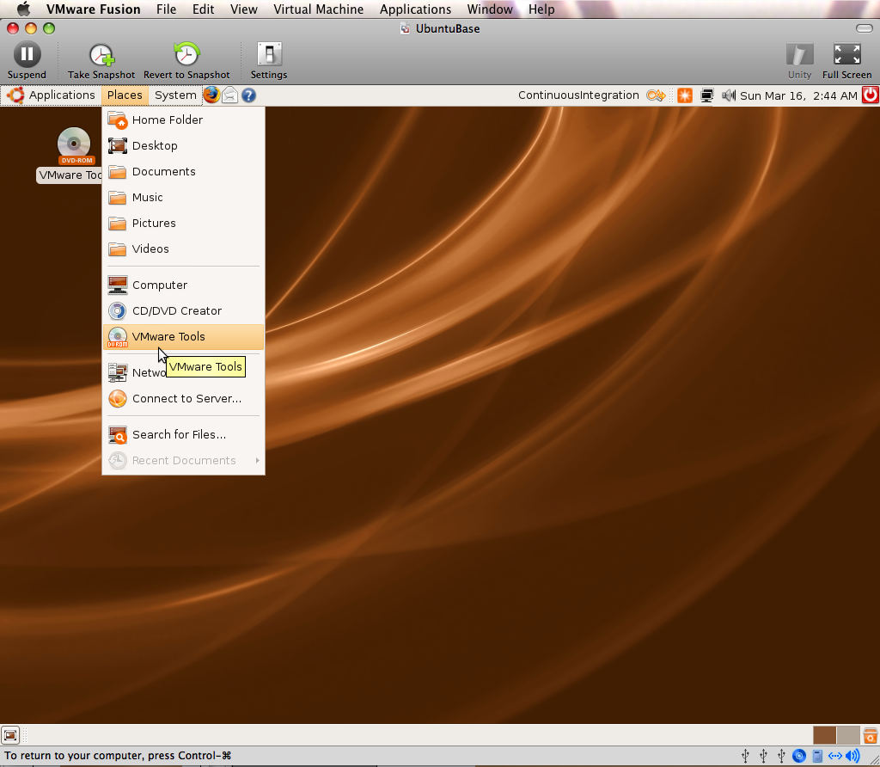
17_Open_VMWare_Tools_Image.png

Slide 114
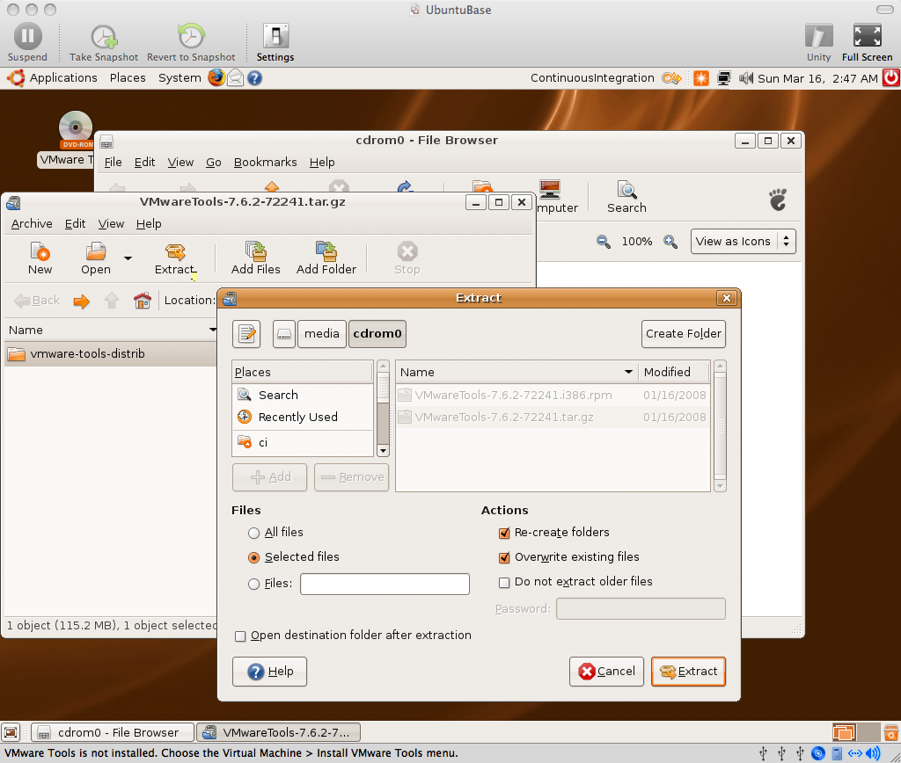
18_Extract_VMware_Tools.png

Slide 115
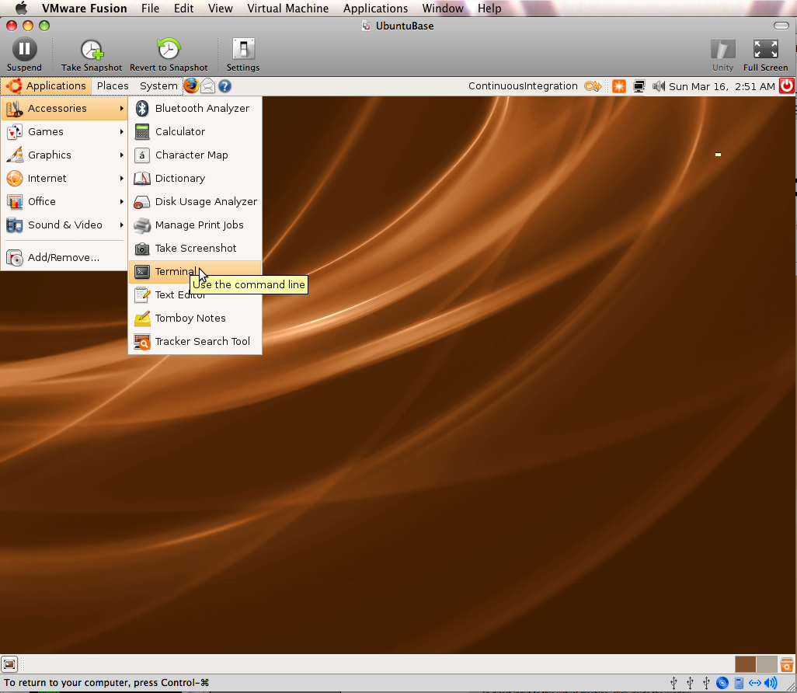
19_Applications_Accessories_Terminal.png

Slide 116
Install VMware Tools (Optional):
$ cd
$ tar -zxvf /media/cdrom0/VMwareTools-7.6.2-72241.tar.gz
$ cd ~/vmware-tools-distrib
$ sudo ./vmware-install.pl
# enter password for sudo
# hit enter repeatedly to accept defaults for all prompts, override display size if desired
# reboot (System -> Quit -> Restart)

Slide 117
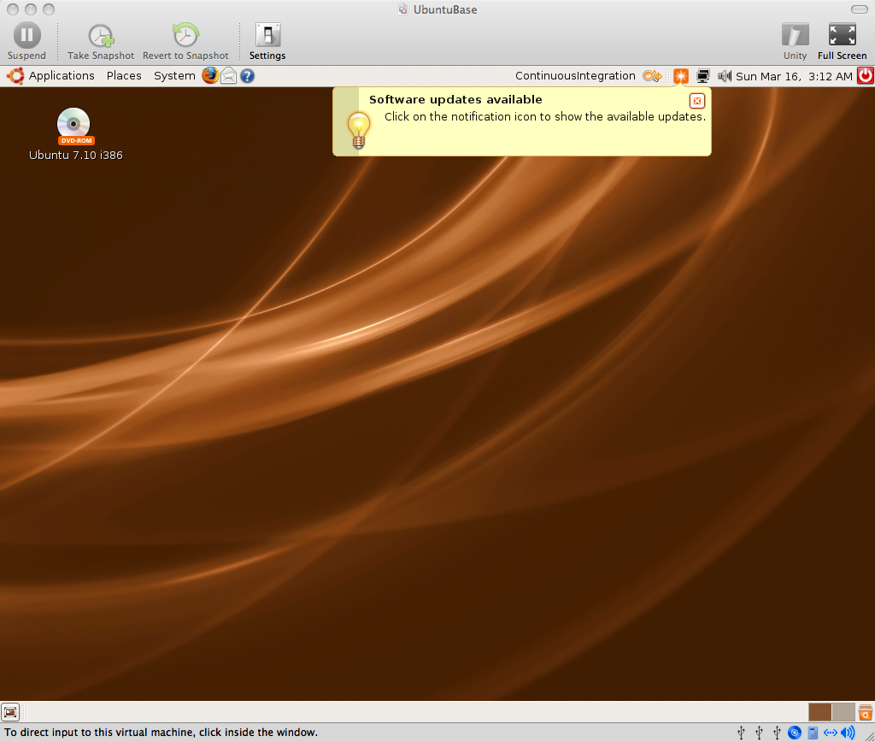
20_Software_Updates_Available.png

Slide 118
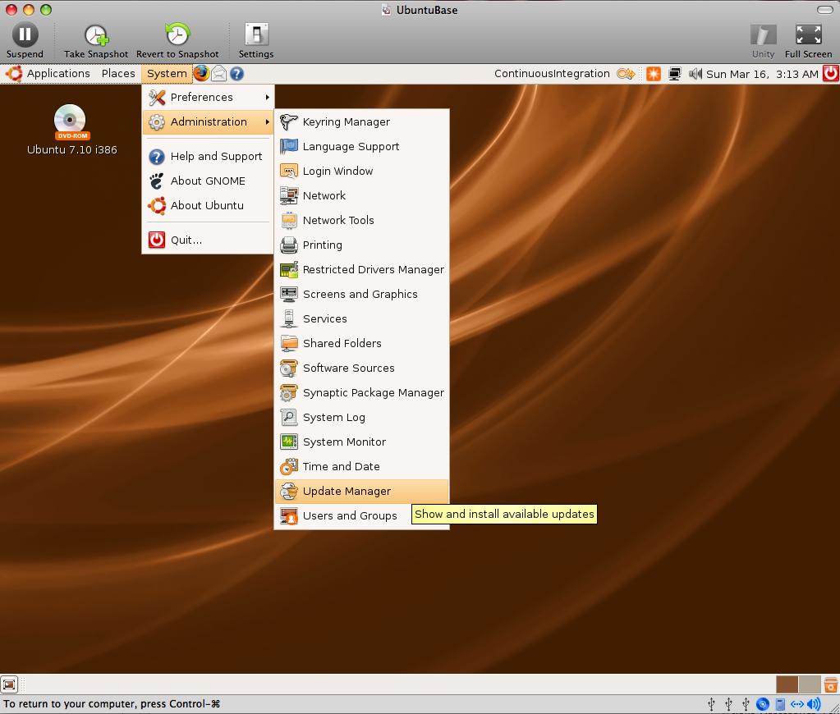
21_Update_Manager_Menu_Item.png

Slide 119
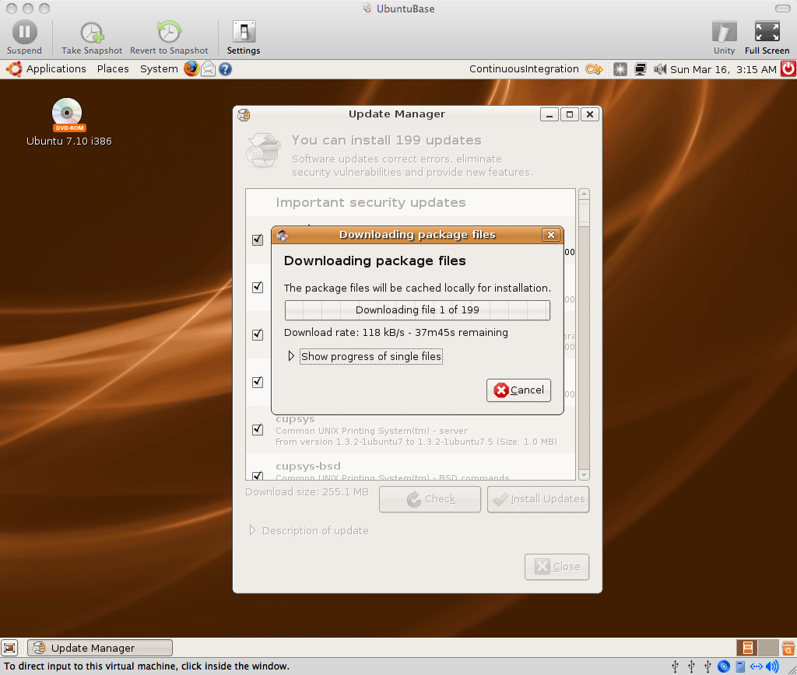
22_Update_Manager_Downloading_Package_Files.png

Slide 120
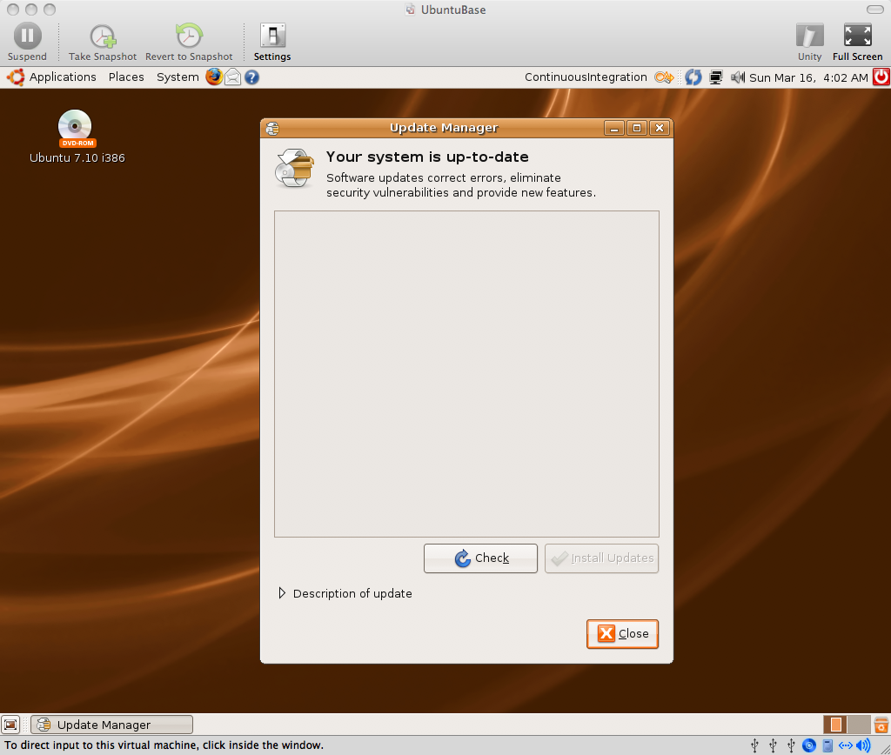
23_Your_System_is_Up_To_Date.png

Slide 121
By default on Ubuntu 7.10, the virtual wired network connection was set to “enable roaming mode”. I had to manually disable this and enable DHCP to get network access.

Slide 122
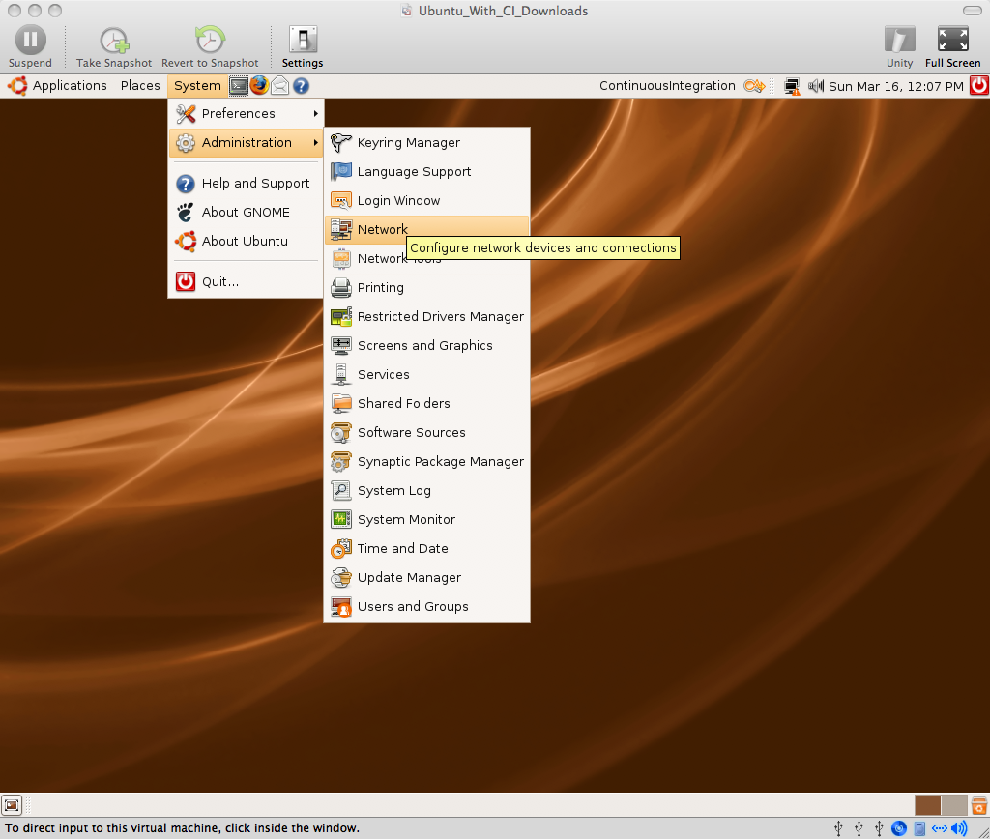
24_Network_Administration.png

Slide 123
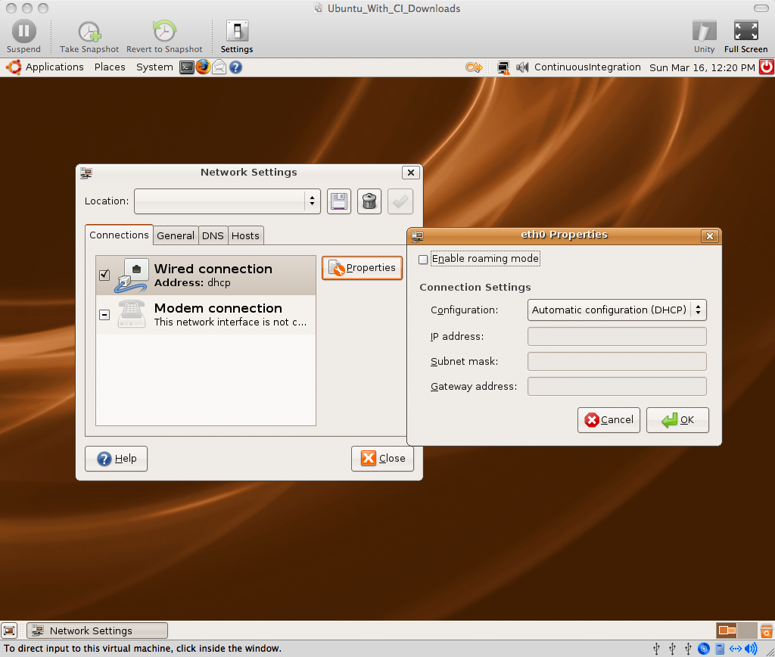
25_Checked_Wired_Connection_DHCP.png

Slide 124
Opening an existing VM Image Copy:
/presentation
/screenshots
/03_virtual_machine_copy

Slide 125
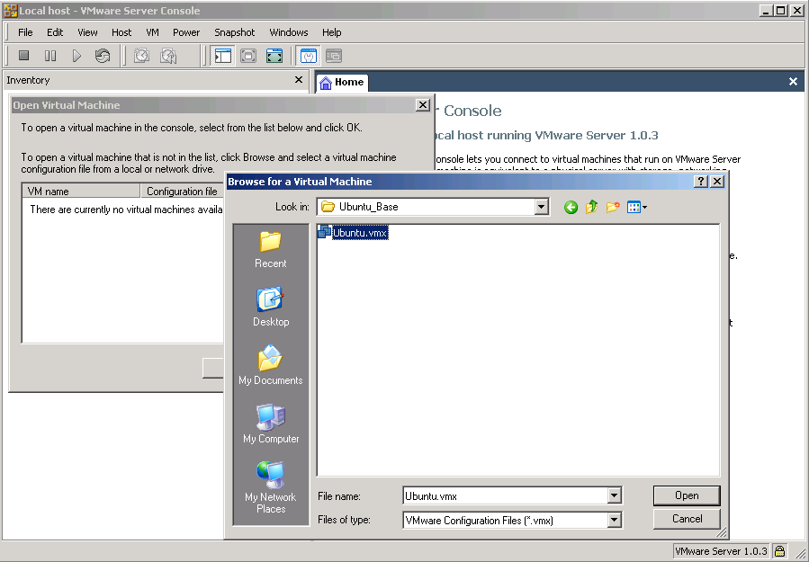
01_Browse_for_a_Virtual_Machine.PNG

Slide 126
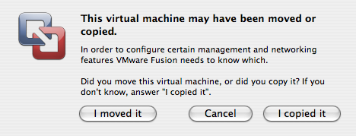
02a_Mac_Virtual_Machine_Copy.png

Slide 127
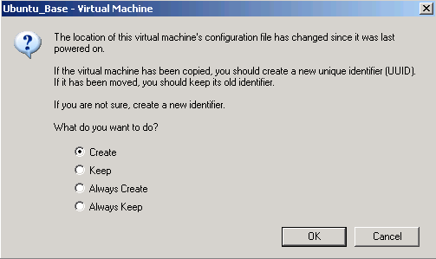
02b_Win_Virtual_Machine_Copy.png

Slide 128
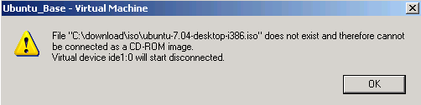
03_Missing_ISO_CDROM_Image.PNG

Slide 129
Other Ubuntu Tweaks (Optional):
* System -> Preferences -> Screen Resolution
* System -> Preferences -> Mouse
* Drag Applications -> Accessories -> Terminal icon to quick launch area
* Terminal -> Edit -> Current Profile -> Scrolling -> Scrollback = 99999
* Ctrl +, Ctrl - in Terminal to change font size

Slide 130
B. Install Prerequisites

Slide 131
Legend
$ == shell input
# == comment or instructions
(nothing) == editor input or stdin
Example:
# sudo should prompt for a password unless you've sudo'd recently
$ sudo ls password
# should get file list

Slide 132
We will keep everything in the home dir, or "~"
You can put it wherever you want

Slide 133
You can install ruby via aptitude, I will build from source to make the instructions more portable.

Slide 134
Install Ruby from source:
# This is already done on the VMware image “Ubuntu_With_CI_Downloads”
# install all prereqs/extensions in case you need them
$ sudo aptitude update
$ sudo aptitude install -y zlib1g zlib1g-dev
$ sudo aptitude install -y libssl-dev openssl
$ wget ftp://ftp.ruby-lang.org/pub/ruby/ruby-1.8.6-p114.tar.gz
$ tar -zxvf ruby-1.8.6-p114.tar.gz
$ cd ruby-1.8.6-p114
$ gedit ext/Setup
# Uncomment all “non-Win” lines (all except Win32API and win32ole) by removing “#”
$ ./configure
$ make
$ sudo make install

Slide 135
Install RubyGems:
# Already done on “CI_Downloads” image
$ cd
$ wget http://rubyforge.org/frs/download.php/35283/rubygems-1.1.1.tgz
# If this fails, check for a new mirror on:
# http://rubyforge.org/frs/?group_id=126
$ tar -zxvf rubygems-1.1.1.tgz
$ cd rubygems-1.1.1
$ sudo ruby setup.rb

Slide 136
Install Sun java:
# Already done on “CI_Downloads” image
$ sudo aptitude install -y sun-java6-bin
# accept all prompts

Slide 137
Install subversion:
# Already done on “CI_Downloads” image
$ sudo aptitude install -y subversion

Slide 138
Install ant:
# Already done on “CI_Downloads” image
# All remaining downloads are in that image too, but won't be specifically pointed out
$ sudo aptitude install -y ant
$ sudo aptitude install -y ant-optional
# By default, this installs Gnu java, not Sun's...

Slide 139
Install “Galeon” as an alternate browser
# because jsunit will kill the browser it is testing
$ sudo aptitude install -y galeon

Slide 140
Create Subversion Repo
$ svnadmin create repo

Slide 141
C. Create sample Ruby on Rails Project

Slide 142
Install sqlite3 and gem (default database for Rails)
$ sudo aptitude install -y libsqlite3-dev sqlite3
$ sudo gem install sqlite3-ruby

Slide 143
Install Rails
$ sudo gem install rails
# version used in this tutorial is 2.0.2
# later versions may behave differently

Slide 144
Create a rails project
$ rails mysite
$ cd mysite

Slide 145
Remove default index.html and create a page
$ rm public/index.html
$ script/generate scaffold User name:string
$ rake db:migrate

Slide 146
Test rails site
$ rake # should pass all tests
$ script/server
# New Terminal Tab: File -> Open Tab or Ctrl-Shift-T
# should be in mysite dir
$ firefox http://localhost:3000/users
# create a user

Slide 147
Import site into subversion
# back to Terminal, new tab
# change back to home dir (~)
$ cd
# remove temp files we don't want to check in
$ rm -rf mysite/log/*
$ rm -rf mysite/tmp
$ svn import mysite file:///home/ci/repo/mysite -m "import"
$ rm -rf mysite
$ svn co file:///home/ci/repo/mysite mysite

Slide 148
Set svn:ignores
# ignore all temp files, always have a clean working copy. Boring and obsessive, but avoids 'mysterious' errors on CI due to missing files
$ cd mysite
$ export EDITOR=gedit
$ svn propedit svn:ignore . tmp logs
$ svn propedit svn:ignore log
# add * to ignore list
*
$ svn commit -m "ignores"
$ cd

Slide 149
D. cruisecontrol.rb setup

Slide 150
cruisecontrol.rb is still in active development. We will use the 1.3.0 release, but there are new features in trunk, like Git support

Slide 151
Check http://cruisecontrolrb.thoughtworks.com/projects for a recent, successfully building revision if you want to use trunk - as soon as they have their new Git repo building there ;)

Slide 152
Download and unzip cruisecontrol.rb:
$ wget http://rubyforge.org/frs/download.php/36026/cruisecontrolrb-1.3.0.tgz
# If this fails, check for a new mirror on:
# http://rubyforge.org/frs/?group_id=2918
$ tar -zxvf cruisecontrolrb-1.3.0.tgz
# rename cruise dir to cc
$ mv cruisecontrolrb-1.3.0 cc

Slide 153
Set up project in cruisecontrol
$ cd cc
$ ./cruise add MySite --url file:///home/ci/repo/mysite
$ ./cruise start

Slide 154
View cruisecontrol web page
# Go to Galeon browser
# Applications -> Internet -> Galeon to start
# open http://localhost:3333
# click MySite
# Should be passing
# Remember, this can be any non-firefox browser, we are just using a different one that won't get killed by jsunit

Slide 155
Take this opportunity to familiarize yourself with cruisecontrol.rb. It's not covered here ;) http://cruisecontrolrb.thoughtworks.com/

Slide 156
Add cruise task to Rakefile
# Go back to Terminal, open another tab
# cd to Rails project dir
$ cd ~/mysite
$ gedit Rakefile
# Add cruise task to bottom after 'requires': task :cruise do
Rake::Task['test'].invoke end
$ svn commit Rakefile -m "add cruise task"
# Check cruise webpage, should still be passing

Slide 157
Tweak firefox for automation
# open or switch to firefox, navigate to 'about:config'
# search for 'browser.sessionstore.resume_from_crash'
# toggle to false
# Edit - Preferences - Tabs - uncheck all warnings
# Advanced - Update - turn off automatic updates
# Note – sometimes this doesn't “take”...
# Exit firefox

Slide 158
E. JsUnit Setup

Slide 159
Download and Unzip JsUnit
$ cd
$ wget http://easynews.dl.sourceforge.net/sourceforge/jsunit/jsunit2.2alpha11.zip
$ unzip jsunit2.2alpha11.zip
# copy junit.jar file to Ant lib dir (required by Ant)
$ sudo cp jsunit/java/lib/junit.jar /usr/share/ant/lib/

Slide 160
Copy jsunit to your app and check in
$ cd ~/mysite/public/javascripts
$ mv ~/jsunit .
$ svn add jsunit
$ export EDITOR=gedit
$ svn propedit svn:ignore jsunit/logs
# add * to ignore list
*
$ svn propedit svn:executable jsunit/bin/unix/start-firefox.sh
# enter “true”
$ svn commit -m "add jsunit"

Slide 161
Create a jsunit test
$ mkdir test_pages
$ gedit test_pages/prototype_test.html
<html>
<head>
<script language="JavaScript" type="text/javascript" src="../jsunit/app/jsUnitCore.js"></script>
<script language="JavaScript" type="text/javascript" src="../prototype.js"></script>
<script language="javascript"> function testPrototypeWordSplit() { string = 'one two three'; assertEquals('one', ($w(string))[0]);
}
</script>
</head>
<body></body>
</html>

Slide 162
Run the jsunit test manually from browser and commit
$ cd ~/mysite
$ ruby script/server # unless you still have it running
$ firefox http://localhost:3000/javascripts/jsunit/testRunner.html
# Enter this in the "Run" field and click “Run”: http://localhost:3000/javascripts/test_pages/prototype_test.html
# exit Firefox, go back to terminal
$ svn add public/javascripts/test_pages
$ svn commit -m "jsunit test"

Slide 163
Take this opportunity to familiarize yourself with JsUnit and JsUnit Server. It's not covered here ;) http://jsunit.net/

Slide 164
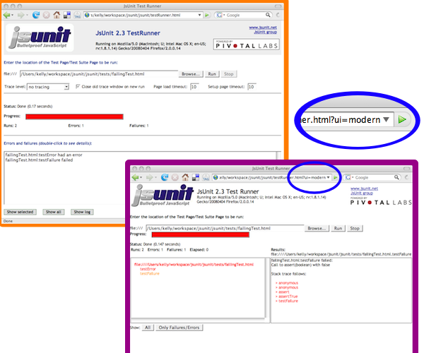
JsUnit Modern UI (in trunk)

Slide 165
"Punt" and make a manual jsunit_start_server script
# Because automated process management is not TSTTCPW for this tutorial, and it's hard
# This is also easily ported to a batch file on windows
$ cd ~/mysite
$ gedit script/jsunit_start_server.sh ant -f /home/ci/mysite/public/javascripts/jsunit/build.xml -DbrowserFileNames=/home/ci/mysite/public/javascripts/jsunit/bin/unix/start-firefox.sh -Dport=8081 start_server

Slide 166
Check in jsunit_start_server script and leave it running
$ svn add script/jsunit_start_server.sh
$ svn propedit svn:executable script/jsunit_start_server.sh
# add 'true' line
$ script/jsunit_start_server.sh
# ignore warning about tools.jar
# make sure it starts and leave it running
# (ctrl-c when you want to kill it later)
# open a new terminal tab
$ cd ~/mysite
$ svn ci -m "add jsunit start script"

Slide 167
Add jsunit task
$ gedit Rakefile task :cruise do
Rake::Task['test'].invoke
Rake::Task['jsunit_distributed_test'].invoke end task :jsunit_distributed_test do output = `ant -f public/javascripts/jsunit/build.xml -Durl=http://localhost:8080/jsunit/jsunit/testRunner.html?testPage=/jsunit/test_pages/prototype_test.html -DremoteMachineURLs=http://localhost:8081 -DresourceBase=public/javascripts distributed_test` raise "JsUnit Failed:\n" + output unless $?.success? puts "JsUnit tests passed" end

Slide 168
Commit jsunit task and check cruise
# Open cruise webpage under galeon, if not open
# jsunit will kill firefox, so we need a different browser
# Applications - Internet – Galeon, open http://localhost:3333
$ svn commit Rakefile -m "add jsunit_distributed_test task"
# Check cruise webpage, should still be passing
# You will see jsunit pop up Firefox automatically as the build is running

Slide 169
F. Selenium Setup

Slide 170
Install Selenium Gem
# WARNING: use capital “S” Selenium – there is another rubyforge lowercase “s” selenium project, and a dozen other similarly-named ones. WhatEVER...
$ sudo gem install Selenium --version=1.0.7
# NOTE: Version 1.0.7 currently has some mirror issue on RubyForge, if it doesn't download, try to pull from my gem server:
$ sudo gem install Selenium --source=http://gems.thewoolleyweb.com

Slide 171
Start selenium using command from Selenium gem
$ selenium
# make sure it starts and leave it running, ctrl-c to kill it
# Open new terminal tab

Slide 172
Set up selenium test dir
$ cd ~/mysite
$ mkdir test/selenium

Slide 173
Create selenium test stub
$ gedit test/selenium/user_test.rb require 'test/unit' require 'rubygems' require 'selenium' class UserTest < Test::Unit::TestCase def setup
@browser = Selenium::SeleniumDriver.new("localhost", 4444, "*firefox /usr/lib/firefox/firefox-bin", "http://localhost:3001", 10000)
@browser.start end def teardown
@browser.stop end def test_user_add_flow end end

Slide 174
Fill in selenium test stub
$ gedit test/selenium/user_test.rb def test_user_add_flow timestamp = Time.new.to_s user_name = 'joe ' + timestamp
@browser.open "http://localhost:3001/users"
@browser.click "link=New user"
@browser.wait_for_page_to_load
@browser.type "id=user_name", user_name
@browser.click "commit"
@browser.wait_for_page_to_load assert @browser.is_text_present(user_name) end

Slide 175
Create selenium_test rake task including start and stop of server
$ gedit Rakefile task :cruise do
...
Rake::Task['selenium_test'].invoke end task :selenium_test do begin process = IO.popen("ruby /home/ci/.cruise/projects/MySite/work/script/server --port=3001") output = `ruby test/selenium/user_test.rb` raise "Selenium Failed:\n" + output unless $?.success? puts "Selenium tests passed" ensure
Process.kill(9,process.pid) end end

Slide 176
Check in and check cruise
$ svn add test/selenium
$ svn commit -m "selenium test"
# check cruise, it should run everything and be green

Slide 177
Break tests and fix them!
# cause ruby/jsunit/selenium failures, and check them in
# see cruise go red, then fix them
# click links for ruby/selenium failures
# there's a test bug! (next page after too many tests)
# good to drop DB before each CI run...
# This naive implementation has return code bugs (crash if webrick already running)

Slide 178
Same concept for other tools/ Languages/
CI Engines

Slide 179
Now for some bleeding edge ccrb + Git, hot off the press

Slide 180
Install Git:
# For some reason, Ubuntu/aptitude wanted to install git off the Ubuntu CD, so disable that
$ sudo gedit /etc/apt/sources.list
# comment first 'cdrom' line and save
$ sudo aptitude install -y git-core git-svn

Slide 181
Clone current svn repository to git:
$ git-svn clone file:///home/ci/repo/mysite ~/mysite-git

Slide 182
Clone and run trunk of ccrb, which has Git support:
$ git clone git://rubyforge.org/cruisecontrolrb.git ~/cc-git
# find tab currently running cc 1.3.0, ctrl-c to stop it (look for localhost:3333 in console)
$ cd ~/cc-git
$ ./cruise start
# go to a new tab

Slide 183
Create and run ccrb project for the mysite git project:
$ cd ~/cc-git
$ ./cruise add MySiteGit -s git -r /home/ci/mysite-git
# open/refresh Galeon for new project
Applications -> Internet -> Galeon -> localhost:3333
Click “Start Builder”
# Watch for jsunit and selenium to run
# should get a successful build!
# Notice truncated GUID as build ID instead of svn revision

Slide 184
Coding Done!

Slide 185
2. Gettin' Fancier

Slide 186
All Handwaving
Now

Slide 187
Multiplatform

Slide 188
Multibrowser

Slide 189
Farms

Slide 190
Selenium Grid
JsUnit Server

Slide 191
Virtualization: One Box,
Three Platforms mac/win/linux

Slide 192
Automate and Test Deployment Process

Slide 193
Test Rollback process!

Slide 194
Configuration Management /
Version Control

Slide 195
Auto-tag Green Builds

Slide 196
Automatically pre-create
Release
Branches

Slide 197
Build ALL active branches under CI

Slide 198
Multiple Libraries/ Projects

Slide 199
Dependencies
Among Common Libraries and
Projects

Slide 200
Dependency modifications should trigger builds of all dependents

Slide 201
Consistent Tags/Baselines
Among
Projects:
Naming/Usage

Slide 202
Versioning of Dependencies (or not):
Mainline / Snapshot / trunk / HEAD vs baselines / tags

Slide 203
Different Builds for Different Environments:
Development vs
Demo/Prod

Slide 204
Publishing Artifacts/ Dependencies:
Deployed (Jars/Gems) vs
SCM (svn:externals)

Slide 205
Hackability vs Stability: Fear should not inhibit improvement of common libraries

Slide 206
What dependency versions are you running on prod? Is it the same as dev?

Slide 207
Cautious Optimism http://tinyurl.com/2cvbj4

Slide 208
Nirvana: Green tags/artifacts instantly used across all dev environments, all deploys have known, green, stable, baselined dependencies

Slide 209
Suites:
You can have more than one!

Slide 210
It's all about Feedback

Slide 211
Timely vs
Comprehensive

Slide 212
Fast vs
Thorough

Slide 213
Commit-Triggered vs Scheduled

Slide 214
Minimize Checkout Time

Slide 215
But safer to do clean builds

Slide 216
Get HUGE Dependencies and binaries out of Source Control if they take a long time to check out

Slide 217
RubyGems vs piston/ svn:externals

Slide 218
Metrics

Slide 219
Code Coverage - rcov

Slide 220
Mutation Testing – Heckle

Slide 221
Flog: Hurt Your Code

Slide 222
red/green trends

Slide 223
Build Length Trends

Slide 224
Notification

Slide 225
Information Radiator(s)

Slide 226
email

Slide 227
CCMenu / CCTray

Slide 228
RSS

Slide 229
IM

Slide 230
Growl

Slide 231
Ambient Orb

Slide 232
13” CRT with red/green background

Slide 233
Suggested audio for first failure, continued failure, fixed: Homer Simpson & Arnold Schwarzenegger Doh!, You Lack Discipline!, WooHoo!
(The Louder the Better)

Slide 234
Whatever people will pay attention to!

Slide 235
Aggregate and display multiple ccrb instances via RSS feeds (easy Rails app)

Slide 236
Tool Shoutouts

Slide 237
jQuery http://jquery.com/

Slide 238
JSSpec http://code.google.com/p/jsspec

Slide 239
Polonium, js_spec (runner),
Funkytown http://rubyforge.org/projects/pivotalrb

Slide 240
Screw::Unit http://rubyforge.org/projects/screwunit/

Slide 241
JsUnitTest http://jsunittest.com/

Slide 242
3. Gotchas

Slide 243
Random Gotchas / Mantras:
* “It's not easy being Green”
* Broken Windows are Bad (“Who cares, it's always red...”)
* False Negatives are Bad
* Crying Wolf (“it failed for no reason”)
* “Intermittent” failures (but it's not intermittent after you can reproduce it)
* “Works Locally” (is your local environment the same as CI? Which one is Prod closer to???)
* You can always “temporarily” disable a test in CI
* One disabled test is better than a red CI
* Browser Settings (autoupdate, etc) Preventing Browser Close

Slide 244
More Random Gotchas:
* False Positives are Bad too - being Green, when return code (echo $?) from some step is not 0
* Tricks to avoid false positives:
* Use rake task exec
* system(“cmd”) || raise(“cmd failed)
* Test::Unit had return code bugs for a long time due to not handling entire Exception class hierarchy correctly (Finally fixed in Ruby 1.8.6/1.9???)

Slide 245
4. Questions?

Slide 246
Chad Woolley
PivotalLabs.com thewoolleyman@gmail.com thewoolleyweb.com/ ci_for_the_rails_guy_or_gal

