Slide 1
For best formatting, please install the FreeSansBold.ttf font under openoffice/share/font: http://thewoolleyweb.com/ci_for_the_web_2.0_guy_or_gal/tools/font/FreeSansBold.ttf
(even then, some OpenOffice platforms may require you to do outline -> select all -> and pick the font. But hey, it's free...)

Slide 2
Welcome! If you want to follow along, borrow a flash drive, copy the contents to your drive, and see the README. Or, download from: thewoolleyweb.com/ ci_for_the_web_2.0_guy_or_gal

Slide 3
CI for the Web 2.0 /G(uy|al)/

Slide 4
Obligatory
Boiler
Plate

Slide 5
Who

Slide 6
Chad Woolley thewoolleyman @ gmail.com

Slide 7
Pivotal Labs
.com

Slide 8
Who are YOU? CI? Linux? Virtualization? Java? Ruby? JsUnit? Selenium?

Slide 9
What

Slide 10
CI == Continuous Integration

Slide 11
Martin Fowler -
Seminal CI Article

Slide 12
Running all your tests on every commit

Slide 13
Automatically

Slide 14
How

Slide 15
Takahashi Method ==
Big Font!

Slide 16
Agenda:

Slide 17
1. Code: The simplest tutorial that could POSSIBLY work

Slide 18
Coding
Tasks
Outline

Slide 19
A. Install
Linux on
VMWare

Slide 20
B. Install Prereqs: ruby, java, mysql, svn, ant, alternate browser

Slide 21
C. Create sample Ruby on Rails Project

Slide 22
D. cruisecontrol.rb setup

Slide 23
E. JsUnit Setup

Slide 24
F. Selenium Setup

Slide 25
2. Gettin' Fancier

Slide 26
3. Gotchas

Slide 27
4. Questions

Slide 28
Tools
Used

Slide 29
Cross-Platform, Mostly*
Free

Slide 30
* VMware is not free on all platforms

Slide 31
VMware

Slide 32
Parallels is a Virtualization Alternative

Slide 33
Or, you can skip Virtualization and install Ubuntu directly on a spare PC. Just burn the ISO image to a CD.

Slide 34
Ubuntu Linux

Slide 35
cruisecontrol.rb

Slide 36
JsUnit

Slide 37
Selenium

Slide 38
There is a lot of material in this presentation

Slide 39
We will move FAST

Slide 40
Maybe too fast for you to follow along during the preso (sorry!)

Slide 41
But it's all on the slides

Slide 42
You can yell “Bingo” if you finish it before I do.

Slide 43
Intended to be comprehensive, easily repeatable, generic, cross-platform

Slide 44
Contains everything* you need to try this on a real project

Slide 45
* “everything” except the stuff that doesn't work on your project or environment. Error messages and Google are your friend :)

Slide 46
As a matter of fact, it almost certainly won't work perfectly for you. Integrating this stuff is hard, and new problems arise as tools and libraries evolve. Embrace the bleeding cutting edge, keep a positive attitude, and help fix bugs.

Slide 47
It's OK to sit back and watch

Slide 48
Try it at your home or workplace, at your own pace

Slide 49
Live!

Slide 50
No Hand Waving

Slide 51
Their WILL be typos!

Slide 52
You down with OCD?

Slide 53
Then you'll know me!

Slide 54
Just please don't be “That Guy” (or Gal)!

Slide 55
You know, “That Guy” who stands up and wants to expound on irrelevant minutiae during the middle of a presentation...

Slide 56
Nitpicks and Linux hints Welcome...

Slide 57
...over beer, AFTER the presentation

Slide 58
...but seriously, if you are a bit OCDish, you might make a good CI G(uy|al) - because there's a lot of moving parts that all have to integrate...

Slide 59
...Continuously!

Slide 60
1. Time to Code!

Slide 61
A. Install
Linux on
VMWare

Slide 62
No time to install Linux live, but VMWare and images are on USB Keys

Slide 63
My Barebones Linux VM Setup:
Base:
VMWare on Macbook Pro 17”
Ubuntu 7.04 desktop VM from ISO
VMware Tools installed
Optional:
Change resolution (1680x1050)
Mouse Acceleration and Sensitivity
Terminal scrollback

Slide 64
Everything should work on pretty much any modern Unix distro

Slide 65
Following are screenshots and instructions to set up basic Ubuntu on VMware

Slide 66
We will skip them for now, but you can use them as a guide when you try it later

Slide 67
Original screenshots in /presentation /screenshots if these are too small to read

Slide 68
VMware Mac Setup:
/presentation
/screenshots
/01a_mac_vmware_ fusion_screenshots

Slide 69
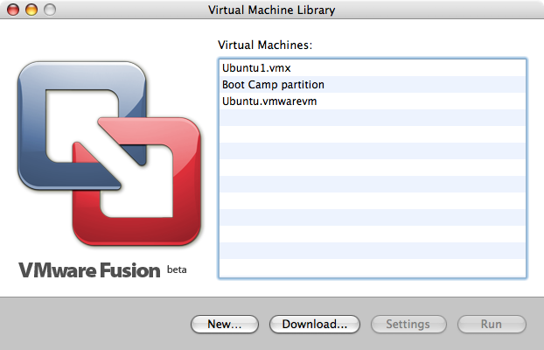
01_Virtual_Machine_Library.png

Slide 70
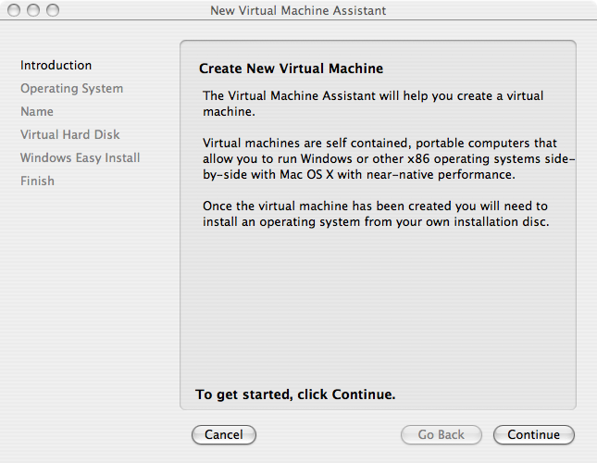
02_Create_New_Virtual_Machine.png

Slide 71
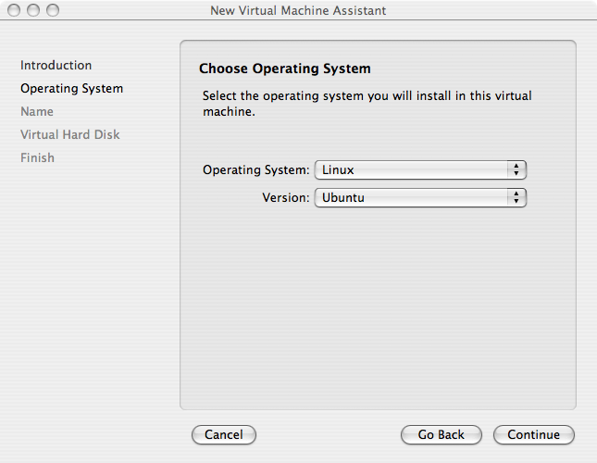
03_Choose_Operating_System.png

Slide 72
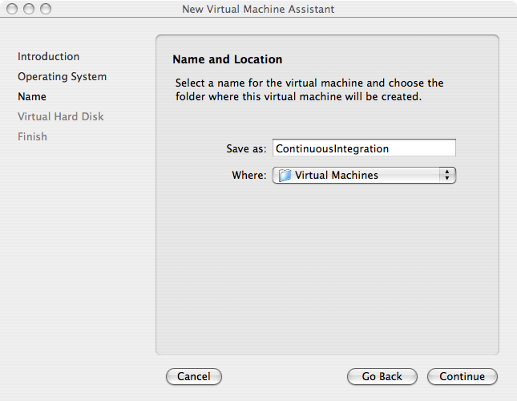
04_Name_and_Location.png

Slide 73
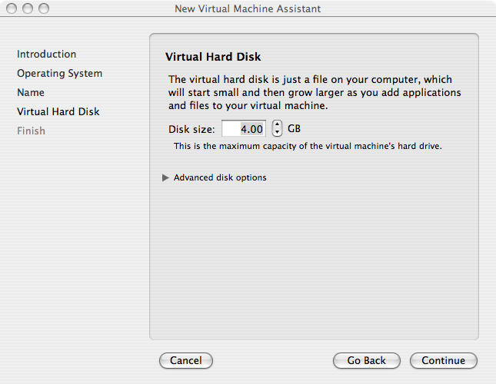
05_Virtual_Hard_Disk.png

Slide 74
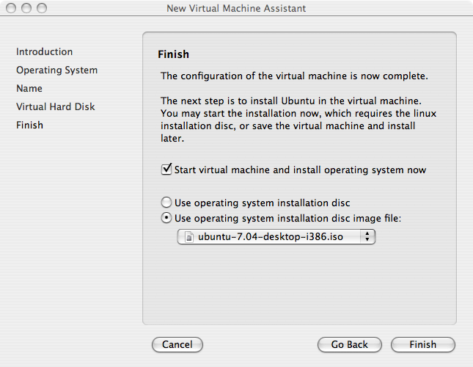
06_Finish.png

Slide 75
VMware Win Setup:
/presentation
/screenshots
/01b_win_vmware_ server_screenshots

Slide 76
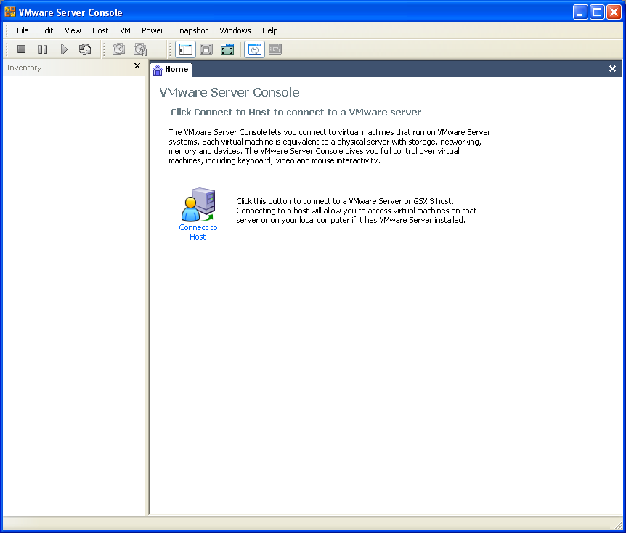
01_VMware_Server_Console.PNG

Slide 77
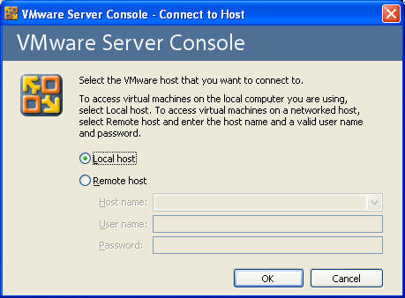
02_Connect_To_Host.PNG

Slide 78
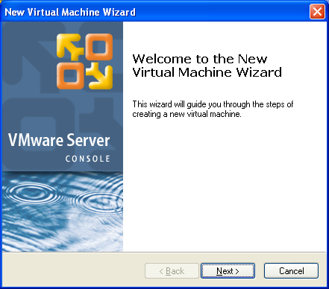
03_New_Virtual_Machine.PNG

Slide 79
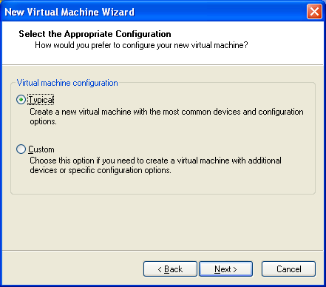
04_Virtual_Machine_Configuration.PNG

Slide 80
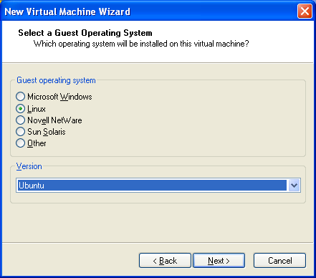
05_Select_a_Guest_Operating_System.PNG

Slide 81
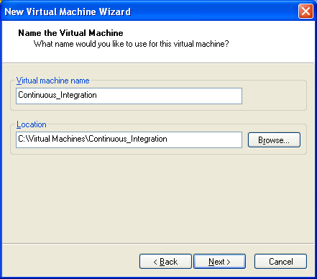
06_Name_the_Virtual_Machine.PNG

Slide 82
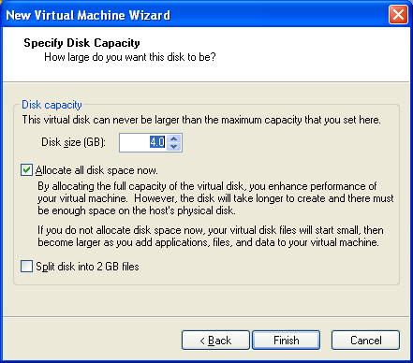
07_Network_Type.PNG

Slide 83
08_Specify_Disk_Capacity.PNG

Slide 84
Mac/Win Ubuntu VM Setup:
/presentation
/screenshots
/02_ubuntu_vm_ setup_screenshots

Slide 85
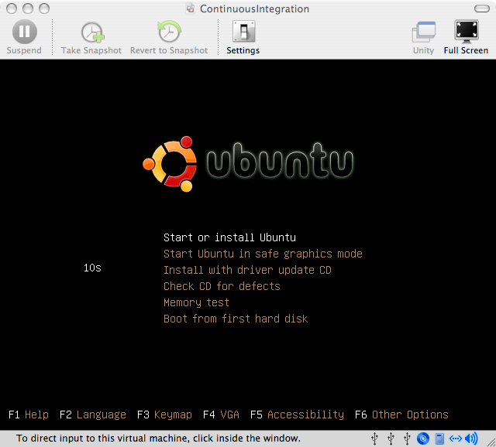
01_Start_or_Install_Ubuntu.png

Slide 86
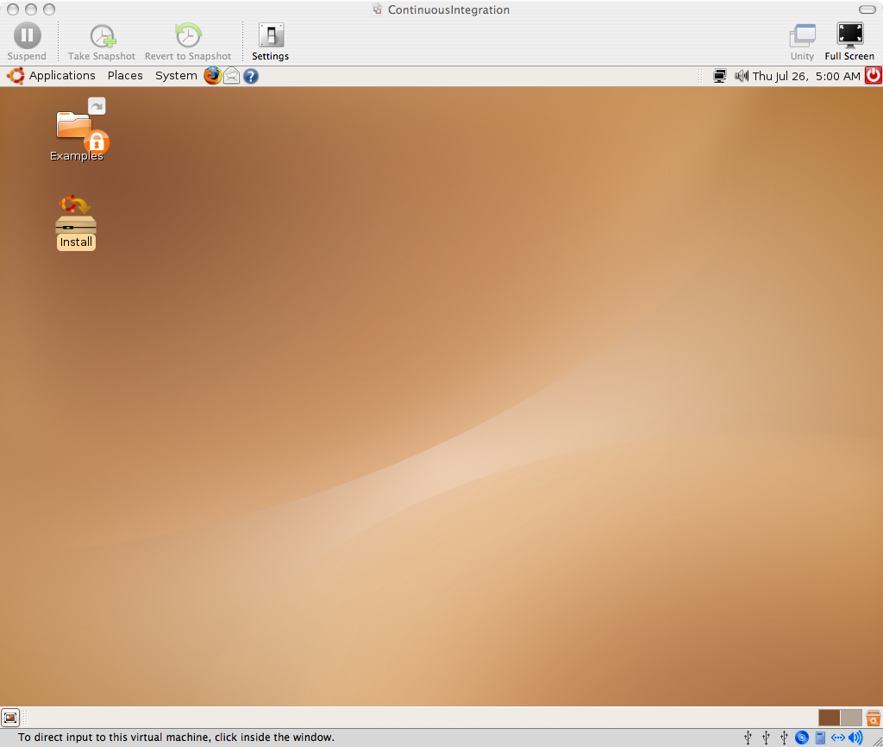
02_Install_Icon.png

Slide 87
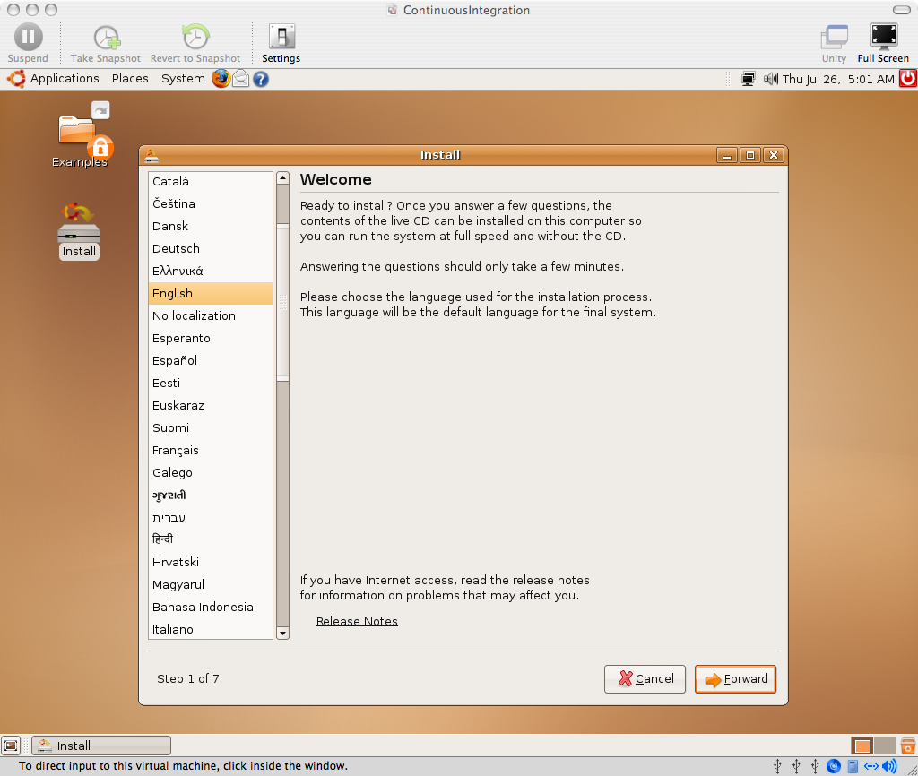
03_Welcome.png

Slide 88
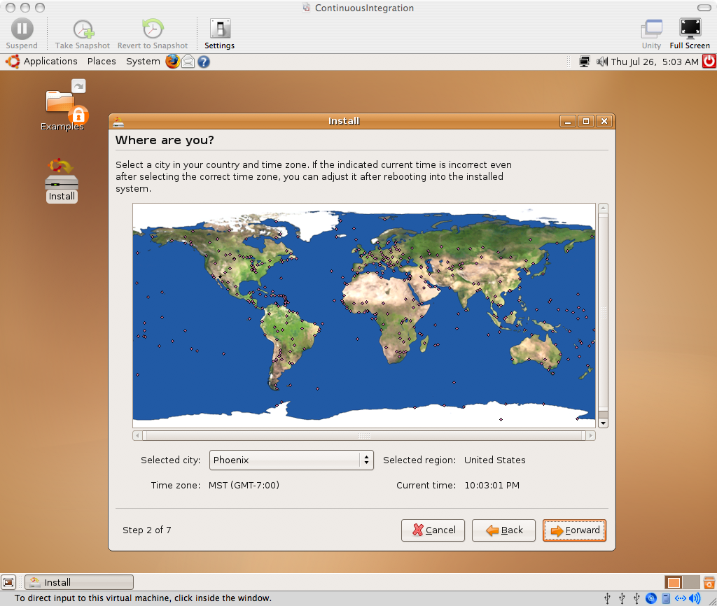
04_Where_are_you.png

Slide 89
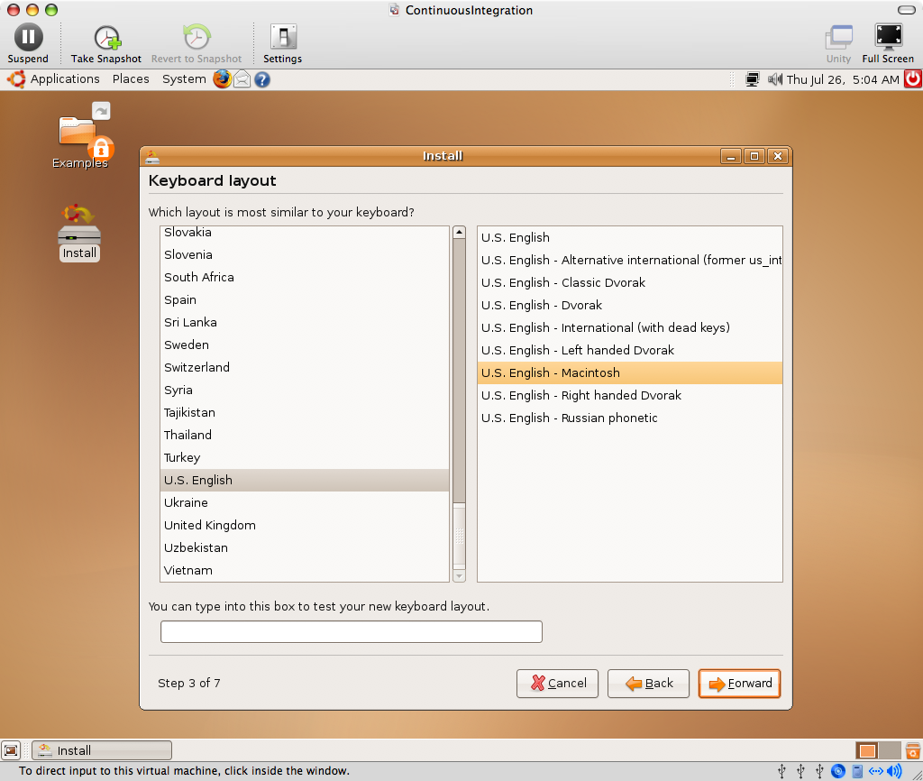
05_Keyboard_Layout.png

Slide 90
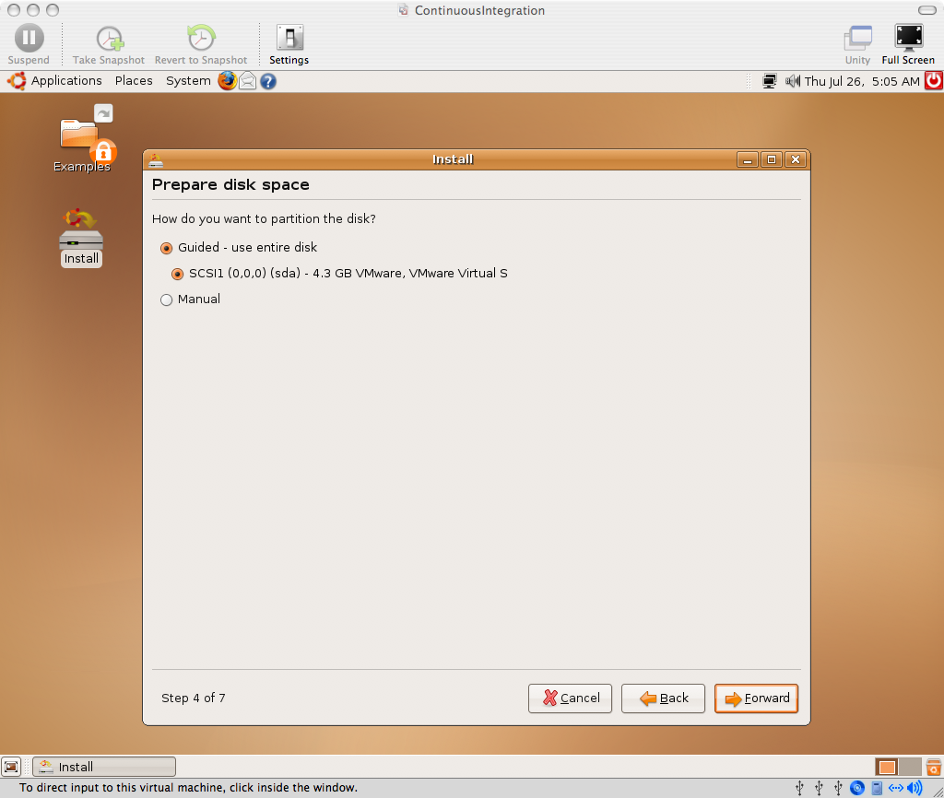
06_Prepare_disk_space.png

Slide 91
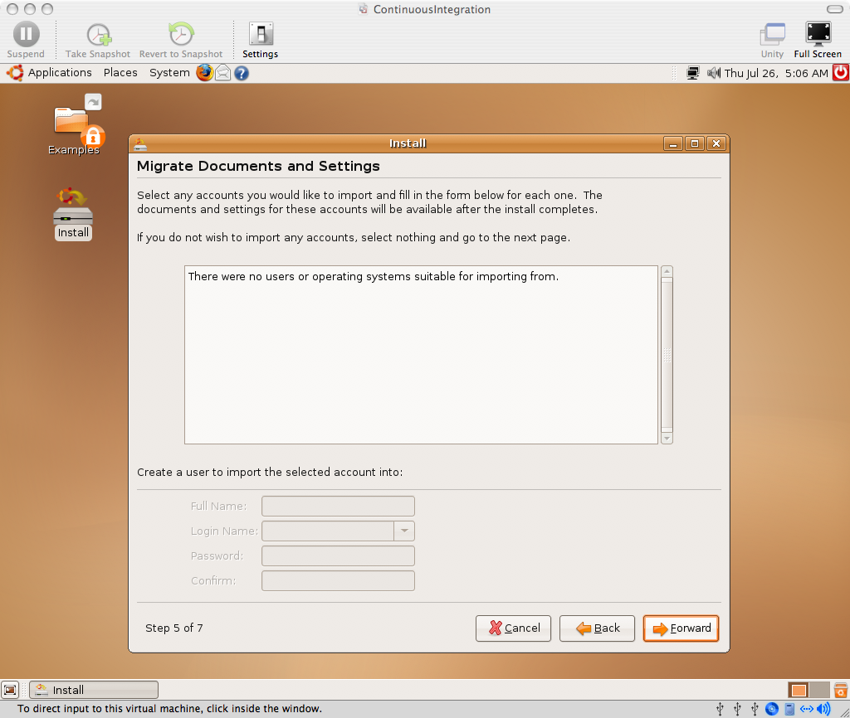
07_Migrate_Documents_and_Settings.png

Slide 92
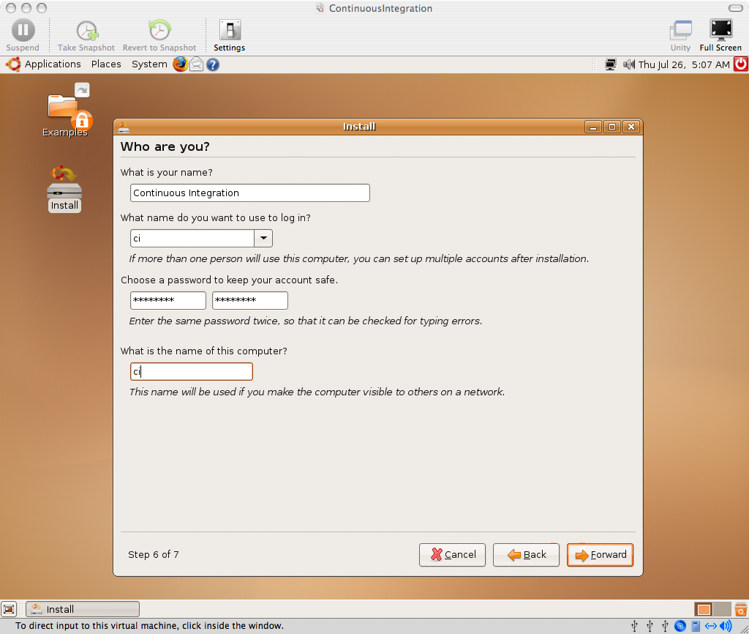
08_Who_are_you.png

Slide 93
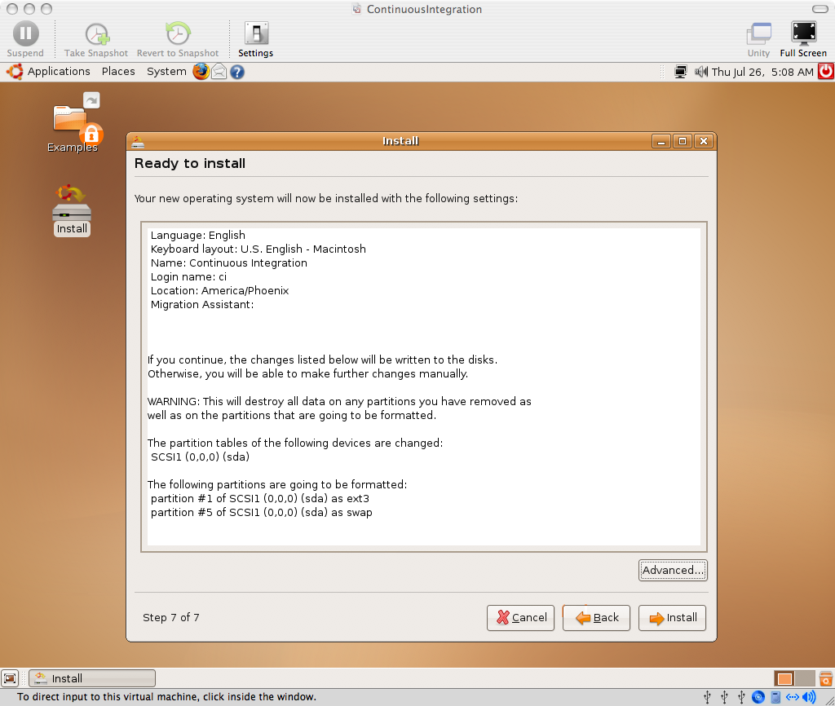
09_Ready_to_install.png

Slide 94
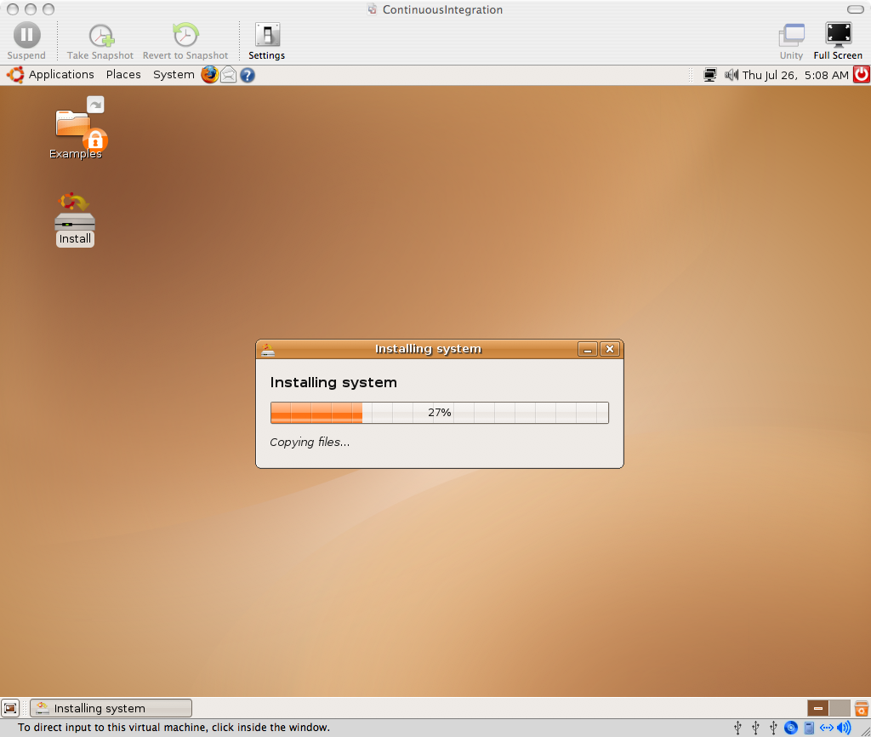
10_Installing_system.png

Slide 95
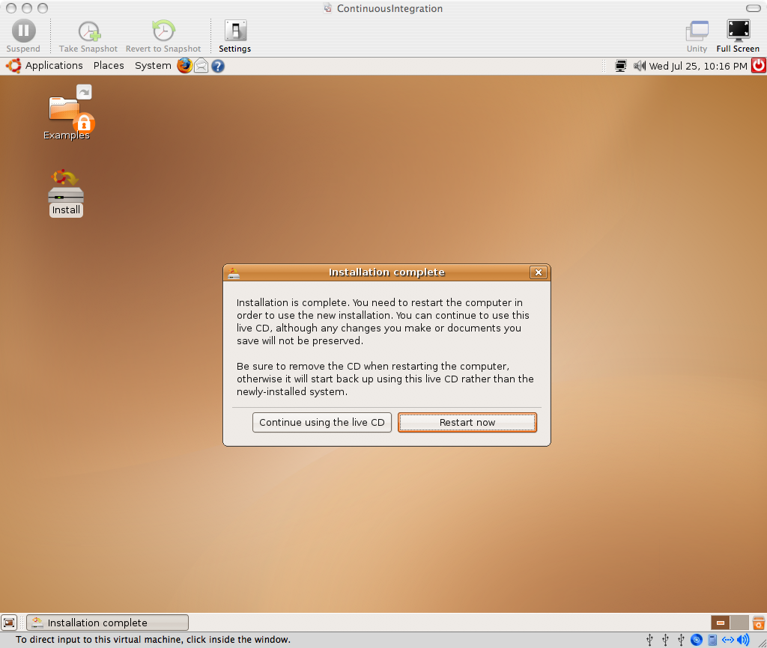
11_Installation_complete.png

Slide 96
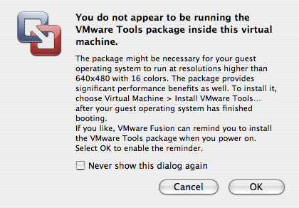
12_VMware_Tools_reminder.png

Slide 97
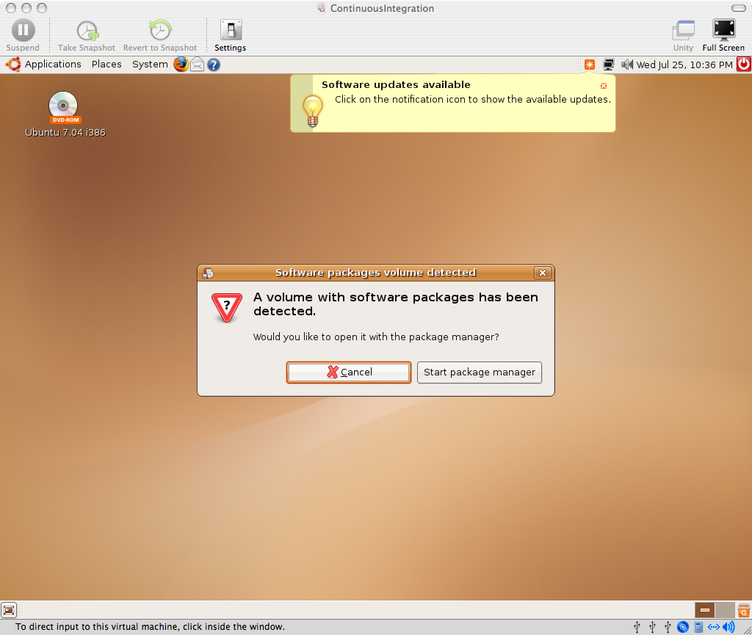
13_Cancel_package_manager.png

Slide 98
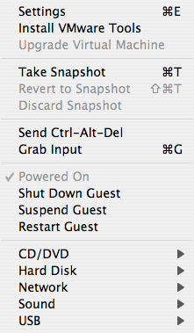
14_Virtual_Machine_Menu_Install_VMware_Tools.png

Slide 99
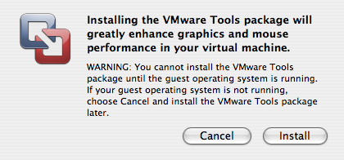
15_Installing_the_VMware_Tools_package.png

Slide 100
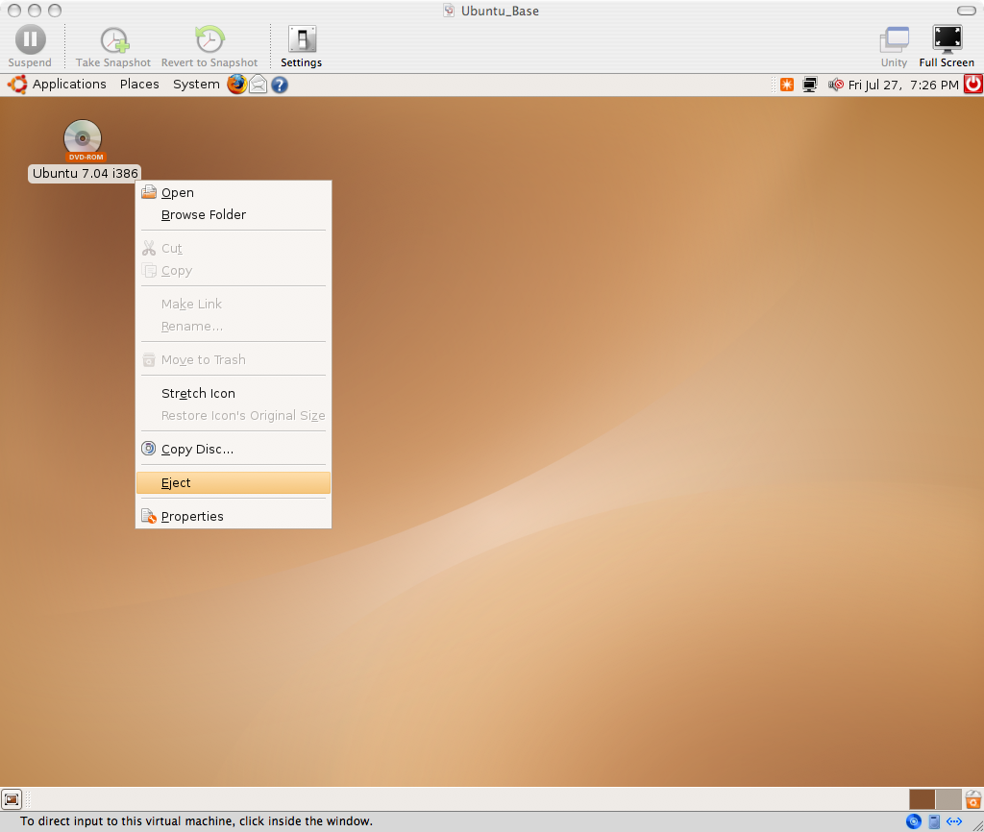
16_Eject_Ubuntu_ISO.png

Slide 101
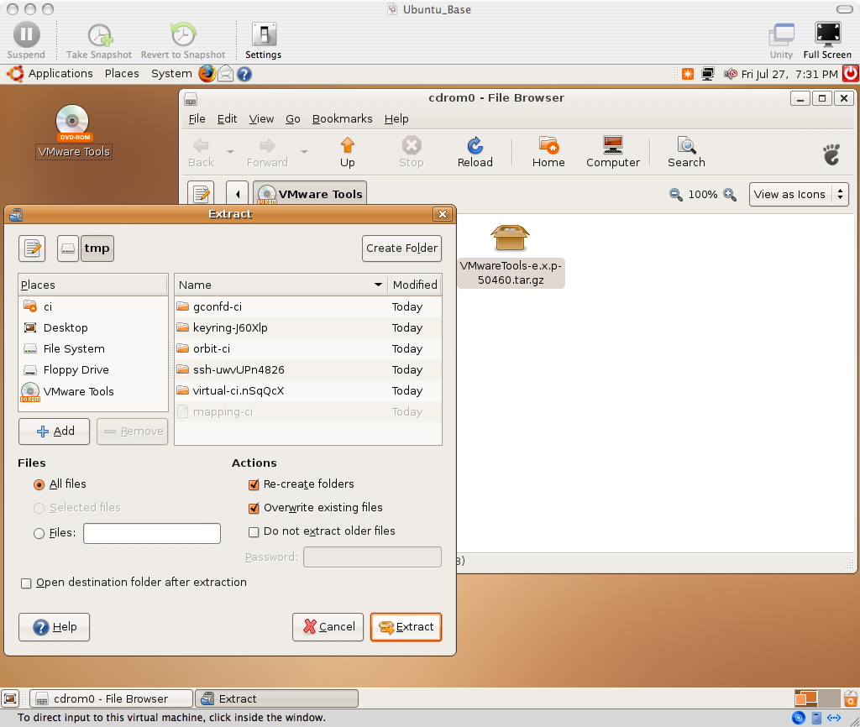
17_Extract_VMware_Tools.png

Slide 102
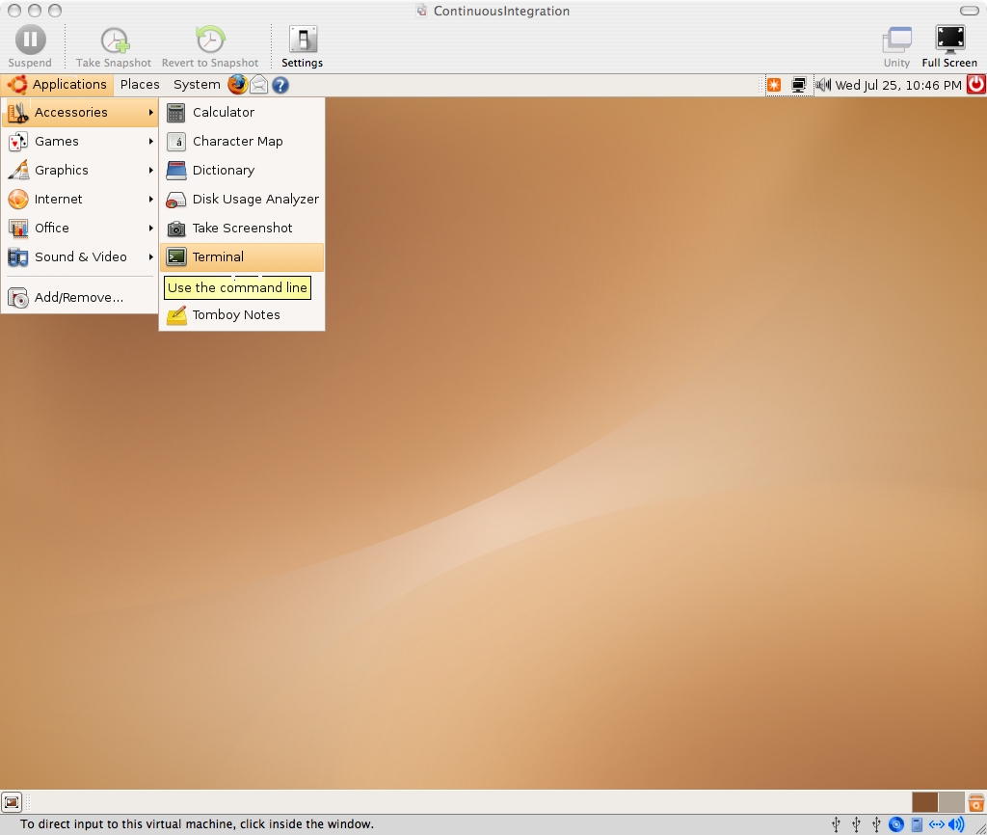
18_Applications_Accessories_Terminal.png

Slide 103
Install Vmware Tools (Optional):
$ cd /tmp/vmware-tools-distrib
$ sudo ./vmware-install.pl
# enter password for sudo
# accept defaults for all prompts
# reboot

Slide 104
Other Ubuntu Tweaks (Optional):
* System -> Preferences -> Screen Resolution
* System -> Preferences -> Mouse
* Drag Applications -> Accessories -> Terminal icon to quick launch area
* Terminal -> Edit -> Current Profile -> Scrolling -> Scrollback = 99999
* Ctrl +, Ctrl - in Terminal to change font size

Slide 105
B. Install Prerequisites

Slide 106
Legend
$ == shell input
# == comment or instructions
(nothing) == editor input or stdin
Example:
# sudo should prompt for a password unless you've sudo'd recently
$ sudo ls password
# should get file list

Slide 107
We will keep everything in the home dir, or "~"
You can put it wherever you want

Slide 108
Ruby Packaging on Ubuntu/Debian: Plan9 vs FHS and LSB == confusing

Slide 109
You can install ruby via apt-get, but building it from source is recommended.

Slide 110
Install Ruby from source:
# install all prereqs/extensions in case you need them
$ sudo apt-get update
$ sudo apt-get install -y zlib1g zlib1g-dev
$ sudo apt-get install -y libssl-dev openssl
$ wget ftp://ftp.ruby-lang.org/pub/ruby/ruby-1.8.5.tar.gz
$ tar -zxvf ruby-1.8.5.tar.gz
$ cd ruby-1.8.5
$ gedit ext/Setup
# Uncomment all “non-Win” lines (all except Win32API and win32ole) by removing “#”
$ ./configure
$ sudo make install

Slide 111
Install RubyGems:
$ wget http://rubyforge.org/frs/download.php/20989/rubygems-0.9.4.tgz
$ tar -zxvf rubygems-0.9.4.tgz
$ cd rubygems-0.9.4
$ sudo ruby setup.rb

Slide 112
Install Sun java:
$ sudo apt-get install -y sun-java5-bin
# accept all prompts

Slide 113
Install MySql (required by default Rails app):
$ sudo apt-get install -y mysql-server

Slide 114
Install subversion:
$ sudo apt-get install -y subversion

Slide 115
Install ant:
$ sudo apt-get install -y ant
$ sudo apt-get install -y ant-optional
# By default, this uses Gnu java, not Sun's...

Slide 116
Install mozilla as an alternate browser
# because jsunit will kill the browser it is testing
# libgtk1.2 is a dependency
$ sudo apt-get install -y libgtk1.2
$ wget http://ftp-mozilla.netscape.com/pub/mozilla.org/mozilla/releases/mozilla1.7.13/mozilla-i686-pc-linux-gnu-1.7.13-installer.tar.gz
$ tar -zxvf mozilla-i686-pc-linux-gnu-1.7.13-installer.tar.gz
$ sudo mozilla-installer/mozilla-installer
# install Navigator only
$ /usr/local/mozilla/mozilla &

Slide 117
Create Subversion Repo
$ svnadmin create repo

Slide 118
C. Create sample Ruby on Rails Project

Slide 119
Install Rails
$ sudo gem install rails --include-dependencies

Slide 120
Create a rails project
$ rails mysite
$ cd mysite

Slide 121
Create databases for rails project
$ mysql -u root mysql> create database mysite_development; mysql> create database mysite_test; mysql> create database mysite_production;
# (prod needed because cruise complained if it was not there) mysql> exit

Slide 122
Hack rails database.yml to match debian defaults
$ gedit config/database.yml
# add the following entry to all three databases socket: /var/run/mysqld/mysqld.sock
# NOTE: Sometimes, Rails will do this for you automatically...

Slide 123
Create a rails migration and db table
$ ruby script/generate migration CreateUserTable
$ gedit db/migrate/001_create_user_table.rb def self.up create_table "users" do |t| t.column "name", :string end end def self.down drop_table "users" end
$ rake db:migrate

Slide 124
Remove default index.html and create a page
$ rm public/index.html
$ ruby script/generate scaffold User
$ gedit test/functional/users_controller_test.rb
# change "users(:first)" to "users(:one)" – there should only be one occurrence

Slide 125
Test rails site
$ rake # should pass all tests
# New Terminal Tab: File -> Open Tab or Ctrl-Shift-T
$ cd mysite
$ ruby script/server
$ firefox http://localhost:3000/users
# create a user

Slide 126
Import site into subversion
# change back to home dir (~)
$ cd
# remove temp files we don't want to check in
$ rm -rf mysite/log/*
$ rm -rf mysite/db/schema.rb
$ rm -rf tmp
$ svn import mysite file:///home/ci/repo/mysite -m "import"
$ rm -rf mysite
$ svn co file:///home/ci/repo/mysite mysite

Slide 127
Set svn:ignores
# ignore all temp files, to have a clean workspace
$ cd mysite
$ export EDITOR=gedit
$ svn propedit svn:ignore . tmp logs
$ svn propedit svn:ignore log
*
$ svn propedit svn:ignore db schema.rb
$ svn commit -m "ignores"

Slide 128
D. cruisecontrol.rb setup

Slide 129
cruisecontrol.rb is still new. We will use a recent build, which has many features not found in the 1.1.0 release

Slide 130
Check http://cruisecontrolrb.thoughtworks.com/projects for a recent, successfully building revision. We'll use rev 521

Slide 131
Check out a recent build of CruiseControl.rb
$ svn checkout http://cruisecontrolrb.rubyforge.org/svn/trunk/@521 cc

Slide 132
Do a temporary hack to fix a bug in cc.rb rev 521
$ cd cc
$ echo '1' > projects/data.version
$ cd

Slide 133
Set up project in cruisecontrol
$ cd cc
$ ./cruise add MySite --url file:///home/ci/repo/mysite
$ ./cruise start

Slide 134
View cruisecontrol web page
# Ctrl-Shift-T for new Terminal tab
$ firefox localhost:3333
# click MySite
# Should be passing

Slide 135
Take this opportunity to familiarize yourself with cruisecontrol.rb. It's not covered here ;) http://cruisecontrolrb.thoughtworks.com/

Slide 136
Add cruise task to Rakefile
# cd to Rails project dir
$ cd ~/mysite
$ gedit Rakefile
# Add cruise task to bottom after 'requires': task :cruise do
Rake::Task['test'].invoke end
$ svn commit Rakefile -m "add cruise task"
# Check cruise webpage, should still be passing

Slide 137
Tweak firefox for automation
# open firefox, navigate to 'about:config'
# search for 'browser.sessionstore.resume_from_crash'
# toggle to false
# Preferences - Tabs - uncheck "warn when closing multiple tabs'
# Maybe turn off update prompts too...

Slide 138
E. JsUnit Setup

Slide 139
Download and Unzip JsUnit
$ wget http://easynews.dl.sourceforge.net/sourceforge/jsunit/jsunit2.2alpha11.zip
$ unzip jsunit2.2alpha11.zip
# copy junit.jar file to Ant lib dir (required by Ant)
$ sudo cp jsunit/java/lib/junit.jar /usr/share/ant/lib/

Slide 140
Copy jsunit to your app and check in
$ cd mysite/public/javascripts
$ mv /home/ci/jsunit .
$ svn add jsunit
$ export EDITOR=gedit
$ svn propedit svn:ignore jsunit/logs
# add * to ignore list
$ svn propedit svn:executable jsunit/bin/unix/start-firefox.sh
$ svn commit -m "add jsunit"

Slide 141
Create a jsunit test
$ mkdir test_pages
$ gedit test_pages/prototype_test.html
<html>
<head>
<script language="JavaScript" type="text/javascript" src="../jsunit/app/jsUnitCore.js"></script>
<script language="JavaScript" type="text/javascript" src="../prototype.js"></script>
<script language="javascript"> function testPrototypeWordSplit() { string = 'one two three'; assertEquals('one', ($w(string))[0]);
}
</script>
</head>
<body></body>
</html>

Slide 142
Run the jsunit test manually from browser and commit
$ cd
$ cd mysite
$ ruby script/server # unless you still have it running
$ firefox http://localhost:3000/javascripts/jsunit/testRunner.html
# Enter this in the "Run" field and click “Run”: http://localhost:3000/javascripts/test_pages/prototype_test.html
$ svn add public/javascripts/test_pages
$ svn commit -m "jsunit test"

Slide 143
"Punt" and make a manual jsunit_start_server script
# Because automated process management is not TSTTCPW for this tutorial, and it's hard
# This is also easily ported to a batch file on windows
$ cd mysite
$ gedit script/jsunit_start_server.sh ant -f /home/ci/mysite/public/javascripts/jsunit/build.xml -DbrowserFileNames=/home/ci/mysite/public/javascripts/jsunit/bin/unix/start-firefox.sh -Dport=8081 start_server

Slide 144
Check in jsunit_start_server script and leave it running
$ svn add script/jsunit_start_server.sh
$ svn propedit svn:executable script/jsunit_start_server.sh
# add 'true' line
$ script/jsunit_start_server.sh
# make sure it starts and leave it running
# ctrl-c if you want to kill it
$ svn ci -m "add jsunit start script"

Slide 145
Add jsunit task
$ gedit Rakefile task :cruise do
Rake::Task['test'].invoke
Rake::Task['jsunit_distributed_test'].invoke end task :jsunit_distributed_test do output = `ant -f public/javascripts/jsunit/build.xml -Durl=http://localhost:8080/jsunit/jsunit/testRunner.html?testPage=/jsunit/test_pages/prototype_test.html -DremoteMachineURLs=http://localhost:8081 -DresourceBase=public/javascripts distributed_test` raise "JsUnit Failed:\n" + output unless $?.success? puts "JsUnit tests passed" end

Slide 146
Commit jsunit task and check cruise
# Open cruise webpage under mozilla
# jsunit will kill firefox, so we need a different browser
$ /usr/local/mozilla/mozilla http://localhost:3333
$ svn commit Rakefile -m "add jsunit_distributed_test task"
# Check cruise webpage, should still be passing

Slide 147
F. Selenium Setup

Slide 148
Selenium 0.8.1 is proven, 0.9.0 is 'iffy'. Latest unreleased version is reported to be OK.

Slide 149
Download Selenium Remote Control
$ cd
$ wget http://release.openqa.org/selenium-remote-control/0.8.1/selenium-remote-control-0.8.1.zip
$ unzip selenium-remote-control-0.8.1.zip

Slide 150
Make a manual selenium_start_server script
$ cd mysite
$ cp /home/ci/selenium-remote-control-0.8.1/server/selenium-server.jar lib
$ svn add lib/selenium-server.jar
$ gedit script/selenium_start_server.sh java -jar /home/ci/mysite/lib/selenium-server.jar -interactive
$ svn add script/selenium_start_server.sh
$ svn propedit svn:executable script/selenium_start_server.sh
# add 'true' line
$ script/selenium_start_server.sh
# make sure it starts and leave it running, ctrl-c to kill it
$ svn ci -m "add selenium start script and jar"

Slide 151
Set up selenium test dir and copy ruby API file
$ cd mysite
$ mkdir test/selenium
$ cp ~/selenium-remote-control-0.8.1/ruby/selenium.rb test/selenium

Slide 152
Create selenium test stub
$ gedit test/selenium/user_test.rb require 'test/unit' require File.expand_path(File.dirname(__FILE__) + '/selenium') class UserTest < Test::Unit::TestCase def setup
@selenium = Selenium::SeleniumInterpreter.new("localhost", 4444, "*firefox /usr/lib/firefox/firefox-bin", "http://localhost:3001/", 10000);
@selenium.start end def teardown
@selenium.stop end def test_user_add_flow end end

Slide 153
Fill in selenium test stub
$ gedit test/selenium/user_test.rb def test_user_add_flow timestamp = Time.new.to_s user_name = 'joe ' + timestamp open "http://localhost:3001/users" click "link=New user" sleep 2 # <- Sleeping is bad! Use a wait_for loop... type "id=user_name", user_name click "commit" sleep 2 assert is_text_present(user_name) end

Slide 154
Create selenium_test rake task including start and stop of server
$ gedit Rakefile task :cruise do
...
Rake::Task['selenium_test'].invoke end task :selenium_test do begin process = IO.popen("ruby /home/ci/cc/projects/MySite/work/script/server --port=3001") output = `ruby test/selenium/user_test.rb` raise "Selenium Failed:\n" + output unless $?.success? puts "Selenium tests passed" ensure
Process.kill(9,process.pid) end end

Slide 155
Check in and check cruise
$ svn add test/selenium
$ svn commit -m "selenium test"
# check cruise, it should run everything and be green

Slide 156
Break tests and fix them!
# cause ruby/jsunit/selenium failures, and check them in
# see cruise go red, then fix them
# click links for ruby/selenium failures
# there's a test bug! (next page after too many tests)
# good to drop DB before each CI run...
# This naive implementation has return code bugs (crash if webrick already running)

Slide 157
Same concept for other tools/ Languages/
CI Engines

Slide 158
Coding Done!

Slide 159
2. Gettin' Fancier

Slide 160
All Handwaving
Now

Slide 161
Multiplatform

Slide 162
Multibrowser

Slide 163
Farms

Slide 164
Virtualization: One Box,
Three Platforms mac/win/linux

Slide 165
Automate and Test Deployment Process

Slide 166
Test Rollback process!

Slide 167
Configuration Management /
Version Control

Slide 168
Auto-tag Green Builds

Slide 169
Automatically pre-create
Release
Branches

Slide 170
Build ALL active branches under CI

Slide 171
Multiple Libraries/ Projects

Slide 172
Dependencies
Among Common Libraries and
Projects

Slide 173
Dependency modifications should trigger builds of all dependents

Slide 174
Consistent Tags/Baselines
Among
Projects

Slide 175
Mainline / Snapshot / trunk / HEAD vs baselines / tags

Slide 176
Development vs
Demo/Prod

Slide 177
Artifacts:
Deployed (Jars/Gems) vs SCM (svn:externals)

Slide 178
Hackability vs Stability

Slide 179
Optimistic Pessimism vs Pessimistic Optimism

Slide 180
Nirvana: Green tags/artifacts instantly used across all dev environments

Slide 181
Suites

Slide 182
Feedback

Slide 183
Fast vs
Thorough

Slide 184
Commit-Triggered vs Scheduled

Slide 185
Minimize Checkout Time

Slide 186
Get HUGE Dependencies and binaries out of Source Control

Slide 187
RubyGems / Maven vs svn:externals / CVS modules

Slide 188
Metrics

Slide 189
Code Coverage - Emma/rcov

Slide 190
Mutation Testing – Heckle, Jester

Slide 191
red/green trends

Slide 192
Build Length Trends

Slide 193
Notification

Slide 194
Information Radiator(s)

Slide 195
email

Slide 196
RSS

Slide 197
IM

Slide 198
Growl

Slide 199
Ambient Orb

Slide 200
13” CRT with red/green background

Slide 201
Whatever people will pay attention to!

Slide 202
3. Gotchas

Slide 203
Random Gotchas / Mantras:
* “It's not easy being Green”
* Broken Windows are Bad (“Who cares, it's always red...”)
* False Negatives are Bad
* Crying Wolf (“it failed for no reason”)
* “Intermittent” failures (but it's not intermittent after you can reproduce it)
* “Works Locally” (is your local environment the same as CI?)
* You can always “temporarily” disable a test in CI
* One disabled test is better than a red CI
* False Positives are Bad too - being Green, when return code (echo $?) from some step is not 0
* Browser Settings (autoupdate, etc) Preventing Browser Close

Slide 204
4. Questions?

Slide 205
Chad Woolley thewoolleyman @ gmail.com thewoolleyweb.com/ ci_for_the_web_2.0_guy_or_gal

