Slide 1
GemInstaller

Slide 2
Chad Woolley thewoolleyman @ gmail.com thewoolleyweb.com

Slide 3


Slide 4
Don't UNDERESTIMATE the power of versions

Slide 5
Vendor Nothing

Slide 6
Explicit Dependencies and Versions

Slide 7
Merb Plugins Are Gems

Slide 8
--- defaults: install_options: --source=http://localhost:8808 gems:
- name: capistrano version: 2.0.0
- name: mechanize version: >= 0.6.10
#check_for_upgrade: true
- name: mongrel version: 1.0.1
- name: rails
<% if ENV['RAILS_GEM_VERSION'] %> version: <%= ENV['RAILS_GEM_VERSION'] %>
<% else %> version: 2.0.2
<% end %>

Slide 9
DISCIPLINE

Slide 10
Continuous Integration

Slide 11
Automated Repeatable Builds with Explicitly Versioned Dependencies

Slide 12


Slide 13
Don't Break My Box!

Slide 14
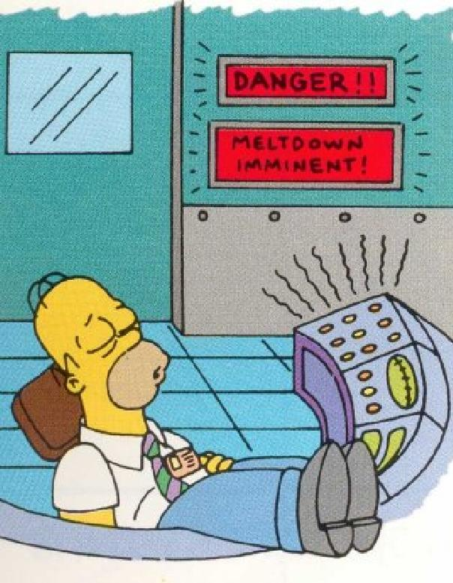

Slide 15
Don't Break the Build!

Slide 16


Slide 17
Don't Break Production!

Slide 18


