Slide 1
Improving LLM Reasoning Through Ontology-driven Knowledge Graphs
Theyaneshwaran Jayaprakash

Slide 2
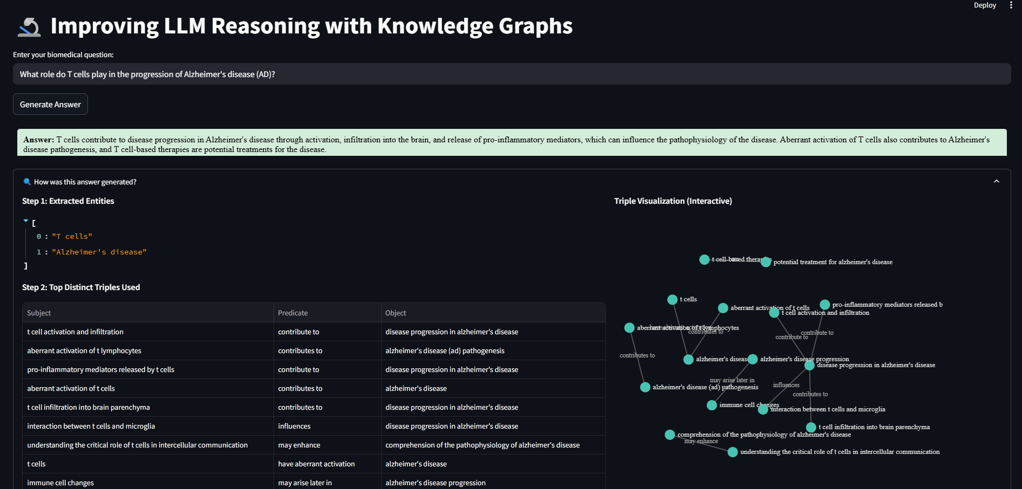
Built an End-to-End Pipeline for Interpretable, Evidence-Based Reasoning from Triples to Answers

Slide 3
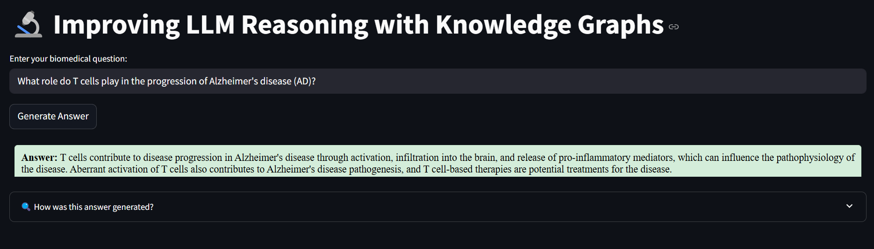
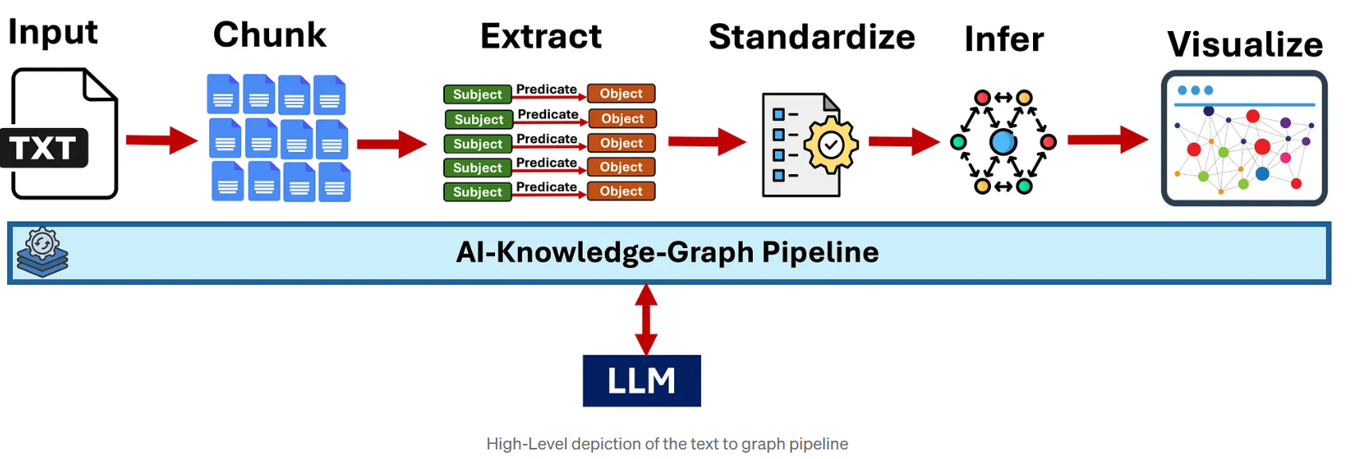
How is this answer being generated?

Slide 4
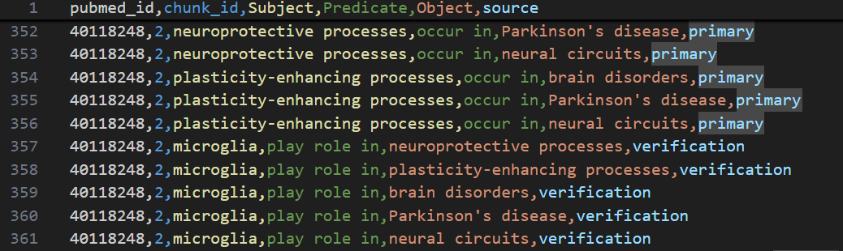
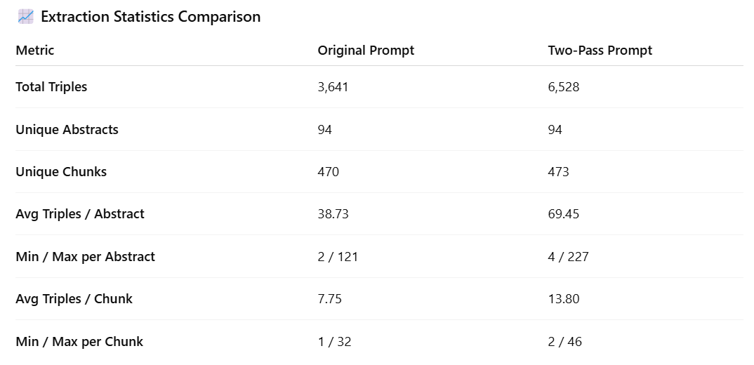
1. Triple Construction (Two Pass Extraction Strategy)
What is it?
A two-step process to extract subject–predicate–object triples from biomedical abstracts:
1. Primary Extraction:
Extracts all entities and direct relationships using domain-specific rules.
2. Verification & Recovery:
Re-analyzes the text with knowledge of entities and previously found triples to uncover missed, implicit, or long-distance relationships.
The two-pass method recovers 79% more triples by identifying relationships missed in the first pass.

Slide 5
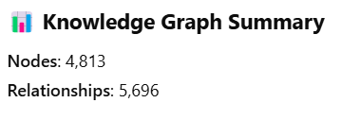
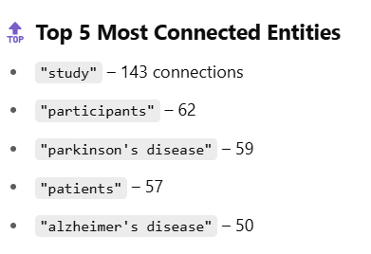
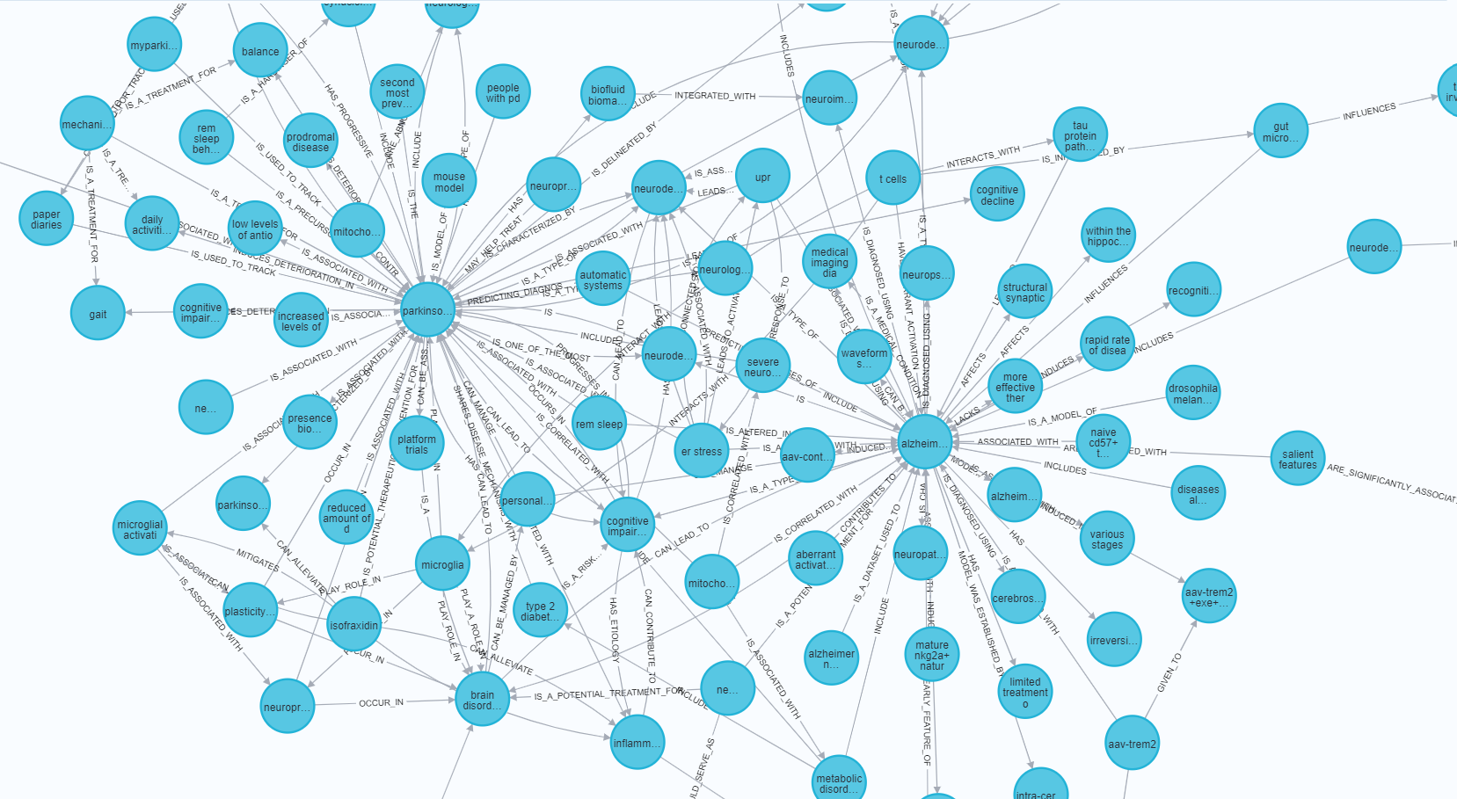
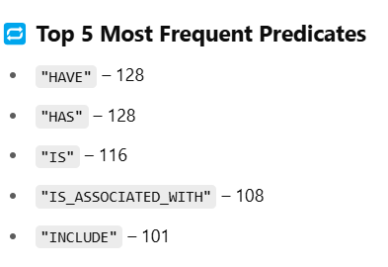
2. Entity Standardization (Rule Based) & Knowledge Graph Construction
Each entity is normalized
  (Lowercasing, Lemmatization, Stopword removal)
2. Canonical name selection
3. Deduplication

Slide 6
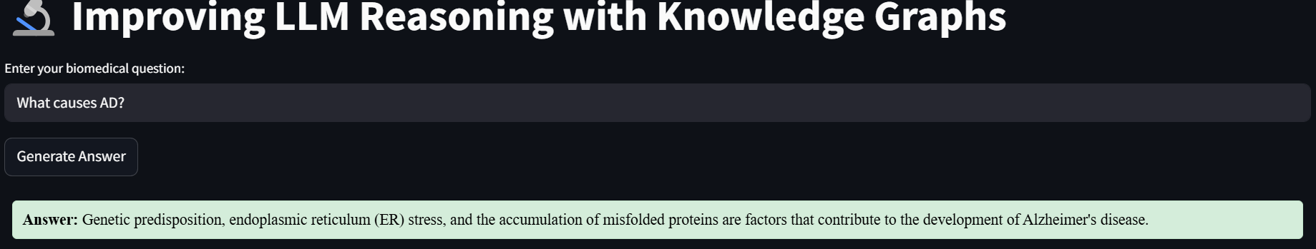
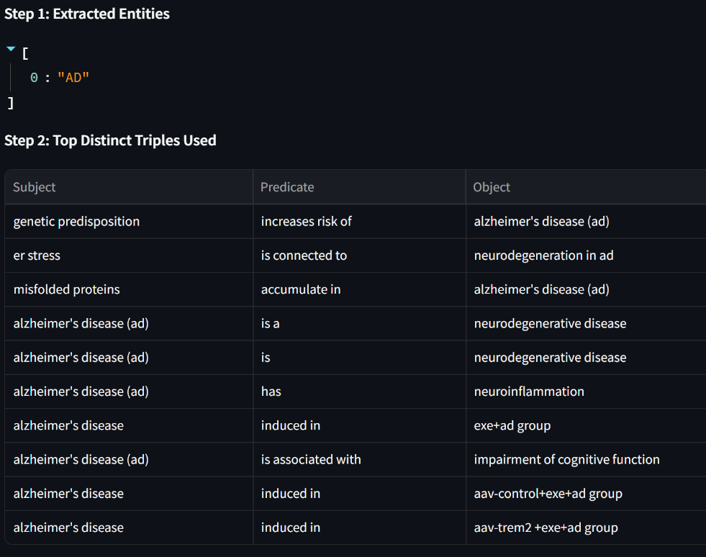
3. Graph Retrieval and Fine-Tuning, Optimization
Phase | What Happens
Offline | Embed all entity names using all-roberta-large-v1 Build and store FAISS index entity_index.faiss, entity_names.pkl Create full-text index on Neo4j entity names for fast retrieval
Online | Extract entities using Claude Query Neo4j for direct matches If missing, expand via FAISS similarity Retrieve related triples from Neo4j Rank triples by question similarity using SentenceTransformer

Slide 7

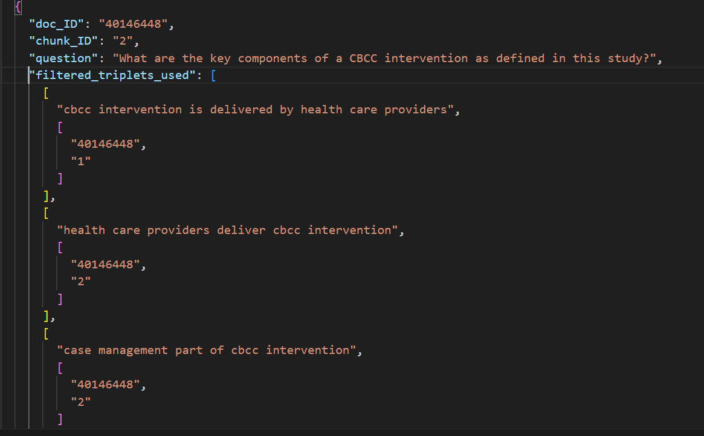
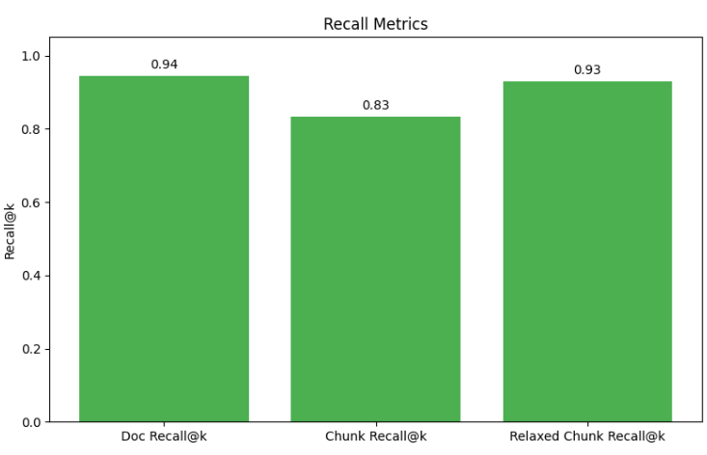
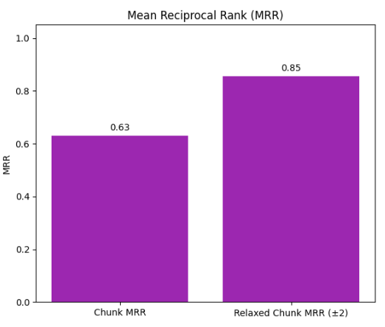
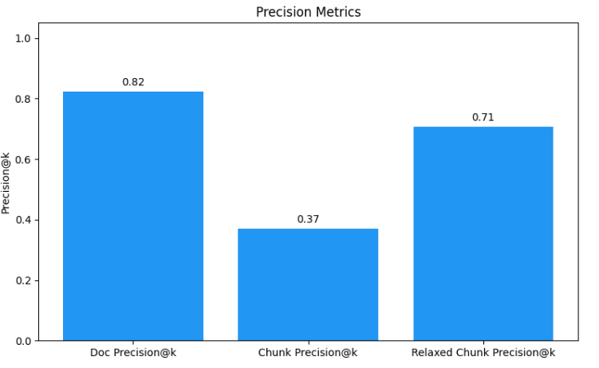
4. Graph Retrieval Validation
1. For each question, retrieved top relevant triples from Neo4j (1 Hop).

Slide 8
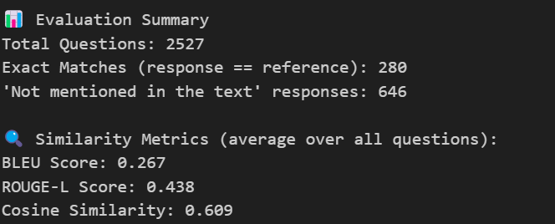
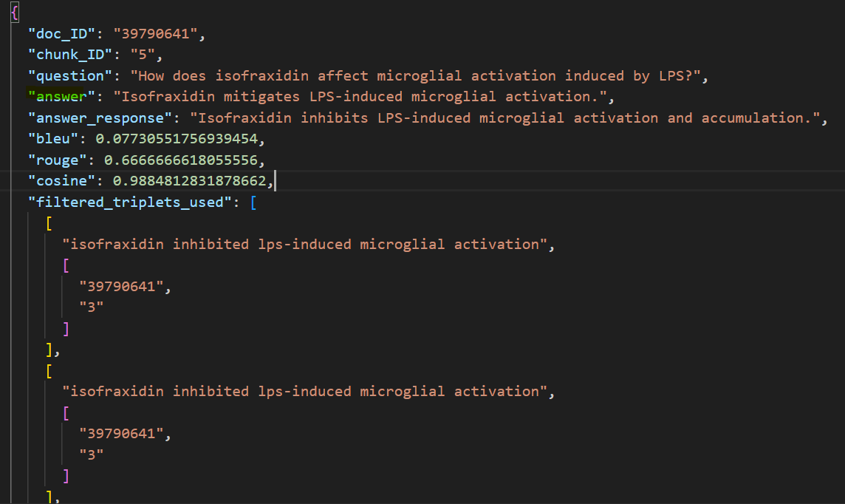
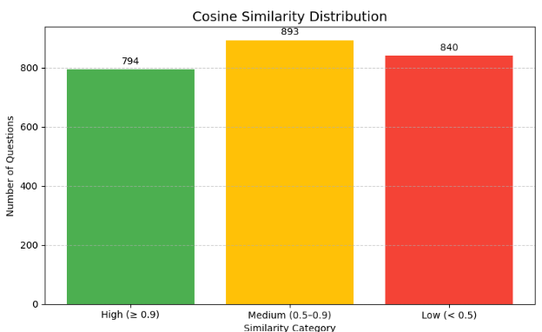
5. Graph Retrieval Evaluation
Generated ground truth answers using Claude, constrained to each chunk’s content
2 . Compared generated answers with retrieved top 10 triplets to reference answers using Cosine Similarity

Slide 9
6. Failure Analysis Summary
Total Failures: 120 (out of 2,647 QA runs)
Success Rate: 95.5%
Common Failure Causes
1. Entity Extraction Failed: Claude could not identify valid entities
2. No Triples Found: Neo4j returned no results for the extracted/expanded entities
3. Unexpected Errors: Format issues (e.g., trying to unpack missing triples)
Most failed questions were vague or underspecified, like:
What is the main focus of the study?” or “What is the objective of the research?”
\

Slide 10
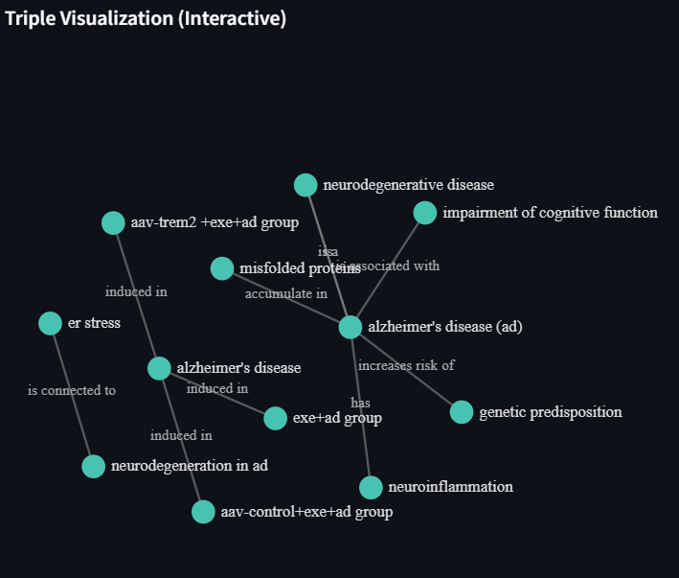
7. Next Steps
1. Entity linking and Better Normalization
2. Current Graph Retrieval pulls only 1 hop.
Need to validate multi hop path reasoning questions and answers (try to pull subgraphs)
MATCH path = (s:Entity)-[*1..2]-(o:Entity)
WHERE toLower(s.name) CONTAINS toLower($name) OR toLower(o.name) CONTAINS toLower($name)
RETURN path LIMIT 50

