Slide 1
Path
Master:
Your Guide to Shortest Routes
Project Presentation
Data Structures (22CSH-211)
By
Muskan Sharma (22BCS12730)
Kavya Rawat (22BCS12706)
Karan Nayal (22BCS12708)

Slide 2
Table of contents
01
02
03
04
05
06
Introduction
Problem & solution
Methodology
Result
Conclution
Future Aspects

Slide 3
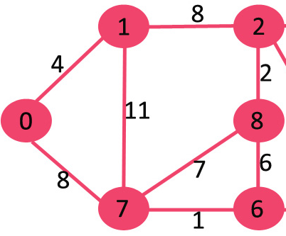
What is Dijkstra's algorithm ?
Dijkstra's algorithm is a fundamental and widely-used algorithm in computer science and mathematics.
It is primarily used for finding the shortest path between nodes in a graph, with applications in route planning, network routing, and more.
The "PathMaster" project harnesses the computational power of Dijkstra's algorithm to calculate and present the shortest path between chosen locations.

Slide 4
01
Introduction

Slide 5
PathMaster: Your Guide to Shortest Routes
What is PathMaster?
How does it work?
"PathMaster" is a web-based navigation application designed for efficient and precise route planning solutions.
It empowers users to input their starting and destination points and calculates the shortest path between them using Dijkstra's algorithm.
Why "PathMaster"?
Users input their route preferences, and the application processes this data using Dijkstra's algorithm.
The recommended route is visualized on an interactive map, providing step-by-step guidance and displaying the exact distance.
"PathMaster" showcases the practical application of data structures and algorithms in real-world scenarios.
Dijkstra's algorithm is a paramount tool for optimizing pathfinding, and "PathMaster" proves its value as a cornerstone of data structure and algorithm knowledge.

Slide 6
02
Problem & Solution

Slide 7
PathMaster: Your Guide to Shortest Routes
The Problem:
The Solution:
  In everyday navigation and transportation, finding the shortest and most efficient route is crucial.
  Existing solutions may lack precision, causing inconvenience and inefficiency for users.
  Users often need to make informed choices when selecting routes for travel or logistics.
"PathMaster" addresses this problem by utilizing Dijkstra's algorithm.
With a user-friendly interface, users can easily input their starting and destination points.
The application calculates the shortest path, visualizes it on an interactive map, and provides the exact distance, enabling precise and informed travel planning.

Slide 8
03
Methodology

Slide 9
PathMaster: Your Guide to Shortest Routes
CSS for Styling:
HTML for Structuring:
JavaScript for Algorithm Implementation:
JavaScript is responsible for implementing Dijkstra's algorithm for route calculation.
It also facilitates map interaction and visualization of the recommended route, creating an interactive and informative user experience.
HTML is used to structure the web page, creating the foundation of the user interface.
It defines the layout, input fields, and other elements for user interaction.
CSS enhances the visual appeal and styling of the web application, making it user-friendly and attractive.
It ensures that the application's interface is visually engaging and easy to use.

Slide 10
04
Result

Slide 11
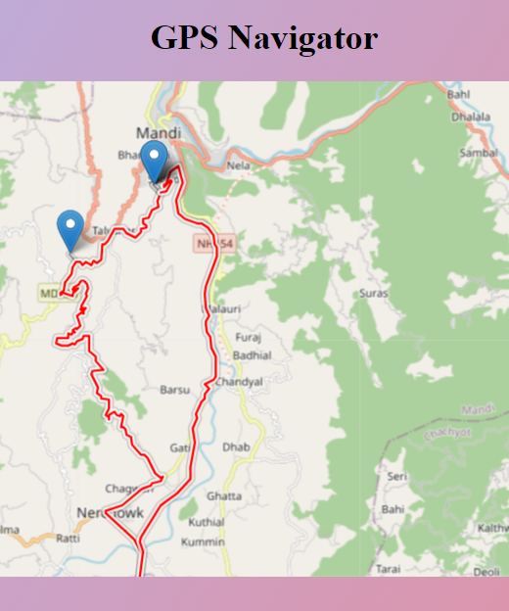
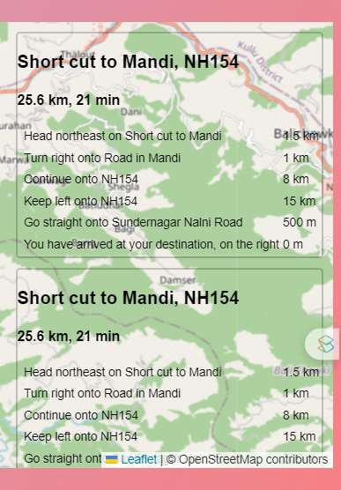
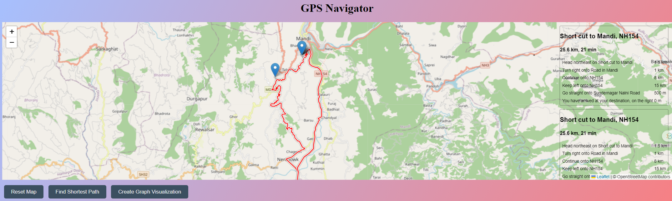
PathMaster: Your Guide to Shortest Routes

Slide 12
05
Conclution

Slide 13
PathMaster: Your Guide to Shortest Routes
"PathMaster: Your Guide to Shortest Routes" is a testament to the practical application of data structures and algorithms in everyday scenarios.
By harnessing Dijkstra's algorithm, this web-based navigation application efficiently calculates and presents the shortest path between chosen locations.
The user-friendly interface, interactive map, and precise route information make "PathMaster" a valuable tool for travel planning, logistics, and efficient navigation.
This project highlights the significance of efficient route finding and demonstrates that Dijkstra's algorithm is a fundamental tool in various domains, emphasizing its value as a cornerstone of data structure and algorithm knowledge.
"PathMaster" serves as a prime example of how technology can simplify complex problems, making everyday life more convenient and enjoyable.

Slide 14
06
Future Aspects

Slide 15
Future Aspects
Outer circle | Include the total size of the market, which represents the entire potential customer base for the product or service
Middle circle | Identify the target market for the product or service, which may be a subset of the total market. This could be based on factors such as demographics, geography, or specific needs
Inner circle | Indicate the current market size, which represents the portion of the target market that the company has successfully captured

Slide 16
Thanks!

