Slide 1
Expense Tracker :
A Java-based Financial
Management Application

Slide 2
Table of contents
01
02
03
04
05
06
Introduction
Problem & solution
Methodology
Result
Conclution
Future Aspects

Slide 3
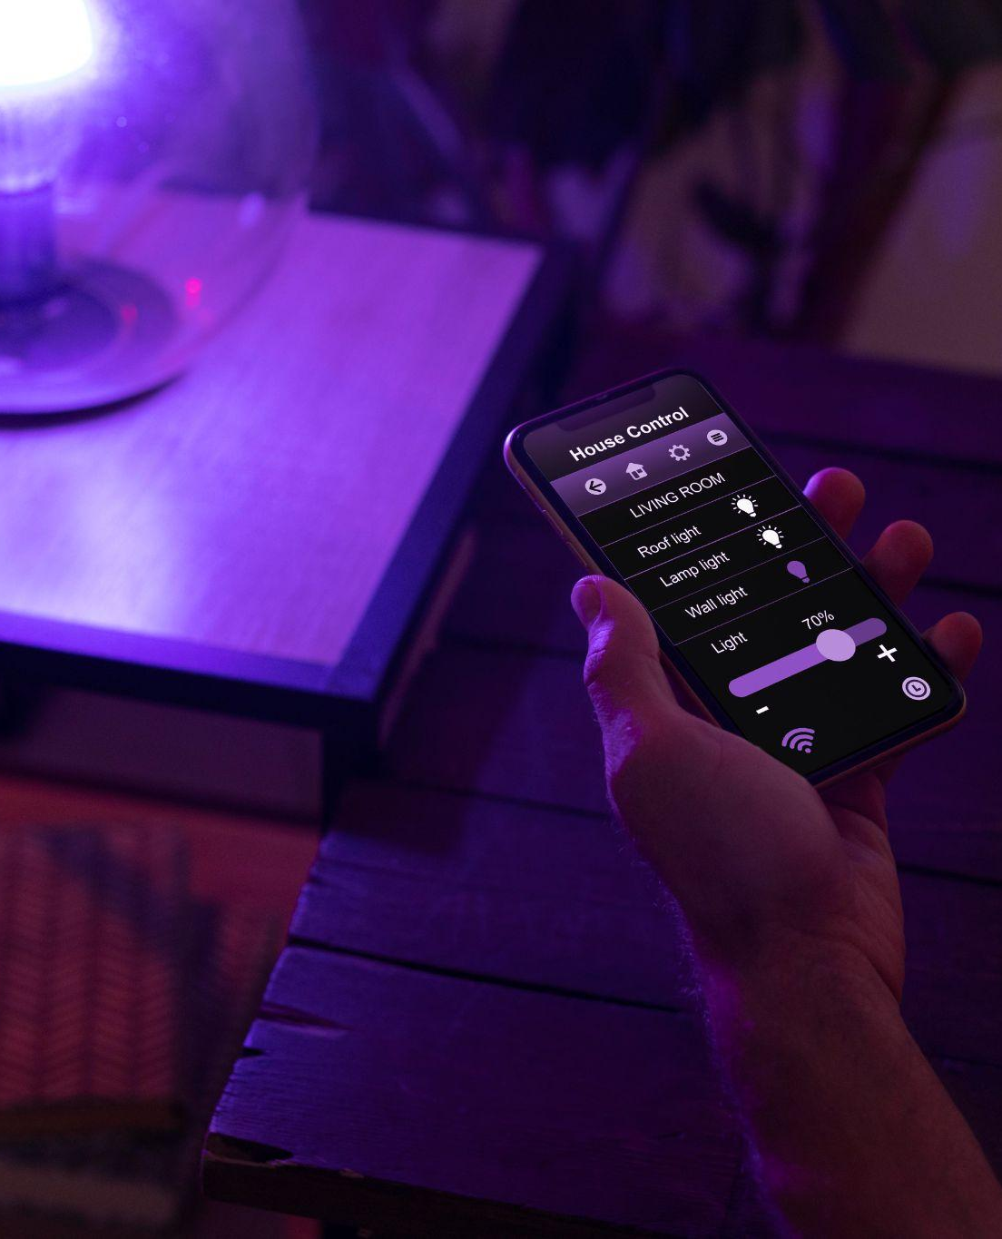
What is Expense Tracker
In an era marked by complex financial landscapes, our project addresses the need for efficient personal expense tracking.
The "Expense Tracker" is designed to help individuals of all backgrounds manage their finances with ease.
Through its user-friendly interface and comprehensive features, it provides a solution to track, categorize, and gain insights into personal expenses.

Slide 4
01
Introduction

Slide 5
Expense Tracker - Charting Your Financial Journey
What?
How?
Why?
The "Expense Tracker" is your personal finance companion, a Java-powered wizard that simplifies the art of financial management.
Through its user-friendly interface, it allows you to seamlessly record and categorize expenses, visualize spending trends, and make informed financial decisions.
In a world where every financial move matters, the "Expense Tracker" empowers you to maintain financial stability, navigate your financial journey, and achieve your monetary goals. It's not just an app; it's your financial ally.

Slide 6
02
Problem & Solution

Slide 7
Expense Tracker - Charting Your Financial Journey
The Problem:
The Solution:
Many individuals face the complex challenge of managing their personal finances effectively. Tracking expenses, understanding spending trends, and making informed financial decisions can be daunting tasks.
The "Expense Tracker" project offers a comprehensive solution. It simplifies expense tracking, categorization, and provides valuable financial insights. Our project is designed to empower individuals to take control of their finances with ease.

Slide 8
03
Methodology

Slide 9
The Code Development Journey
Requirements Analysis:
Design and Architecture:
Implementation and Testing:
Our journey began with a comprehensive analysis of the project's requirements. This step involved understanding the functionality needed for the "Expense Tracker."
We then moved on to design and architecture. The project was divided into classes, each responsible for specific functions like tracking expenses and user interaction.
With the blueprint in place, we entered the implementation phase. We wrote the code for each class, ensuring it aligned with the design. Thorough testing was performed to identify and rectify bugs and issues.

Slide 10
04
Result

Slide 11
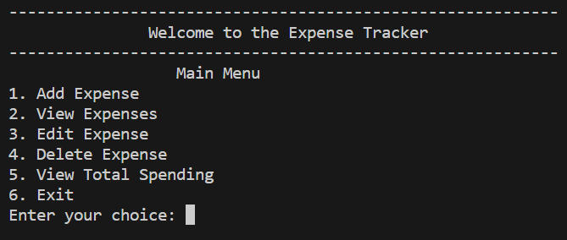
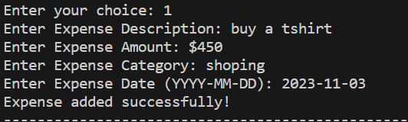
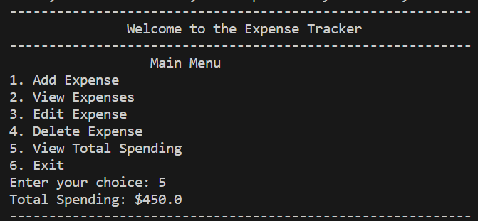
The "Expense Tracker" in Action

Slide 12
05
Conclution

Slide 13
Achieving Financial Control
Robust and Reliable:
Empowering Financial Management:
User-Centric Approach:
The "Expense Tracker" has successfully empowered users to take control of their finances, enabling them to make informed financial decisions and achieve their personal financial goals.
The "Expense Tracker" has proven to be a robust and reliable tool, capable of handling various financial scenarios with efficiency. Our commitment to continuous improvement means that the "Expense Tracker" will evolve to meet the changing needs of its users.
Throughout the project, we prioritized user feedback and usability, resulting in a user-centric application that addresses contemporary financial challenges

Slide 14
06
Future Aspects

Slide 15
Market size overview
Outer circle | Include the total size of the market, which represents the entire potential customer base for the product or service
Middle circle | Identify the target market for the product or service, which may be a subset of the total market. This could be based on factors such as demographics, geography, or specific needs
Inner circle | Indicate the current market size, which represents the portion of the target market that the company has successfully captured

Slide 16
Thanks!

