Slide 1
Assignment on
Blockchain development
Submitted to: olcademy
Sumitted by:Yashwant Soni

Slide 2
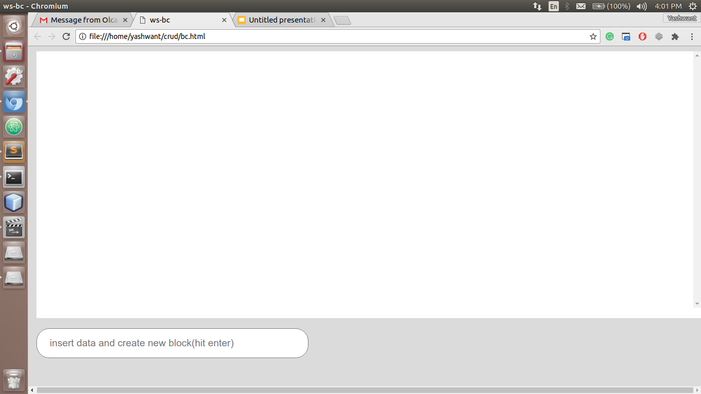
Generation time is mentioned for each block in web app.
Empty-chain

Slide 3
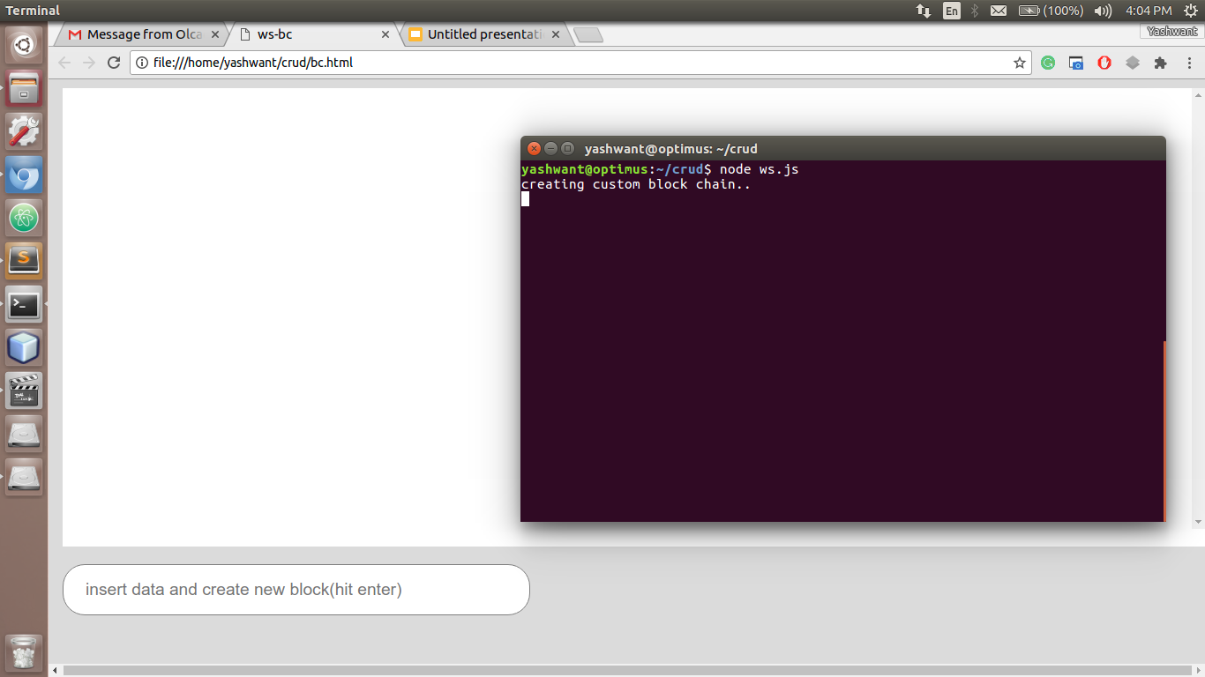

Slide 4
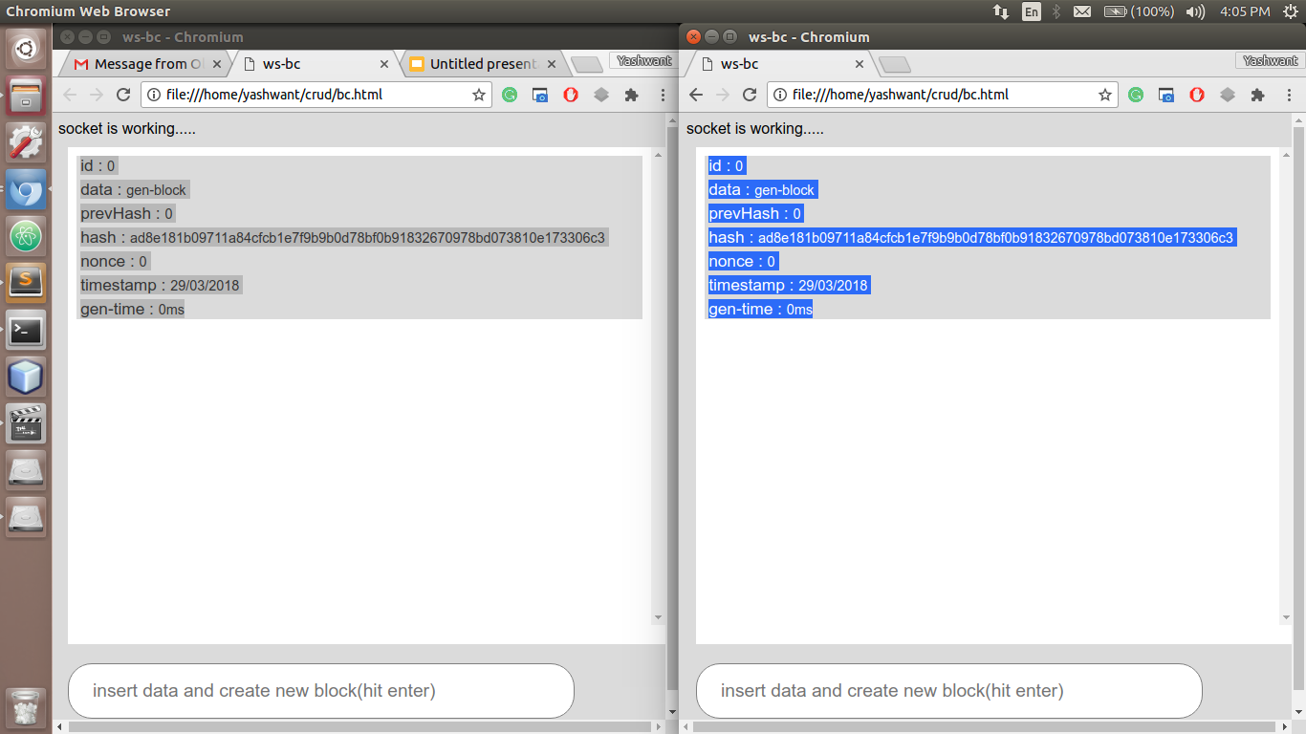
Initiation in P2P network.

Slide 5
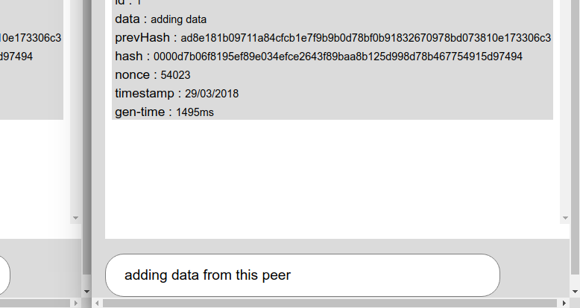

Slide 6
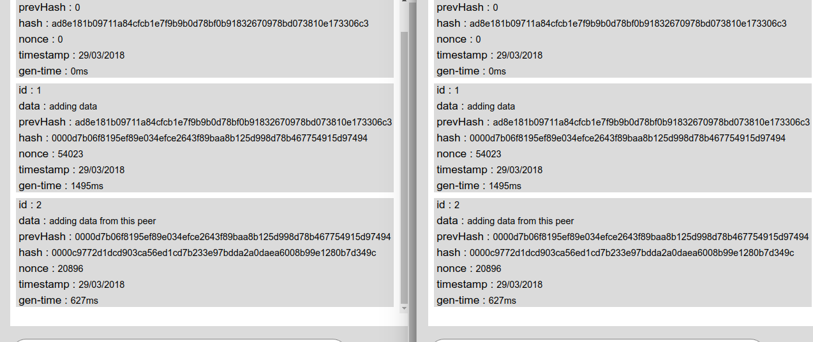

Slide 7
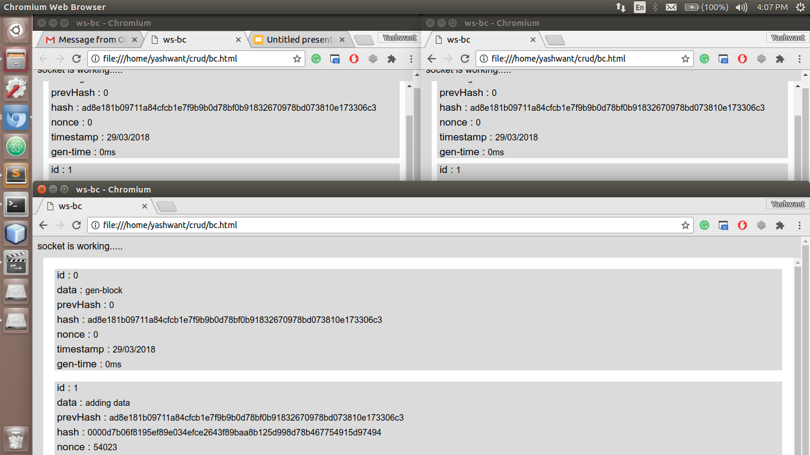
Another peer joined the network.

Slide 8
Thank you.

